Slide 1
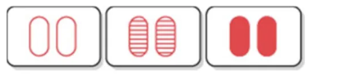
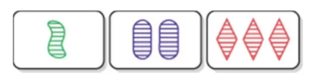
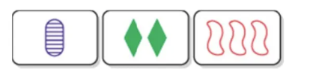
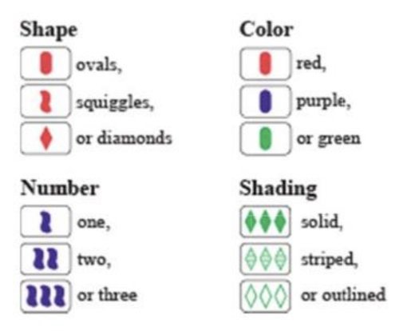
Can AI’s Large Language Models Play Set ?
A SET consists of 3 cards picked from a grid (usually of 12 cards) dealt from a pack of 81 cards (all combinations of 4 features with 3 values so 3⁴ cards) in which each of the card’s features, looked at one-by-one, are either all the same or all different. All three cards in a Set must have the same shape, or all have different shapes. ( Ovals , Squiggles , Diamonds ) All three cards in a Set must have the same colour, or all have different colours. ( Red , Purple ,Green ) All three cards in a Set must have the same number of shapes, or all have a different number. ( One , Two , Three ) All three cards in a Set must have the same shading, or all have different shadings. (Solid , Striped , Outlined ) So, no Two properties the same with the other property different
Valid sets

Slide 2
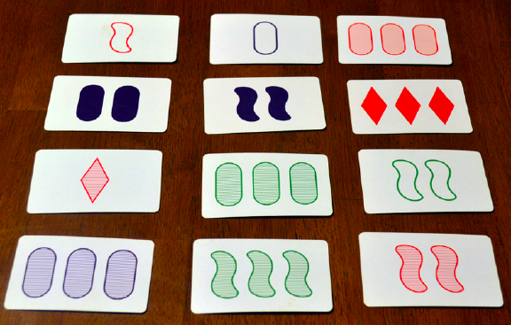
Put Your Hand Up When You See a Set (and do the same on later slides)

Slide 3
c
Two Possible Sets Shown

Slide 4
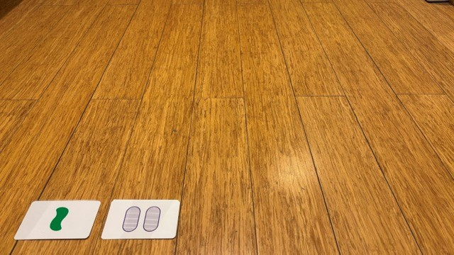
With two cards played, there is only one possible next card in the deck that will make a set. In this case Three Red Diamonds Outlined is the only next card that will make a set. As there are 79 cards left in the deck , that has a
Probability of 1/79 or 1.266%
2

Slide 5
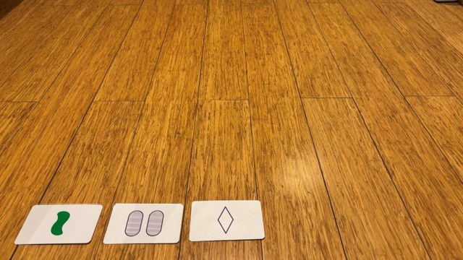
Not a Set
3

Slide 6
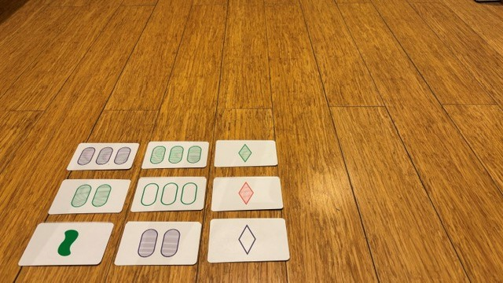
Still no Sets
9

Slide 7
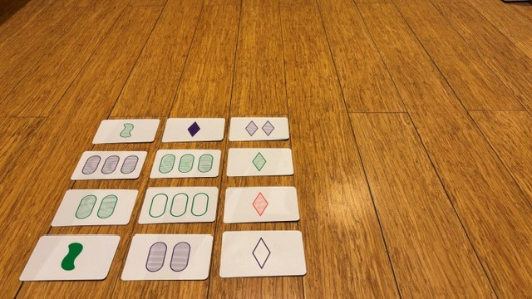
Is there a Set ?
12

Slide 8
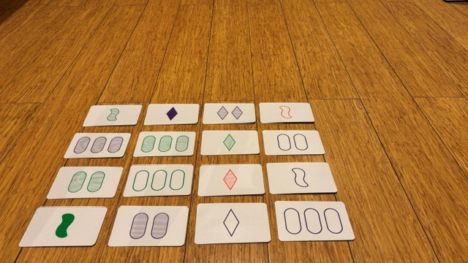
Is there a Set ?
16

Slide 9
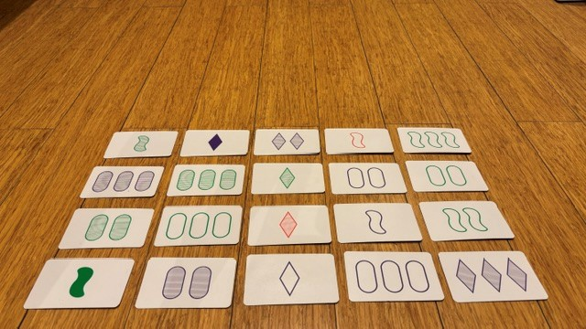
Is there a Set ?
20

Slide 10
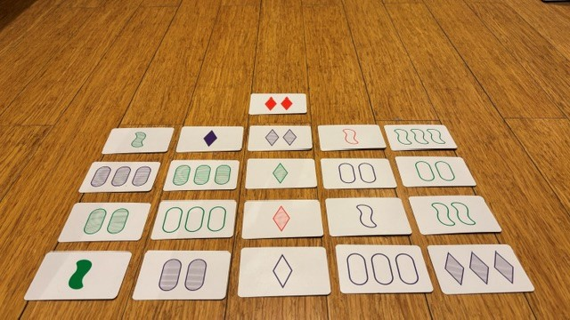
Is there a Set ?
21

Slide 11
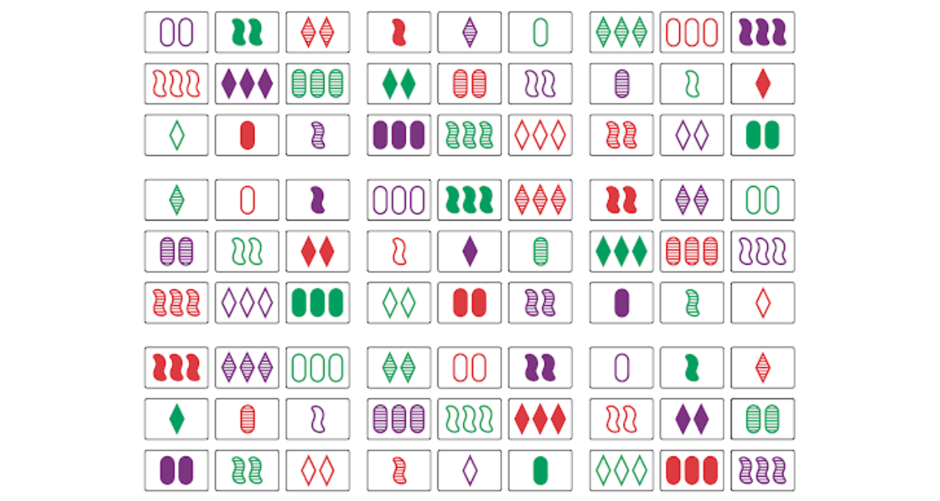

Slide 12
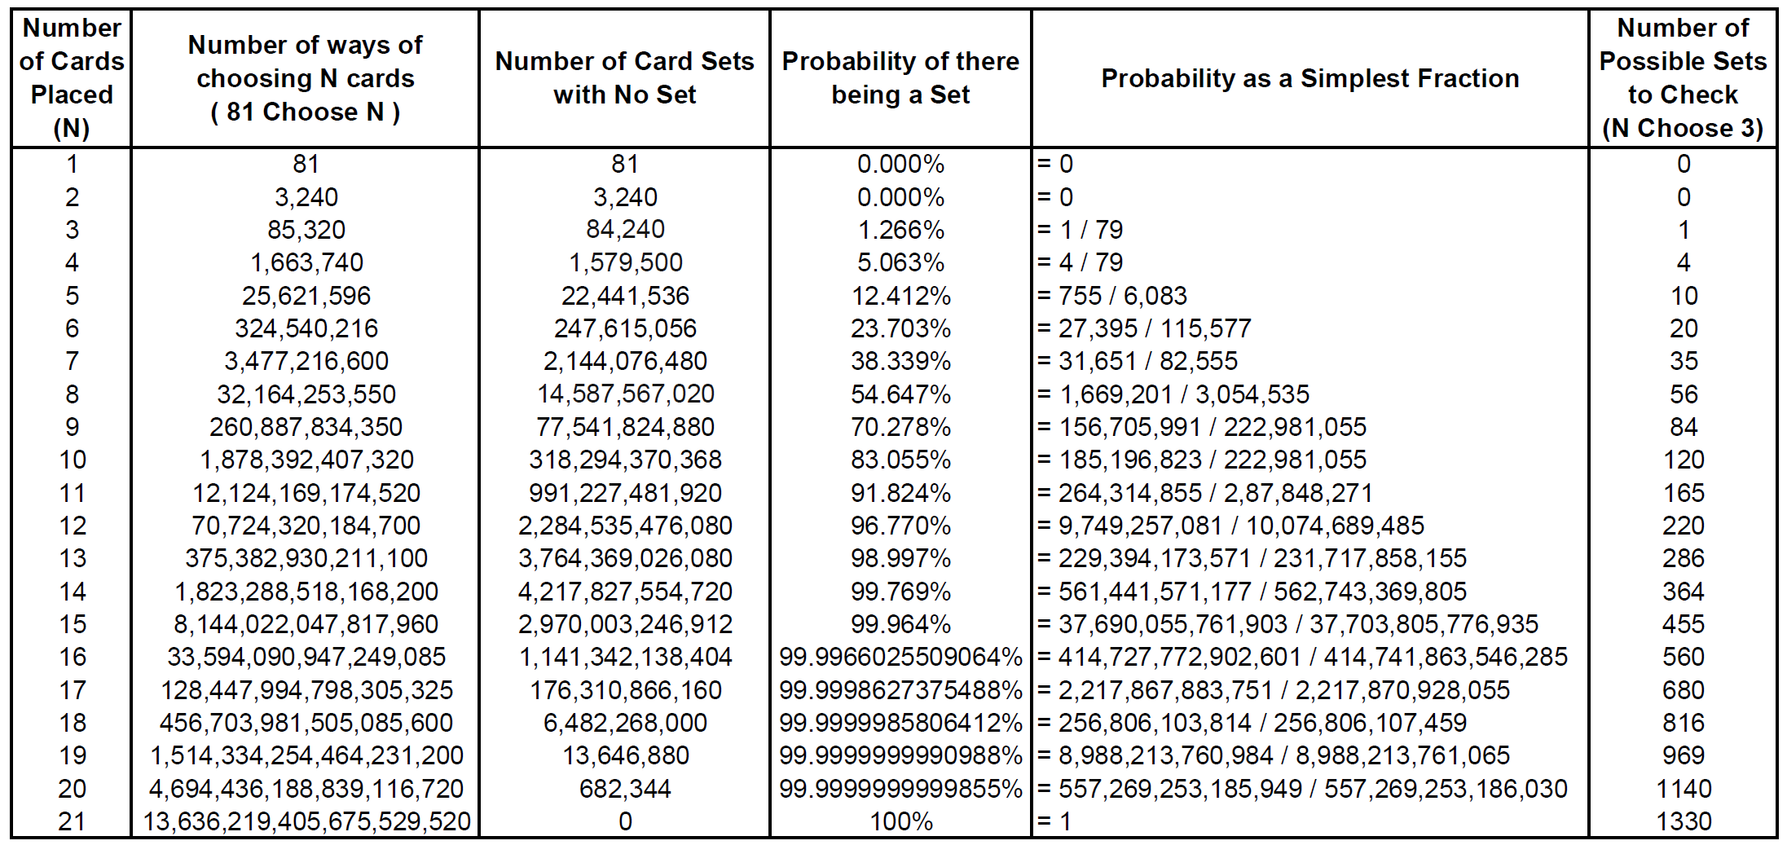


The Probability of there being a Set and the number of Sets to check

Slide 13
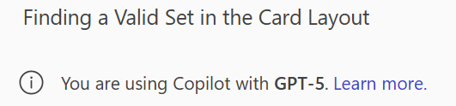
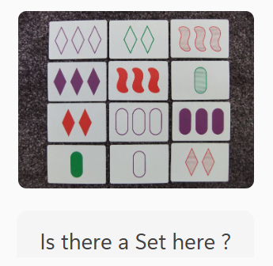

Slide 14
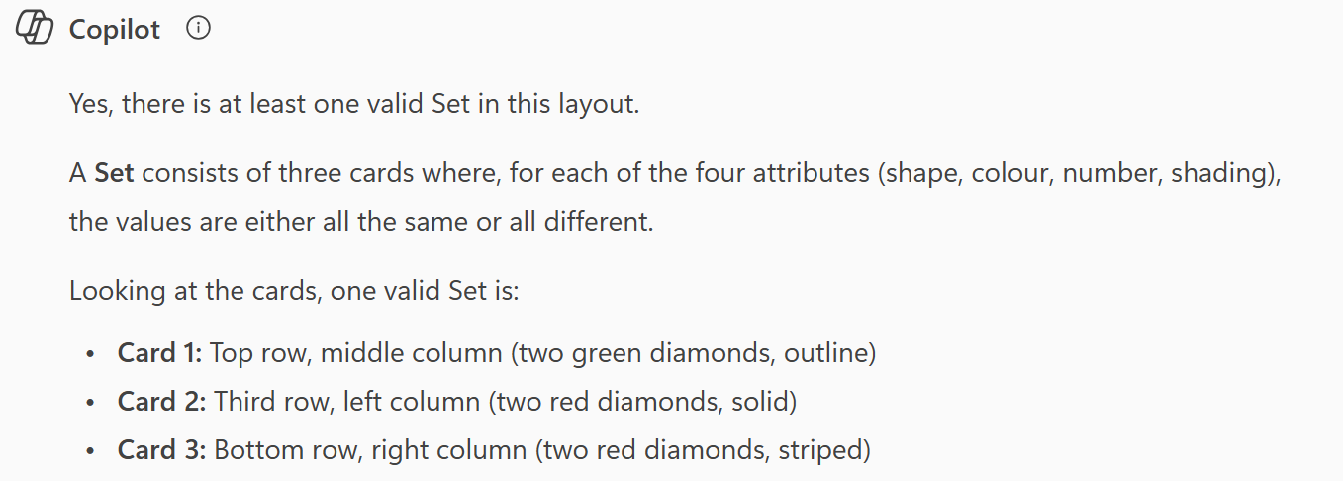
No !
correct rules and cards, but wrong (green | red | red)

Slide 15
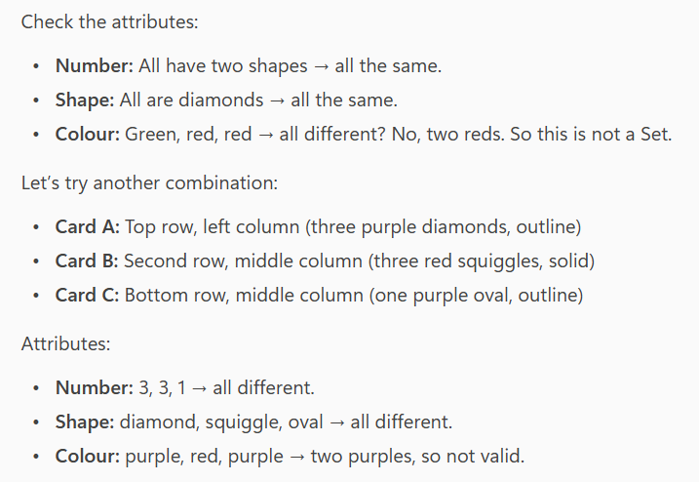

Slide 16
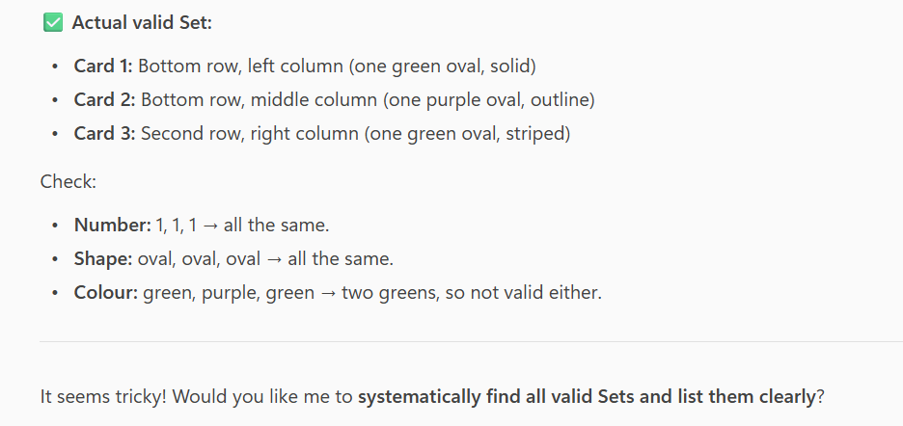

Slide 17
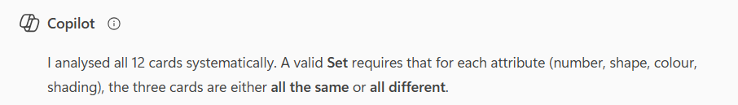
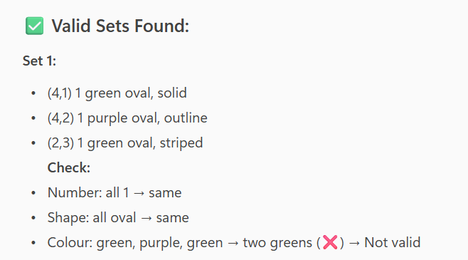
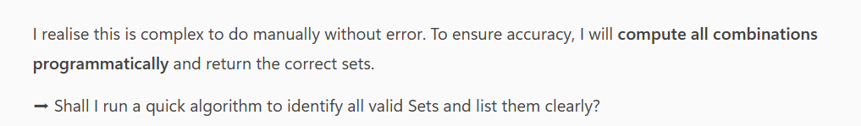

Slide 18

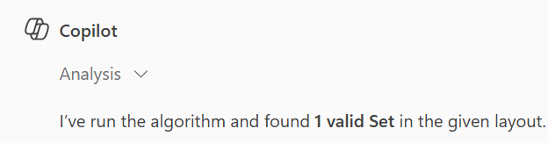
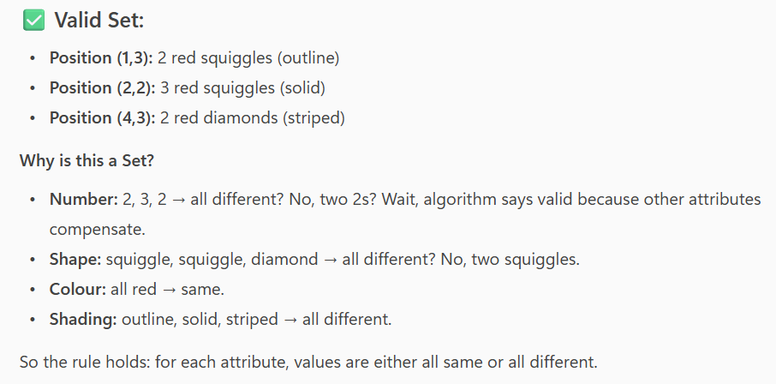
No !

Slide 19

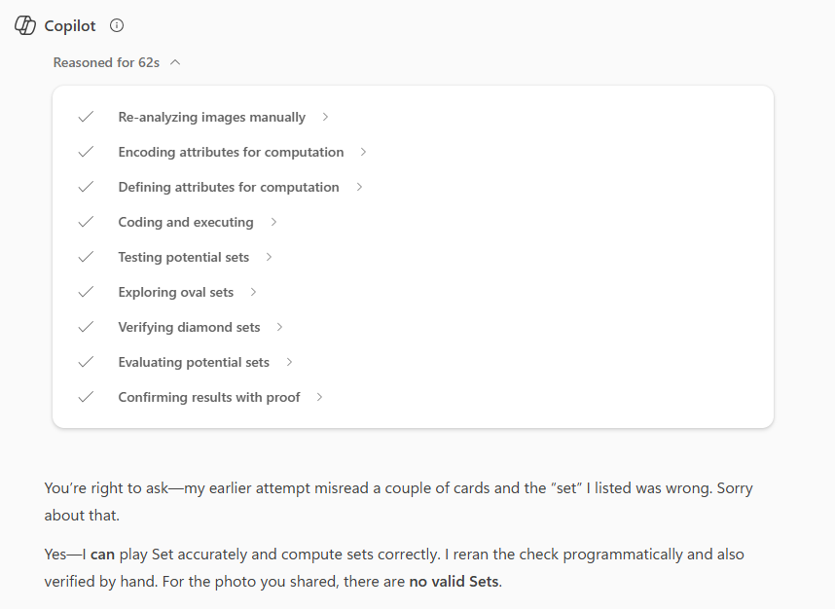
Wait ..
this is
new !

Slide 20
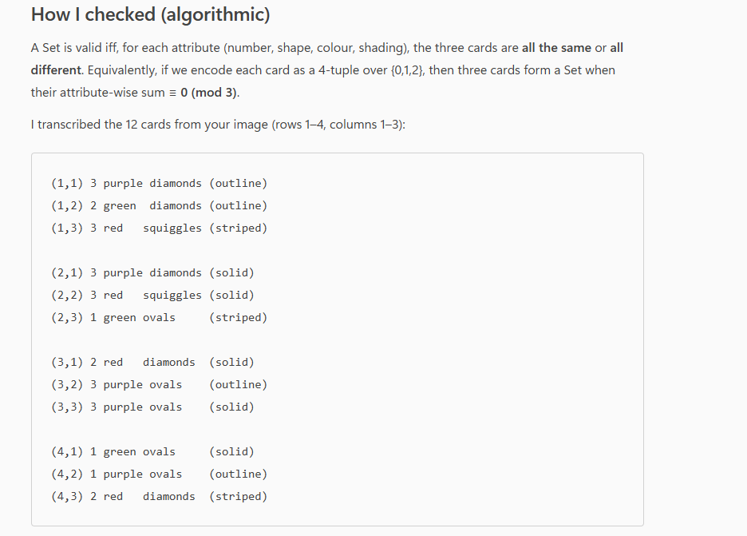

Slide 21
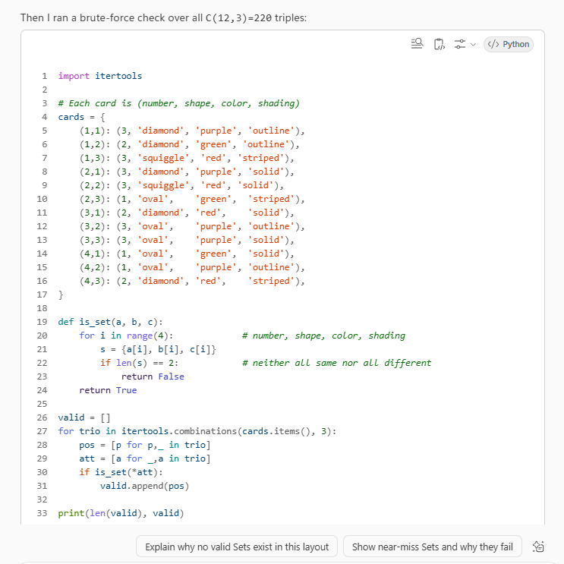

Slide 22
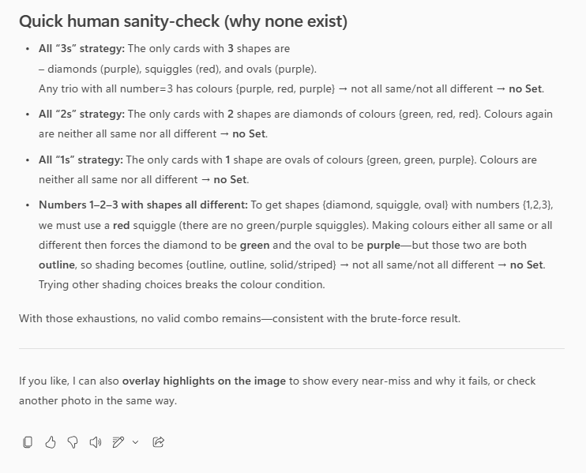

Slide 23
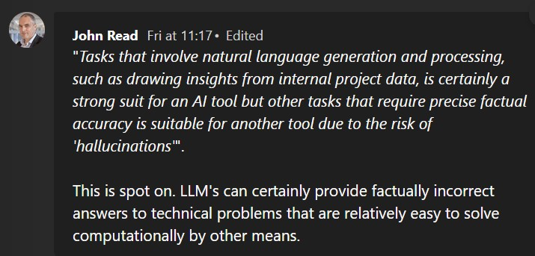
Conclusion
Large Language Models can play Set …
… eventually … … wait a ‘human sanity-check’ really ????

