Slide 1


Jørn Hafver

Slide 2
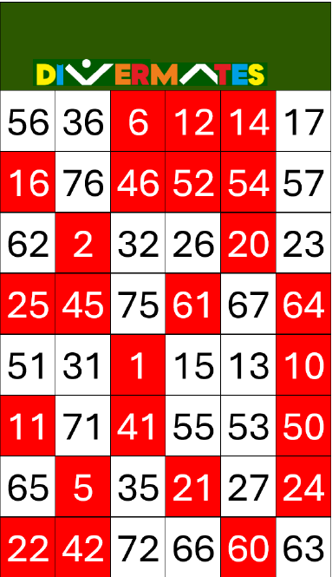
Inspiration

Slide 3
Rules:
Pick a number
Swap the colour of your number
Read out all the colours on the corresponding line (keeping the colour of your number swapped)

Slide 4
Rules:
Pick a number
Swap the colour of your number
Read out all the colours on the corresponding line (keeping the colour of your number swapped)
Example:
You pick 75
Read out «red, red, red, red, white, red»

Slide 5
Rules:
Pick a number
Swap the colour of your number
Read out all the colours on the corresponding line (keeping the colour of your number swapped)
Let’s try!

Slide 6
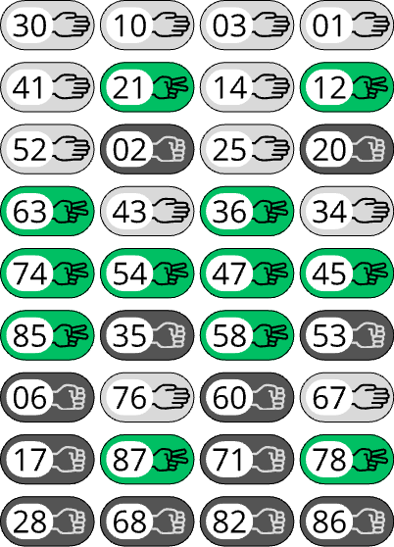

Slide 7
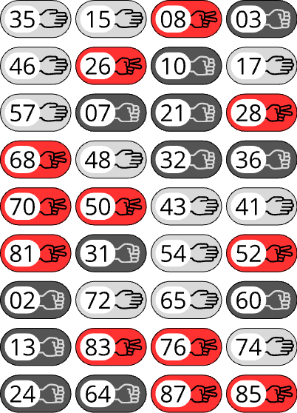

Slide 8
Rules:
Pick a number
Swap the symbol of your number with the symbol that beats it in rock-paper-scissors
Read out all the symbols on the corresponding line (keeping the symbol of your number swapped)

Slide 9
Rules:
Pick a number
Swap the symbol of your number with the symbol that beats it in rock-paper-scissors
Read out all the symbols on the corresponding line (keeping the symbol of your number swapped)
Example:
You pick 32
Paper beats rock
Read out «scissors, paper, paper, rock»

Slide 10
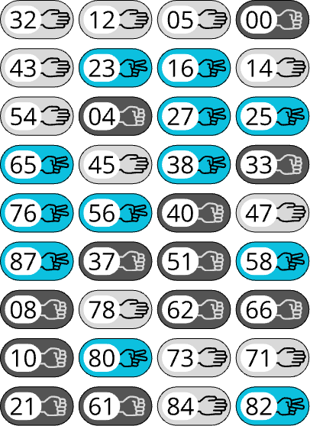
Rules:
Pick a number
Swap the symbol of your number with the symbol that beats it in rock-paper-scissors
Read out all the symbols on the corresponding line (keeping the symbol of your number swapped)
Let’s try!

Slide 11
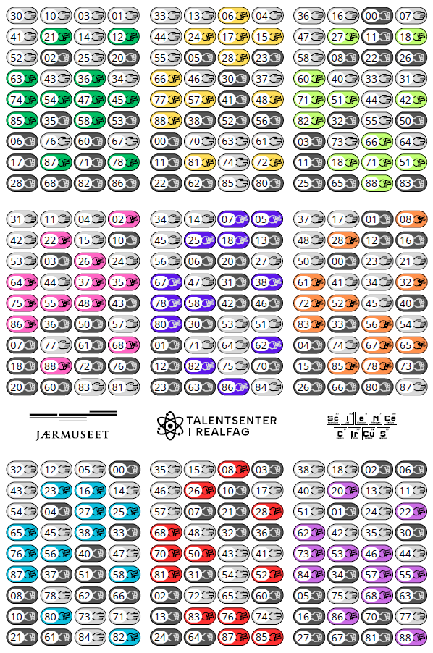

Download here!
bit.ly/rockpaperscissors-magic

