Slide 1
How large is a piece of paper?
Martin Whitworth
martin_whitworth@mathstodon.xyz
Notes:
c.f. “How long is a piece of string?”
This is a bit of a mixed bag of things that arise from the aspect ratios of various standard paper sizes, specifically aspect ratios.

Slide 2
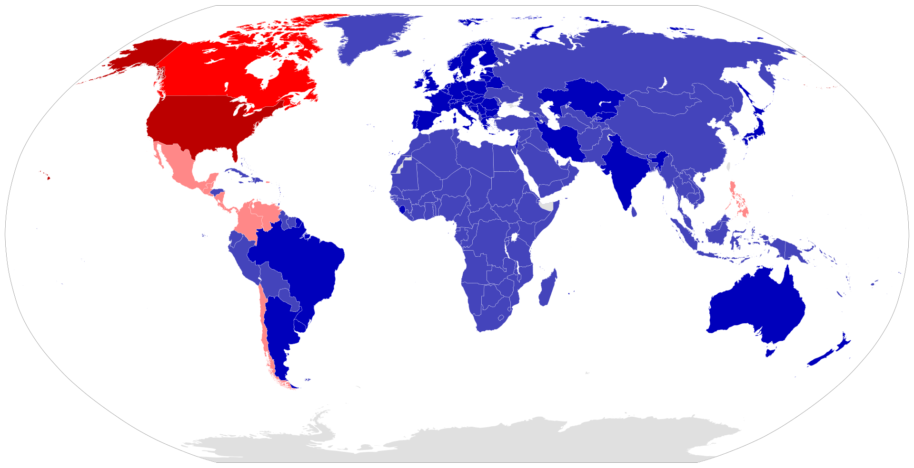
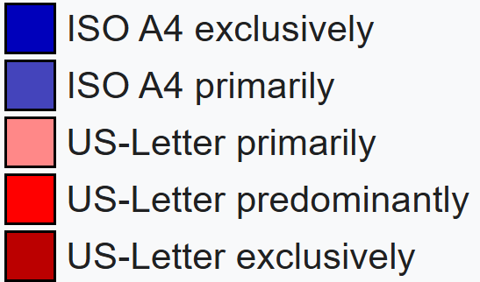
Most countries use ISO 216 (A series etc.)
Paper size - Wikipedia
Notes:
You’re probably familiar with A series paper. It’s the international standard, used by most countries apart from the Philippines and some of the Americas.

Slide 3
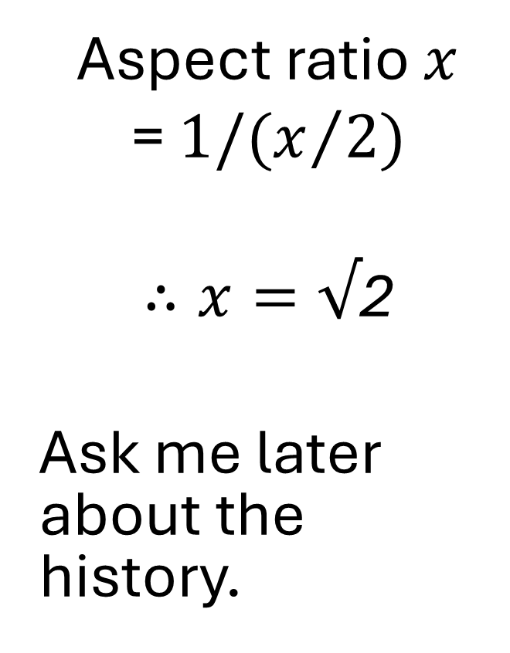
ISO 216: Cutting in half maintains the aspect ratio
x/2
Aspect ratio $x$
= $1/(x/2)$
$∴x=√$2
Ask me later about the history.
1
x
Notes:
The key concept is that cutting a sheet of paper in half maintains the aspect ratio.
I don’t have time for the full history, but one of the pioneers was Wilhelm Ostwald, winner of the 1909 Nobel prize for Chemistry. I was familiar with him from Ostwald ripening which is relevant to my research – ask me later.
[The approach was proposed in 1786 by the German Scientist Georg Christoph Lichtenberg; early variants were used in France.
Then, in 1911 Wilhelm Ostwald proposed a global format based on this approach, but linking it to the metric system. He wanted 1 cm to be the width of the base unit. Eventually, the standard was based on area, with that of A0 being 1 m2.]
But let’s see what we can do with it.

Slide 4
ISO 216 paper sizes
A0 has an area of 1 m²
B sizes are the geometric mean of A sizes.
Effectively Bn ≡ An-½
C sizes are the geometric mean of A and B sizes.
Cn ≡ An-¼
A series
B series
Length (mm)
C series
Area (m²)
Width (mm)
Passport size B7 (≡A6.5)
ISO/IEC 7810 ID3
Notes:
I feel that plotting on a log 2 scale gives some insight.
They halve in area at each scale, so the gradient is -1.
A0 has an area of 1m2.
I’m not subscripting. That’s not an error – it’s how it’s done.
For linear dimensions, the gradient is half that for areas, corresponding to a reduction of sqrt2 per size.
The width of one size is the length of the next one.
The spacing vertically is 0.5 on the log scale representing the aspect ratio of sqrt2.
B sizes are the geometric mean of the A sizes so, on a log scale, that’s the arithmetic mean.
I’ve displaced the series on the x-axis, but to make the point that rather than saying for example B4, we could just call it A3.5
C sizes are the geometric mean of the A and B sizes of the same index.
They tend to be used as envelope sizes for the A size just below. So C4 is used for A4 documents, C5 for A5 etc.
Common sizes that you may recognise:
I assume there will be a flip chart in the room. That’s A1.
We’re all familiar with A4 copy paper.
Your passport is B7 (or A6.5).

Slide 5
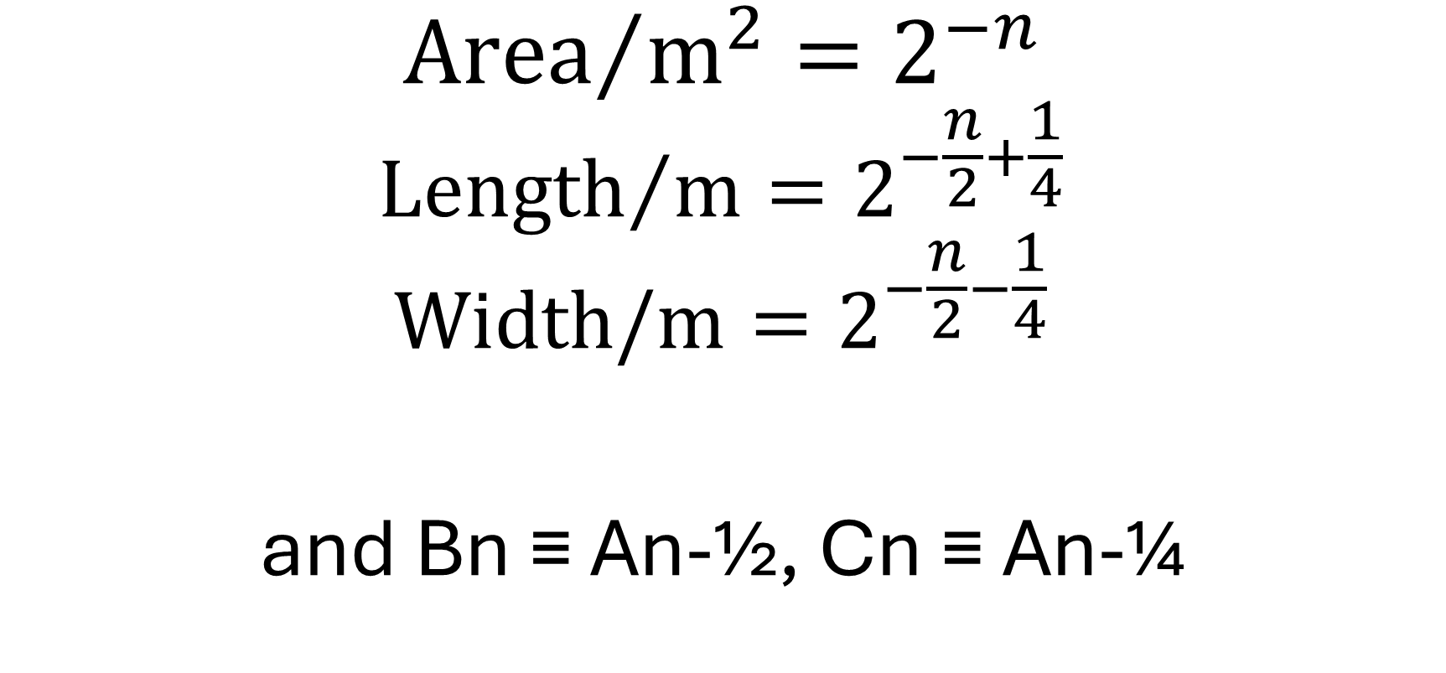
Size of An paper
$${\text{Area}}/{{\text{m}}^{2}}=2^{−n}$$
$${\text{Length}}/{\text{m}}=2^{−\frac{n}{2}+\frac{1}{4}}$$
$$\text{Width}\text{/}\text{m}=2^{−\frac{n}{2}−\frac{1}{4}}$$
and Bn ≡ An-½, Cn ≡ An-¼
Notes:
So that answers the question I posed in the title – but there are other sizes, and I want to explore the consequences.

Slide 6
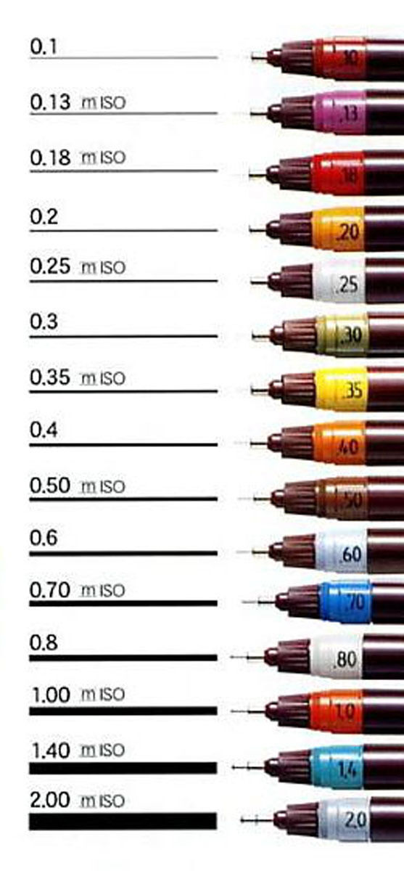
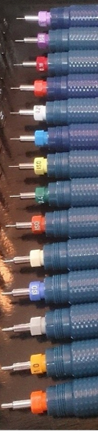
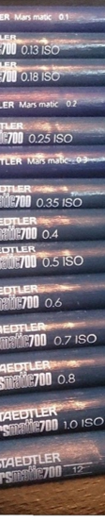
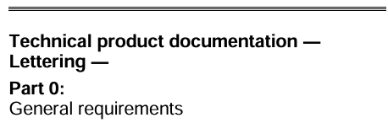
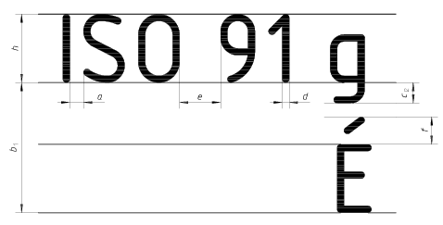
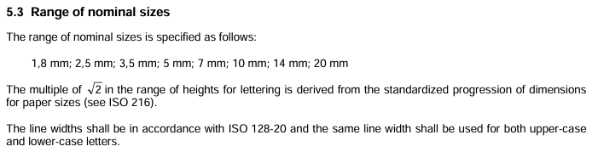
Technical drawing
Technical pens (ISO 9175-1) and lettering (ISO 3098-0) also follow the √2 ratio.
Notes:
I’ll gloss over the detail since I don’t have time – ask me later.

Slide 7
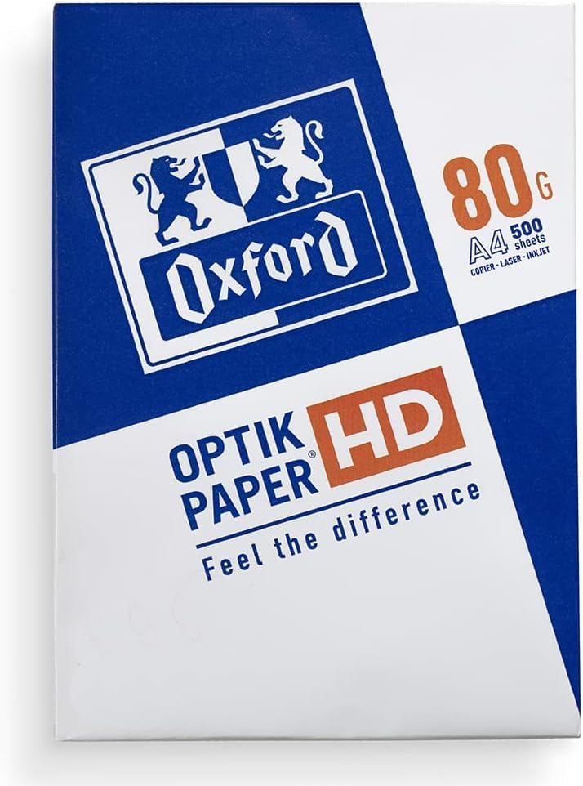
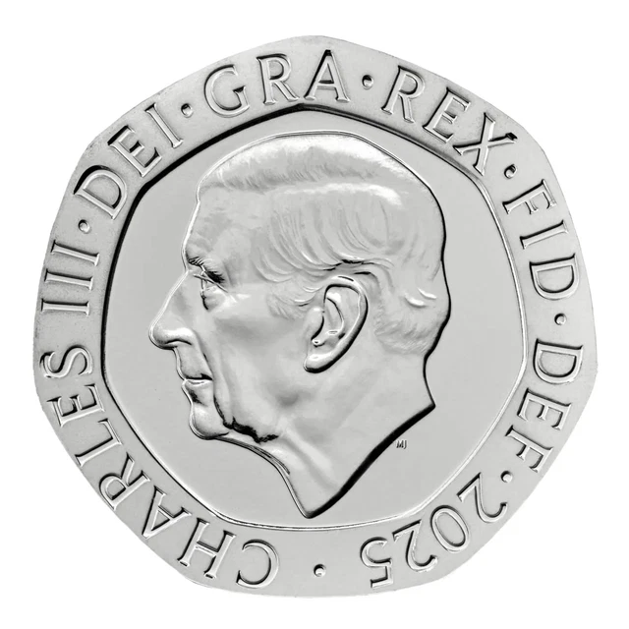
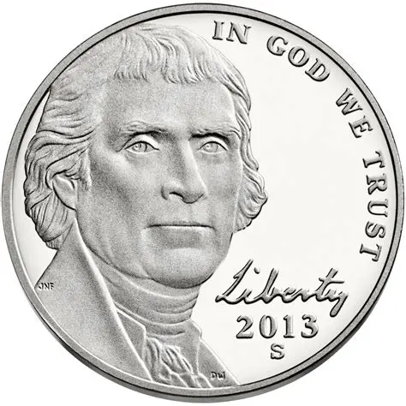
Paper mass
Masses are given as gsm (grams per square metre): g m⁻²
A common mass for copy paper is 80 gsm.
That’s 80 g for a sheet of A0.
So a sheet of A4 has a mass of 80/2⁴ = 5 g.
That’s the same as a 20p piece, or a US nickel.
I brought scales and can prove it
– Ask me later
Notes:
Paper has dimensions. It also has mass.
NB this manufacturer wrongly uses an upper case G for grams.
When I see a mass per unit area, I think pressure.
A sheet of 80 gsm paper exerts a pressure of 0.78 Pa. When I looked for a comparison, Wolfram Alpha told me it’s about 0.8 times the pressure exerted by a US dollar bill.

Slide 8
Exploiting the √2 aspect ratio
Is this a kite?
What is its perimeter?
1
√2
Notes:
I’m mindful that maybe this is becoming a physics talk, so here’s some maths.
Part of the inspiration for this talk was the following problem.
Is the resulting shape a kite? i.e. is it symmetrical?
What is its perimeter?

Slide 9
Making a rhombus
1
√2
Notes:
If you fold in ¼ of the length, and then do these folds, you get a rhombus.

Slide 10
Trisecting the diagonal
Diagonal = √3
Pythagoras
Dropping perpendiculars (or folding in) trisects that.
Similar triangles
1/√3
1/√3
1
√3
1/√3
√2

Slide 11
Square paper – widely used for origami

Slide 12
Square paper How to fold it accurately into a regular octagon?
Ask me later

Slide 13
Square paper
1
What are the coordinates of this point?
Ask me later – there’s more…
(x,y)?
0
0
1

Slide 14
US sizes
US size | Width (inches) | Length (inches)
Letter | 8 ½ | 11
Foolscap | 8 ½ | 13
Foolscap folio | 8 ½ | 13 ½
Legal | 8 ½ | 14
Notes:
There are some countries that still use imperial sizes. I’m going here with some US sizes.

Slide 15
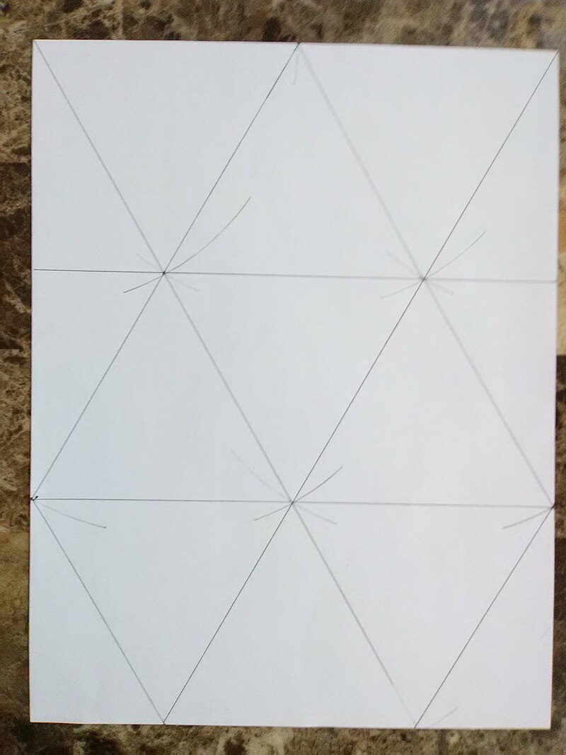
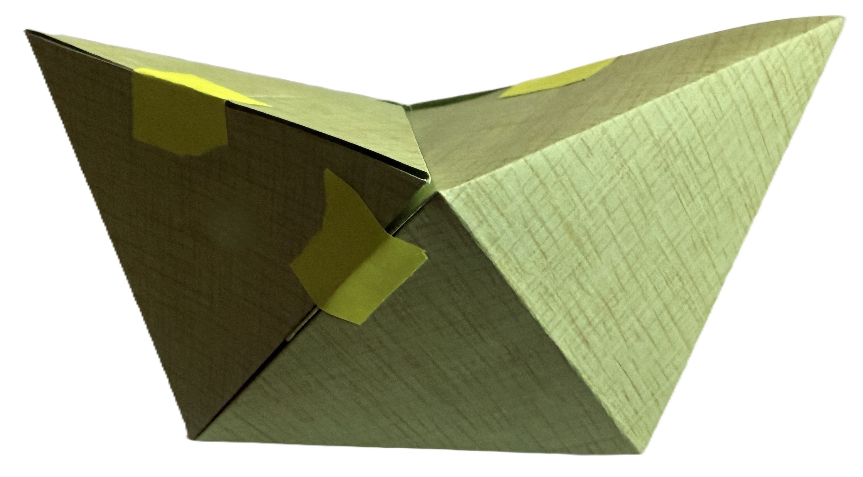
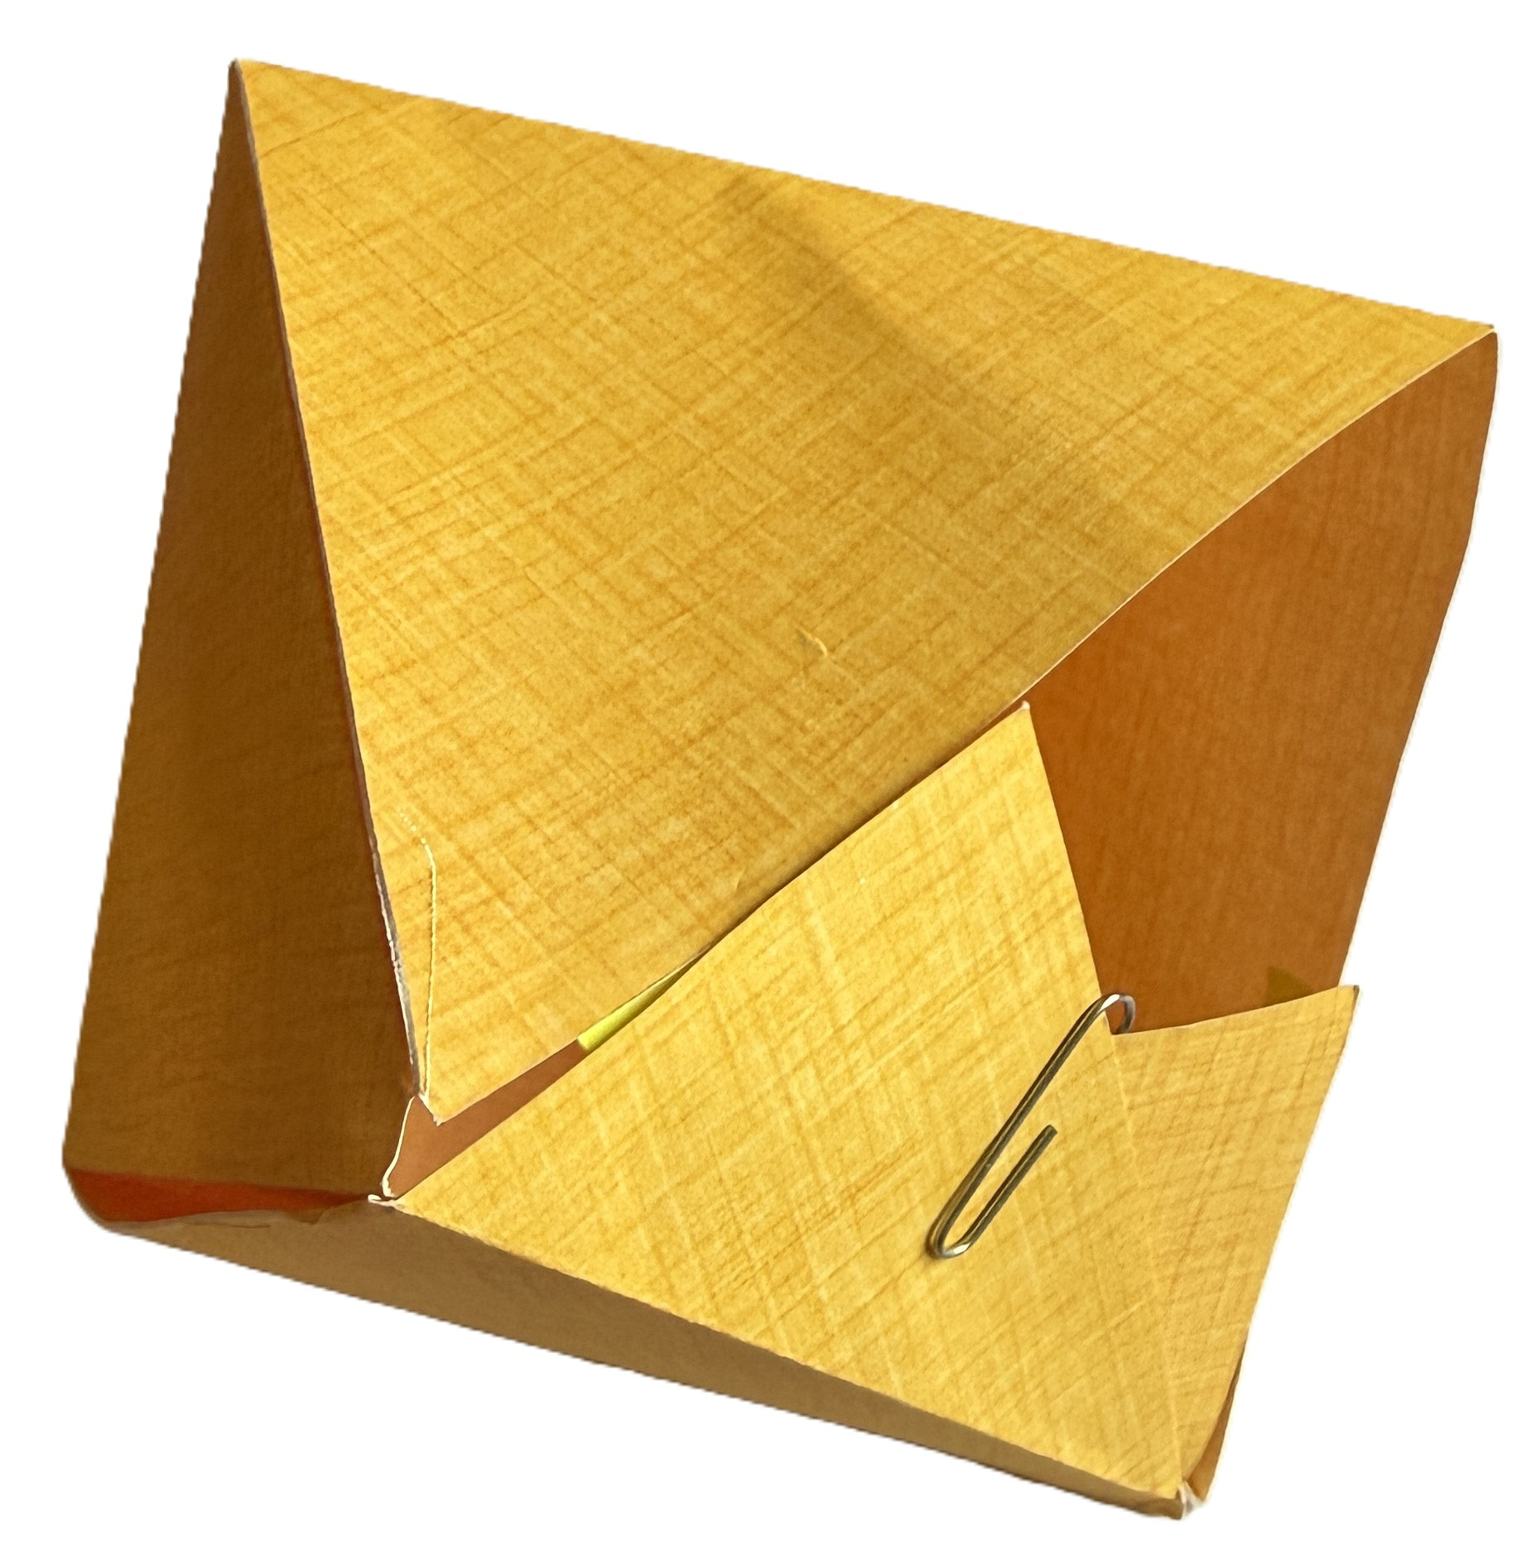
US Letter paper: 8 ½ ″ × 11 ″
Aspect ratio = 11 / 8.5 ≈ ¾√3
To within 0.4%
We can triangulate thus…
What can it be folded into?
Octahedron?
Regular octahedron?
Nearly
By VectorOrigami - Own work, CC BY-SA 4.0, https://commons.wikimedia.org/w/index.php?curid=134643285
Notes:
Letter is perhaps the most widespread US size.
Letter (paper size) – Wikipedia
The approximation is to within 0.4%, or to within 1 mm.
This image uses a compass. The construction can be done by folding. Faintly mark half and then quarter. Then we can fold one of the diagonals and the rest follows…
I’ve managed to fold that into 7 2/3 faces of an octohedron.

Slide 16
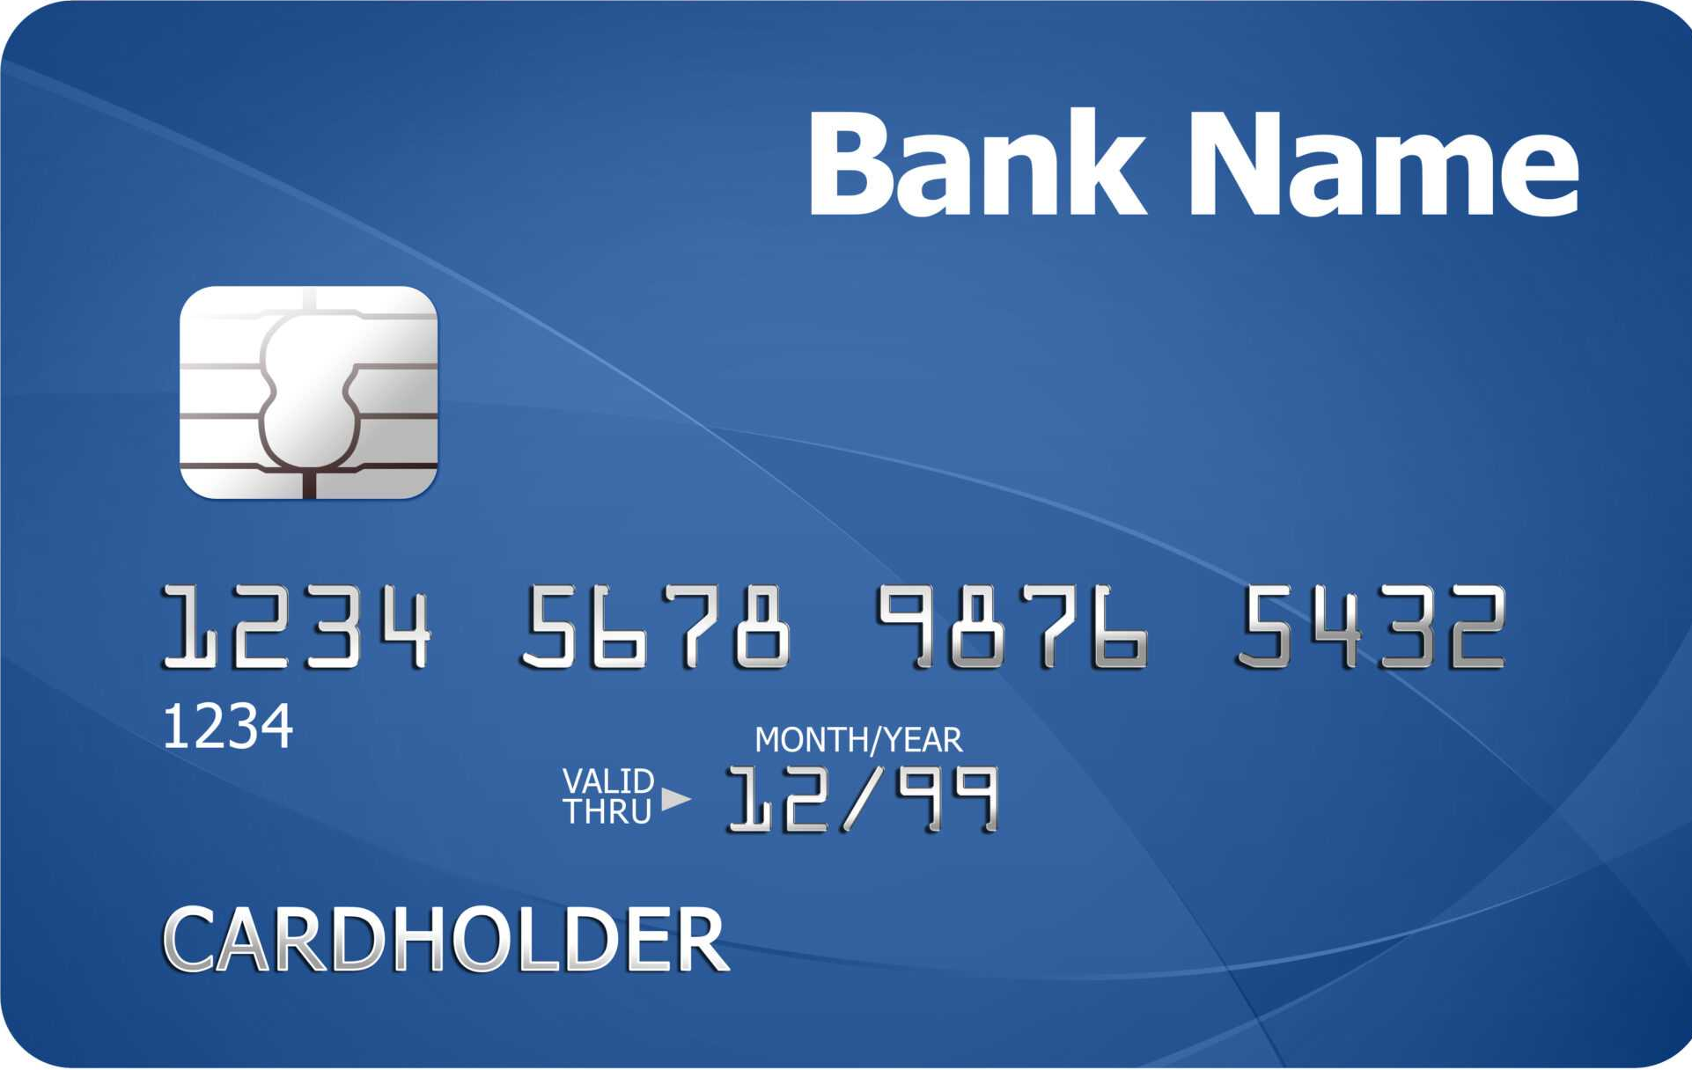
Credit cards
Standardised
To work in machines worldwide: ISO/IEC 7810 ID-1
85.60 × 53.98 mm (based on 3 ⅜ " × 2 ⅛ ").
¼ of the dimensions of Foolscap folio (8.5 " × 13.5 ")
13.5 "
8.5 "
Notes:
They’re not paper, but they have standard sizes.
The size was standardised in 1958 by Bank of America.
They’re now standardised in metric, but it’s based on an imperial size.
I can’t find information on the reason for the choice. However, I note that a 4 x 4 grid of credit cards matches Foolscap folio.
So I speculate that maybe they had the means to print that size and cut 16 cards from a sheet.
Credit card – Wikipedia
ISO/IEC 7810 - Wikipedia
A history of payment cards - from clay tablets to EMV cards... | Thales Group

Slide 17

Foolscap folio
8.5$"$ × 13.5 $"$
Converting to metric, that’s 215.9 × 342.9 mm.
To within 0.1mm accuracy, that’s 6³ × 7³ mm!
Notes:
Foolscap folio (16x the size of a credit card) is interesting.
It’s an imperial size – 8.5 x 13.5”.
I can only assume this is a coincidence. But it means I’ll always remember the size of a credit card, or at least how to work it out.
I also note that the ISO standard for A series paper is ISO 216.

