Slide 1
Statistical Plot Twists
A 5-minute journey through statistical illusions

Slide 2
Frequentist vs Bayesian Inference Coin Problem
A coin is flipped 14 times and shows 10 heads. We must decide whether to bet on the next two flips being both heads (HH) or not.
Frequentist Approach
Estimate: p^ = 10/14 = 5/7
Predictive probability: P(HH) (5/7)^2 = 25/49 = 0.510204...
Decision: Since P(HH) > 0.5 bet FOR HH
Bayesian Approach (Uniform Prior)
Prior: p ~ Beta(1,1) (uniform prior)
After 10 heads, 4 tails Posterior: p ~ Beta(11,5)
Predictive probability: E[p^2] = (1112)/(1617) = 132/272 = 33/68 = 0.4853
Decision: Since P(HH) < 0.5 bet AGAINST HH

Slide 3
Earlier, the Bayesian and the Frequentist just had a friendly argument. But give them a giant dataset — and they go to war.
This is Lindley’s Paradox, where a Frequentist shouts ‘Highly significant!’ and the Bayesian calmly replies, ‘There’s no evidence at all.
n = 10,000 flips, 5,098 heads Is the coin fair?

Slide 4

Frequentist: n = 10,000 flips, 5,098 heads
z = 1.96, p = 0.05 Reject the null, the coin is not fair.
Bayesian:
Prior Beta(1,1)
Bayes factor 11.7 : 1 for H0
Posterior(H0) = 92% → coin probably fair
Not Fair
Probably fair

Slide 5
Sample size is huge
Observed effect is tiny
Alternative model (H₁) uses a diffuse prior
Frequentist says “significant!”, Bayesian says “meh, still probably null.”

Slide 6
Simpson’s Paradox, 2 Batsmen, K vs R
Year 2023 | Runs | Innings | Average
K | 825 | 15 | 55
R | 1620 | 30 | 54
Year 2024
K | 900 | 30 | 30
R | 290 | 10 | 29
Total average
K = 1725/45 = 38.33 R = 1910/40 = 47.75
“K > R in each year, but R > K overall — weighting (innings) changed the verdict. That’s Simpson’s paradox: aggregation with unequal group sizes can flip conclusions.

Slide 7
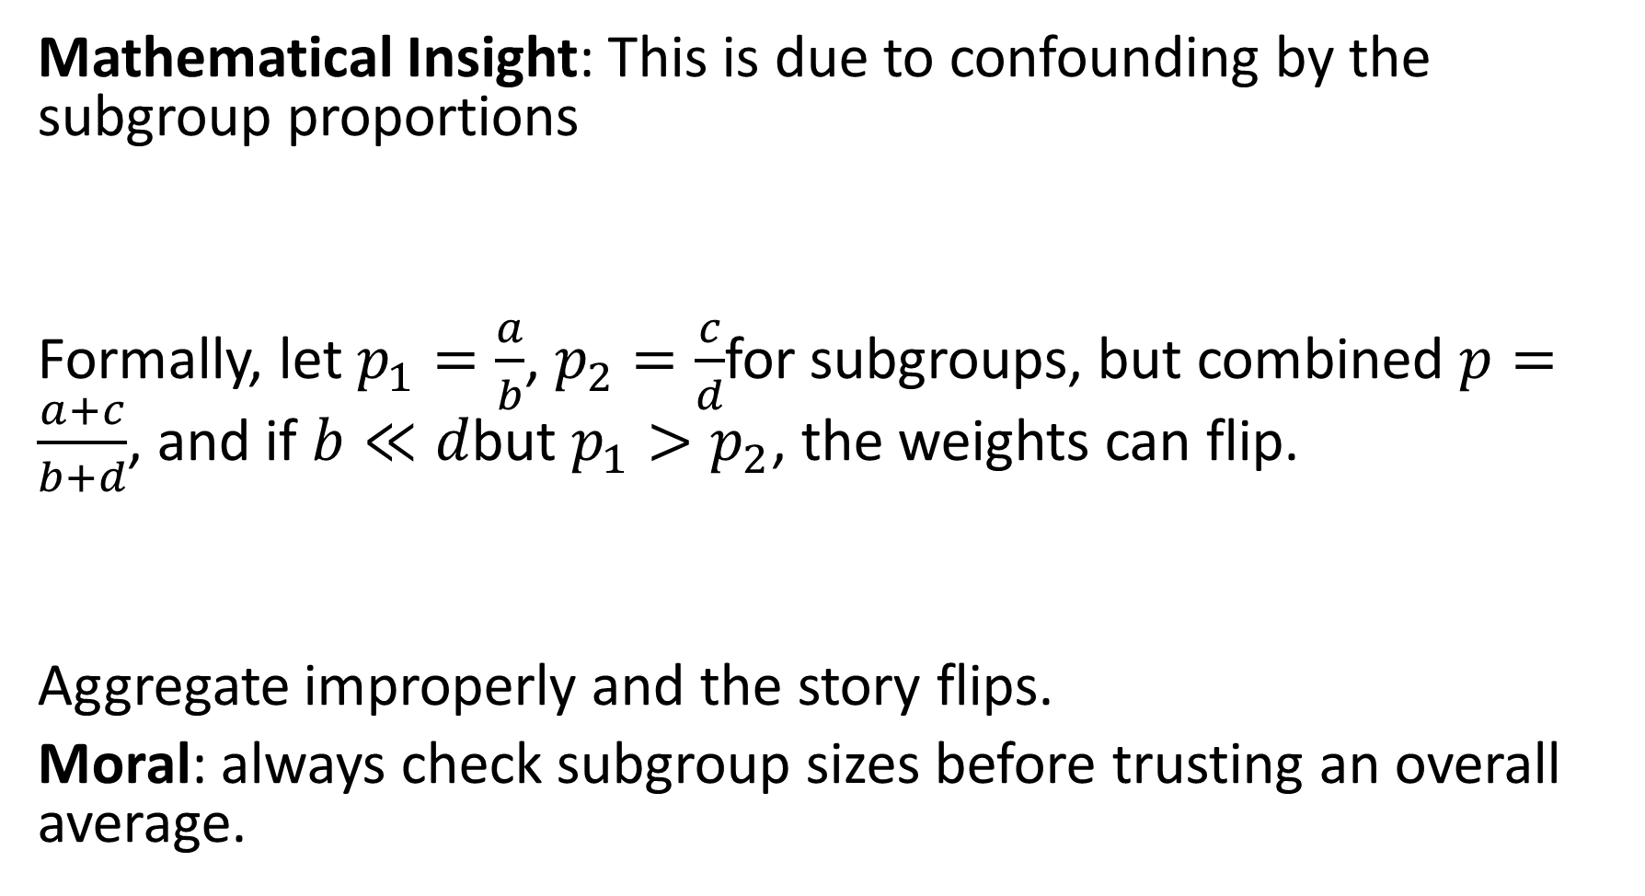
Mathematical Insight: This is due to confounding by the subgroup proportions
Formally, let $p_{1}=\frac{a}{b}$, $p_{2}=\frac{c}{d}$for subgroups, but combined $p=\frac{a+c}{b+d}$, and if $b≪d$but $p_{1}>p_{2}$, the weights can flip.
Aggregate improperly and the story flips.
Moral: always check subgroup sizes before trusting an overall average.

Slide 8
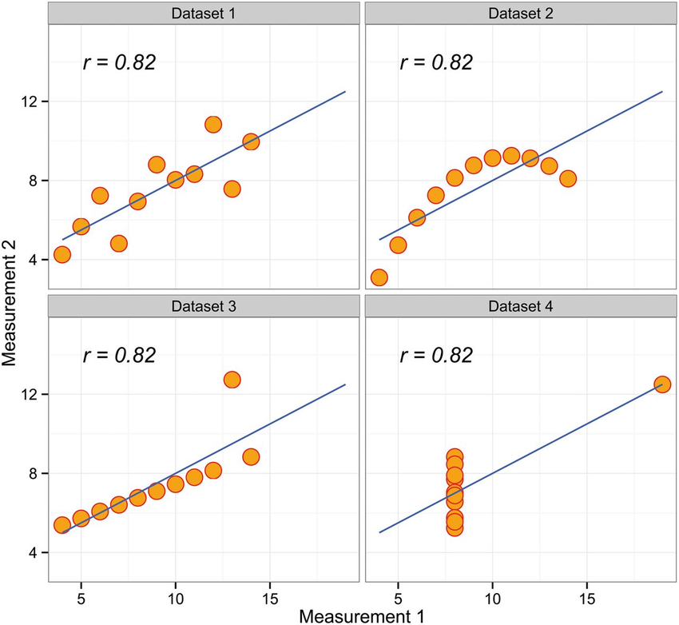
Anscombe’s Quartet — When Averages Lie Same mean of x = 9.0
Same mean of y = 7.5
Same variance of x = 11
Same variance of y = 4.127
Same correlation (r) = 0.816
Same regression line: 𝑦=3+0.5𝑥y=3+0.5x “Always plot your data before you trust your stats.” Ex : 13 Datasets of Datasaurus Dozen.

Slide 9
Berkson's Paradox :The Hospital Illusion
Why diabetics in hospital seem less likely to have cancer
In the general population, diabetes and cancer are independent.
Both increase the chance of hospital admission.
Among hospital patients, people with diabetes are less likely to also have cancer —because either one is enough to get admitted.
The negative correlation is an illusion — caused by conditioning on “being in hospital.”
Conditioning on a common effect creates false relationships.

Slide 10
Beyond the paradox
Lindley: Significance isn’t evidence.
Anscombe: Summary isn’t the story.
Simpson: Aggregates can lie.
Berkson: Conditioning can mislead.
Together: “It’s not the data — it’s the viewpoint.”

