Slide 1
The Art of Puzzles
Izzy Whistlecroft

Slide 2
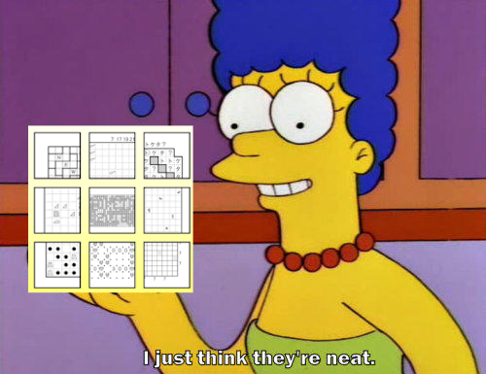
Logic Puzzles
More than just sudoku!
Hand made > generated!
Variety! Cool solution paths!
Fun logic!
Playful!

Slide 3
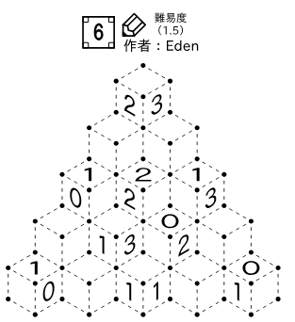
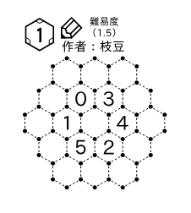
Toketa
Huge variety in puzzles
New variants!
Playful puzzle setting!
Starts easy, increasing difficulty
Evolving puzzle design over a set
https://toketa.booth.pm/

Slide 4
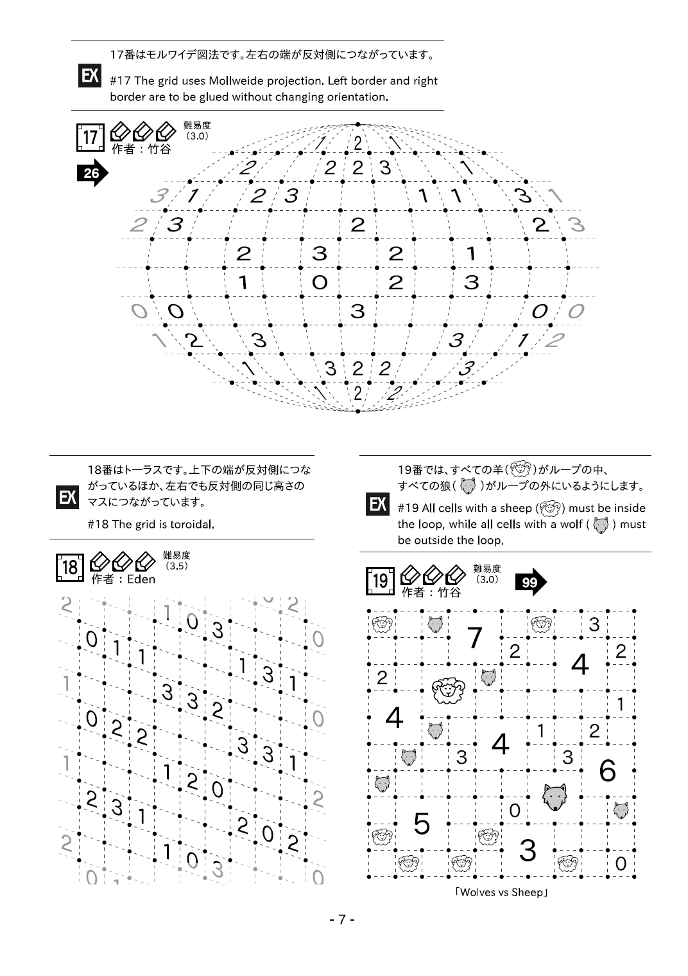

Slide 6
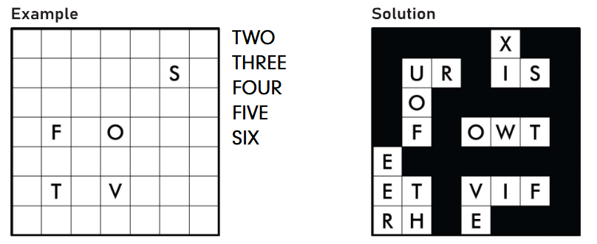
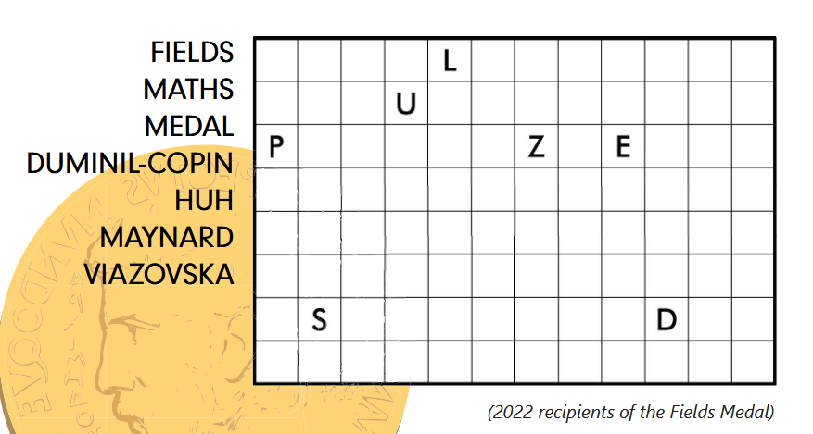
Pulze
https://www.tam-box.com/pulze
3 Issues so far
Latest issue is Maths based
Example puzzle: “Word Nurikabe”

Slide 7
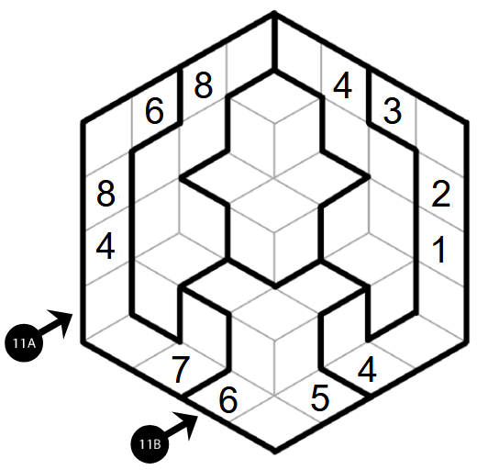
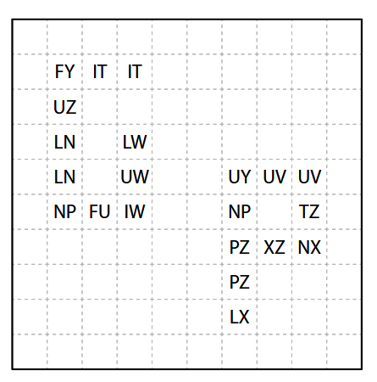
World Puzzle Grand Prix
https://gp.worldpuzzle.org
Has Sudoku and Puzzle versions
Archive editions are available
3D Sudoku
Sudoku Grand Prix 2025, Round 8
Pentominous (Ambiguous)
Puzzle Grand Prix 2025, Round 8

Slide 8
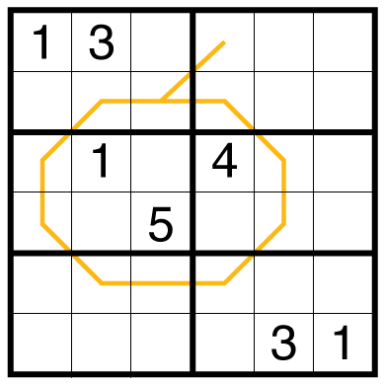
GMPuzzles
https://www.gmpuzzles.com/blog/
Regular puzzles on their blog
Handmade puzzles + sudoku
A variety of difficulties
Dutch Whispers Sudoku from gmpuzzles

Slide 9
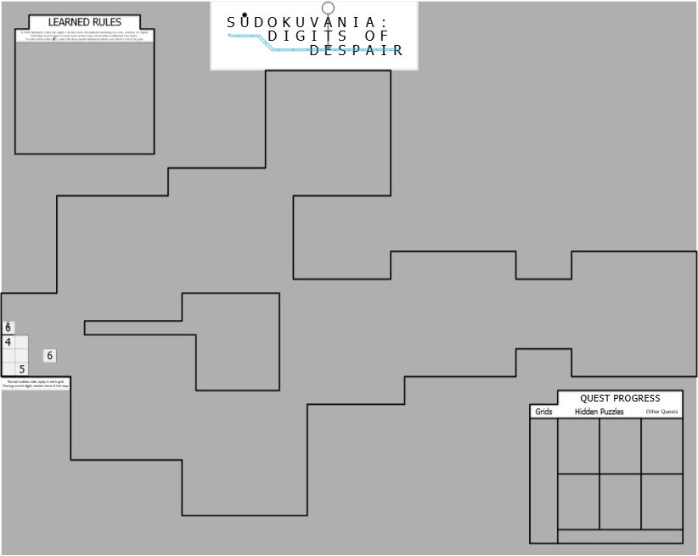
Sudokuvania
A huge fog sudoku
Difficult, satisfying!
Fun discoveries
Well made “boss” puzzles
Note: don’t try this one on mobile
https://tinyurl.com/SudokuvaniaFAQ

Slide 10
What to do next?
Solve cool puzzles!
Tell me about cool puzzles!

