Slide 1
Xen-V-Thon
Problem Statement : AI-Assisted Protein Function Classifier
Theme : Computational Biotechnology
PS Category : Software
Team Members :
- Kishor Bhuvaneswaran M
- Mathubharathi A
- Bala Prakash B
- Dharshana G
College Name : PSNA College of Engineering and Technology

Slide 2
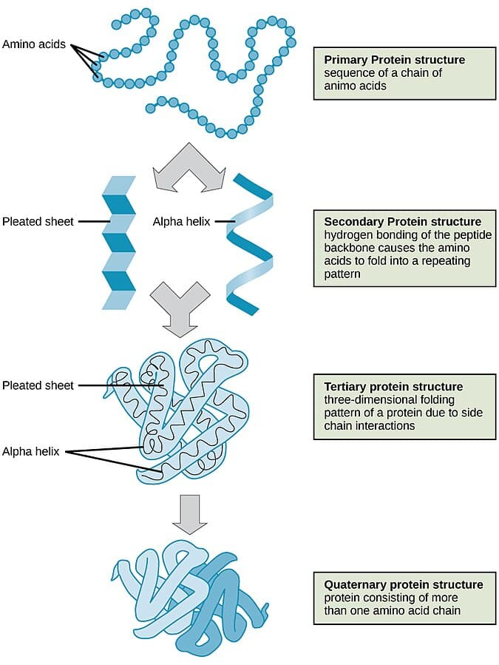
Introduction
Modern sequencing technologies generate protein sequences far faster than they can be experimentally analyzed
Determining protein function through wet-lab experiments requires significant time, cost, and expertise
As a result, a large number of proteins remain functionally unannotated or partially understood
Computational analysis of amino acid sequences offers a rapid way to infer functional characteristics
This project applies machine learning to assist coarse-grained protein function classification

Slide 3
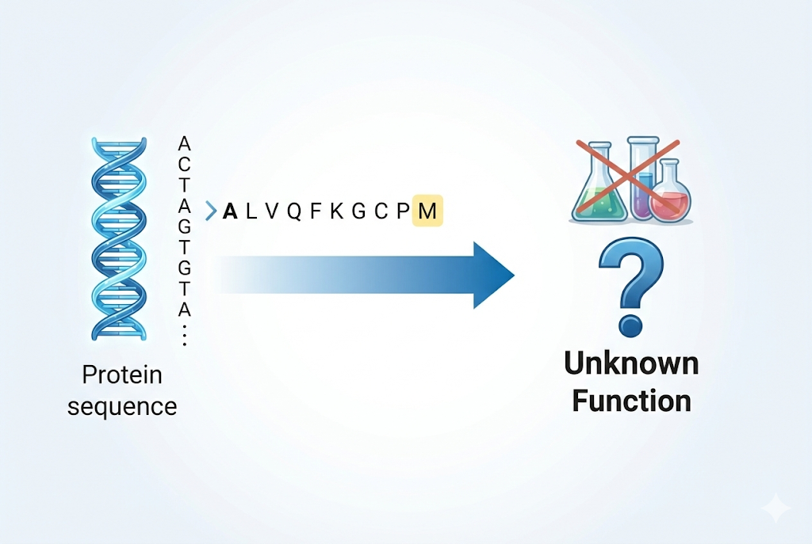
Problem statement
Protein sequencing technologies generate data faster than functional validation can be performed
Experimental determination of protein function is expensive, slow, and not scalable
A large proportion of protein sequences lack reliable functional classification
Existing computational tools are often complex, opaque, or focused on fine-grained annotations
There is a need for a fast, interpretable system to classify protein function using sequence data

Slide 4
Objectives
To develop a machine learning–based system for protein function classification
To extract biologically meaningful features from amino acid sequences
To classify proteins into broad functional categories using sequence data
To evaluate model performance against a random baseline
To demonstrate a working, reproducible prediction prototype

Slide 5
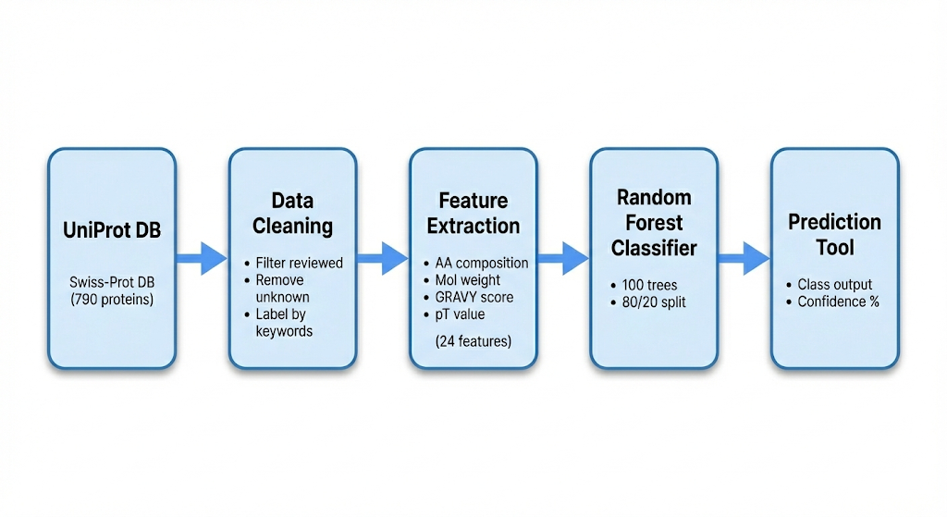
Methodology/Technical approach
(flow chart/Images)
Features Used (24 Total):
• Amino Acid Composition: 20 features (frequency of each amino acid)
• Sequence Length: 1 feature
• Molecular Weight: 1 feature
• Isoelectric Point (pI): 1 feature
• GRAVY Score (hydrophobicity): 1 feature
Why Random Forest?
• Works well with small datasets
• Handles non-linear patterns
• Provides feature importance
• No hyperparameter drama
• Fast training

Slide 6
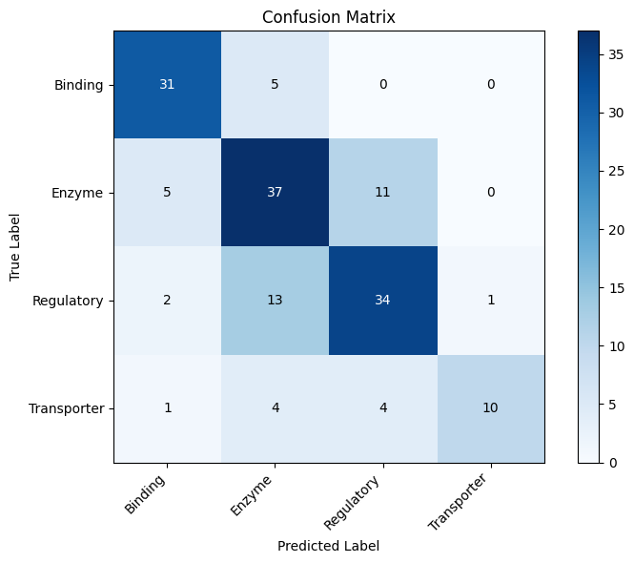
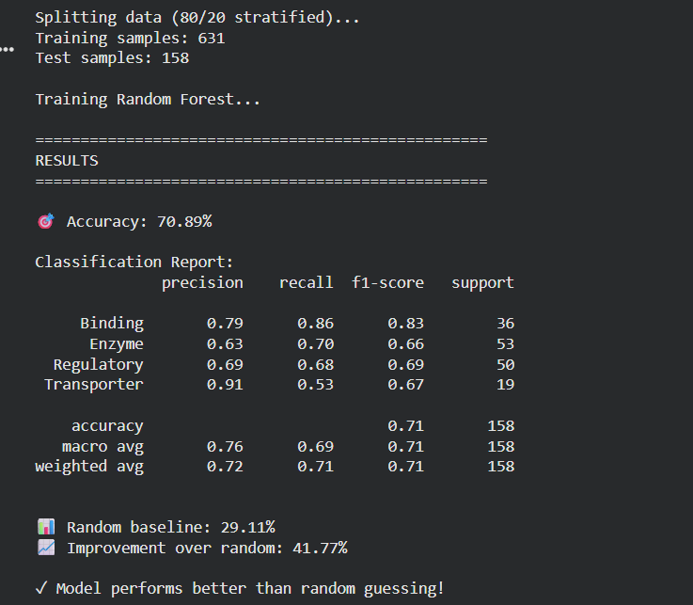
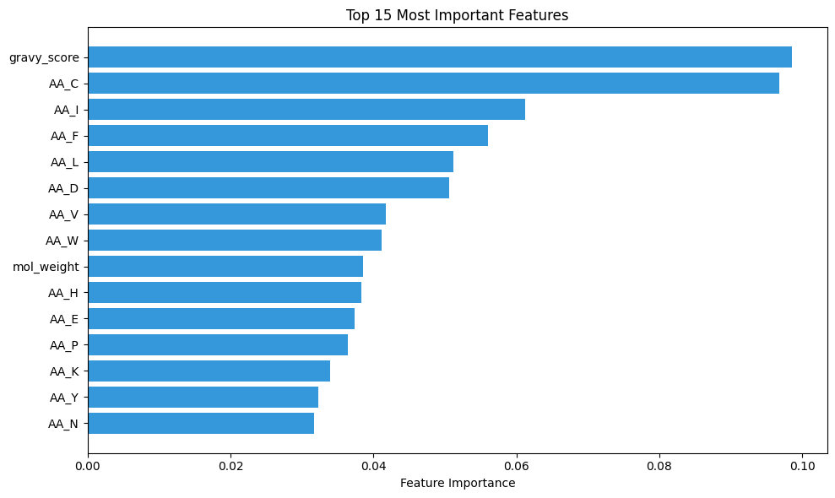
Prototypes/Outcomes

Slide 7
Research Gap

Slide 8
Reference

