Slide 1

CART- Classification and Regression Trees
Author: Mateusz Maj
Akademia Górniczo-Hutnicza im. Stanisława Staszica w Krakowie
AGH University of Krakow
Data

Slide 2

Goal of the project
The main goal of this project is educational—to understand how the CART (Decision Tree) algorithm works internally.
We aim to do three things:
Demonstrate the Core Logic: Show the mathematical process of Entropy and Information Gain.
Implement Theory: Use our custom code to calculate these metrics on flight data.
Compare Models: Contrast a heavily constrained model with a fully optimized one to see the performance difference.

Slide 3
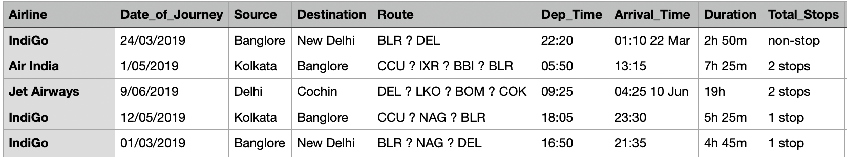
Database
We used the flight data from dataset.csv to train our models.
Key Setup Details:
Data Size: We used a fixed set of 5,000 rows.
Input Features: Airline, Source, and Destination.
Output Target: We predict Total_Stops (4 unique classes).
Preparation: Before training, all categorical text data was converted into numerical integers using Label Encoding.
Data Split: The data was split into 90% for Training and 10% for Testing.

Slide 4
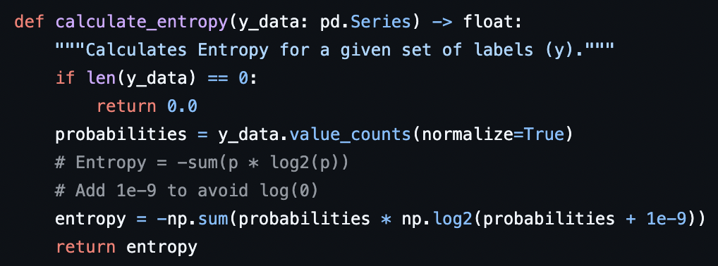
Entropy and Information Gain
The tree is built by continuously reducing uncertainty. This is done using two core functions:
1. Entropy: This measures the impurity or randomness in a set of class labels.
Low Entropy (near 0) means the data is clean (e.g., all flights have '1 stop').
The Initial Entropy of our training set (e.g., 1.43) shows high uncertainty that the model must solve.
2. Information Gain: This is the reduction in Entropy achieved by splitting the data using a specific feature.
The calculate_information_gain function tests all features.
The feature that yields the highest IG is chosen as the best feature for the split, as it introduces the most 'order' into the data.

Slide 5
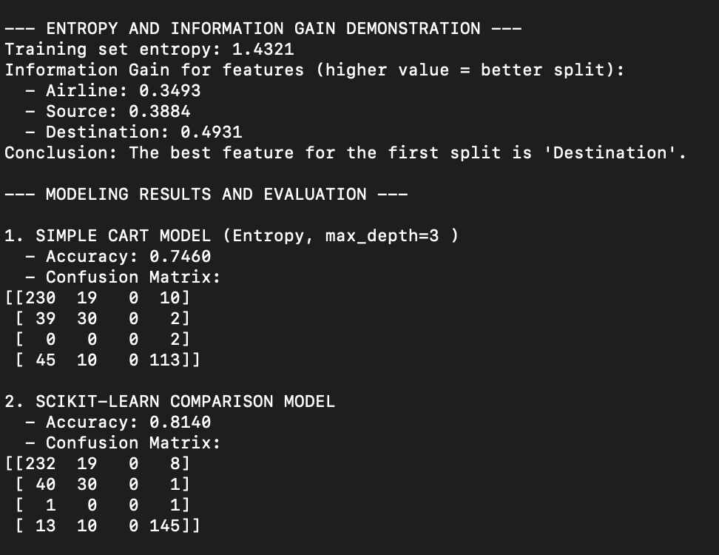
Results and comparison
We compare two models, both trained using a random seed to ensure variable results across sessions.
- the Information Gain analysis consistently identified Destination as the most important feature for the initial split
-the training set entropy (1.43) confirmed high initial uncertainty, requiring the model to find strong patterns.
- the simple CART model achieves significantly lower accuracy. This confirms that limiting complexity directly limits performance.
- The Confusion Matrix confirmed that the simple model struggles most with minority classes (flights with 1 or 2 stops)

Slide 6
Thank you for your attention!

