Slide 1
Save Time: use Selenium Grid
Matias Caruso
Martin Villarruel

Slide 2

Matias Caruso
Test Automation Engineer
Haufe Group
Rosario, Argentina
Barcelona, Spain
No internet at home
Notes:
Position
Company
Pais
Donde vives
Fun fact

Slide 3
Martin Villarruel
Test Automation Engineer
Verizon Connect
Rosario, Argentina
Dublin, Ireland
Jiu Jitsuka
Dublin, Ireland
Notes:
Position
Company
Pais
Donde vives
Fun fact

Slide 4

Summary
Theory about Selenium Grid.
Configure and connect the Nodes whit the Hub.
Run the Hub and Nodes on Docker Images.
Setup a Test Suite to run on the Nodes.
Tips and tricks to avoid usual mistakes.

Slide 5
Introduction
What?
When?
Selenium-Grid is a tool that allows you run your tests on different machines against different browsers/OS in parallel.
Versatility: To run your tests against multiple browsers, multiple versions of browser, and browsers running on different operating systems.
Velocity: To reduce the time it takes for the test suite to complete a test pass.

Slide 6
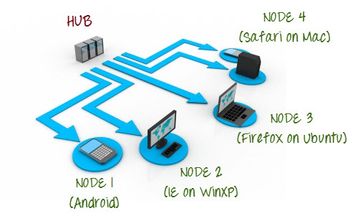
Grid Architecture
A grid consists of a single hub, and one or more nodes.
Hub
The hub is the central point where you load your tests into and distribute them.
Acts as a server, so it acts as a central point to control the network of test machines.
Each test set with DesiredCapabilities is given to hub, it search for the node which matches the given configuration

Slide 7
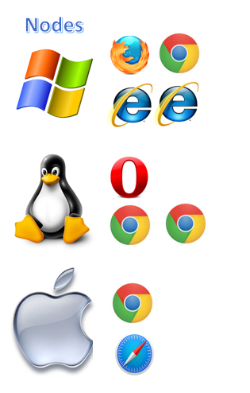
Grid Architecture
A grid consists of a single hub, and one or more nodes.
Nodes
Nodes are the Selenium instances that will execute the tests.
A Grid network can have multiple nodes.
A node is supposed to have different platforms, i.e. different operating system and browsers.
The node does not need the same platform for running as that of the hub.

Slide 8
Hands on
Setup Selenium Grid
Project Download
Run Docker Containers
Run Tests

Slide 9
Selenium Server Console Commands
java -jar selenium-server-standalone-XXX.jar -role hub
https://bit.ly/2TlkRyu
java -jar selenium-server-standalone-XXX.jar -role node -port 5556
NOTE: You now have to give path to the Gecko driver if using Firefox.

Slide 10
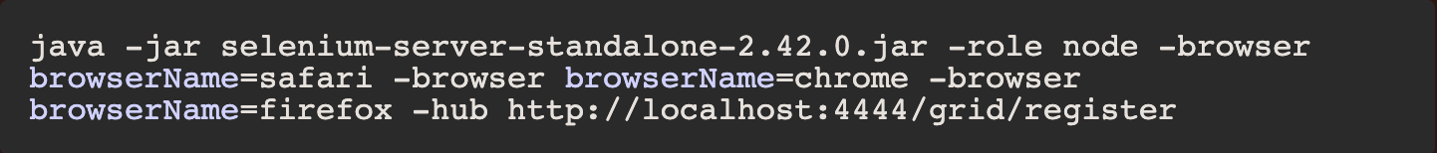
Nodes parameters
seleniumProtocol=WebDriver,
browserName=chrome,
maxInstances=1,
version=61.0.3163.100,
platform=LINUX

Slide 11
Project Download
https://github.com/MatiCaruso/SaveTime

Slide 12
Docker Console Commands
docker-compose -f docker-compose.yaml up
docker-compose -f docker-compose.yaml down
https://github.com/SeleniumHQ/docker-selenium

Slide 13
VM Viewer
RealVNC - All OS
Windows Remote Desktop - Win 10
Remmina - Linux

Slide 14
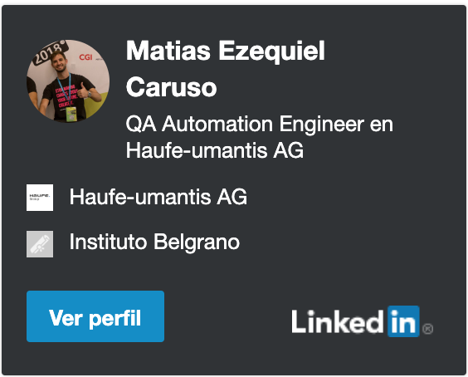
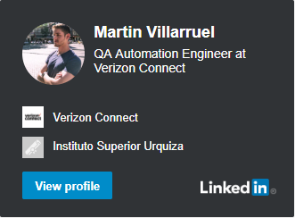
Thank you

