Slide 1
Introduction to Biocomputing Tutorial Week 5
Debartolo 319

Slide 2
Announcements
Office hour: Monday 4-5 pm, Galvin 266
Work through "Making choices" section of the Software Carpentry, Quiz on Monday
Homework is due before next tutorial on Friday

Slide 3
Tutorial
Analyzing Patient Data (UNTIL import matplotlib.pyplot)
http://swcarpentry.github.io/python-novice-inflammation/01-numpy/
%matplotlib inline is not needed for now. It is for Jupyter notebook later
Exercise 5
GitHub repo: https://github.com/lyy005/Intro_Biocom_ND_319_Tutorial5
Notes:
import matplotlib.pyplot is not needed for today’s hw. We’ll have a separate tutorial talking about making plots
pandas and numpy

Slide 4
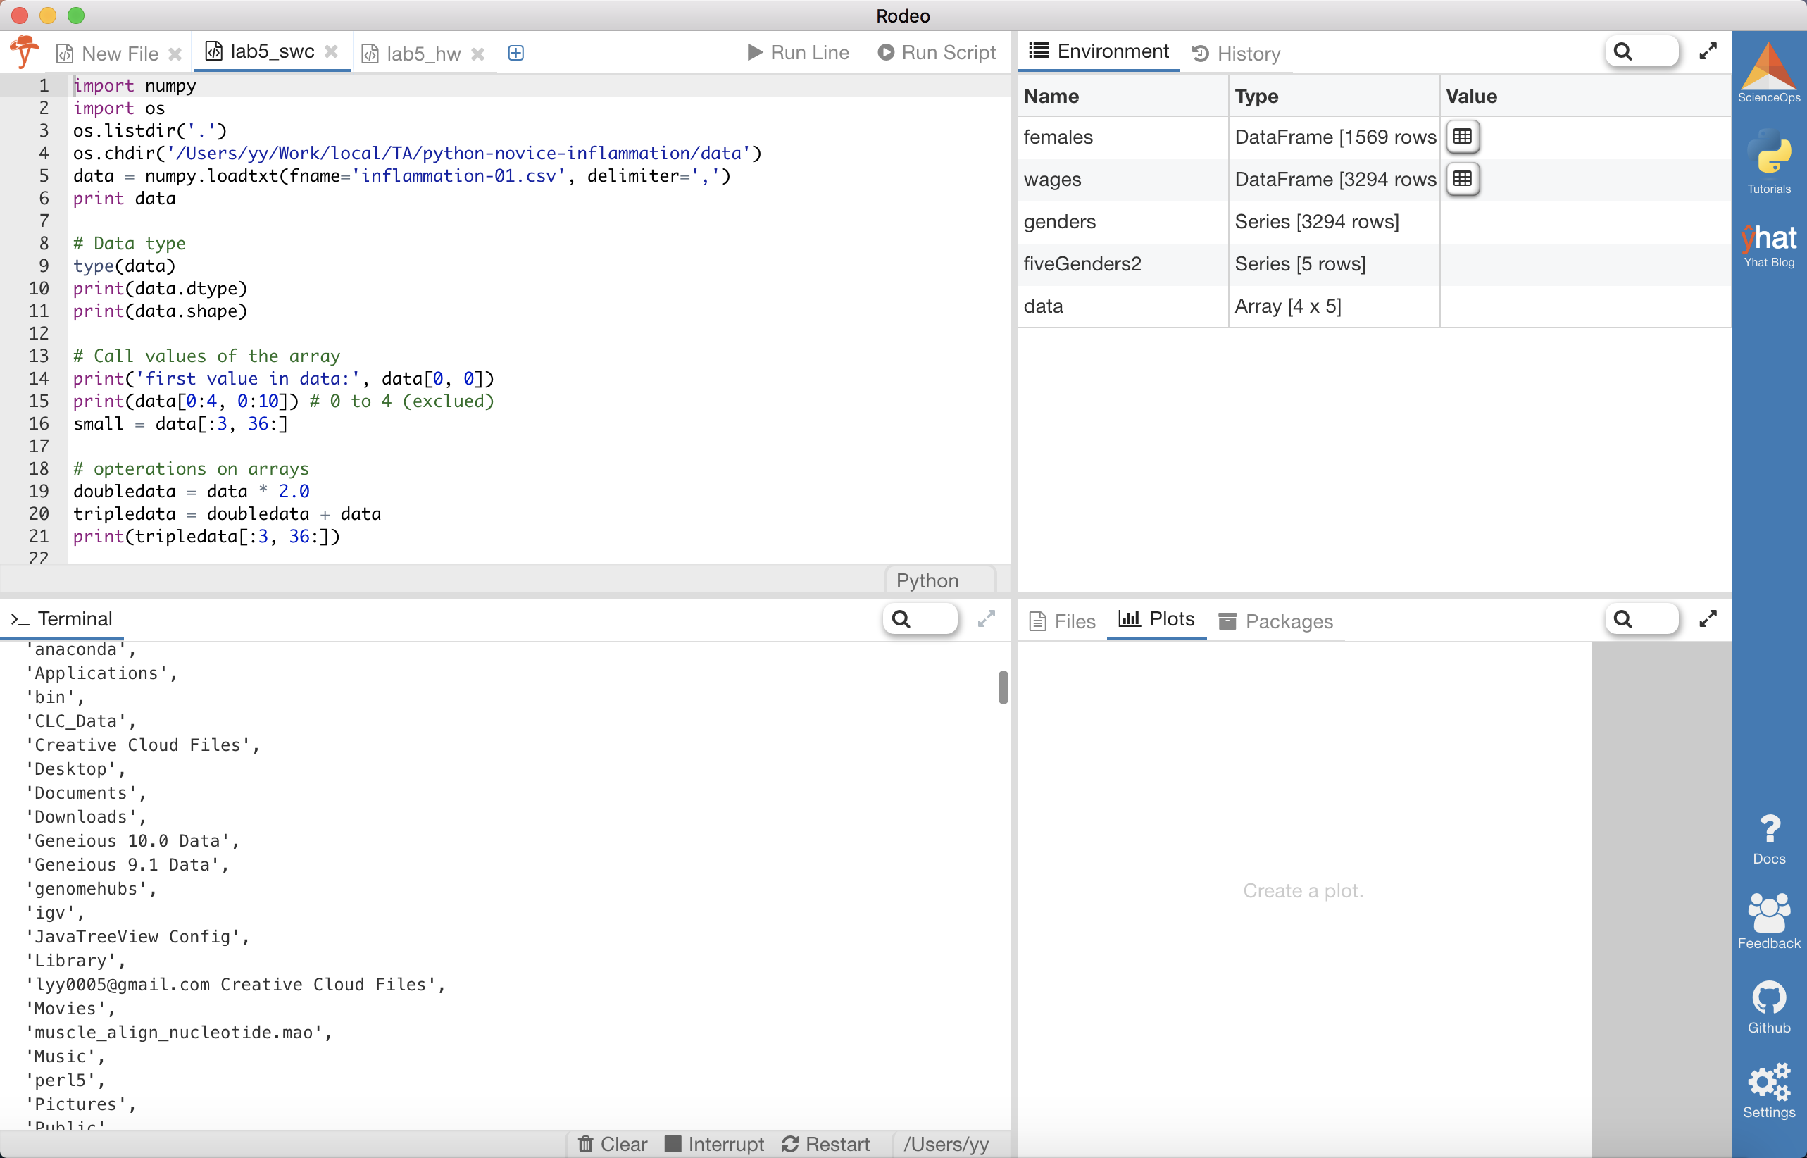
Rodeo
Code
Workspace
Console
Plots

Slide 5
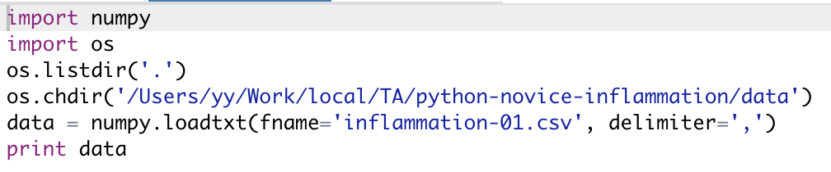
Read file
data = numpy.loadtxt(fname=’path_to_the_file/inflammation-01.csv', delimiter=',')
import os
os.listdir('.') == ls
os.chdir('path_to_the_file') == cd
os.getcwd() == pwd
Notes:
Change os.chdir after the SWC exercise and change it to the github repo dir

Slide 6
Track changes
Have a terminal open with the repo as the working directory and run git add/commit and push/pull using the terminal, but edit the script in Rodeo (Cygwin, Rodeo, IPython)
Use system commands from Rodeo to do your git work (Rodeo, IPython):
import os
os.system("git add -A")
os.system("git commit -m 'commit message'")
Notes:
Make sure you used single quotation mark

Slide 7
Homework
Work with a partner. One of you will be the owner, the other on will be the collaborator.
Devise a plan for splitting up the work and generating the required code. Work in parallel and check each other’s code (commit, pull and push).
Homework is due on Friday. Turn in homework through pull request with your names

