Slide 1

LAB4:
Multidimensional Data Visualization/ Advanced techniques – UMAP vs TSNE
Zespół: Wizualizacja dużych zbiorów danych
Kod: qgq2t7b
Prof dr hab. inż. Witold Dzwinel
Instytut Informatyki AGH

Slide 2
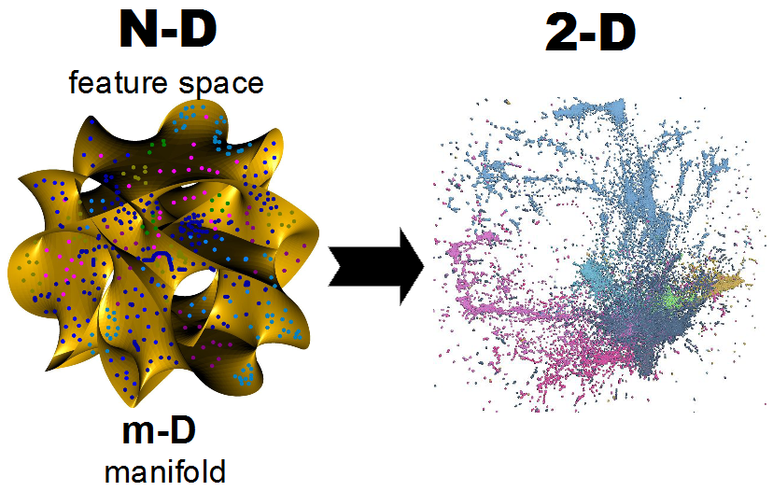
Topic → interactive visualization via embedding of large high dim data

Slide 3

UMAP
Phase 1: constructing a fuzzy topological representation
Phase 2: optimizing the low dimensional representation to have as close a fuzzy topological representation as possible as measured by cross entropy.
Phase 3: reduce the dimension to n<<N or visualize scatter plot
https://github.com/lmcinnes/umap

Slide 4
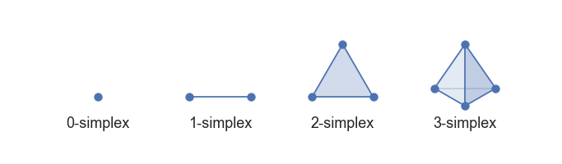
constructing a fuzzy topological representation
K-simplexes and simplical complexes
Next we need to understand how to apply that process to a finite set of data samples.
Čech complex → a combinatorial way to covert topological space into a simplicial complex. Let each set in the cover be a 0-simplex; create a 1-simplex between two such sets if they have a non-empty intersection; create a 2-simplex between three such sets if the triple intersection of all three is non-empty; and so on.

Slide 5
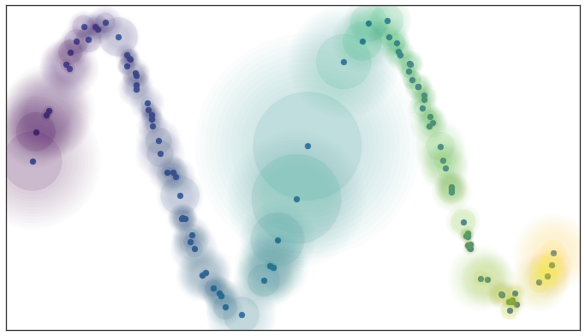
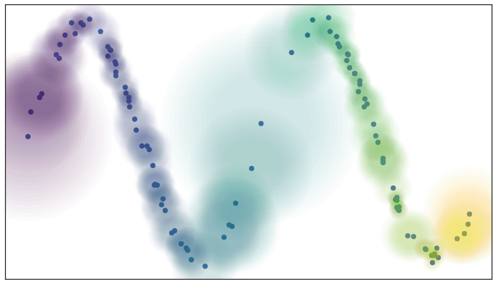
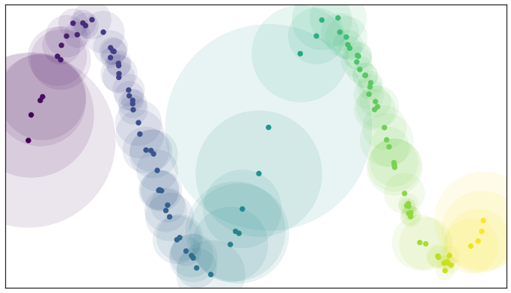
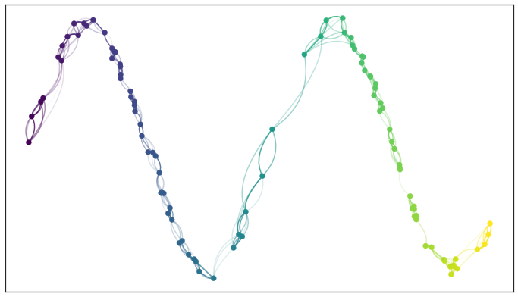
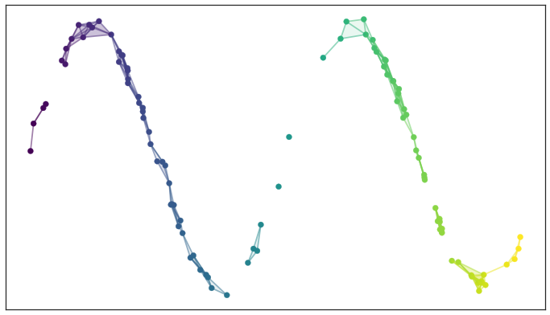
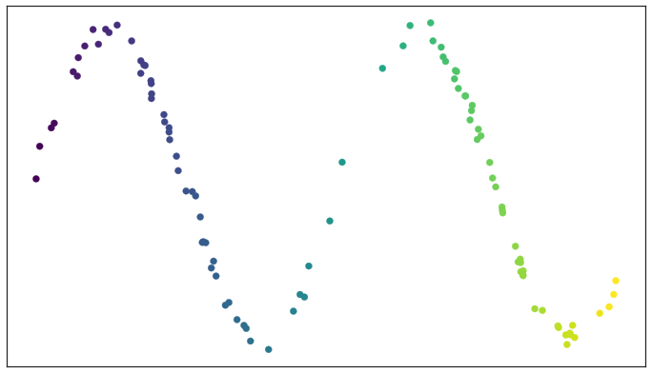
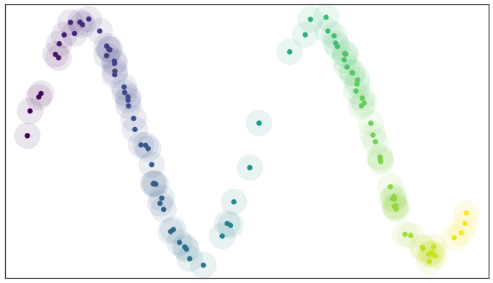
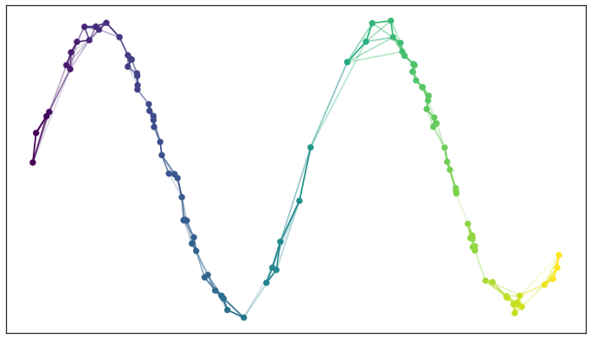
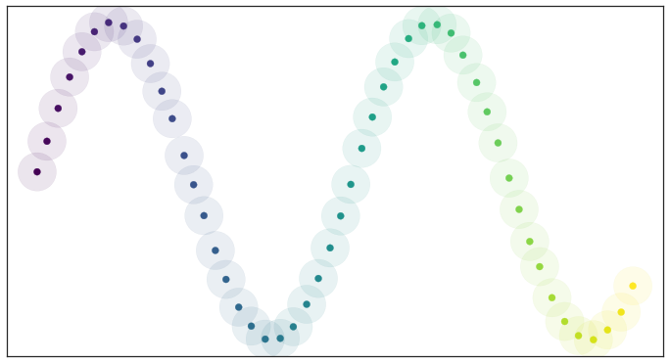
How to guess the space topology
Kernel distance
the fuzzy confidence decay in terms of distance beyond the first nearest neighbor
Ultimately that means we need a way to quickly compute (approximate) nearest neighbors efficiently, even in high dimensional spaces.
If we want to merge together two disagreeing edges with weight a and b then we should have a single edge with combined weight 𝑎+𝑏−𝑎⋅𝑏.
The way to think of this is that the weights are effectively the probabilities that an edge (1-simplex) exists.
The combined weight is then the probability that at least one of the edges exists.
Each point has its own local metric associated to it, and from point a’s perspective the distance from point a to point b might be 1.5, but from the perspective of point b the distance from point b to point a might only be 0.6.
Which point is right?
How do we decide?
The local connectivity constraint ensures that we focus on the difference in distances among nearest neighbors rather than the absolute distance
Local geometry defined by using k-NN . Balls of radius 1 to k-NN
Use a k-neighbor graph instead of using balls of some fixed radius to define connectivity.
https://umap-learn.readthedocs.io/en/latest/how_umap_works.html

Slide 6
UMAP
Phase 1: constructing a fuzzy topological representation
Phase 2: optimizing the low dimensional representation to have as close a fuzzy topological representation as possible as measured by cross entropy.
Phase 3: reduce the dimension to n<<N or visualize scatter plot
https://github.com/lmcinnes/umap

Slide 7
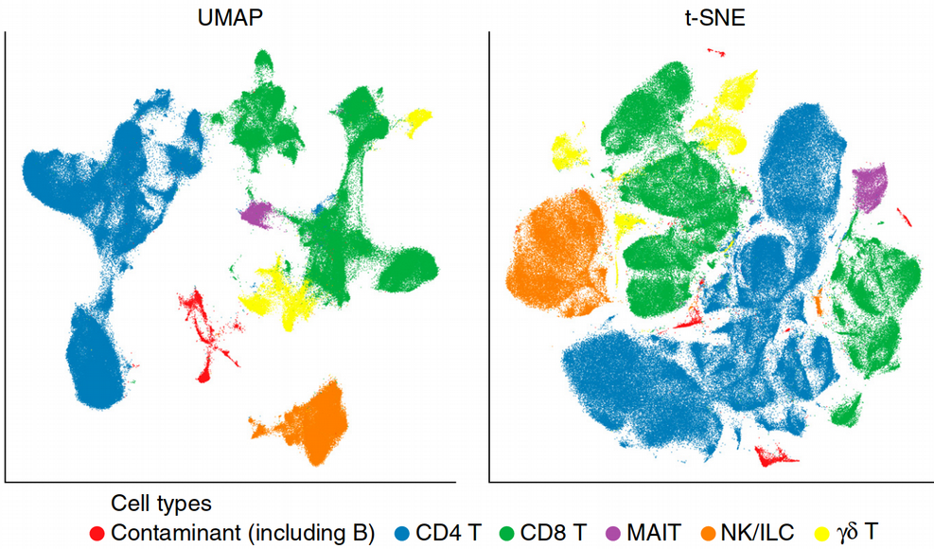
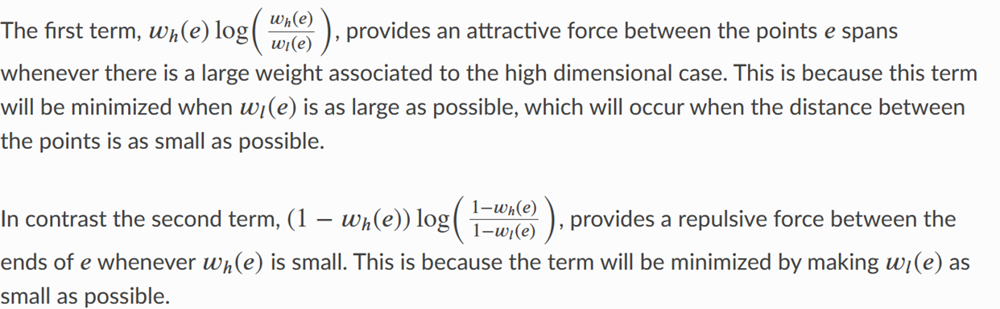
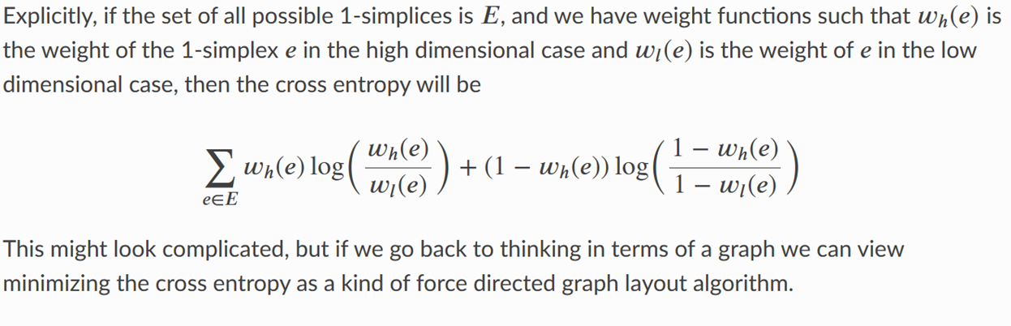
UMAP- optimizing
https://umap-learn.readthedocs.io/en/latest/how_umap_works.html

Slide 8
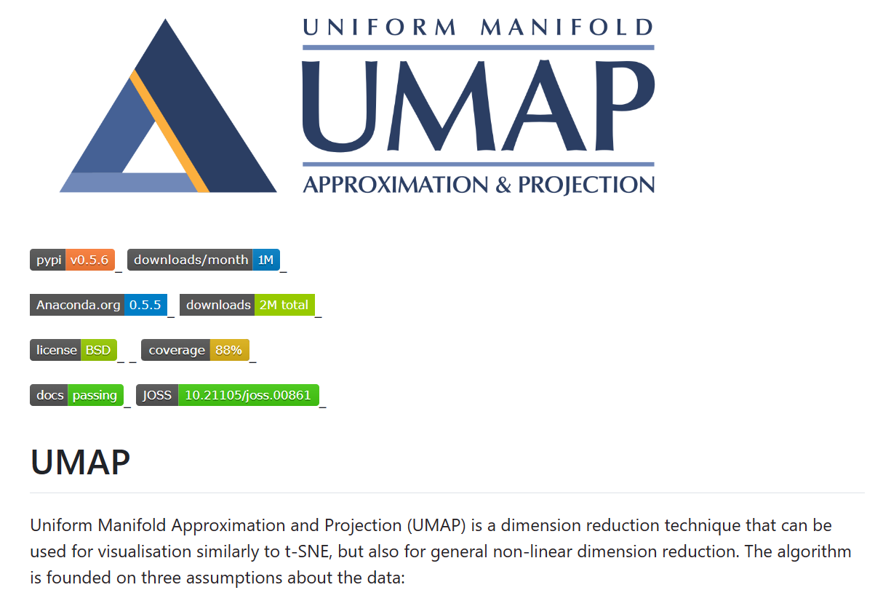

Slide 9
Task #1 Visualizing a dataset using UMAP
Select a data file e.g., from 16 Best Sklearn Datasets for Building Machine Learning Models | HackerNoon. Read carefully its description!! Use rather a larger dataset starting from position 9 (California housing).
Use UMAP implementation from GitHub - lmcinnes/umap: Uniform Manifold Approximation and Projection
Assess the quality of UMAP embedding using Shepard plot and k-nearest neighbor classifiers.
What do you observe changing the UMAP parameters:

Slide 10
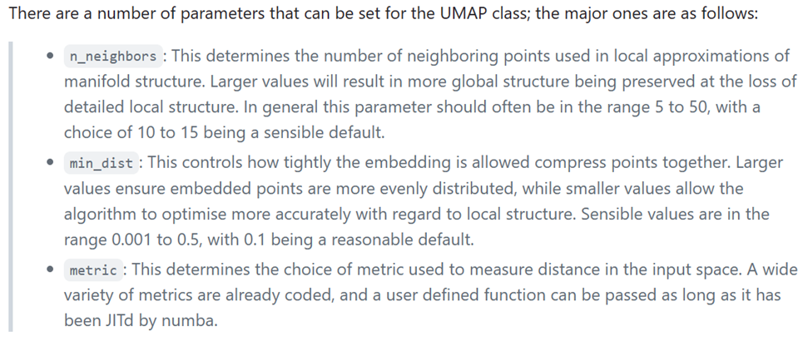
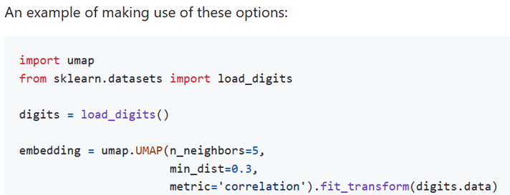

Slide 11
Task #2 Visualizing a dataset using t-SNE
Do EXACTLY the same as in Task#1 for t-SNE implementation from scikit-learn or using more advanced implementation GitHub - DmitryUlyanov/Multicore-TSNE: Parallel t-SNE implementation with Python and Torch wrappers.
Make it for various perplexity and exaggeration metaparameters.
Summarize the differences of the two approaches (UMAP and TSNE) in quality and efficiency of embedding

