Slide 1
NFL Player & Team Performance Database
Lance Heinrich, Matias Avila
CSCI 126 – Spring 2025

Slide 2
Project Overview
Goal:
Explore how individual NFL player performance contributes to overall team success across 20 seasons (2003–2023).
Focus on key questions such as:
Does quarterback production strongly predict team wins?
How important is defensive performance to winning seasons?
Do specific positional stats (rushing, receiving, tackles) correlate with team wins?
Tools & Technologies Used:
MySQL: Database design, schema implementation, and data querying
MySQL Workbench: Schema management, relationship modeling, and query testing
Python: Data cleaning, aggregation of player game stats into season totals, and conversion of JSON to CSV formats
Data Scope:
NFL Player Stats Dataset: ~86,300 rows (player performance by season)
NFL Team Stats Dataset: ~670 rows (team performance by season)
Covers 20 NFL seasons (2003–2023) with a focus on linking individual contributions to team outcomes

Slide 3
Why We Chose These Datasets
Focused on the NFL due to its rich, structured historical data and strong positional statistics.
The NFL provides clear win/loss outcomes each season, which allows direct measurement of success.
Chose two complementary datasets:
One capturing individual player performance (passing yards, rushing yards, tackles, etc.).
One capturing team-level outcomes (wins, losses, points scored/allowed, turnovers).
These datasets supported the key analytical questions we proposed

Slide 4
Dataset Details
Dataset 1: NFL Player Stats & Profiles
Source: Kaggle — NFL Football Player Stats
~86,300 rows, 50+ attributes
Structure:
Season-level totals per player (passing yards, rushing touchdowns, interceptions, tackles, etc).
Aggregated from game-level data into season totals to simplify analysis.
Dataset 2: NFL Team Stats (2003–2023)
Source: Kaggle — NFL Team Data 2003–2023
~670 rows, 20–30 attributes
Structure:
Team performance metrics per season (wins, losses, points for/against, turnovers).
Provides the outcomes needed to link player contributions to team success.

Slide 5
Database Design Approach
Separated Static vs. Dynamic Data:
Static Tables:
Player: Player ID, name, position
Team: Team ID, name
Season: Year of the season
Dynamic Tables (Performance Data):
PlayerStats: Season totals for individual player performance
TeamStats: Team performance metrics per season
PlayerTeamSeason Join Table:
Handles many-to-many relationships between players, teams, and seasons
Tracks which player played for which team in which season
Supports accurate historical tracking, especially for players who change teams
Normalization to Third Normal Form (3NF):
Eliminated redundancy by using foreign keys instead of repeating values
Ensured flexibility for querying across multiple seasons and positional groupings
Improved data integrity and simplified updates

Slide 6
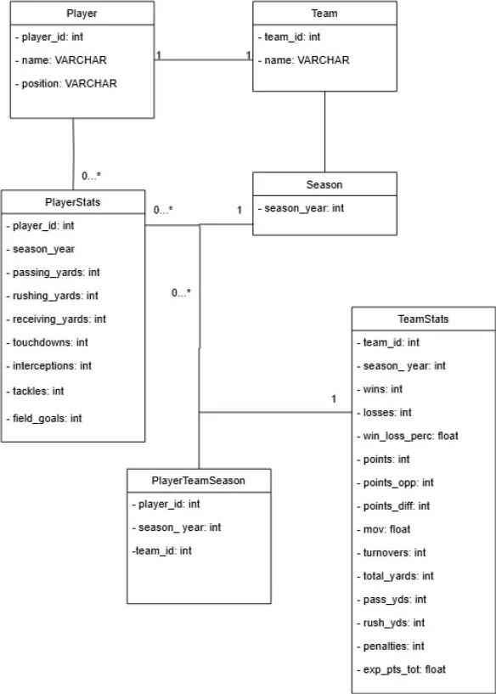
UML Diagram

Slide 7
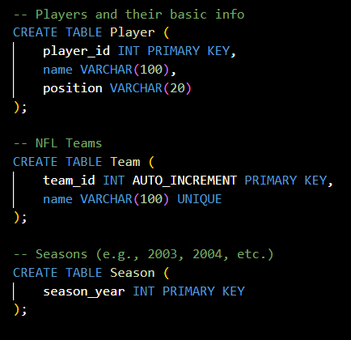
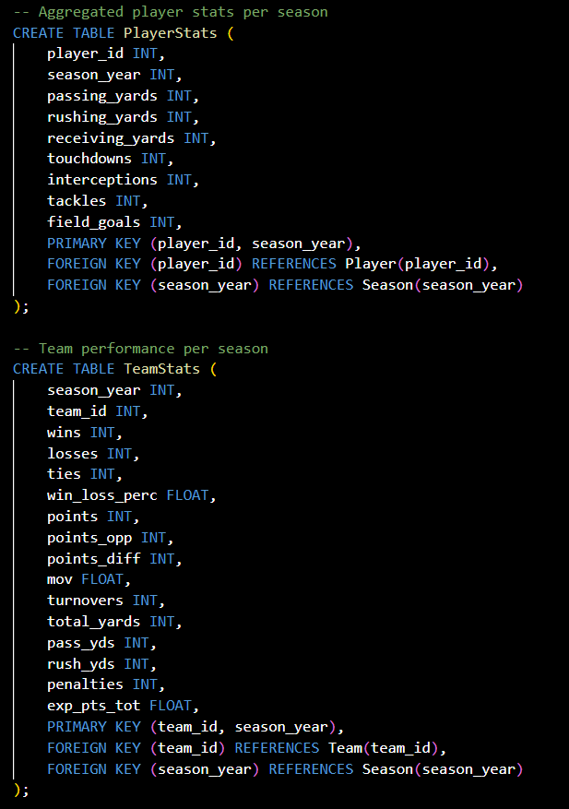
Database Tables
Static Tables
Dynamic Tables

Slide 8
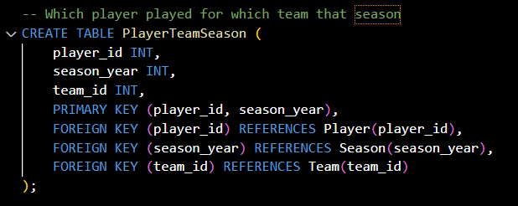
Database Tables
Join Table

Slide 9
Normalization Highlights
Applied Third Normal Form (3NF) to ensure data integrity and avoid redundancy:
1NF: All tables use atomic columns.
2NF: All non-key attributes fully depend on the entire primary key.
3NF: No transitive dependencies — every non-key attribute relates directly to the key.
Used foreign keys and join tables to support accurate tracking and flexible query writing.

Slide 10
Data Exploration and SQL Queries
Queries focused on key questions like:
How important is quarterback production for team wins?
Does a strong defense (low points allowed) correlate with success?
Do elite rushing, receiving, or defensive stats influence playoff appearances?
Query types included:
Joins across PlayerStats, TeamStats, PlayerTeamSeason, and identity tables (Player, Team, Season)
Aggregations using GROUP BY, AVG, SUM, and COUNT to calculate season averages and totals
Filtering and Subqueries to compare playoff vs. non-playoff teams, high-performance players vs. others
One View to simplify repeated analysis of player-team-season relationships
Example Queries:
Top 10 Highest Passing Yard QBs All Time with their teams’ win totals
Average wins for teams with vs. without a 3000-yard quarterback
Average wins for teams allowing fewer than 300 points vs. those allowing more

Slide 11
Results and Insights
Quarterback performance is a strong predictor of team success
Teams with a 3000+ passing yard quarterback averaged 9.2 wins, while teams without averaged 6.3 wins. ( Large Correlation )
Defense plays a major role in winning seasons
Teams allowing fewer than 300 points averaged nearly 11 wins, while teams allowing over 300 averaged 7.5 wins. ( Large Correlation )
Turnover margin is highly correlated with success
Teams with 10+ wins averaged about 21 turnovers, while teams with less than 10 wins averaged nearly 27. ( Moderate Correlation )
Impact of a single star wide receiver
Teams with a 1200+ receiving yard wide receiver averaged 9.36 wins, compared to 7.33 for others. ( Moderate Correlation )
Impact of a single star running back
Teams with a 1000+ rushing yard running back averaged 8.85 wins, compared to 7.22 for others. ( Small Correlation )

Slide 12
Challenges Faced
Data cleanup and standardization:
Inconsistent player and team names across datasets required manual correction and alignment.
Converted player game-level data into season totals to enable season-level analysis.
Adjusted team names in the player dataset to match the team_id values in the team table for accurate joins.
Data aggregation and formatting:
Aggregated player statistics from individual games into per-season totals using Python.
Converted player data from JSON format to CSV to simplify database import.
Ensured accurate player-team-season relationships when linking player stats to the correct team and season.
Maintaining relational integrity:
Prevented data duplication through careful schema design and normalization.
Verified foreign key relationships between players, teams, seasons, and their corresponding stats.

Slide 13
Conclusion
This project successfully integrated NFL player and team data into a relational database to explore how individual performance relates to team outcomes.
The results highlighted that while every position contributes to success, quarterback production and strong defensive performance were the most consistent predictors of winning seasons.
The results align with typical NFL team draft patterns with defensive players and quarterbacks typically being picked early in the draft.

Slide 14
Team Contributions
Lance Heinrich:
Dataset Description, Schema Design, Data Aggregation/Cleaning, SQL Queries & Results
Matias Avila:
UML Diagram, Schema Justification, Written Report, Presentation Slides

Slide 15
Questions
Thank you for your time! Any questions?

