Slide 1
Gunfire Genesis and “Ironic shooting game experience”
Matias Myllymäki, Jesse Mäkelä

Slide 2
Game idea
- The player must survive in a chaotic environment, constantly needing to watch their back.
- The player wins by eliminating all toxic enemies and staying alive.

Slide 3
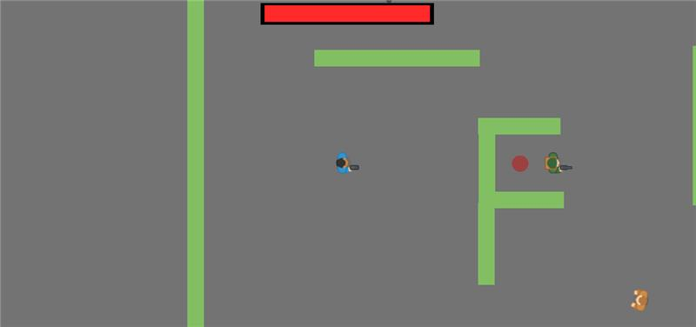
Enemies
Enemies are challenging and require a strategy to defeat, which the player must figure out.

Slide 4
Game mechanics
1. The player can move around the map using the “WASD” keys and shoot by pressing the left mouse button.
2. When an enemy dies, a power-up style sound plays, encouraging the player to keep fighting. The player can take up to 10 hits before dying.

Slide 5
Self-evaluation
Goals: The primary goal was to develop a playable action shooter where the player can move around using “WASD,” shoot enemies with the left mouse button, and manage health with a hit system. Additionally, we wanted to implement rewarding mechanics, such as a power-up sound upon enemy death, and create a challenging environment where the player must strategically overcome enemies.
Did We Achieve them?: Yes, we achieved these goals. The player can move freely around the map with the “WASD” keys, shoot using the left mouse button, and the power-up sound successfully plays upon an enemy’s death. The hit system works with the player being able to take 10 hits before dying, providing a challenging but manageable experience.

Slide 6
Was there enough time?: The timeline depends on the scope of the game. Given that we focused on basic mechanics like movement, shooting, and enemy interaction, we were able to implement those within the available time. However, if more complex systems (e.g., advanced AI, levels, more power-ups, or multiplayer features) were to be added, additional time would have been needed for proper balancing and testing.

