Slide 1

Portfolio://
Designed and coded by Matilda Morton
Notes:
Thank you for watching me present today.
I know it might get tedious watching everyone present, but hopefully it’s a new experience.

Slide 2
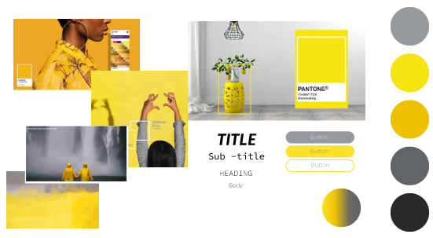
Initial design
http://www.website.com
Notes:
I wanted to first chat about selecting a design, I always find this difficult. I wanted to first go with a rainbow neon theme, but thought it would be too buzy and difficult to style, so I looked at other current popular colours. I didn’t want to go the standard black and white because I wanted to do something new. I started with this colour design but got bored very quickly, so went back to my original idea after getting some inspiration.

Slide 3
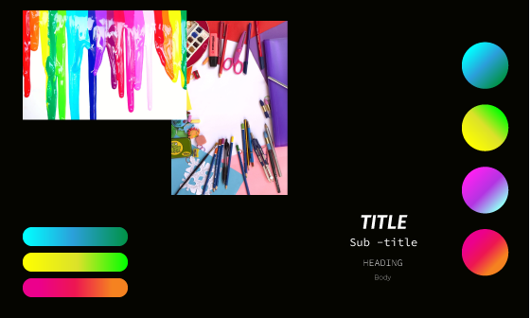
Initial design
http://www.website.com
Notes:
This was the end design I settled on as I really wanted to take on the challenge.

Slide 4

Notes:
Do I somewhat regret it now? Maybe, it is a lot of more design work than I have time for and it’s not necessarily teaching me better code, but I did want to do something that I could use for a real portfolio one day.

Slide 5
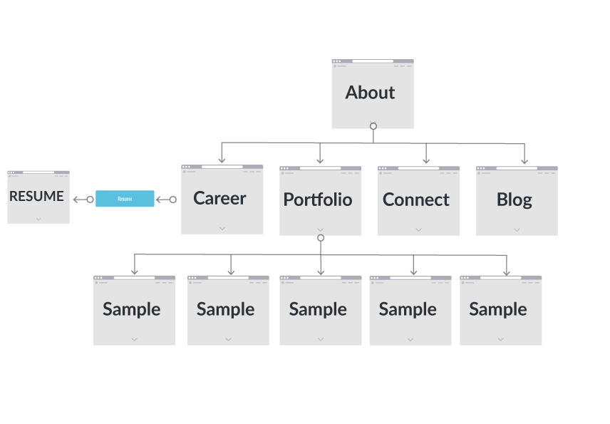
Sitemap
<!DOCTYPE html>
<html lang="en">
<head>
<title>Document</title>
</head>
<body>
<p>Matilda’s portfoliop>
<p>Designing the future</p>
</body>
</html>
Notes:
Let’s look at some of the design elements,

Slide 6

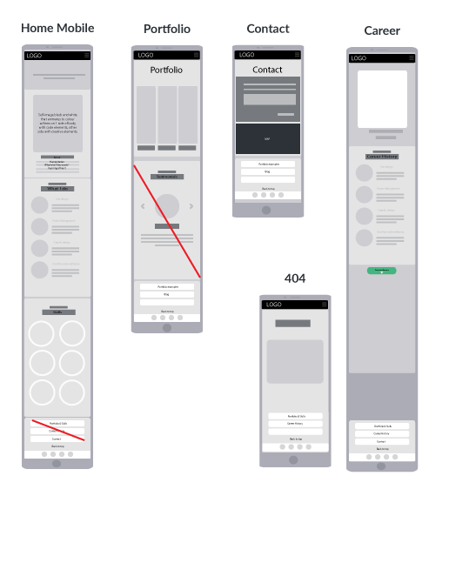


Wireframing
coder://
2019.All Rights Reserved
Notes:
I started designing with mobile and mainly just scaled this up to desktop.

Slide 7
Languages
styles.css
HTML
JS
body {
background-color: powderblue;
}
h1 {
color: blue;
}
p {
color: red;
}
<!DOCTYPE html>
<html>
<head>
<link rel="stylesheet“ href="styles.css">
</head>
<body>
<h1>This is a heading</h1>
<p>This is a paragraph.</p>
</body>
</html>
const toggleButton = document.getElementsByClassName('toggle-button')[0]
const navbarLinks = document.getElementsByClassName('navbar-links')[0]
toggleButton.addEventListener('click', () => {
navbarLinks.classList.toggle('active’)
})
Notes:
I have only used HTML and CSS for this, with a small bit of Java for the navigation bar. I made this decision as I wanted to get a better base on using the basics and how to get things to work, I also did not want to use code I did not understand as I thought this would be detrimental to my own learning.
I have also not really had the time to work with CSS animations, but I understand how these work.

Slide 8
Let’s have a look
https://mystifying-cray-6ea88a.netlify.app/index.html
Search
Notes:
https://mystifying-cray-6ea88a.netlify.app/index.html
Let’s have a look at the current state, I am still working on the styling and adding in some design element’s but I think it’s mostly there.
A few challenges I had were
When I did my original design, I did not understand the limitations of Flexbox and so spent quite a lot of time trying to investigate how to get my layout to work. It wasn’t until I did more resource and discovered CSS grid that I was able to bring my design to life.

