Slide 1
NEXT.js
The React Framework for Production
Next.js Course By Matin Sangabi

Slide 2
The difference between React and Next.js
React :
React library for building UI
Needs to third-party libraries : RRD , authentication , styling , …
Next.js :
A package that uses React for building user interface
Enable you to building ready to production apps by features like routing , styling , authentication , bundle optimization etc.
No need to install additional package

Slide 3
Why use Next.js ?
SEO : fix SEO issues of javaScript Apps
Better performance of Application

Slide 4
Why Learn Next.js ?
Next.js simplifies the process of building react application for production
File based Routing
Pre-rendering
Api Routes (internal Backend)
Support css modules
Authentication
Optimized build system

Slide 5
Install Next.js
npx create-next-app@latest
#or
yarn create next-app
#or
pnpm create next-app
If you want use typeScripts
npx create-next-app@latest –typescript
#or
yarn create next-app –typescript
#or
pnpm create-next-app --typescript

Slide 6
Routing
In React : React router dom => create components => export components => <Routes element = {<… />}/>
In Next.js : in pages folder => files => create new file and finish .
Routes with pages
Nested pages : domain.com/about or domain.ir/login
Dynamic pages : post/1 or post/2 , …
Catch all Routes
So : in pages folder create index.js is main page or home page that’s it and Run npm run dev
Se on localhost:3000 see this page
// index.js
Const Home = () =>{
return <h1>Hello Next.js</h1>
}
export default Home;

Slide 7
If we want about page in page folder create about.js file and special components so in url => localhost:3000/about see this page
And other pages like this is created
Dynamics Routes
Create dynamic page like posts and post/1 or post/2 to post/n
Create folder as name you like in url for example posts :
Create folder posts and in posts directory create index.js so index is main page of posts localhost:3000/posts see index and if we want see post/1 or post/2
create new file in posts directory like this [postId].js
#[postId].js
Import {useRouter} from “next/router”;
const Post () => {
const router = useRouter();
const {postId} = router.query;
return <h1>post page {postId}</h1> // out => ex : post/1 => post page -1 => ex : post/matin => out : post page – matin
}
Export default Post;

Slide 8
Nested dynamic Routing
Like localhost:3000/post/2/10
So : create [postId] folder in posts folder and create index.js so search localhost:3000/posts/1 see post if we want review localhost:3000/posts/review/1 => create review folder in [postId] folder and create index.js or [reviewId].js
Notice : if we want query set we need same like name of folder
Localhost:3000/posts/2?sort=last&page=1
In router.query = > {postId : 2 , sort : last , page : 1}

Slide 9
Catch all Routes
Create new folder as name blogs => blogs/2020/1/23 or blogs/a/b/c
Blog : if we want blog between year 2000 – 2020 and in any year 10 blogs so 2000 page of blogs => handle this => create year folder => [dayId.js] => 1*10
If we want new as month or any thing so we must create [dayId] folder and suppose many of this sorted or any thing we must create 1000 folder and this is not working and not good .
So : for fix this in next => [dayId] * [year] => [a] * [b] * [c] = 1 this is catch all routes
For better performance in blogs folder create […params].js
Import {useRouter} from “next/router”;
// blogs/2020/10/24
const Blog () => {
const router = useRouter();
console.log(router.query) // out => is array [2020 , 10 , 24] and we easiest send to backend
return <h1>catch all routes</h1>}
Export default Blog;

Slide 10
If we search localhost:3000/blogs => error 404 not found for fix this use optional catch all routes => we must convert […params].js to [[…params]].js => so this is fix

Slide 11
Link components
How to displaced in pages ? In next we use link componetns as work same like <a> tag
Import Link from `next/link`;
Cosnt Home = () =>{
Return <Link href=`posts`>post page</Link>
}
Export default Home;
If we want button what we do ?
Import {useRouter} from ‘next/router’;
Cosnt Home = () =>{
Const router = useRouter();
Const clickHandler = () =>{
router.push(“/”);
}
Return <button onClick={clickHandler}>post page</button>
} // but this one in js so absolutely we must run js on browser if js not load or any thing this not work

Slide 12
Not found page 404
In next.js as default build 404 page if we want style to 404 or personal 404 page we must in root of pages folder create 404.js and special components => now we can edit or any thing …

Slide 13
Season 2
SEO in javascript application

Slide 14
Pre Rendering and data fetching
In React app or vue.js app … any app make with js SEO problem it’s mean if js in browser not working or stop js app not render in browser
If you go to view page source see on element with one id or class and in SEO (google bot) not see this Element for SEO
So in next fix this problem it’s prerendering data fetching => it’s mean if stop js this app build and convert .html file and (google bot ) see this Element and SEO is fixable .
Notice : next.js pre-rendering on all pages by defaults.

Slide 15
Pre Rendering
In Next.js as two factor for pre renderinh :
1- static Generation => is the pre rendering method that generation at html build time .the html is then reused on each Request.
2- server-side Routing => the generate html on each requeset .
The difference is when is generate HTML page .

Slide 16
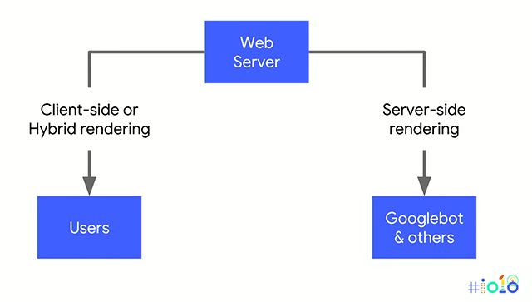
Dynamic rendering
Like digikala
if google bot see this app render by server side and shw link and any thing … whit out css
If user see this app show orginal app

