Slide 1

Empirical Evaluation and Cost Optimization of Large Language Models in Azure Cloud Environments
Bachelor Thesis Defense, Computer Science
Matin Abaszada
Supervisor: Prof. Dr. Ivan Ovsyannikov
Constructor University, May 2026

Slide 2
Why Cloud Hosting and Model Choice Both Matter
1
The Expensive Reality
2
The Shift to Cloud
3
Azure as the Platform
Because of GPU clusters, cooling, dedicated operations and millions in CapEx, hosting LLMs locally is expensive.
Enterprises move to cloud environments. One API call replaces an entire on-premise GPU server room. Pay only for what you use.
Microsoft Azure: a unified catalog of OpenAI / DeepSeek / Meta models, pay-per-token pricing, quotas, and rate limits.
In the cloud, “best model” ≠ “strongest model”.
A top-accuracy model that costs ~20× more per request than the next-best may be the wrong enterprise choice.
Accuracy, cost, and latency must all be evaluated together.
MOTIVATION
2 / 16

Slide 3
Research Gap & Questions
Where the existing literature falls short
Research Questions
• Most existing studies evaluate models in isolation: accuracy only, or cost only, never together.
• Optimization strategies (routing, cascading) are benchmarked against their own internal goal, not a unified deployment reward.
• Almost no studies test these strategies in a real cloud environment, where pricing, quotas, and rate limits directly shape latency and cost.
1
How do Azure-hosted LLMs differ across accuracy, latency, and cost?
2
Is reasoning-enabled inference economically justified?
3
Can a proxy optimization layer improve cost-efficiency?
MOTIVATION
3 / 16

Slide 4
Study Design at a Glance
6 Azure Models (2 generations × 3 tiers)
gpt-4.1-mini · gpt-5.4-mini | gpt-4.1 · gpt-5.4 | o3-mini · gpt-5.4-pro
5 Benchmark Datasets
HumanEval (Python coding) · MBPP (Python coding) · MMLU-Pro (multi-subject multiple-choice) · GPQA (graduate-level science Q&A) · GSM8K (grade-school math word problems)
Evaluated Under 4 Strategies
Standalone · Cascade · Router · Self-Consistency
All strategies evaluated under the same economic reward function.
METHODOLOGY
4 / 16

Slide 5
The Unified Evaluation Framework
Reward = − ( Cost + λ_latency × Latency + λ_error × Error )
$ Cost
⏱ Latency
✗ Error
Cost of each request, deterministically calculated from tokens used × Azure price.
Wall-clock time per API call (seconds).
Represents whether the model response is correct or wrong, encoded as a binary value.
• λ_latency = penalty per second of waiting.
• λ_error = penalty per wrong answer.
• Defaults: λ_latency = 0.01, λ_error = 1.0 (sensitivity swept).
• Higher reward (closer to zero) is better.
METHODOLOGY
5 / 16

Slide 6
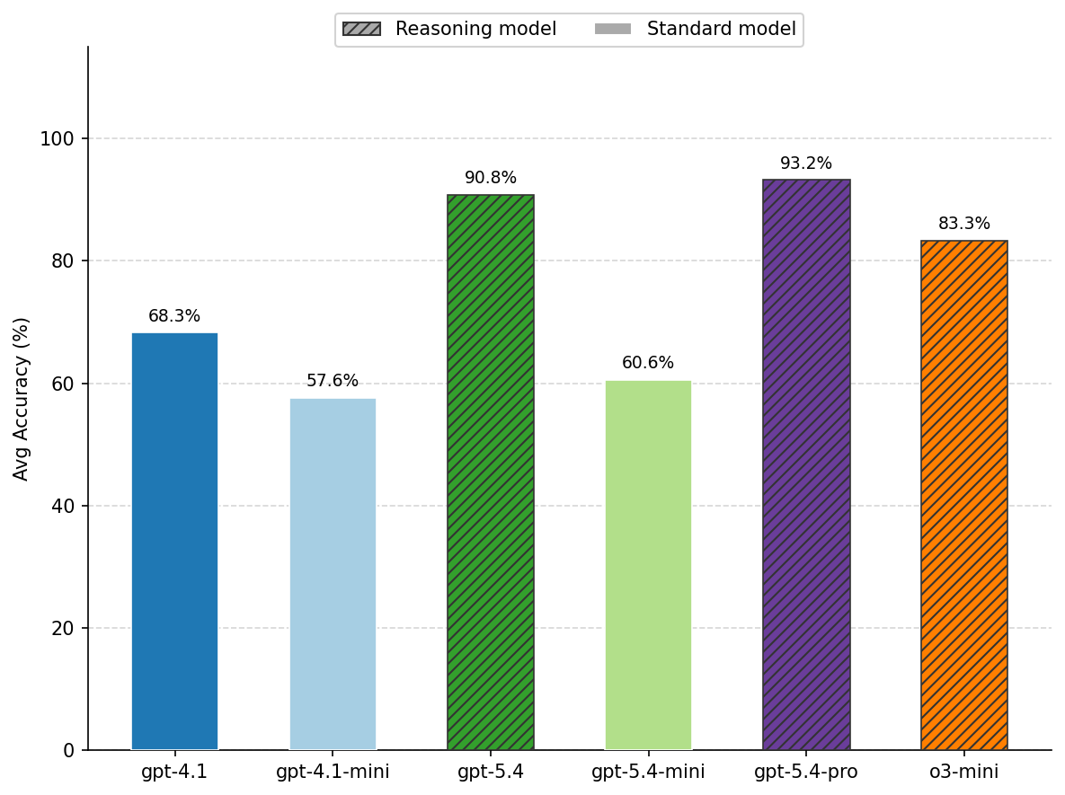
Accuracy: A Two-Tier Structure
Two clear tiers
• Top tier (>80%): gpt-5.4-pro 93.2%, gpt-5.4 90.8%, o3-mini 83.3%
• Bottom tier (<70%): gpt-4.1 68.3%, gpt-5.4-mini 60.6%, gpt-4.1-mini 57.6%
• Gap between tiers ≈ 15 pp, larger than the spread within either tier
Not gradual improvement; a structural jump.
RESULTS • STANDALONE
6 / 16

Slide 7
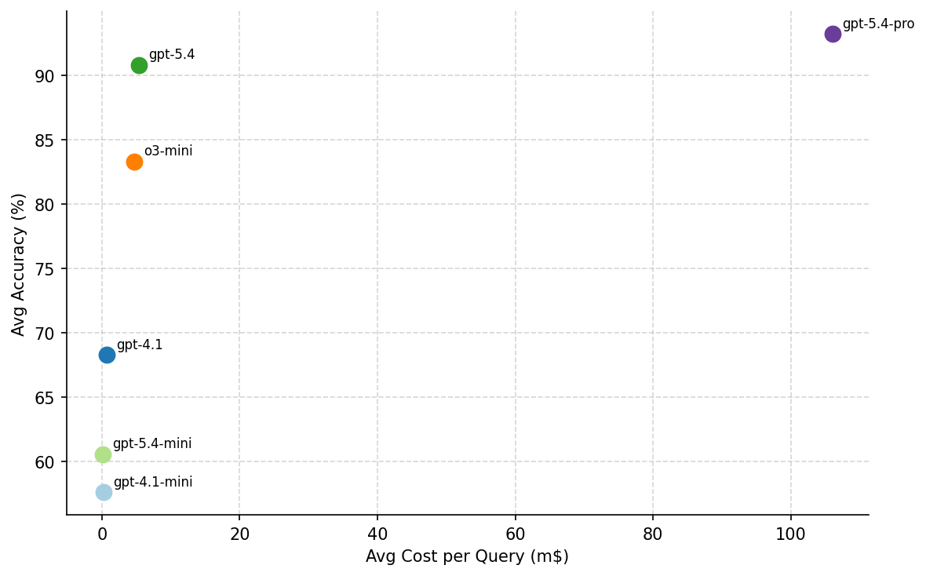
Cost vs. Accuracy: ~20× Gap at the Pareto Frontier
Pareto frontier
• gpt-5.4: 90.8% accuracy at 23× lower cost than gpt-5.4-pro
• gpt-5.4-pro: +2.4 pp over gpt-5.4 at ~20× the cost
• o3-mini and gpt-4.1 are Pareto-dominated
Cost spans almost three orders of magnitude.
RESULTS • STANDALONE
7 / 16

Slide 8
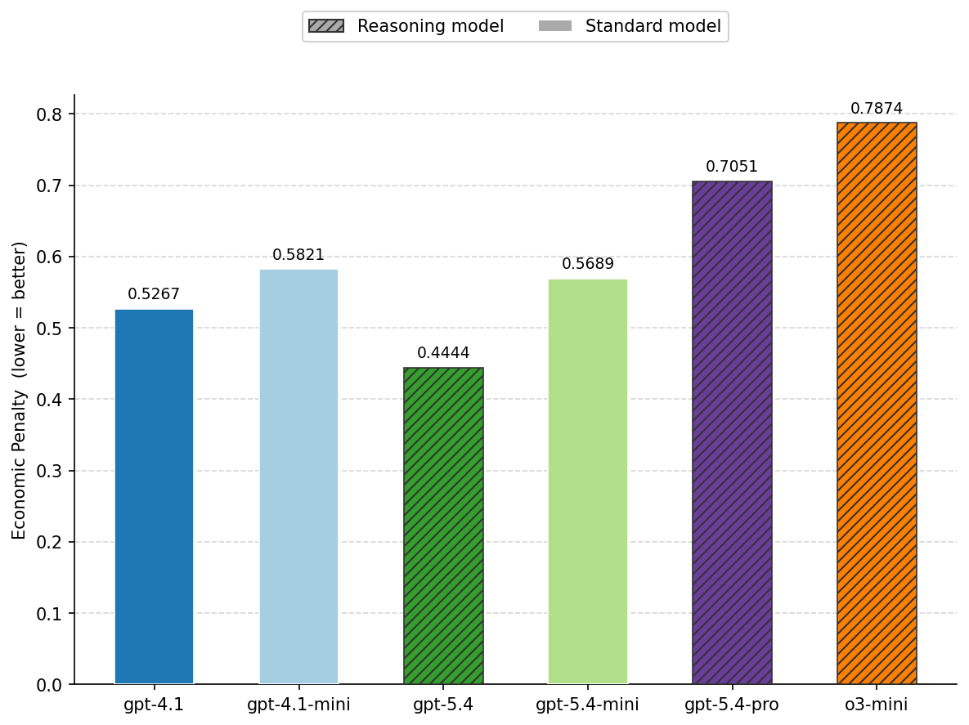
Economic Reward: The Ranking Changes
Most accurate ≠ best reward
• gpt-5.4-pro: #1 accuracy → #5 reward (cost + latency penalty)
• o3-mini: #3 accuracy → #6 reward (65.7 s mean latency)
• gpt-5.4: #2 accuracy → #1 reward (best balance)
RESULTS • STANDALONE
8 / 16

Slide 9
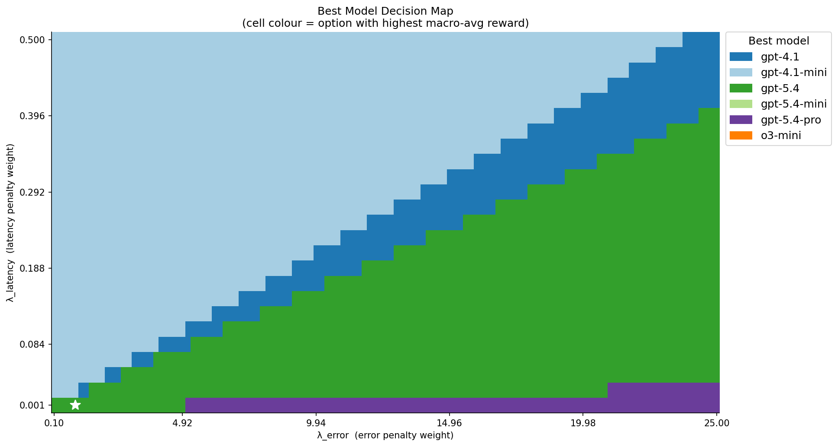
Which Model Wins, and When?
• Each cell = winning model at those (λ_error, λ_latency) weights
• ★ marks the default deployment setting
• Mini wins under high latency penalty; gpt-5.4 wins the centre; gpt-5.4-pro wins under high error penalty
RESULTS • STANDALONE
9 / 16

Slide 10
Cascade: Why not ask the small model first and only escalate when needed?
How it works
Query
Configuration | T=60 | T=75 | T=90 | Small alone | Large alone
gpt-4.1-mini → gpt-4.1 | −0.601 | −0.602 | −0.606 | −0.582 | −0.527
gpt-4.1-mini → gpt-5.4 | −0.601 | −0.601 | −0.601 | −0.582 | −0.444
gpt-5.4-mini → gpt-4.1 | −0.680 | −0.689 | −0.708 | −0.569 | −0.527
gpt-5.4-mini → gpt-5.4 | −0.680 | −0.680 | −0.681 | −0.569 | −0.444
Small Model (cheap)
Confidence ≥ Threshold ?
YES → return
NO → Large Model
Large Model (final answer)
Table 7: Cascade reward at default weights (λ_l = 0.01, λ_e = 1.0). No cascade beats its large-alone baseline.
Maximum escalation rate: only 7.3%, even at T = 90. Modern LLMs are overconfident; the gate almost never opens.
OPTIMIZATION • 1 / 3
10 / 16

Slide 11
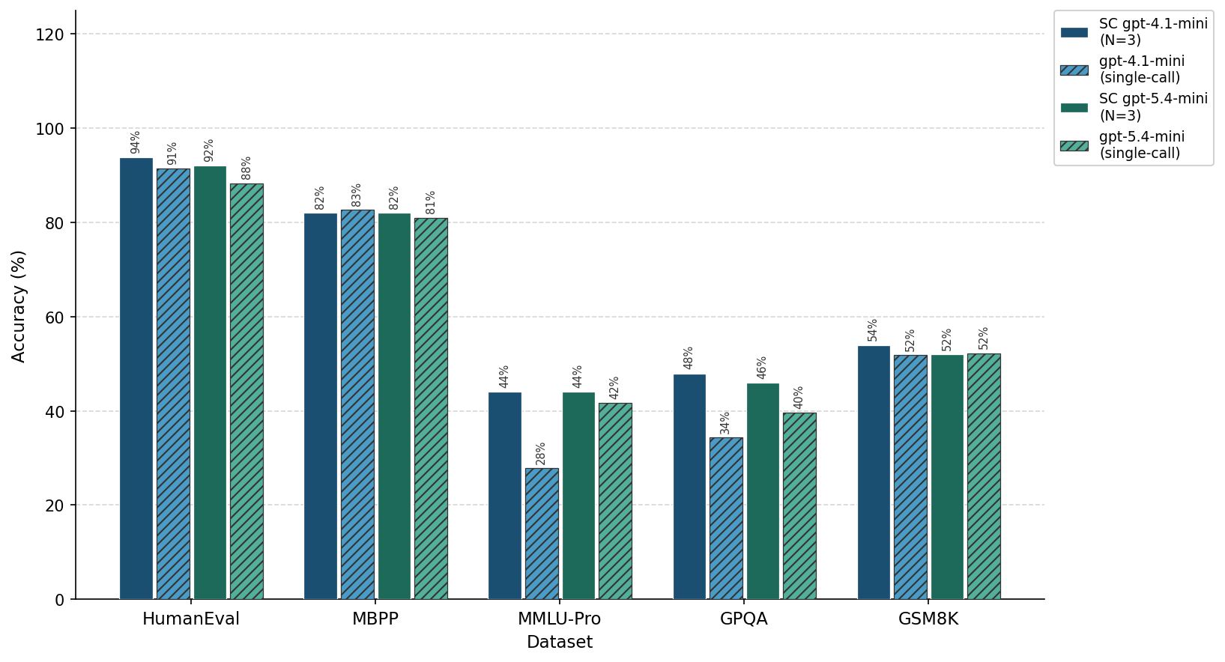
Self-Consistency: Why not let the small model double-check its own answer?
How it works
Query
Run 1
Run 2
Run 3
Majority Vote → Final Answer
gpt-4.1-mini N=3: +6.8 pp accuracy.
MMLU-Pro: 27.8% → 44.0%.
Modest gain: cost = exactly 3×,
and accuracy stays below the next
standalone tier (68.3%).
OPTIMIZATION • 2 / 3
11 / 16

Slide 12
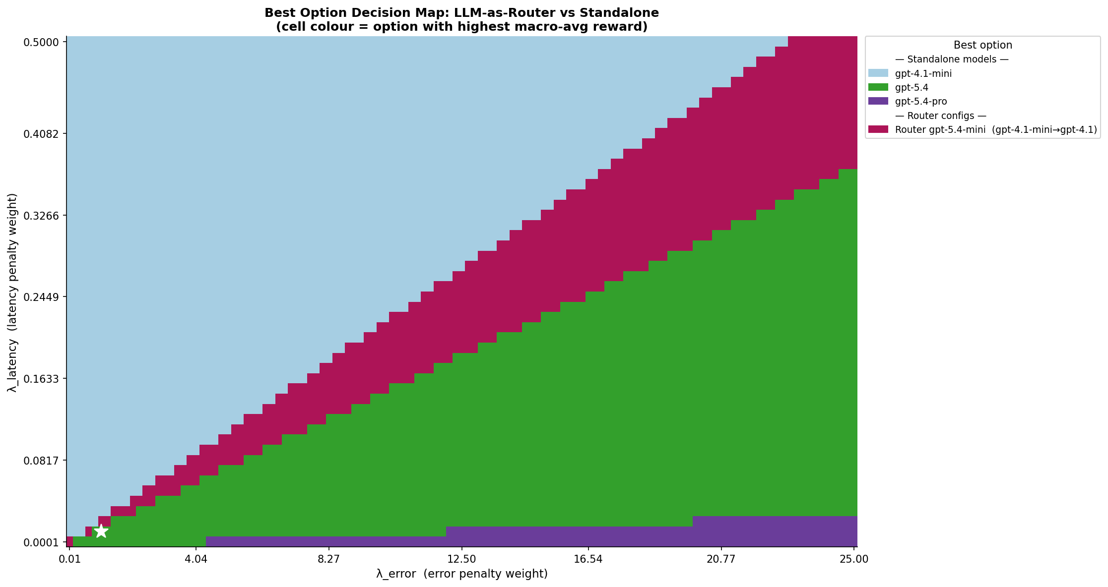
Router: Why not let an intelligent LLM decide which model to use?
How it works
Query
Router (gpt-5.4-mini)
EASY → Small (gpt-4.1-mini)
HARD → Large (gpt-4.1)
Accuracy clearly above the small baseline, at a fraction
of the cost of the large model.
Trade-off: latency stays close to the large model,
because every query first passes through the router.
OPTIMIZATION • 3 / 3
12 / 16

Slide 13
Head-to-Head: Best Configuration per Strategy
Strategy | Best Configuration | Accuracy | Latency | Cost (m$) | Reward
Standalone | gpt-5.4 | 90.8% | 34.7 s | 5.370 | −0.444
Router | rtr=gpt-5.4-mini → gpt-4.1-mini / gpt-4.1 | 73.1% | 22.9 s | 0.344 | −0.498
Self-Consist. | gpt-4.1-mini N=3 | 64.4% | 18.6 s | 0.765 | −0.543
Cascade | gpt-4.1-mini → gpt-5.4 T=75 | 57.7% | 17.7 s | 0.261 | −0.601
Cost (m$) = milli-dollars per request (1 m$ = 0.001 USD = one thousandth of a US dollar). Computed as token counts × Azure list price.
• At default weights, the best reward belongs to a standalone model.
• This ordering changes as the latency and error penalty weights are varied, as the next slide shows.
RESULTS
13 / 16

Slide 14
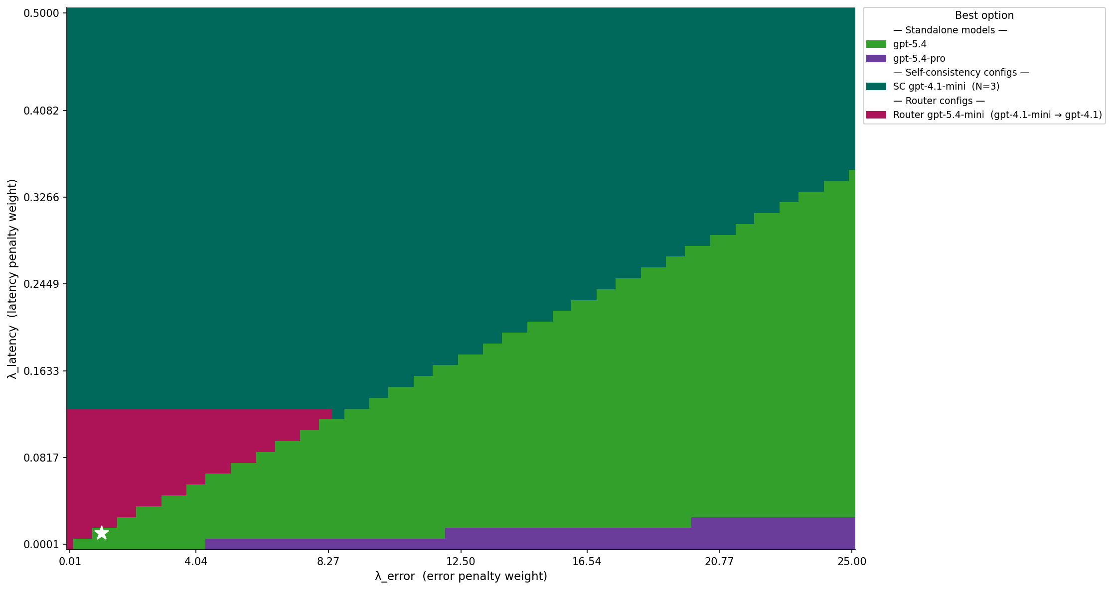
Best Model & Optimization Strategy Across the Penalty Plane
Who wins each cell
• SC gpt-4.1-mini (N=3): removes noise from a cheap and fast model, but accuracy still trails the standalone models
• gpt-5.4: slower than SC, but reaches higher accuracy (fewer errors) — ★ default sits here
• gpt-5.4-pro: highest accuracy of all, wins where error penalty is high and latency penalty is low
• Router: accurate at a much lower cost than the large models, but latency stays high
RESULTS
14 / 16

Slide 15
Conclusions: Answering the Research Questions
RQ 1
How do Azure LLMs differ in accuracy, latency, and cost?
Two-tier structure: 15 pp accuracy gap and ≈7× cost gap at the tier boundary (o3-mini vs gpt-4.1). No model Pareto-dominates. gpt-5.4 = best balanced choice at default weights.
RQ 2
Is reasoning-enabled inference economically justified?
Only for accuracy-critical, latency-tolerant tasks. gpt-5.4-pro adds +2.4 pp at 20× the cost and 1.5× the latency. Not justified for general workloads.
RQ 3
Can proxy optimization improve cost-efficiency?
• Cascade fails to optimize because neutralized by LLM overconfidence.
• Self-Consistency optimizes the cheap/fast regime by reducing noise.
• Router optimizes the accuracy-vs-cost trade-off, winning a band of the decision map.
CONCLUSIONS
15 / 16

Slide 16
Thank You
Questions & Discussion
Empirical Evaluation and Cost Optimization of Large Language Models in Azure Cloud Environments
Matin Abaszada
Supervisor: Prof. Dr. Ivan Ovsyannikov • Constructor University, May 2026

Slide 17
BACKUP
Additional charts & detail for Q&A

Slide 18
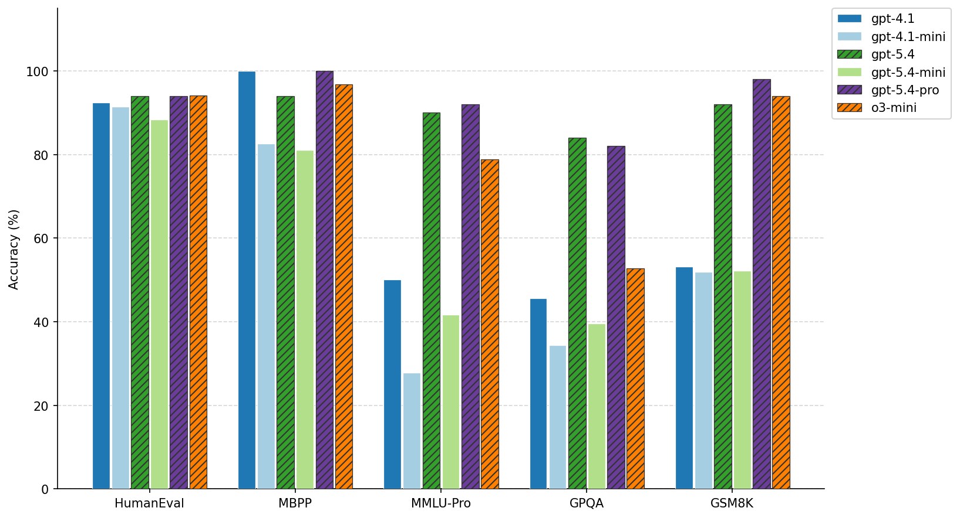
Per-Dataset Accuracy Breakdown
Coding benchmarks are saturated (80–100%). GPQA and MMLU-Pro are the most discriminating datasets.
BACKUP • B1

Slide 19
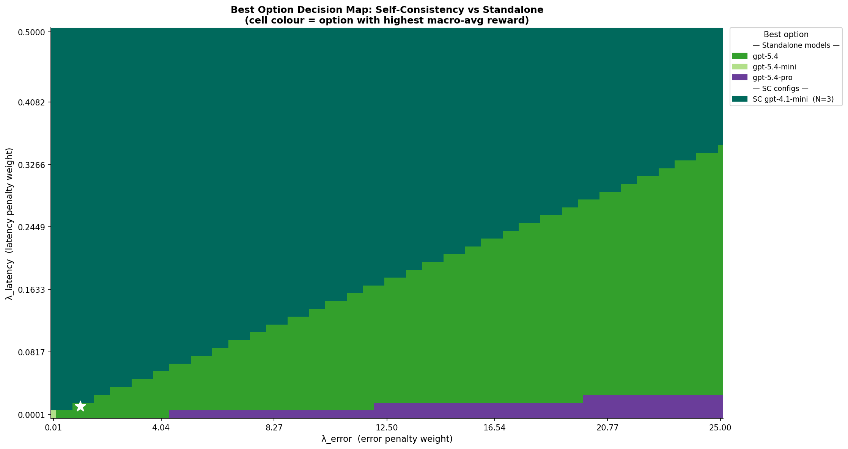
Self-Consistency Decision Map
gpt-4.1-mini N=3 dominates the upper-left (latency-tolerant, accuracy-important) region.
BACKUP • B2

Slide 20
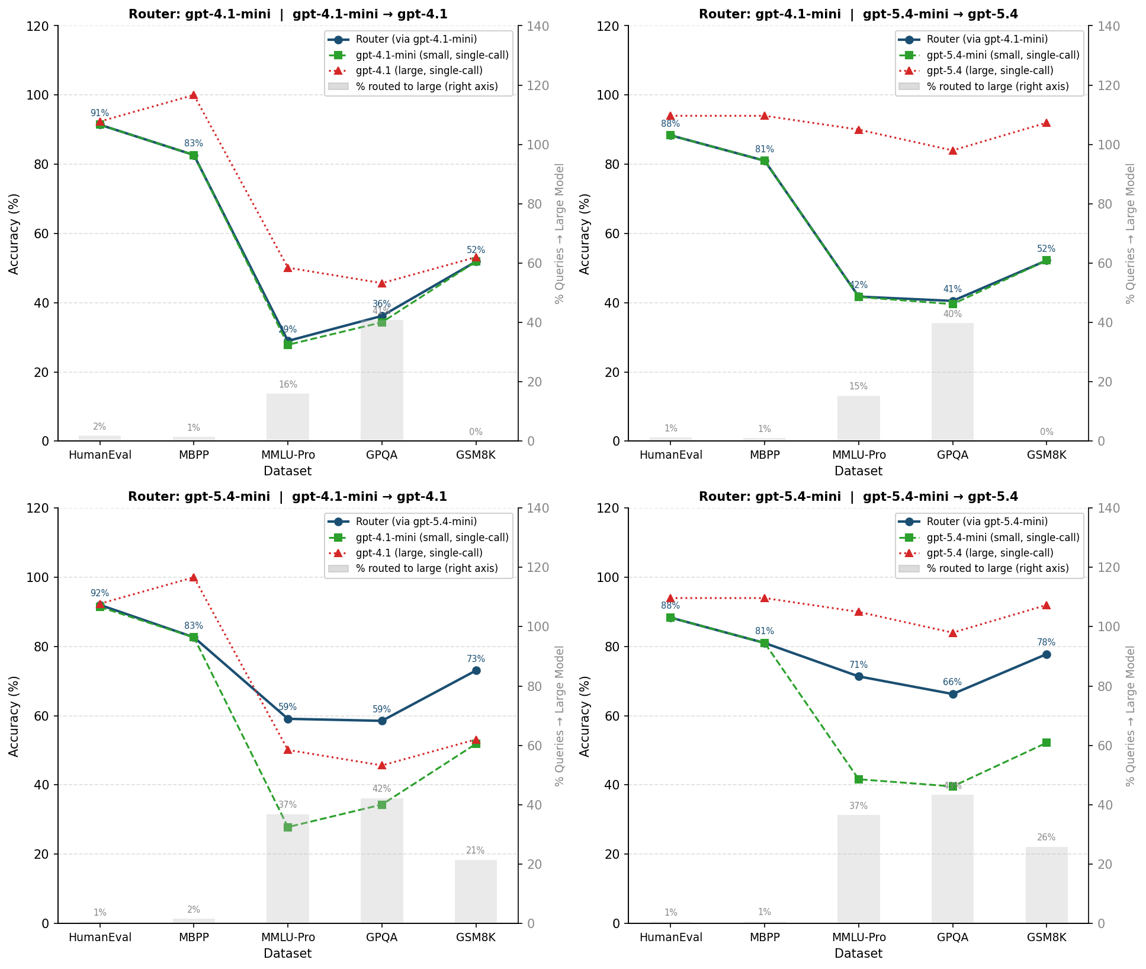
Router Detail: Routing Behavior by Dataset
Coding tasks are almost never escalated; GPQA gets 40%+ escalation rate.
BACKUP • B3

Slide 21
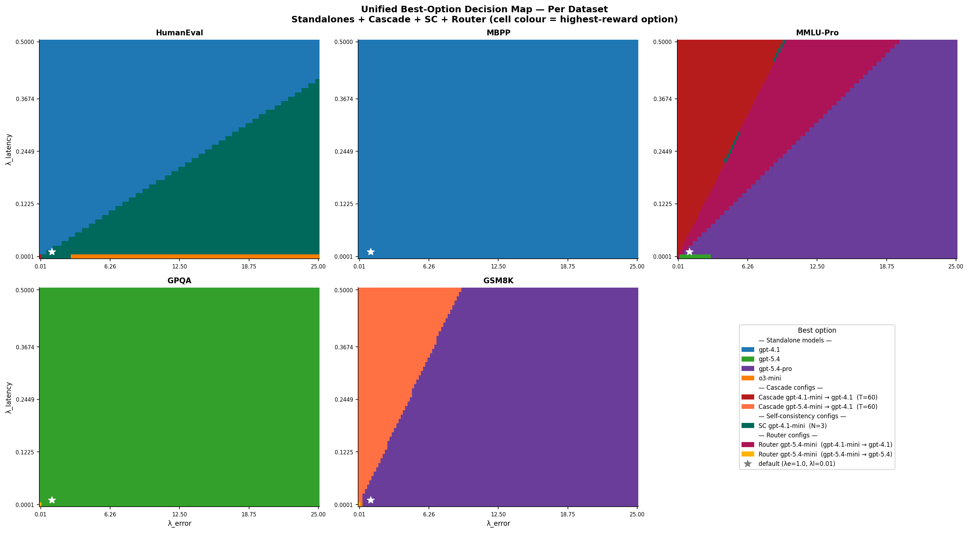
Per-Dataset Decision Maps
Winner per (λ_error, λ_latency) cell, broken down by dataset. Shows that the best strategy is not uniform across benchmarks — e.g. coding tasks favor the small model almost everywhere, while GPQA and MMLU-Pro give the Router and the large models more room.
BACKUP • B4

Slide 22
Reward Formula: Full Detail
Equation
Reward = − ( Cost + λ_latency × Latency + λ_error × Error )
Why a negative penalty?
A positive utility would require an arbitrary ceiling for what a “perfect” answer is worth. The negative-penalty form has a natural zero (no cost, no latency, no error), which is the theoretical ideal. Every real model can only be penalized from there.
Units & defaults
Cost in dollars per request (token counts × Azure price). Latency in seconds. Error binary (0 or 1). Default weights: λ_latency = 0.01, λ_error = 1.0. Sensitivity is swept on a 2-D grid.
Interpretation
−0.444 means the average request incurs 0.444 units of combined penalty. Higher (closer to 0) = better.
BACKUP • B4

