Slide 1
DCF255
Lecture 7 | Ethernet: Wired and Wireless

Slide 2
Agenda
Wired Ethernet IEEE 802.3
Hierarchical Structure
Frame Format
Types of Ethernet Networks and Switches
Types of Switches
Wired Ethernet Security
RSTP
802.1x
Wireless Ethernet 802.11
Wireless Errors
Wireless Frame Format
Wireless Security and VPNs
Notes:
May require more than one slide

Slide 3
Wired Ethernet
IEEE 802.3

Slide 4

Ethernet
Wired IEEE 802.3 most popular today
Great cost to performance ratio.
Being developed into a MAN and WAN technology:
MAN: Metro Ethernet
WAN – on hold
Wireless Ethernet IEEE 802.11
Most popular method to access Internet
Wired and Wireless work together to provide seamless network communication
Notes:
Ethernet standards are controlled by the Institute for Electrical and Electronic Engineers (IEEE) and ISO. They are name IEEE 802.3 which is the most common local area network today with speeds of 100 Mbps speeds. Ethernet’s popularity continues to grow because of its exceptional performance to cost ratio. It now being used as a MAN technology (Metropolitan Area Network) called Metro Ethernet. The IEEE also had a study group researching making Ethernet a WAN technology, but that group is now on hold.
Wireless Ethernet is controlled by the IEEE 802.11 standard. Many people think that wired and wireless standards are competitors, but they are used in a complimentary fashion to provide cost effective network performance. This lecture will focus only on Ethernet LAN technology: types of networks, the cabling and devices used and the standards that tie the network together.

Slide 5
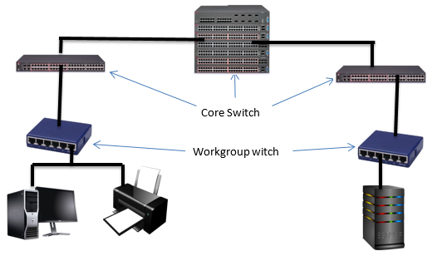
Wired Ethernet 802.3
Network built in a hierarchical manner using a combination of workgroup and core switches
Allows combining expensive with cheaper equipment to match performance
Workgroup switches connect devices to the network
Core switches connect switches to switches
Notes:
An Ethernet network is built in a hierarchical manner using Core and Workgroup switches. Core switches are used to connect switches to switches. Workgroup switches join devices to the network such as printers, workstations and servers. This Switched Ethernet diagram below, is effectively upside down; assume this network represents a LAN which occupies a multi-storey building. There would be a workgroup switch on every floor connecting to a central core switch in the basement of the building.
Figure 1: Switched Ethernet
Core Switch
Workgroup witch
Creating a hierarchical switched network provides the optimal balance between cost and performance. It allows combining less expensive cabling and switches with expensive switches and cabling and using them only were higher performance is required. On any network, however, there are only a few users who place high loads on the network; these users will be given a dedicated port. Less demanding users, can be grouped into a shared subnet, using wireless Ethernet, and the access point is connected to a port.

Slide 6
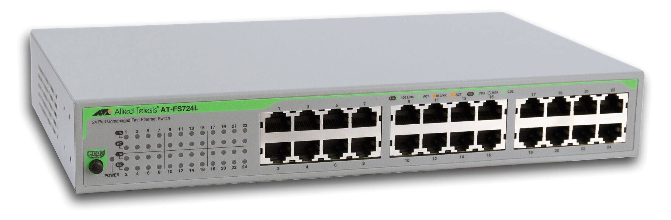
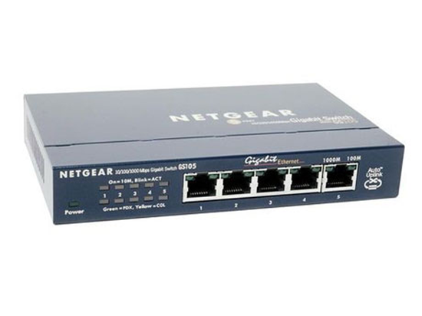

Aggregate Speed
1 X 10 Gbps 10G BASE
6 X 1 X 1000 Mbps 1000BASE SX
10 X 100 Mbps 100BASE TX
Key design principle is that you have enough bandwidth to handle the aggregate speed of all devices on the network
10 devices @ 100 Mbps connected to workgroup switch
Workgroup switch must be able to carry 1000 Mbps total aggregate speed. Most likely cable is 1000 BASE SX
6 Workgroup switches @ 1000 Mbps means that the core switch must carry 6 Gbps of total capacity
Best – 10G core switch allows for future growth and over-provisioning
Notes:
A key design principle of a hierarchical network is that the cabling and switches must be able to accommodate the aggregate of the workgroup switches. An excellent analogy for this situation is to look at the 401 highway between Highway 400 and Don Valley Pkwy at 4:00 a.m. there is usually very little traffic, and you can reach your destination quickly and unimpeded. However, at 4:00 p.m.,during rush hour, there are more cars than the road can handle resulting in congestion. Traffic slows to a crawl, and a trip that would take ten minutes at 4:00 a.m. now takes over an hour to complete. To solve the congestion problem, we could built a dedicated road from each person's driveway directly to his or her destination. Then the rush hour congestion problem would go away. A switch’ s port provides a "dedicated road" between individual users (or small groups of users) and their destination (usually a file or web server). Workgroup switches run at 100 Mbps interconnected through a high-speed fiber-optic backbone. Each frame has a destination address; the switch examines this field and forwards it only to the port attached to the destination device. The most common cabling scheme today for wired Ethernet is 100BASE-TX, which is unshielded twisted pair, transmitting a 100 Mbps for up to 100 meters (IEEE 802.3u); it is used to connect devices such as workstations and printers to the network workgroup switches. This cabling is inexpensive, durable and combined with the RJ-45 connector, expansion of the network is easy, provided the workgroup switch has an available port.
Building a dedicated highway for each person is impracticable in real life. It is also impracticable in a network because most users do not need a dedicated port. To allocate a dedicated port would be an inefficient use of resources, when performance does not require it. Most users want to send information to print or browse the Internet. A group of these less demanding users can be placed in a wireless Ethernet subnet with the access point connected to a wired port. This results in shared bandwidth with a group users whose combined throughput is 100 Mbps, the maximum for the port.
As you move up from the workgroup switches, the core switches must be designed to accommodate the aggregate bandwidth of all downstream devices. For example, if you have 10 users connected to a workgroup switch and each user transmits at 100 Mbps, then the cabling from the workgroup switch to the core switch must be handle 10 X 100 Mbps, or 1000BASE-SX. Six core switches sending data at 1 Gbps requires a centre core switch of 10GBASE transmitting at 10 Gbps (Ethernet speeds increase by a factor of 10). This allows for “over-provision” where networks are designed to handle loads surpassing the maximum for short periods of time and future growth.
Multi-port core 10GBASE switches are very expensive. The hierarchical design properly balances demand with performance to limit the cost of expensive cabling and switches to areas where performance justifies the cost. The most common backbone today is 1000BASE-SX which is a fiber optic cable and can transmit up to a 1Gbps up to 550 meters. Fiber-optic cable is more expensive, but it is invaluable in situations where electronic emissions and environmental hazards are a concern. It is often used in inter-building applications to insulate networking equipment from electrical damage caused by lightning or electromagnetic interference, such as on a factory floor. The Ethernet standard allows for fiber-optic cable segments up to two kilometers long, making fiber-optic Ethernet perfect for connecting nodes and buildings that are otherwise not reachable with copper media In earlier days of networking devices where joined to the network with hubs, which broadcast all traffic to devices. A special protocol CSMA/CD, Carrier Sense Multiple Access with Collision Detection was used at the Data Link layer to control the shared medium and avoid packet collisions. Today, however, Ethernet is exclusively a switched network. With a direct cable connecting each device. CSMA/CD is not needed because the cable is no longer shared. Ethernet designed as a LAN technology is being developed as a MAN and WAN technology because of its excellent balance between cost, speed and reliability.

Slide 7
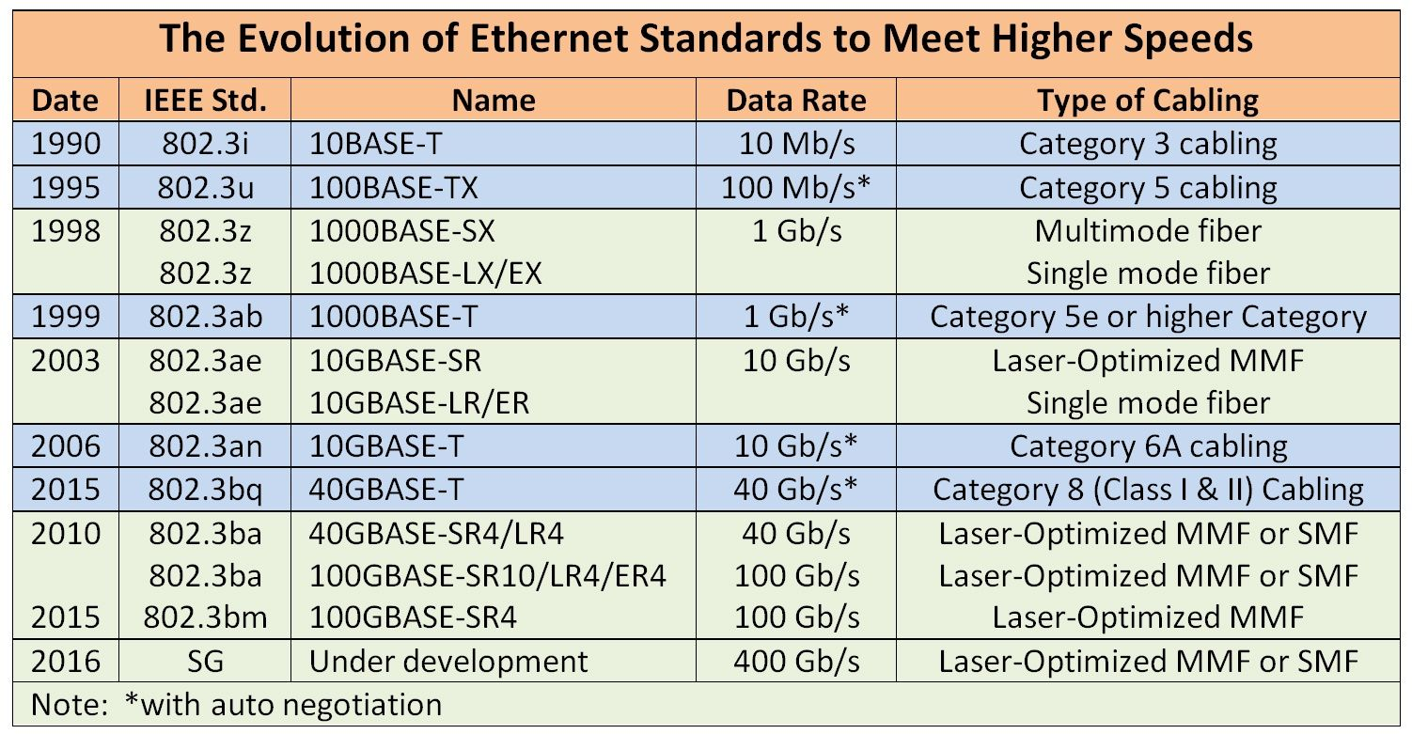
The 40 Gbe is designed for use within the organization between servers and the Ethernet switch, while 100 GbE is geared to long-distance switch-to-switch transmission.

Slide 8
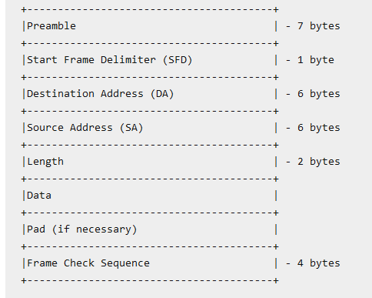
Frame Format
Preamble – synchronization 0s and 1s
SFD – beginning of frame
Destination MAC address
Source MAC address
Length of Header
Data – Max 1500 bytes (MTU)
Pad – padding used on frames less than 64 bytes (needed for Collision Detection)
FCS – 4 bytes
Total size 1518 bytes
Jumbo Frames-To improve data transmission efficiency by sending a bigger frame of data instead of the standard 1518 octets/bytes. The jumbo frame is typically set at 9000 MTU value size when enabled.
Notes:
Ethernet 802.3 Frame Format
The preamble is 7 byes of “0s” and “1s” where the data link layers synchronize their clocks. The frame begins with the start frame delimiter with indicates the beginning of a transmission. The destination and source address are the layer 2, MAC addresses for communication to occur across a link. The length field is used by router’s data link layer when headers have to be removed. The router needs this information to calculate where the payload, contained in the data section, begins. Padding with “0s” is used to prevent very small frames; the smallest frame allowed on Ethernet networks is 64 bytes. The reason for the minimum frame size is for collision detection. If a device sent a very short frame, it may think it had sent it successfully because it did not have heard a collision, before it sent the next frame. Keeping a minimum frame size ensures that each device will hear a collision if they transmit at the same time.
The Maximum Transmission Unit (MTU) size specifies the maximum payload that can be encapsulated in the data portion of the frame which is 1500 bytes. With a header length of 18 bytes, the maximum frame size of a standard Ethernet frame is 1518 bytes. This includes the Ethernet header (14 bytes), the payload (IP packet, usually 1500 bytes), and the Frame Check Sequence (FCS) field (4 bytes). However, GigE allows a very large default size of 9000 bytes called a “jumbo” frame. These larger frames reduce the number of frames created by the data link layer which greatly reduces the processing power and improves network performance.

Slide 9
Types Ethernet Networks
And 3 Types of Switches Used

Slide 10
Types of Ethernet Networks
Gigabit Ethernet: IEEE 802.3z
10 Gigabit Ethernet: IEEE 802.3ae
Power over Ethernet (PoE): IEEE 802.3-2012
Metro Ethernet
Ethernet
LAN
WAN
MAN
Notes:
Types of Ethernet LAN Technology
Gigabit Ethernet: IEEE 802.3z
Gigabit Ethernet was developed to meet the needs of multimedia applications and Voice over IP (VoIP) where real time transmission is required. Commonly called GigE, the latter runs over copper or fiber-optic at speeds 10 times faster than 100Base-T . GigE is currently used for Ethernet backbones to interconnect high performance switches and servers. From the data link layer, GigE is identical to that of Ethernet, except that GigE is optimized for full duplex operation.
10 Gigabit Ethernet: IEEE 802.3ae
10 Gigabit Ethernet is the fastest and most recent of the Ethernet standards with a transmission rate 10 X GigE. Unlike other Ethernet systems, 10 Gigabit Ethernet is based entirely on the use of optical fiber connections. Presently, it is used as a high-speed backbone for high volume transmissions.
Power over Ethernet (PoE): IEEE 802.3-2012
PoE provides both power and data transmission over a single cable. This solution is ideal for surveillance equipment, access points and IP telephones where running power would be difficult or expensive. PoE supports fast data rates up to 100 meters in cable length while delivering 25.5 Watts of power. This is enough power to run cameras, IP telephones and access points, but not workstations.
Metro Ethernet
Metro Ethernet is a Metropolitan area network (MAN) technology based on Ethernet standards. It is commonly used to connect subscribers to a larger service network or the Internet. Larger businesses can also use metropolitan-area Ethernet to connect their own offices to each other and greatly extend the concept of a LAN.
An Ethernet interface is much cheaper than any current MAN technology such as SONET (Synchronous Optical Network) or FDDI (Fiber Distributed Digital Interface) while providing similar bandwidth and speeds. Another distinct advantage of an Ethernet-based access network is that it can also be easily connected to the customer’s network and is well known to network administrators; this means that special training is not necessary and LAN personnel can troubleshoot network problems. Often metro Ethernet is combined with a IP/MPLS backbone which is used to connect to the service provider’s switches and routers; these MPLS-based deployments are costly, but highly reliable, very scalable and are typically used by large service providers, such as TELCOs, who service a large number of businesses.

Slide 11
Types of Switches – 3 Types
Store and Forward
Receives the entire frame and stores in memory
Checks errors by computing the CRC and checking frame length
If OK then looks at the destination address (if not deletes frame)
Forwards the frame out the destination port
Advantage – Uses bandwidth efficiently
Disadvantage – increases latency
Notes:
There are two basic types of switches used on an Ethernet network: store and forward and cut through.
There are two basic types of switches used on an Ethernet network: store and forward and cut through. A store and forward switch stores each incoming frame and checks for errors. When a frame arrives, the switch stores the entire frame in memory. It then checks the CRC and the frame length, if both are valid, the switch then looks at the destination MAC address and forwards the frame to the destination port. If the frame has errors, the switch deletes it. With a store and forward switch bandwidth is not wasted on invalid or damaged frames. The disadvantage is that it increases the latency of the switch slightly. The store and forward switch is commonly used as a workgroup switch.

Slide 12
Types of Switches – 3 Types
Cut Through
Starts to forward the frame as soon as it receives the destination address
Does no error checking
Advantage – very fast used on high speed backbones
Disadvantage – may waste bandwidth forwarding frames with errors
fragment-free switching,
lies between the extremes of cut-through switching and store and forward switching.
With fragment-free switching,the first 64 bytes of the frame are read and stored. The switch examines the first 64 bytes (which contain all the header information for the frame)
if all the header data appears correct, the switch presumes that the rest of the frame is error free and begins transmitting
Note: For a cut through switch to work the speed coming into the switch MUST be the same as the speed leaving the switch
Notes:
There are two basic types of switches used on an Ethernet network: store and forward and cut through.
A Cut Through switch, on the other hand, does not error check and begins forwarding the frame immediately upon receiving the destination Address. This results in lower latency, but can propagate errors from one subnetwork to another, wasting bandwidth on invalid or damaged frames.
For a Cut Through switch to work, the speed of the transmission coming into the switch must be the same speed leaving the switch. If you have a workgroup switch connected to a high-speed backbone, as is usually the case, then the switch must operate in store and forward mode. There is also a hybrid switch combining the two types. This switch monitors the frame error rate, and if it is below a level set by the administrator, the switch will function in Cut Through mode, otherwise it uses Store and Forward mode.

Slide 13
Ethernet Security
RSTP and IEEE 802.1x

Slide 14
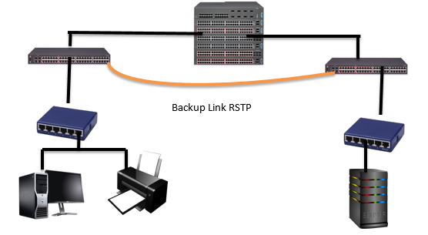
Rapid Spanning Tree Protocol (RSTP)
A hierarchical network cannot have loops
Network prone to single points of failure
RSTP protocol to allow backup links.
Core switch polls the Main switch to see if alive.
If true – ignores backup link
If false – uses backup link
Notes:
Ethernet Security
Figure 3: Switched Ethernet with RSTP
Backup Link RSTP
The creation of a hierarchical switched network is best for combining performance with cost. It also ensures a single path between any two devices which provides a single lookup table for each switch – providing fast performance. However, a single path between any two devices makes Ethernet vulnerable to single points of failure, in which the failure of a single component (switch or backbone) can cause network failure. For example, in the diagram below if the central core switch stops functioning, the network goes down. Or, if one of the core switches goes down half the network cannot communicate with the other half.
To avoid single point failures, the IEEE 802.1 Working Group on Ethernet have provided a way to create backup links using the Rapid Spanning Tree Protocol (RSTP). On a hierarchical network, there can only be one path to each device, loops are prohibited. To avoid single points of failure, the RSTP protocol can be used to create backup links. The core switch on the left, before it forwards a packet, is constantly polling if the central core switch is alive. If the central core switch is alive and working the backup RSTP link is NOT used. On the other hand, if the cores switch determines that the central core switch is down, then the RSTP backup link is used to send the frame. For simplicity, the above diagram only shows one backup link. An Ethernet administrator would create backup links between each workgroup and core switch to provide multiple pathways to different parts of the network.

Slide 15
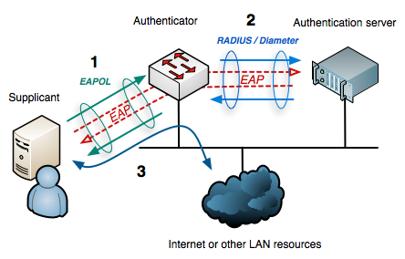
802.1x Port Security
Designed to protect data ports
Divides the port into 2 virtual ports
Unauthorized port – uses EAP to allow only authentication traffic to RADIUS server
RADIUS server sends message to switch if user authorized or not,
Authorized user – port changes to authorized mode – full access
Notes:
802.1x Port Security
Figure 4: Ethernet IEEE 801x Port Security
A major security concern with switched Ethernet is the unauthorized use of a data port. Anybody can walk into a conference room, and plug into an empty data jack and get access to all internal network resources using DHCP. The 802.1x specification is designed to prevent unauthorized access to a data port. The 802.1x security protocol uses the Extensible Authentication Protocol (EAP) combined with a RADIUS (Remote Access Dial In User Service) server which stores user accounts and passwords. It divides each data port into 2 virtual switch ports; one for unauthenticated traffic and one for authenticated traffic. Until the user is authenticated all traffic passes through the unauthenticated port, and the only traffic allowed is EAP authentication traffic; all other traffic is dropped. In this sense the authenticator, the switch, acts like a security guard protecting the switch port from unauthorized use.
To initiate authentication the authenticator periodically transmits an EAP-Request Identity frame to a special data link address. The supplicant, the client software, listens on this address, and when it receives an EAP-Request Identity frame, it responds with an EAP-Response Identity frame containing an identifier for the supplicant such as username and password. The supplicant can also initiate authentication by sending an EAPOL-Start frame (EAP over LAN) to the authenticator, which immediately sends an EAP-Request Identity frame.
The authenticator then encapsulates this Identity response in a RADIUS Access-Request packet and forwards it on to the RADIUS server for authentication. An analogy to this is providing a valid driver’s license when entering a nightclub for proof of age. The RADIUS server then checks for matching credentials. If a match is found the server sends and EAP Success message to the switch. If no credentials are found, then an EAP Failure message is sent to the switch. Upon receiving an EAP Success message the switch opens the authorized port and the user has full access to the network. An EAP Failure message keeps the switch in authentication mode.

Slide 16
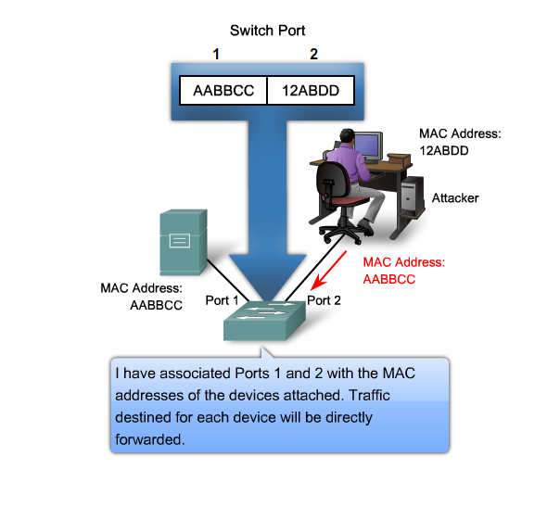
MAC Spoofing
On single switched network devices communicate by MAC address
MAC address stored in ARP Cache and must be updated regularly by client
Can not prevent someone from client side changing the MAC address
Spoofing MAC address bases for evil twin and MITM attack
Switch have built in intelligence to prevent changing port address
or recognizing if there are duplicate MAC addresses on the network and alerting administrator
Notes:
Another security concern with switched Ethernet is the ability of a malicious person to “spoof” a MAC address. When two devices are communicating, such as when you PING someone, the devices exchange MAC addresses and store this information is memory called the ARP Cache. On a single network the MAC address is used not the IP address to forward frames and there is no way to prevent MAC address spoofing on the client, since the ARP cache must be regularly updated. Thus, it is possible for someone to change the MAC address of a device and replace it with his/her device’s MAC address. This is the essence of a very dangerous attack called the Man in the Middle Attack (MITM). If the attacker can exchange MAC addresses, prior to the beginning of an encrypted transmission, then the attacker would be able to talk to both parties. Each party talking to each other, not knowing that the attacker is seeing all traffic and can modify the frame and send it to the other party.
Since MAC address spoofing cannot be prevented on the client, it can be prevented or monitored at the switch level. Most enterprise switches have built-in intelligence to alert if someone is trying to spoof a MAC address. The switch will not allow the MAC address of the switch port to be changed with proper administrative authentication, or the switch may take proactive action and the block the switch port alert the administrator that some is tried to change an address, or there is a duplicate MAC address on the network.

Slide 17
Wireless Ethernet
WLAN – 802.11i

Slide 18
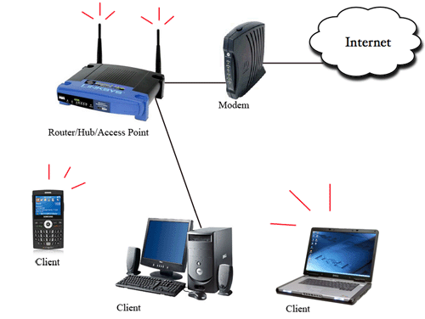
WLANs
Use radio frequency to transmit and receive data.
First WLAN specification called WEP (Wired Equivalent Privacy)
Had security problems and quickly replaced by WPA (Wi-Fi Protected Access)
WPA backward compatible with WEP
New standard WPA2 not compatible requires firmware upgrade
WPA2 works in 2 modes
Pre-shared key mode (Personal Mode)
Enterprise mode (Infra-structure Mode)
WPA2 – Enterprise mode works with 802.1x to provide secure authentication and transmi
Notes:
Wireless Local Area Networks (WLANs) - 802.11
Wireless LANs, or WLANs, use radio frequency technology to transmit and receive data over the air. This minimizes the need for wired connections within the network area. Wireless connections are the most common method today to access the Internet because of the increased mobility.
The first WLAN specification was called WEP, (Wired Equivalent Privacy) this technology had some security problems and was quickly replaced by WPA (Wi-Fi Protected Access). It is backward compatible with WEP products, and uses the temporal key integrity protocol (TKIP) to ensure that keys have not been tampered with and scrambles the keys used for encrypted transmission during the session. WPA also provides user authentication with the extensible authentication protocol (EAP).
Figure 6: WLAN Security 802.11i
The current standard is WPA2; some hardware cannot support WPA2 without firmware upgrade or replacement. WPA2 uses an encryption device that encrypts the network with a 256-bit key; the longer key length improves security over WEP. WPA2 was designed by the Wi-Fi Alliance standard organization and is basically the same as the IEEE 802.11i standard, with one exception. The WPA2 standard allows the sharing of keys when the network is formed. For example, when setting up your wireless network, you were probably asked to create a Pre-Shared key which wis used to join the network. This Pre-Shared Key (PSK) mode is ideal for small or temporary networks. The key is only used for initial authentication; after initial authentication, the wireless access point gives each user a new key to access the Internet and randomly changes the key during the session. This prevents attackers, who may be listening to the traffic from cracking the key which was a major problem with WEP.

Slide 19
WLANs
Problem with WPA2
The Wi-Fi networks found in public locations, such as airports, hotels and coffee shops, are open and allow traffic to be sent over them that isn't routinely encrypted
Solution WPA3
WPA3 fixes this by automatically encrypting all traffic between a device and the Wi-Fi access point by using a unique key, without the need for any prior setup by the user (Opportunistic Wireless Encryption (OWE) – RFC 8110 ) to avoid most of the MITM attacks
Does not provide the same level of security and assurance as authenticated encryption, but better than having no encryption
WPA3 works in 2 modes like WPA2 but with increased security
WPA3-Personal uses 128-bit encryption key.WPA3-Enterprise uses 192-bit encryption key.
WPA3 replaces the traditional pre-shared key (PSK) with simultaneous authentication.
Notes:
Problem with WPA2
The Wi-Fi networks found in public locations, such as airports, hotels and coffee shops, are open and allow traffic to be sent over them that isn't routinely encrypted, and the traffic can sniffed or hacked during transmission
Solution WPA3
WPA3 fixes this by automatically encrypting all traffic between a device and the Wi-Fi access point by using a unique key, without the need for any prior setup by the user (Opportunistic Wireless Encryption (OWE) – RFC 8110 ) to avoid most of the MITM attacks
WPA3 works in 2 modes like WPA2 but with increased security
WPA3-Personal uses 128-bit encryption key.WPA3-Enterprise uses 192-bit encryption key.
WPA3 replaces the traditional PSK with simultaneous authentication.

Slide 20
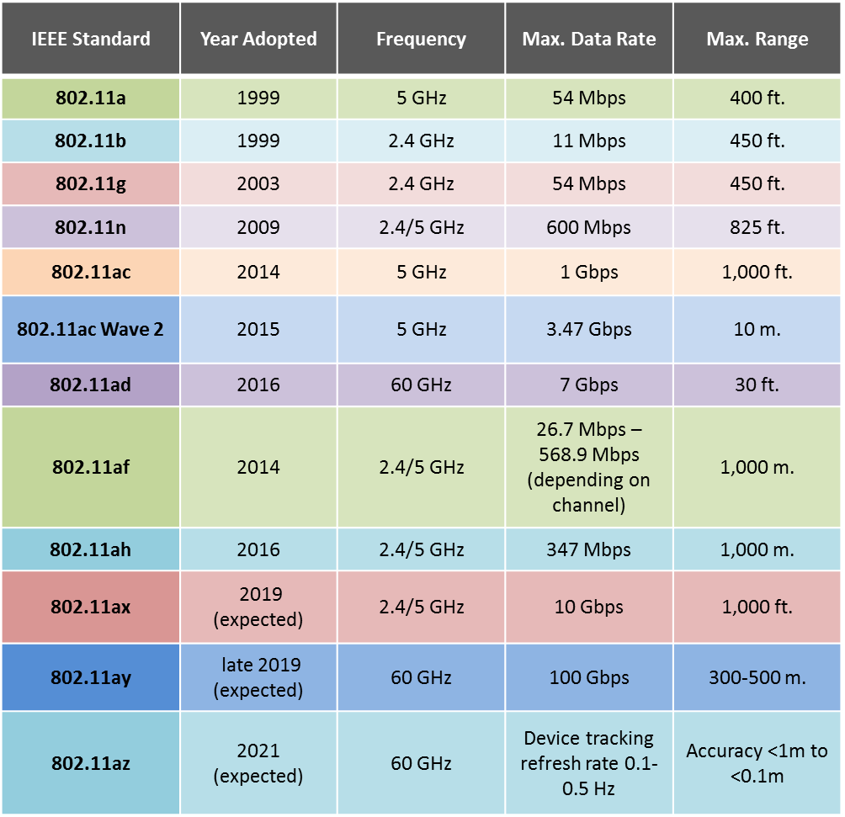
Wireless Protocols
Notes:
Information only

Slide 21

Wireless Errors
Greater attenuation than copper or fiber optic cable
“Absorptive attenuation” of plants
Higher frequencies do not bend around objects can get shadow or dead zones
Multipath interference main wireless problem requiring retransmission
Original signal bounces off ceiling
Creates a reflected signal
Both signals out of phase with each other and arrive out of time.
Notes:
Wireless errors
Wireless transmission is good because it allows mobile users to use the network without cables. On the negative side, wireless transmission as security and propagation problems. Setting up a wireless network is difficult and expensive. In addition, to the errors of crosstalk, EMI, jitter and noise, wireless transmissions have special problems. As Signal strength attenuates as it travels down a medium. In copper and fiber optic cable, this attenuation is confined to a fixed path. With radio waves the attenuation is much greater because the signal travels in all directions at the same time. In addition, plants are the “natural enemy” of radio waves and cause “absorptive attenuation” which greatly limits signal travel. Radio waves in the high frequency range cannot reflect around objects, resulting in “shadow or dead” zones. The main problem with wireless communication, however, is “multipath interference”. Radio waves can bounce off walls and ceiling, and other objects which creates two signals, the original signal and a reflected signal. Often the two signals arrive at the access point out of phase; one signal may arrive at its highest amplitude, and the reflected signal, with a slight delay, arrives at its lowest amplitude, this causes the signal to be unreadable and will require a retransmission

Slide 22
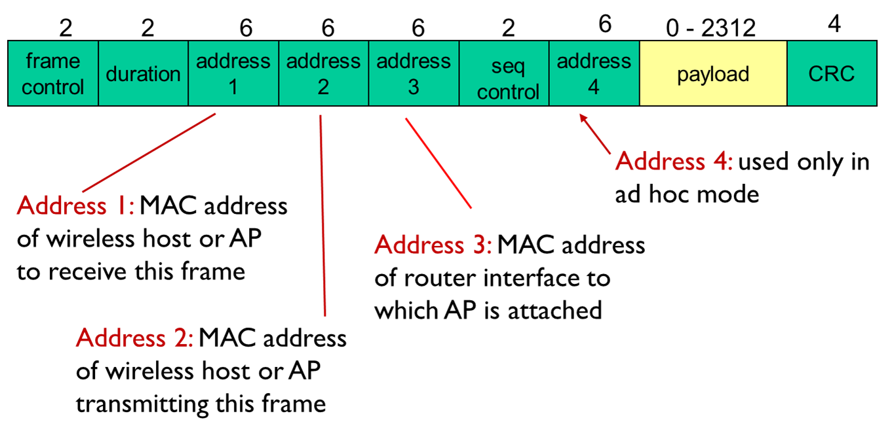
Wireless Frame Format
Frame Control contains flags for type of data frame, acknowledgement, etc.
Duration 16 bit field reserver transmission channel for the user
Four 48—bit long MAC addresses:
MAC of sender
MAC of AP
MAC of next WiFi device(Router or AP) or the destination host
MAC address (optional)
Sequence 12 bits number that is incremented for each data frame
Payload – message
CRC – 12 bits – error detection
Frame size: The standard frame size if the wired backbone allows frame greater than 1518 octets/bytes is 2346 octets. T
The jumbo frame size is 7395 octets
Notes:
The first part of the header is the 16-bit Frame Control field. This field contains flags that indicate the type of data frame, acknowledgement, etc. The Duration is a 16-bit field that is used to reserve the transmission channel to the sender. The Sequence control field contains a 12 bits’ sequence number that is incremented for each data frame so the access point can tell the frames that go together or if there is a duplicate frame. Notice that a wireless frame has three 48-bits address fields. This is surprising compared to other protocols in the network and datalink layers whose headers only contain a source and a destination address. Then the next field is payload field. The payload size is variable. Like if the backbone ethernet LAN segment supports MTU of 1500 octets/bytes then wireless frame payload is 1460 octets/bytes. Similarly, if ethernet LAN segment supports jumbo frame the wireless frame payload can from2312 octets to 7395 octets.
The last field is the 4 octet/byte long CRC for the error detection.

Slide 23
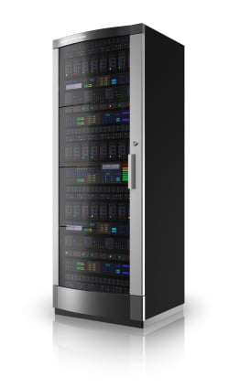
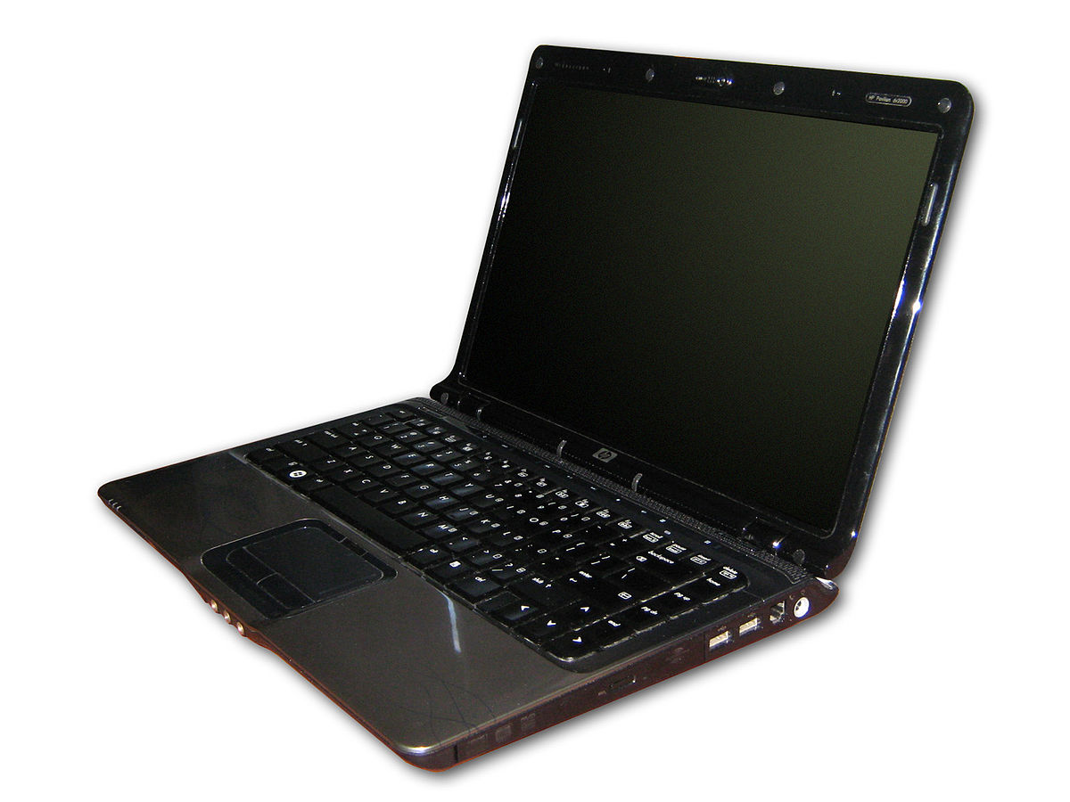
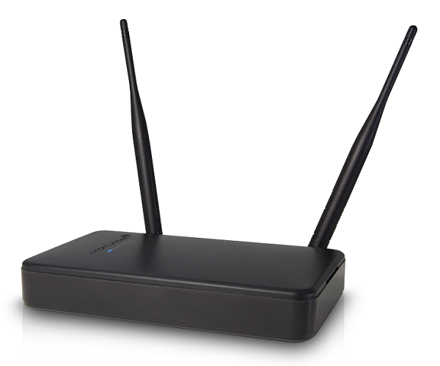
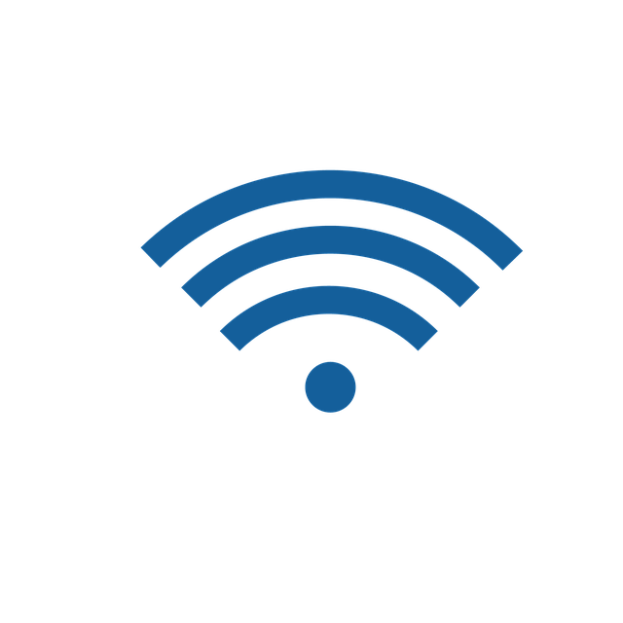
Wireless Addressing-Scenario 1
Interface MAC:Address 1
Dest.MAC:Address 3
Source MAC:Address 2
Notes:
There are four 6-bytes (48-bit address fields) in 802.11 header unlike the wired ethernet 802.3 header which contains only two 6-bytes long address fields (source and destination MAC addresses).The need for a third address in the 802.11 header comes from the infrastructure networks. When a frame is sent from a WiFi device to a server attached to the same LAN as the access point, the first address of the frame is set to the MAC address of the access point, the second address is set to the MAC address of the source WiFi device and the third address is the address of the destination on the LAN. When the server replies, it sends an Ethernet frame whose source address is its MAC address and the destination address is the MAC address of the WiFi device. This frame is captured by the access point that converts the Ethernet header into an 802.11 frame header. The 802.11 frame sent by the access point contains three addresses : the first address is the MAC address of the destination WiFi device, the second address is the MAC address of the access point and the third address the MAC address of the server that sent the frame. Every access point acts like a “bridge” joining to different networks: 802.3 wired Ethernet network to an 802.11 wireless Ethernet network.

Slide 24
Wireless Addressing-Scenario 2
Interface MAC:Address 3
Source MAC:Address 2
Dest.MAC:Address 1
Interface MAC:Address 4
Notes:
In this scenario if all four addresses are being utilized by the 802.11 frame, then the address 1 is the MAC address of the destination, address 2 is the MAC address of the source, address 3 is the AP connecting the source, and the address 4 is the AP connecting the destination entity.

Slide 25
Wireless Security
Rouge AP Evil Twin

Slide 26

Rouge Access Point
Unauthorized access point installed with network SSID
Created by intruder to steal data or by employee who wants unfettered access.
Clients connected to Rouge AP must be considered rouge clients because AP bypasses security protocols set by management
Notes:
Wireless Security
Wireless networks by nature are not as secure as wired networks. The two main threats from hackers are route access points and evil twin.
Rogue Access Points
A Rouge AP is a Wi-Fi access point that is installed on a network with the SSID as the network ID, but is not authorized by management. This could be an access point set up by either an employee who wants unfettered access, or by an intruder. Rogue access points can be used to steal data or create a Denial of Service (DoS) attack. Any client who connects to a rogue access point must be considered a rogue client because it is bypassing the authorized security protocols set by management.

Slide 27
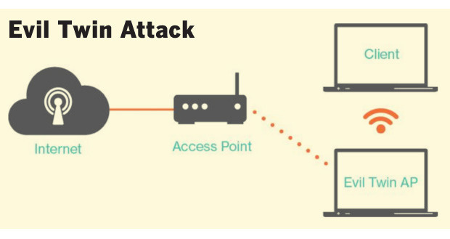
Evil Twin
AP operating at high power with network SSID
Wireless devices connect to strongest signal – client thinks imposter is the real AP
Imposter now in the middle (Man in the Middle-MITM) attack.
Intruder has full access to both sides of the communication and can alter the communication without the other side knowing it
Used to steal personal information or corporate intellectual property
Notes:
Evil Twin
Figure 8: Evil Twin Attack
An evil twin is an access point that is operating at high power, usually in a public area, with the same SSID as the real access point. Wireless devices will connect automatically to the strongest signal; thus the wireless client is associated with an imposter network that is operated by a hacker. The evil twin will establish a secure encrypted connection to the wireless client. The hacker now has access to all communication between the client and the access point. In a public area, this technique can be used to steal personal information. In a corporate environment, it is used to steal encrypted keys, trade secrets, or launch DoS attacks.

Slide 28
Virtual Private Network
VPN

Slide 29
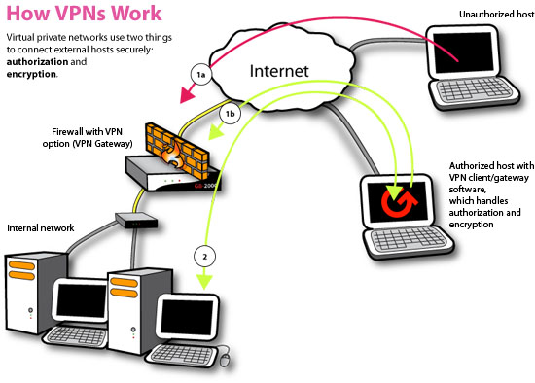
VPN
Costly but allows the use of the Internet as extension of private network
VPN server encrypts outbound traffic, then encapsulates it in an unencrypted IPv4 packet
Destination VPN, removes IPv4 packet from inbound traffic
Decryptes the message and forwards to destination host
Notes:
VPN (virtual Private Network (VPNs)
Figure 9: How a VPN Protects a Network
A VPN network can be used to defeat the evil twin and MITM attacks. A ritual private network (VPN) is a cryptographic connection between the client and a server. VPNs provide end-to-end protection, including authentication. If the PVN authentication is based on a secret shared password, the evil twin would not be able to launch an attack because the shared password is never transmitted. The evil twin would not be able to decrypt the messages passing between the client and server and it would not be able to send authenticated attack messages to create a DoS attack. Using a VPN is a way of using the public Internet as a private network. The network VPN server encrypts outbound network traffic, then wraps the encrypted message in an unencrypted IPv4 packet so it can be routed. If a hacker captures the packet he/she will be unable to read it. The destination VPN server, removes the unencrypted IPv4 packet and decrypts the message to forward onto the destination host.

Slide 30
Summary
Wired Ethernet IEEE 802.3 is the most popular LAN architecture today. Its excellent cost to performance ratio has increased the use of Ethernet as a MAN and WAN technology. Switched Ethernet is created using a combination of workgroup and core switches.
The network bandwidth must be able to accommodate all of the downstream devices. The most popular cable to connect devices to workgroup switches is 100BASE TX. The workgroup switches are connected to core switches using a fiber optic backbone. The most popular cable to connect core switches is 1000BASE SX. High speed core switches will need 10GBase with provides 10 Gbps. The more popular cable is 10GBASE SW
The main security concerns of wireless Ethernet is using RSTP to create backup links and 802.1x to control port access
Wireless Ethernet is 802.11. The WLAN standard is WPA2 and 802.11i. These protocols work together to provide excellent security for both small and large networks. Wireless networks have special propagation and security concers.
Using VPNs is an excellent choice in providing secure access across the Internet. VPN provides both authentication and encryption services for all connected hosts.

