Slide 1
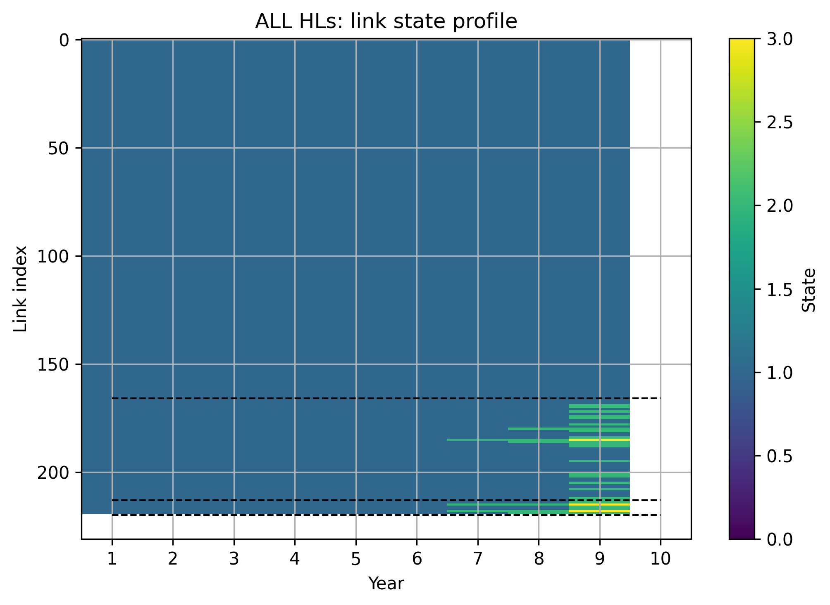

No HL3 Bypass
With HL3 Bypass
HL4
HL4
HL3
HL3
HL2
HL2

Slide 2
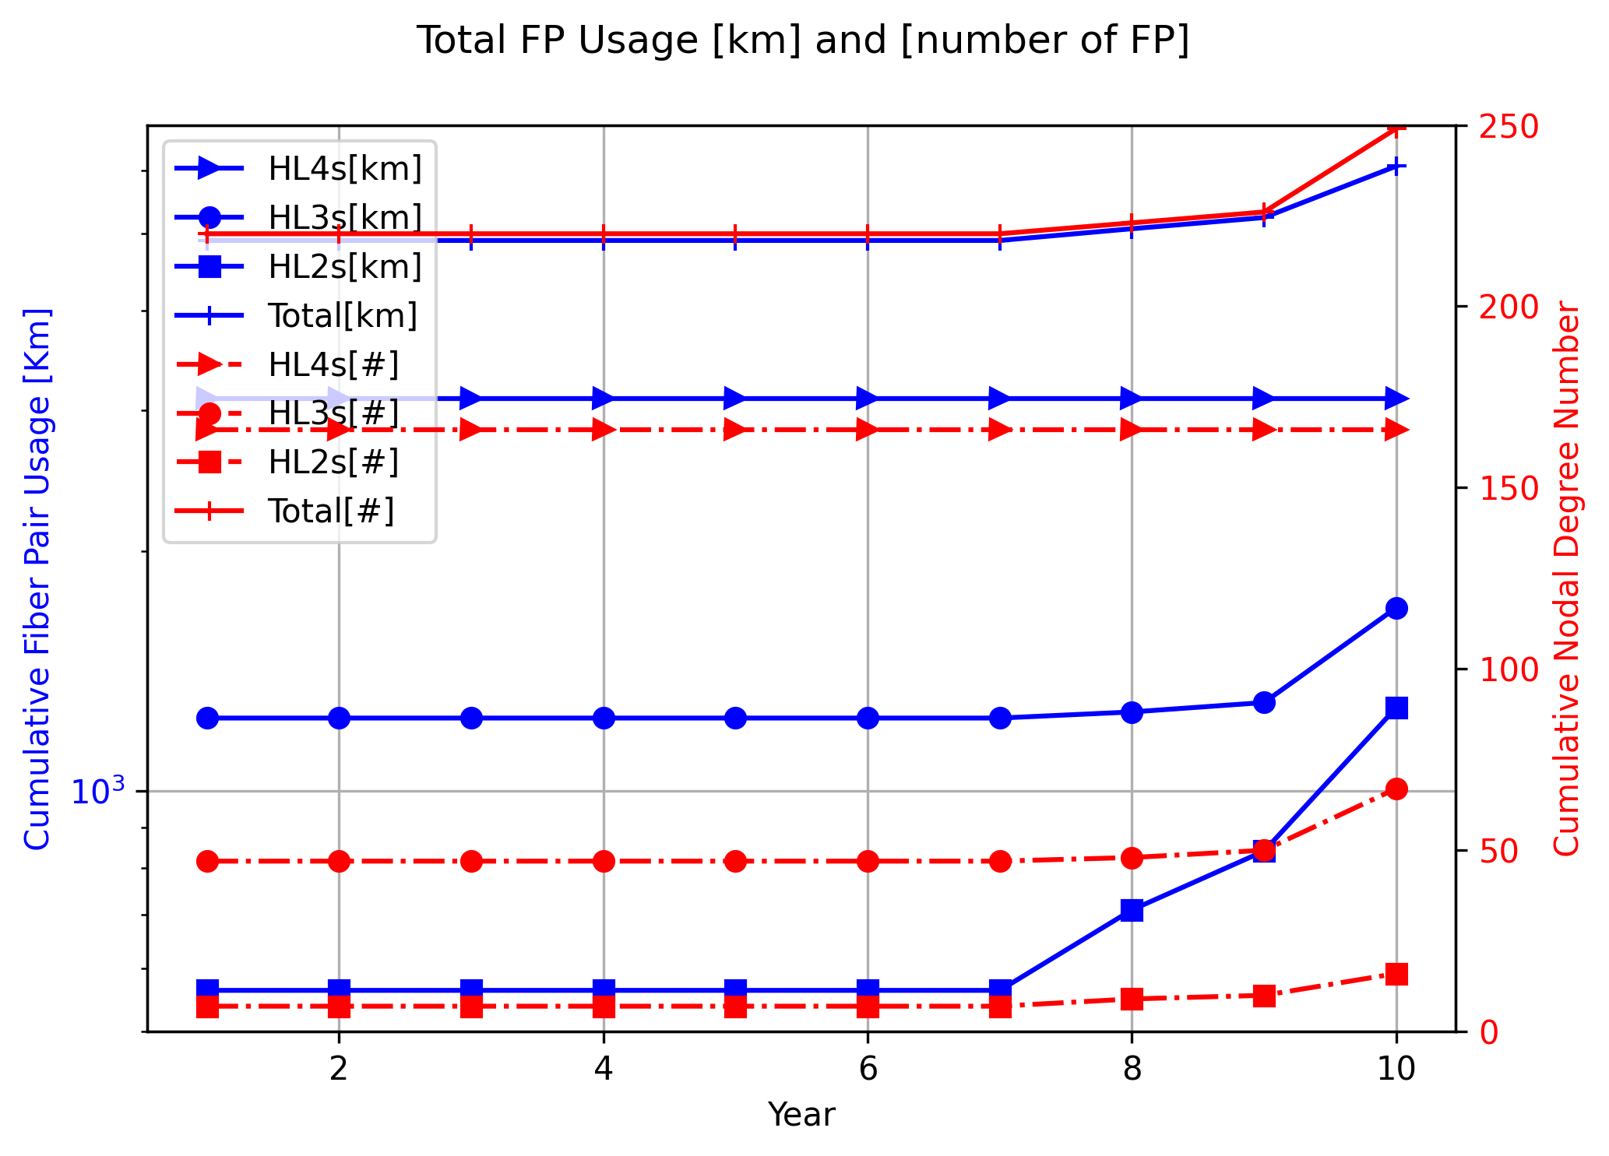
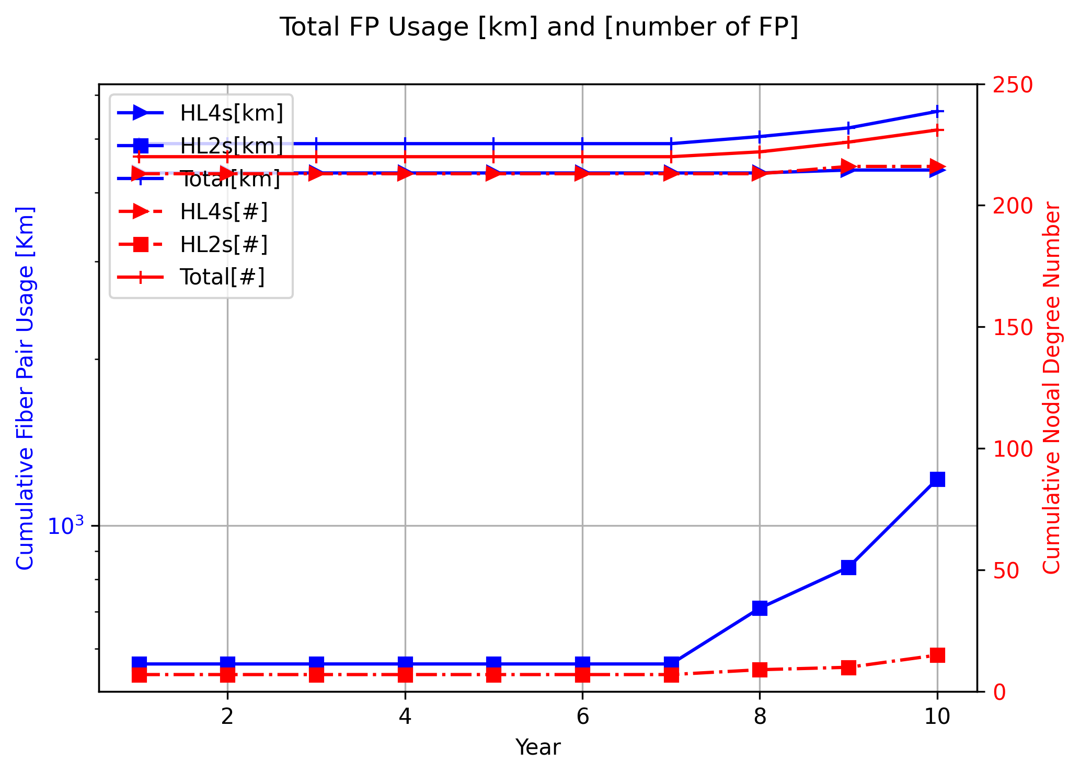
No HL3 Bypass
With HL3 Bypass

Slide 3
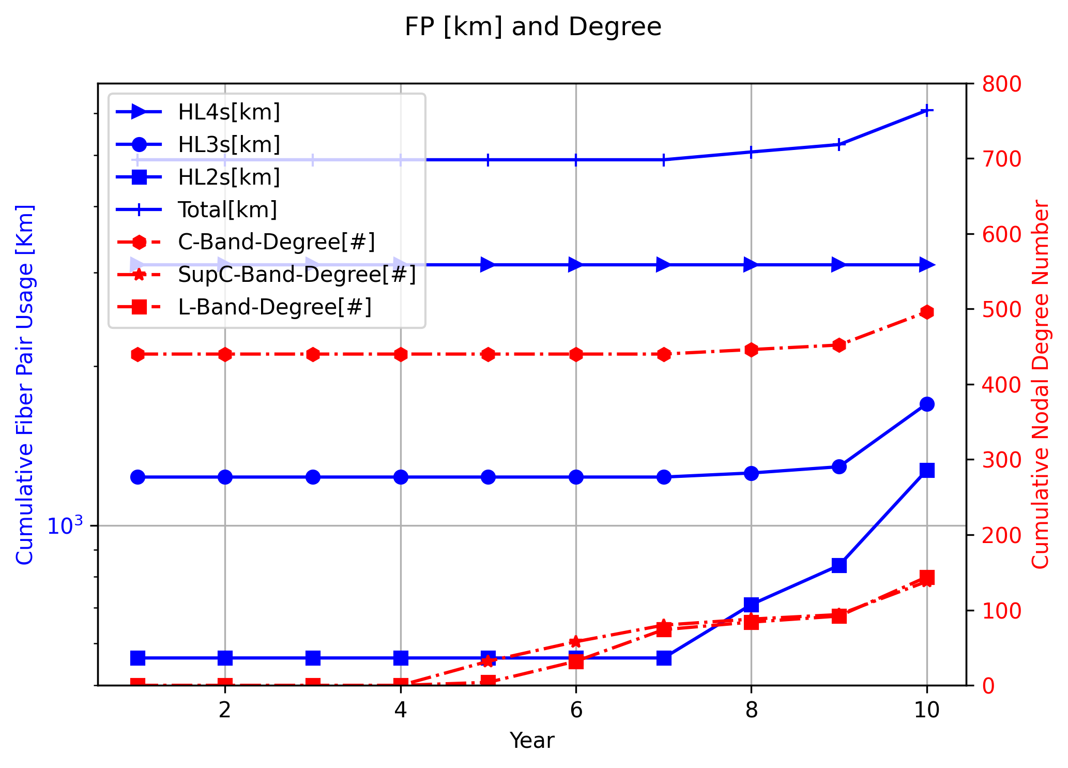
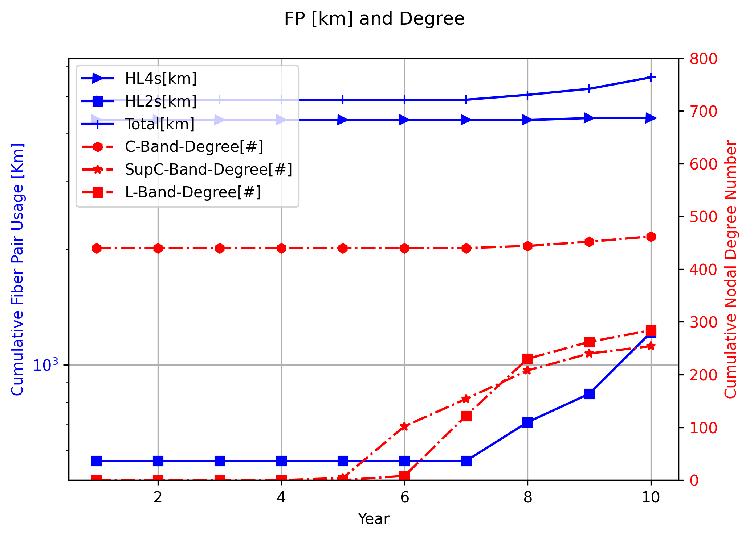
No HL3 Bypass
With HL3 Bypass

Slide 4
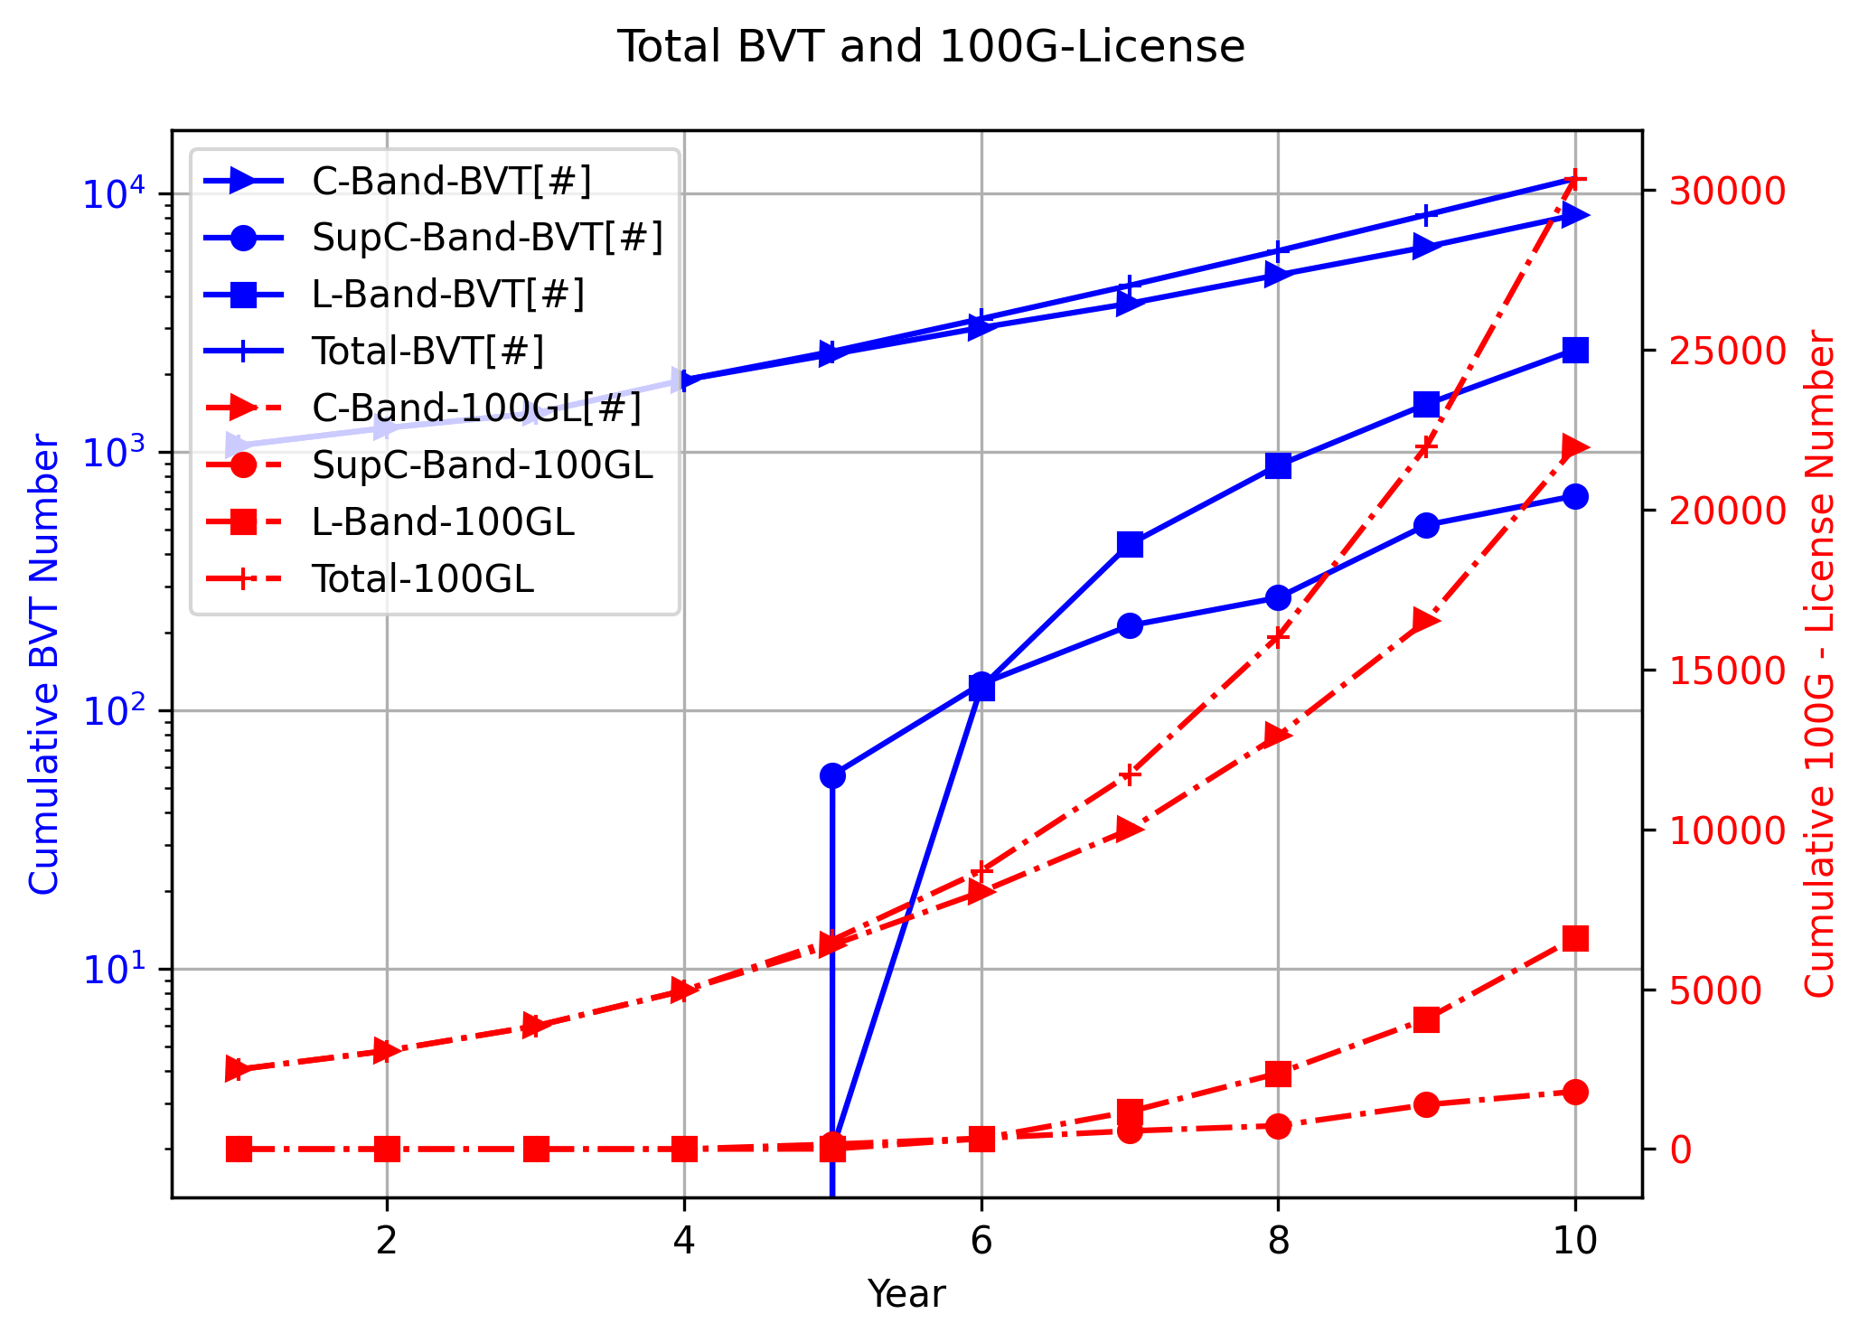
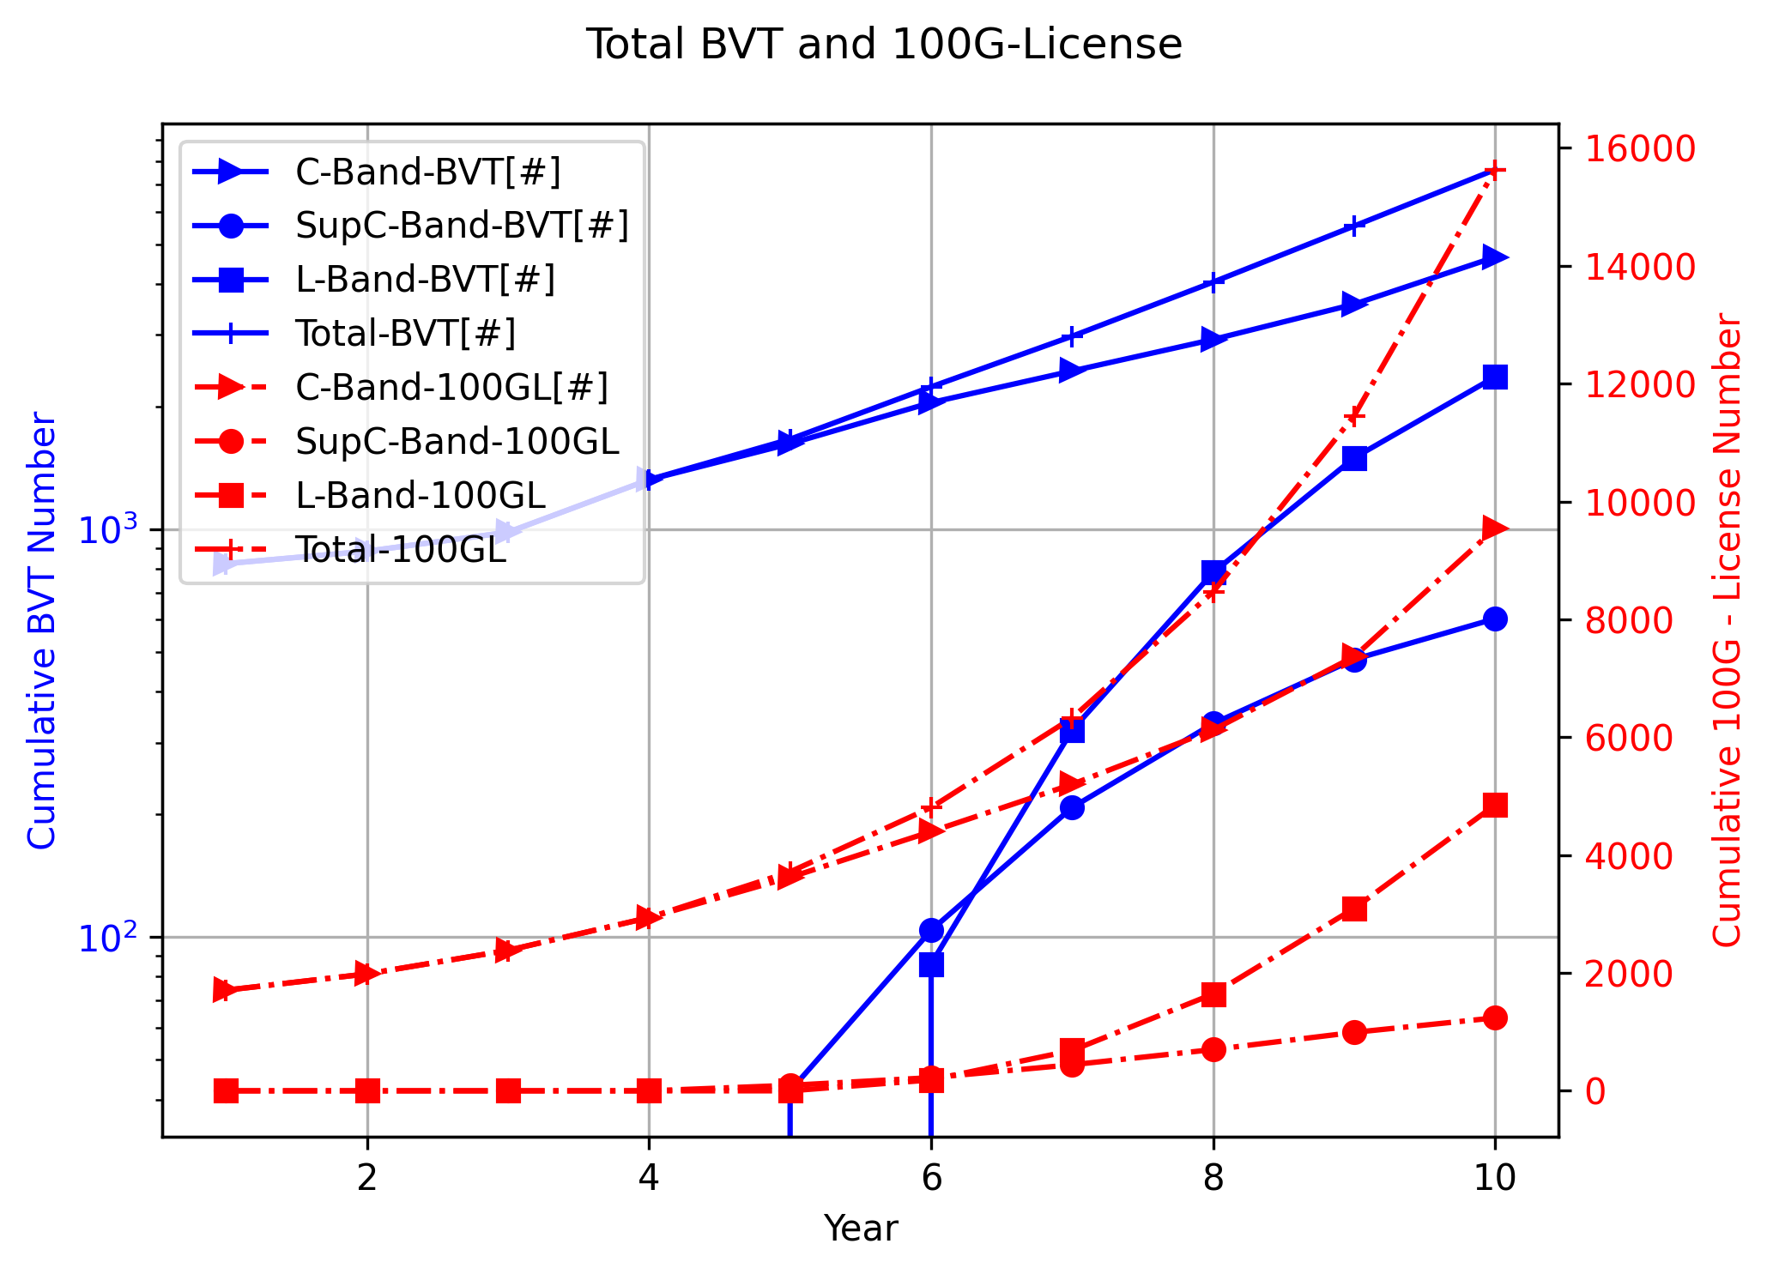
No HL3 Bypass
With HL3 Bypass

Slide 5
No HL3 Bypass
With HL3 Bypass
OPEX | Capex_RoB | Capex_MCS | Capex_100GL | CAPEX
2450.22 | 836 | 46.2 | 2492 | 3374.2
2450.22 | 0 | 7.875 | 3076 | 3083.875
2450.22 | 0 | 7.525 | 3848 | 3855.525
2450.22 | 0 | 21.175 | 4960 | 4981.175
2450.22 | 4.487724 | 24.13 | 6549.496 | 6578.114
2450.22 | 8.279851 | 36.77077 | 8756.436 | 8801.486
2450.22 | 9.6329 | 50.85245 | 11871.01 | 11931.49
2534.79 | 13.69009 | 71.2679 | 16263.37 | 16348.33
2617.77 | 13.01942 | 101.6467 | 22357.1 | 22471.76
3036.47 | 93.40484 | 140.3333 | 30883.34 | 31117.08
OPEX | Capex_RoB | Capex_MCS | Capex_100GL | CAPEX
2450.22 | 836 | 36.05 | 1708 | 2580.05
2450.22 | 0 | 2.625 | 1984 | 1986.625
2450.22 | 0 | 4.375 | 2384 | 2388.375
2450.22 | 0 | 14.875 | 2940 | 2954.875
2450.22 | 0.448772 | 14.9835 | 3721.538 | 3736.971
2450.22 | 11.51101 | 25.56906 | 4839.54 | 4876.62
2450.22 | 25.4454 | 33.58031 | 6414.65 | 6473.676
2523.79 | 29.68297 | 48.52746 | 8639.613 | 8717.823
2615.89 | 22.26655 | 68.46787 | 11734.27 | 11825.01
2802.14 | 22.84244 | 93.83737 | 16013.48 | 16130.16

