Slide 1
Early Sepsis Diagnosis
Matjaž Zupančič Muc

Slide 2
Challenges
Imbalanced dataset (2% of sepsis positive patients)
About 50% of features have more than 90% of missing values
Classification between patients in Intensive Care Unit (ICU)
Prediction ahead of time, since sepsis positive label is set 6 hours in advance
Early symptoms of sepsis tend to be mistaken for influenza or other infections.
One of the most difficult conditions to diagnose.

Slide 3
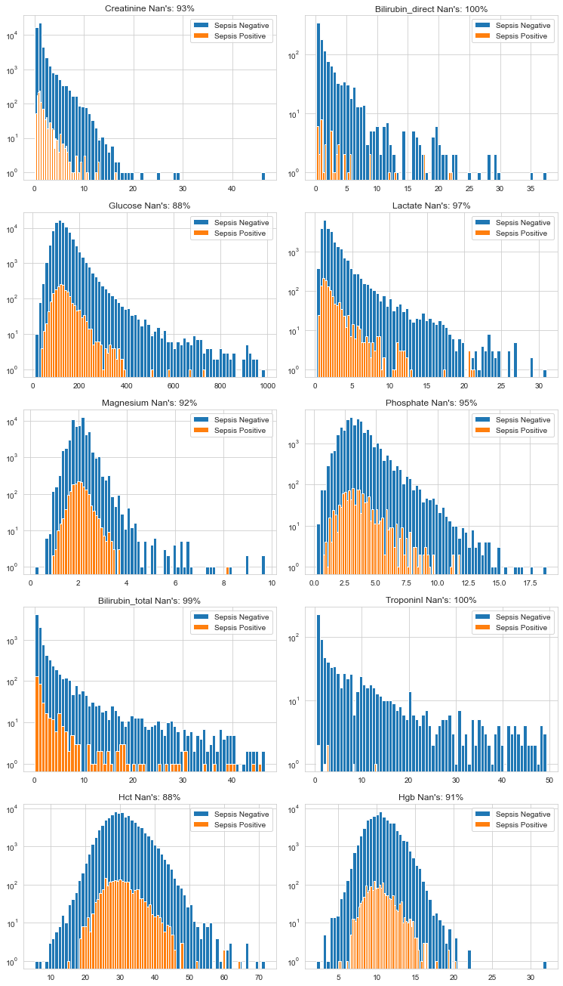
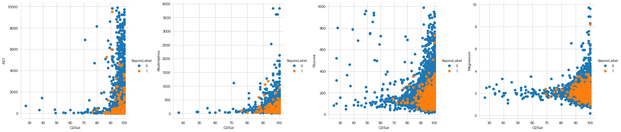
Data Analysis and Feature Engineering
Features with high perc. of missing values and poor statistical properties are removed
In case features correlate, pick more typical feature.
30 out of 40 features are kept.

Slide 4
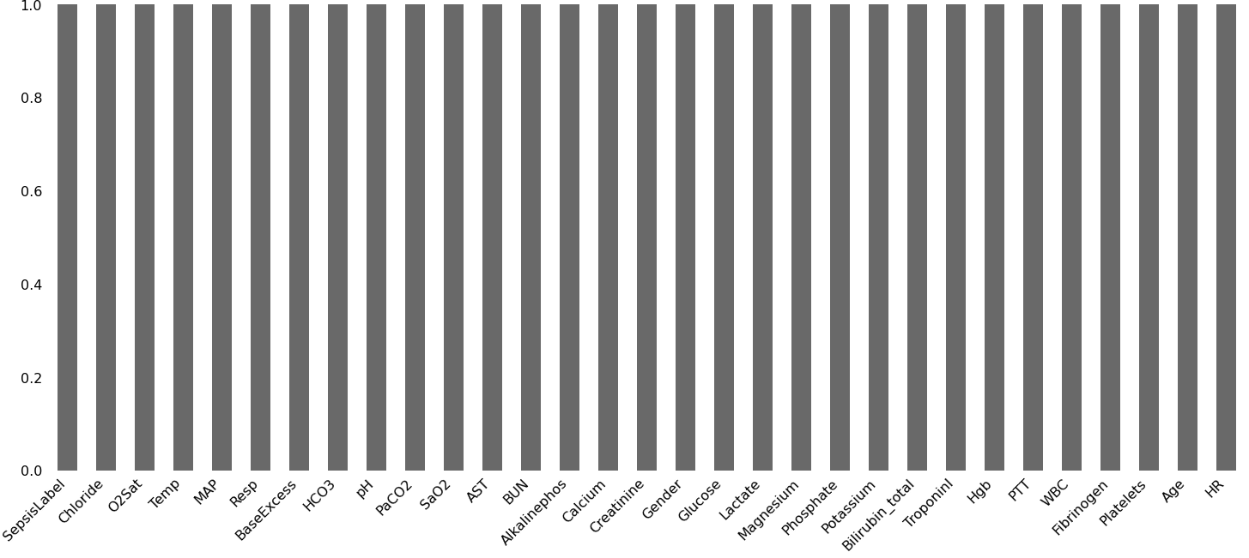
Data Imputation
Since features with large percentage of missing values may still hold valuable information, we decide to impute missing data by choosing the closest value.

Slide 5
Data Imbalance
Models use one of the following approaches to deal with imbalance.
Random oversampling
Synthetic Minority Oversampling Technique (SMOTE)
Weighting the minority class.

Slide 6
Models
Linear Regression with Random oversampling
Linear Regression with SMOTE
Random Forest with minority class weighting
Random Forest with minority class weighting and feature selection
One class classifier (Isolation Forest)
Neural Network baseline
Neural Network with minority class weighting
Neural Network with minority class weighting using features selected by random forest
Neural Network with minority class weighting using features selected by Relief algorithm

Slide 7
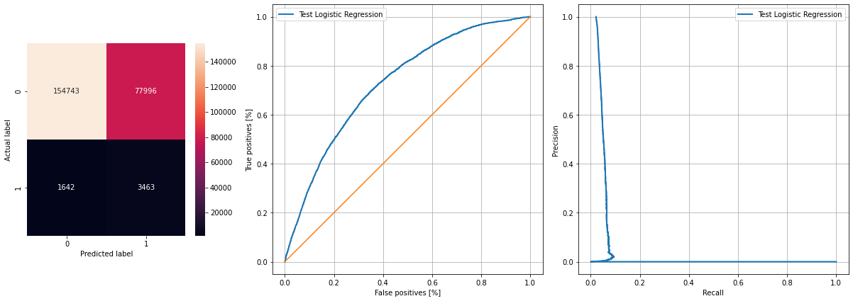
Logistic Regression SMOTE
A search for optimal hyper-parameters is performed, using 10 cross validations.

Slide 8
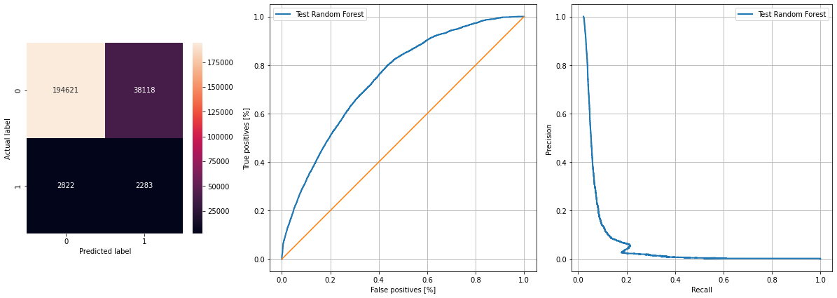
Random Forest with Feature Selection
Feature selection is performed, algorithm takes advantage of minority class over-weighting.

Slide 9
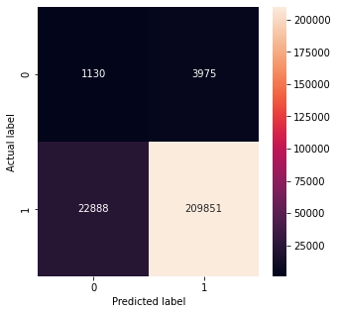
Isolation Forest
Originally designed for anomaly detection. Can be effective for imbalanced classification where there is no coherent structure to separate the classes that could be learned by a supervised algorithm.
A search for optimal hyper-parameters optimising f1 score (on septic patients) is performed using 10 cross validation folds

Slide 10
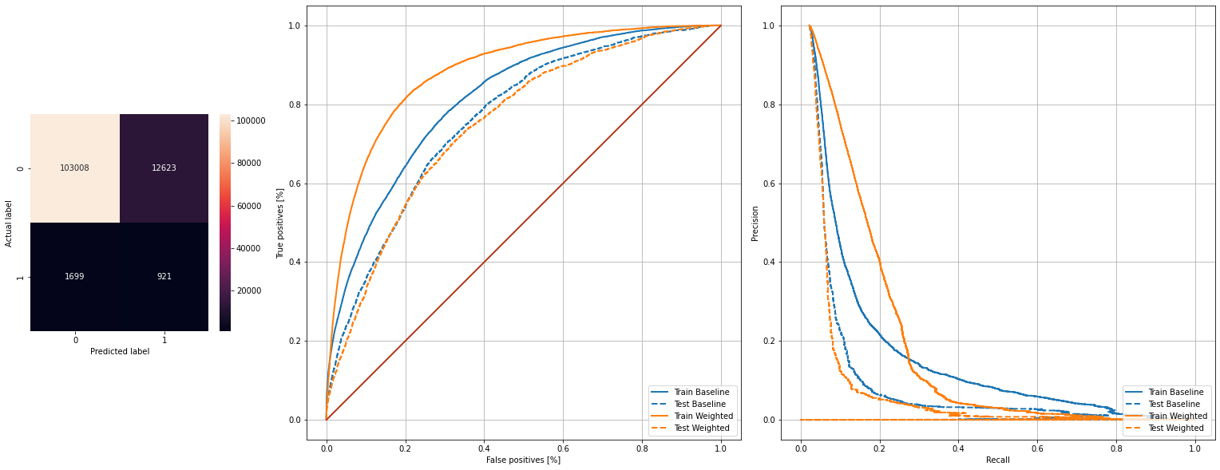
Neural Network with minority class weighting
Using validation set we train the model using 100 epochs and a batch size of 60(experimentally picked to decrease overfitting)

Slide 11
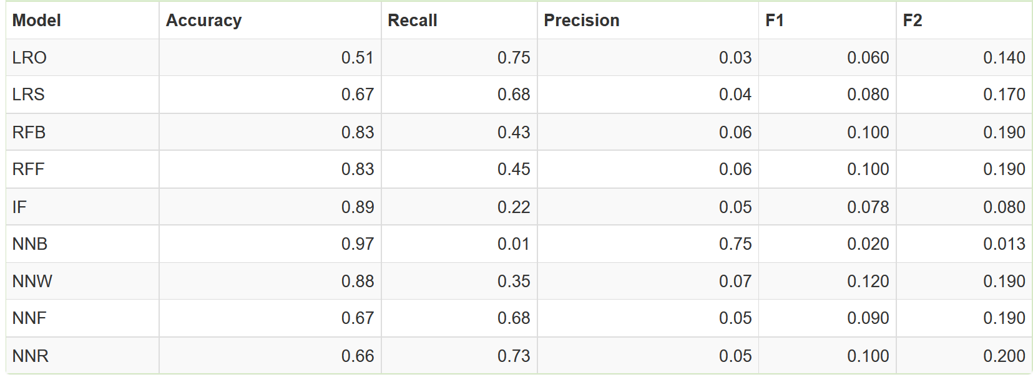
Results

Slide 12
Conclusions
Classification on imbalanced datasets seems to still present a challenge. Especially in case where there is a large percentage of missing values and therefore potentially synthetic data.
Methods such as over-sampling and SMOTE do increase the recall, but the price we pay results in precision and accuracy drop
Algorithms that provide the ability to weight minority classes perform competitively, they provide a benefit of fast training
One class learning approach presents an alternative method, this approach may be more effective if the feature space of the classes were more distinct

