Slide 1
Comparison of S&P 500 Volatility Index

Slide 2
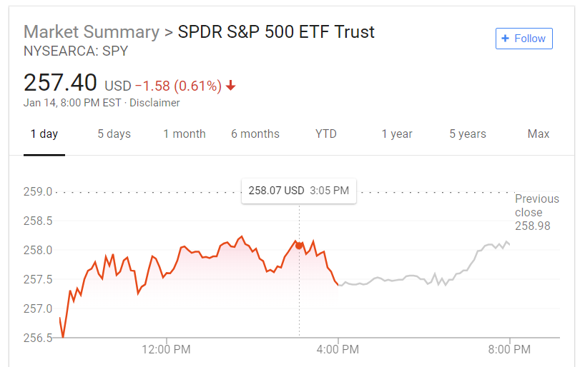
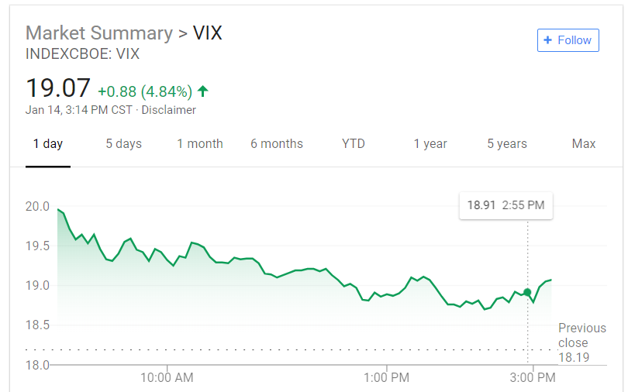
Hypothesis
Is the S&P500 (SPY) inversely correlated to the Volatility Index (VIX)?
Is there a correlation between market performance and unemployment rate?

Slide 3
Data Sources
Yahoo Finance using Pandas DataReader
Bureau of Labor Statistics for Unemployment Rate (CSV Download)

Slide 4
Solutions
Challenges
Market data is readily available so the major challenge was navigating some MongoDB issues.
We worked together to think of different troubleshooting ideas and also had to reformat and reinsert things into MongoDB.

Slide 5
Process
Pulled SPY and VIX data from pd.datareader and saved to CSV.
Renamed and removed columns from both tables.
Calculated a rolling 100 Day Moving Average for the SPY and VIX.
Joined the tables on date and stored in MongoDB
Downloaded Unemployment CSV and saved to MongoDB
Extracted from MongoDB and plotted charts to view correlations.

Slide 6
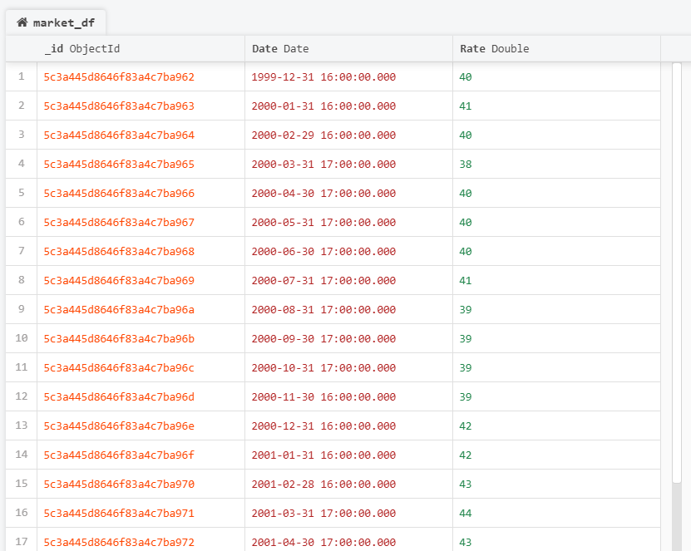
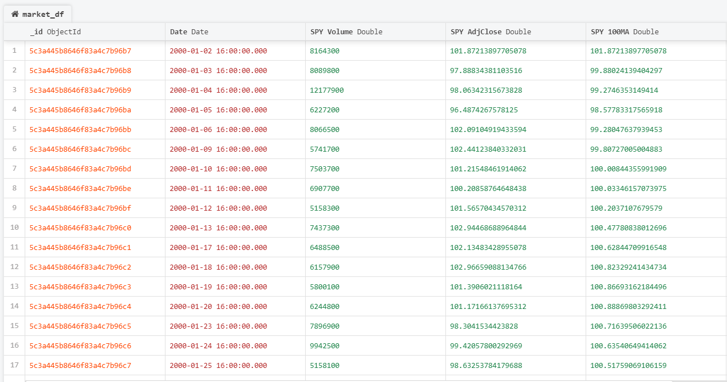
MongDB

Slide 7
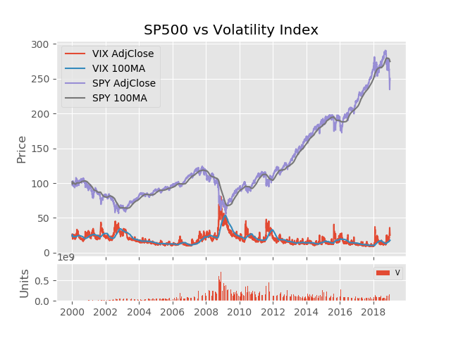
SPY vs VIX

Slide 8
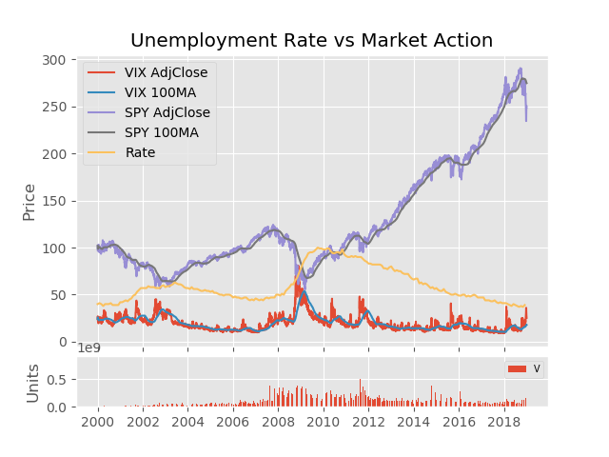
SPY/VIX vs Unemployment

Slide 9
Conclusion
The ^VIX is negatively correlated to the S&P500
The Unemployment Rate is directly affected by the market, all though with a slight delay in reaction. The unemployment rate also takes longer to recover than the S&P500.

