Slide 1
Commercial Auto Risk Scoring Case Study
Bc. Matej Bebej
1

Slide 2
Table of contents
Exploratory data analysis
Modeling methodology improvements
Production readiness improvements
Deployment roadmap
2

Slide 3
Explanatory data analysis (EDA)
We have plenty null values in different columns
We are working with data types:
  numeric – int, float
  object – categorical data, dates
Columns that are not present in both dataframes:
  labels – claim_count, total_loss_ammount
  other – has_safety_program
Duplicate rows:
  full duplicates – 42 records
  duplicate id (policy_id) – 33 records
3

Slide 4
Explanatory data analysis (EDA)
Attributes are not normally distributed – data is skewed:
  normaltest, histogram
Most numeric attributes have outlier values
Relationships and correlations:
  Used spearman correlation
  Data leaks: Claim_paid_ammount_current_period – has value only when labels contain value > 0
    Correlation ≈ 100%
  Multicolinearity:
    vehicle_count - prior_year_mileage_000
    prior_apd_claim_claim_count - prior_loss_amount
    prior_al_claim_count - prior_loss_amount
4

Slide 5
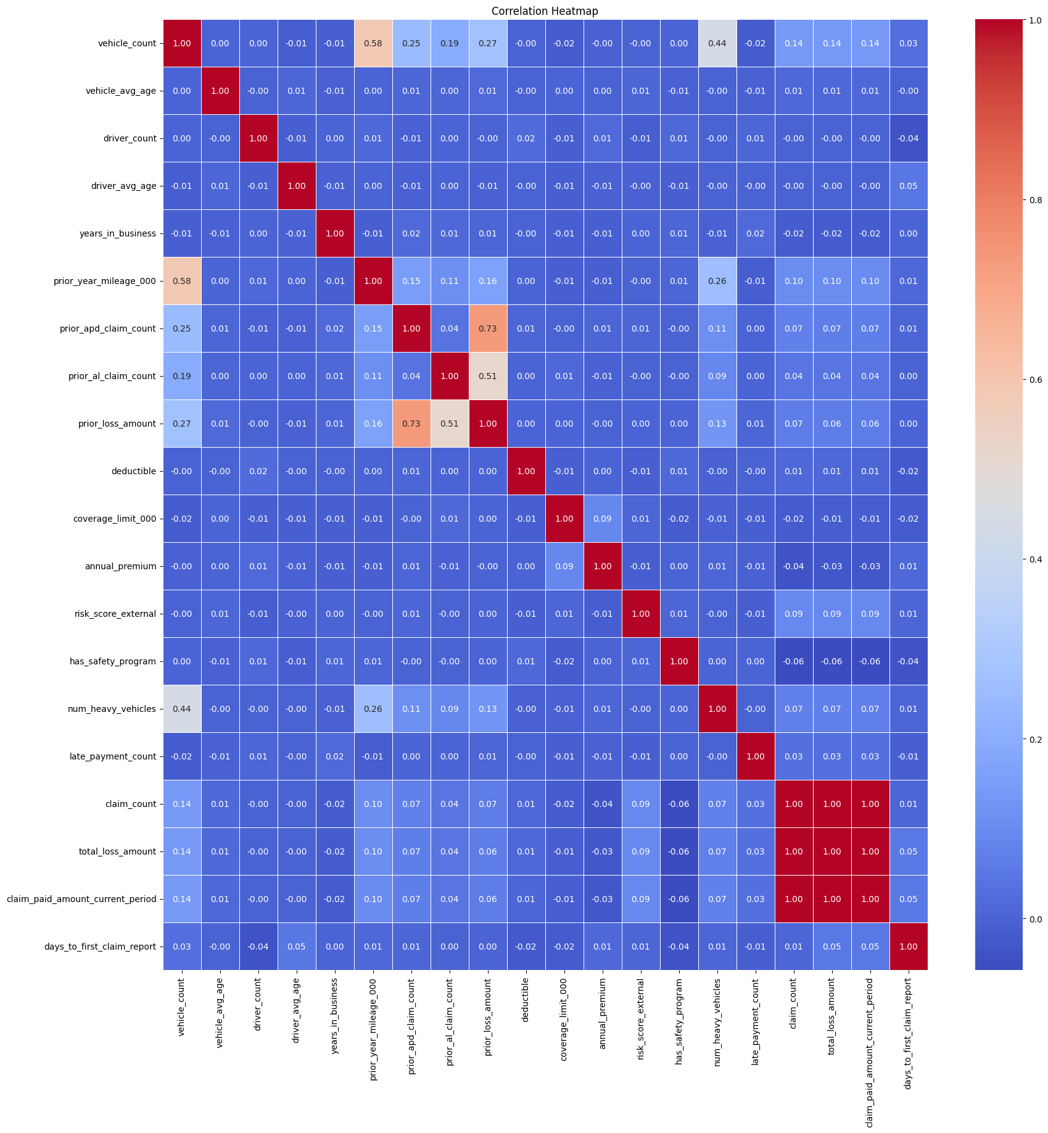
5

Slide 6
Modeling methodology improvements
Different feature selection
Current split used -> X_train, X_test, y_train, y_test = train_test_split(X, y, test_size=0.2)
This split is created with unordered randomly shuffled data
More fitting would be splitting after ordering based on year – time-based
Results of time-based validation set would be more generalizing
Years (or months) can be extracted from policy_effective_date
6

Slide 7
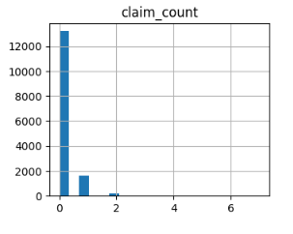
Modeling methodology improvements
Imbalanced target column
EDA showed us how imbalanced our label attribute – claim_count
Vast majority of records are without claim (13146)
If predictions are all 0, we still get great accuracy
Solution: tmp = LogisticRegression(max_iter=1000, class_weight='balanced')
7

Slide 8
Modeling methodology improvements
Different feature selection
Model is fed leaky columns:
  claim_paid_ammount_current_period – shows 100% correlation with our label columns
  first_claim_reported_date, claim_status_current_period, days_to_first_claim_report:
    Found by manual observation
    If they do not contain specific values (null/ No Claim) they predict target values
Model is fed multicolinear attributes
  Filter them with cross validation
8

Slide 9
Production readiness improvements
      Using pipeline:
        Provides end-to-end execution
        Eliminates training-serving-skew
        Replaces current manual preprocessing
      Modular code architecture:
        Separating one script to several modules
        Improves readability
        Improves scalability
      Adding schemas for data validation:
        Automatic solution to detect possible threats
        Deals with corrupt values
        Deals with missing values/ columns
        Ensures Model is fed safe records
9

Slide 10
Deployment Roadmap
Containerization
Package code, model, pipeline into a Docker container
Ensures environment compatibility
Testing
Creating scenarios for edge cases
Performance and load testing
Regression testing
10

Slide 11
Deployment Roadmap
Monitoring
Track prediction quality, compare obtained results
Setting alerts, triggers in case of errors, or quality drop
Documentation
Record data sources
Track versions
Technical and operational documentation
11

Slide 12
AI use
  Models used
    Gemini by Google (3.1 pro/ 3.5 Flash-lite)
  Data navigation
    Used to parse, navigate, and understand unfamiliar insurance dataframes
  Methodological correction
    Challenged initial assumptions and identified tailored methods for specific scenario of the given task
  Research
    Used to research complex topics, such as specifics of deployment roadmap
12

Slide 13
Thank you for your attention!

