Slide 1
Cloud-Based Battery Data Collection Tool
Cole Fuerth and Mathew Pellarin
B.A.S.c Computer Science,
O.C.A.D Electronics Engineering Technology
Dr. Bala Balasingam and the BMSLabs Team
May 2023

Slide 2
Implementation
Devices
Communication
API
Database
Cloud Computing

Slide 3
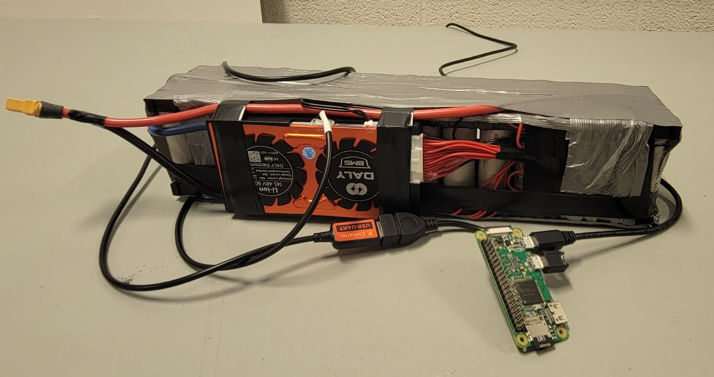
Device
Raspberry Pi
Connects to Daly Battery Management System
Every second collects information including:
Time
Voltage
Current Draw

Slide 4
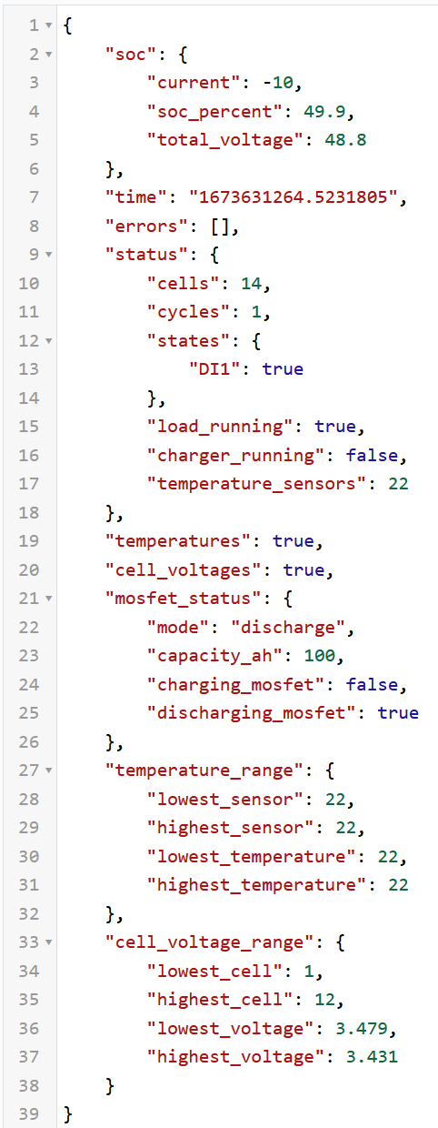
Communication
Serial
Raspberry Pi connects to Daly battery management system through UART
MQTT
Raspberry Pi sends the data to centralized server over (MQTT) MQ Telemetry Transport
This is a lightweight messaging protocol that is simple and low bandwidth dependent
Data is encoded in JSON format
Notes:
Explain Serial
MQTT

Slide 5

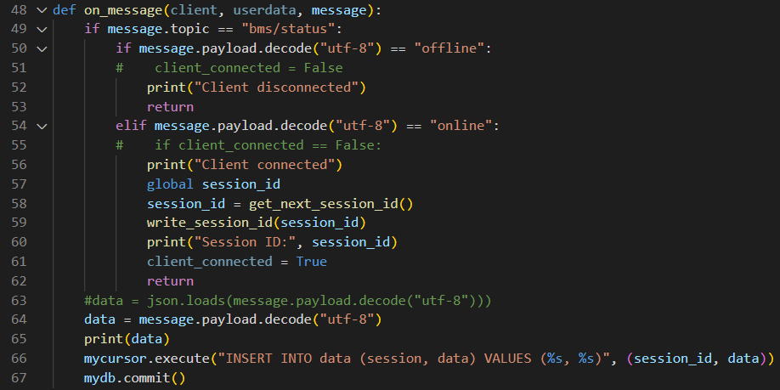
API
Python Script
Watches the MQTT server for new publishes
Decodes and uploads data to a MySQL Database
Notes:
Explain how the API watches the MQTT server and when one is online, it checks if serial number is already there and adds it, then starts writing data info every new publish of the connected device

Slide 6



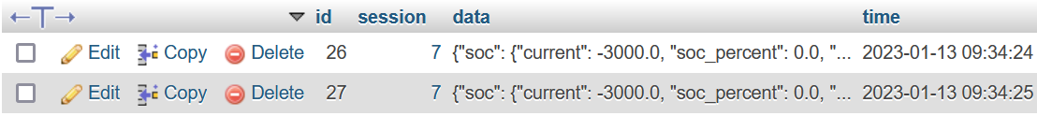
Database
MySQL
3 different tables total
Serial Number
Session ID
Data
Notes:
There are probably faster, better databases to use, but we chose MySQL due to familiarity and integration with myPHPadmin for easier and quicker deployment
Talk about the schema, how one relates to another
k-param shows amongst the cache batteries which is closest to

Slide 7
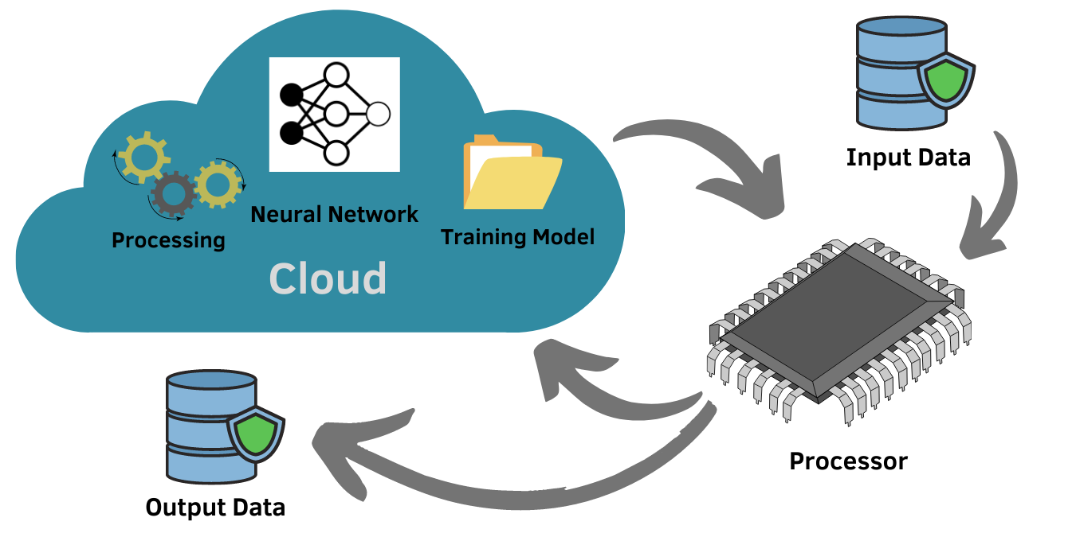
Cloud Computing with AI
Once the Neural Network determines there is enough information after the charge or discharge cycle session, it performs a prediction on which cache of battery the cell preformed closest to.

Slide 8
Thank You!
More information can be found at
https://github.com/colefuerth/AI-Characterization
https://github.com/colefuerth/CloudBFG
https://github.com/colefuerth/BattSim

