Slide 1
Cloud-Based Battery Data Collection Tool
Cole Fuerth and Mathew Pellarin
B.A.S.c Computer Science,
O.C.A.D Electronics Engineering Technology
Dr. Bala Balasingam and the BMSLabs Team
May 2023

Slide 2
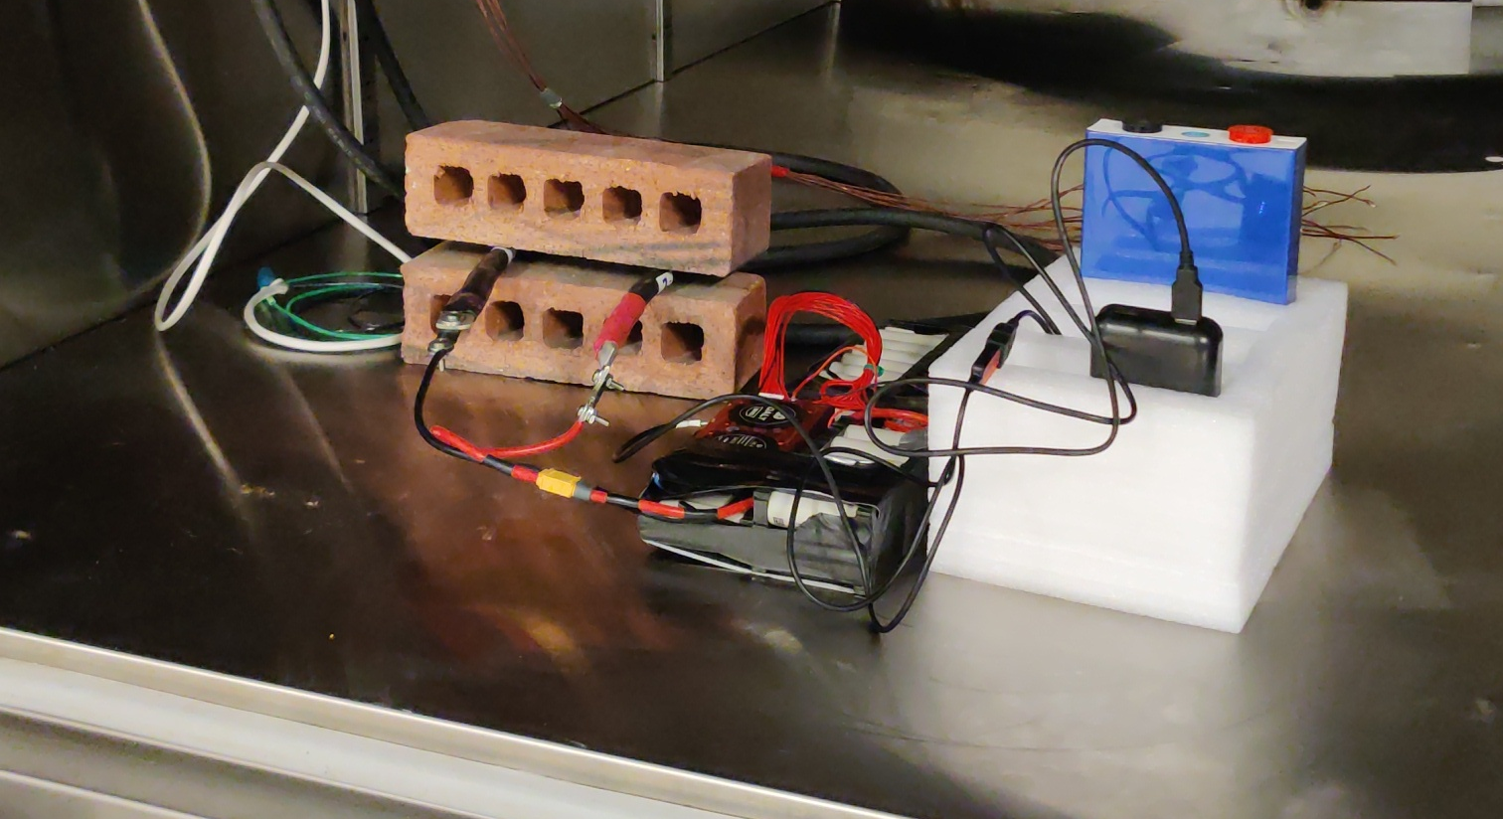
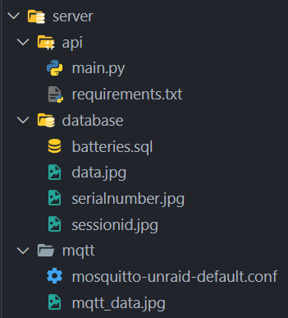
Introduction
For scalable collection of battery data, a cloud-based implementation was created by Mathew Pellarin
Originally created for an AI battery characterization project, it is now being used for other projects within the BMSLab team.
This system was created such that potentially millions of clients can upload data simultaneously for processing later.

Slide 3
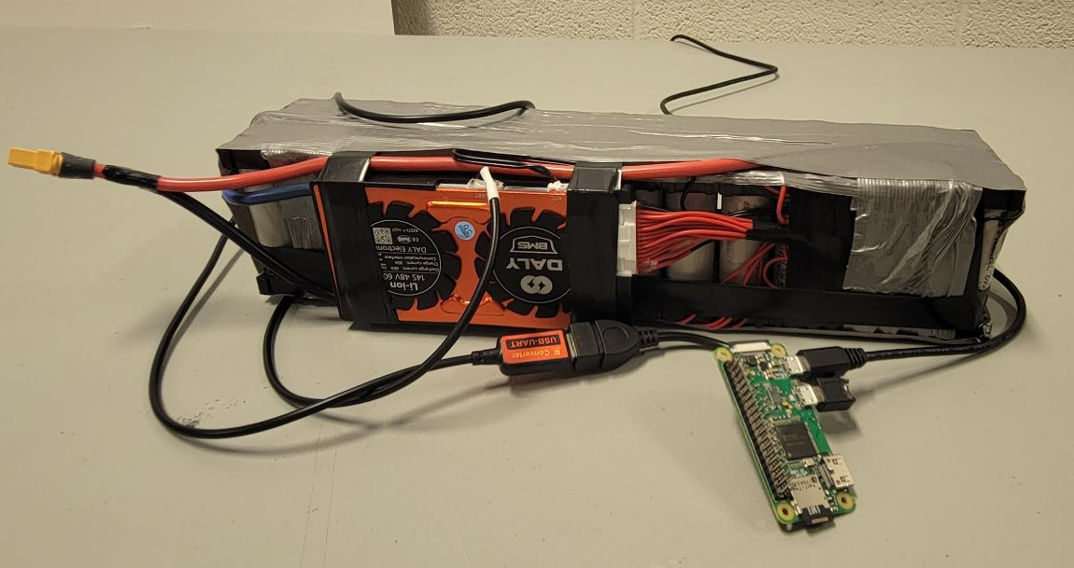
Hardware
The local, battery-side operations are on a Raspberry Pi
The RPi connects to the DALY Battery Management System as soon as it is detected, no user interaction is required!
Once per second, all available information is collected, including:
Time
Voltage
Current

Slide 4
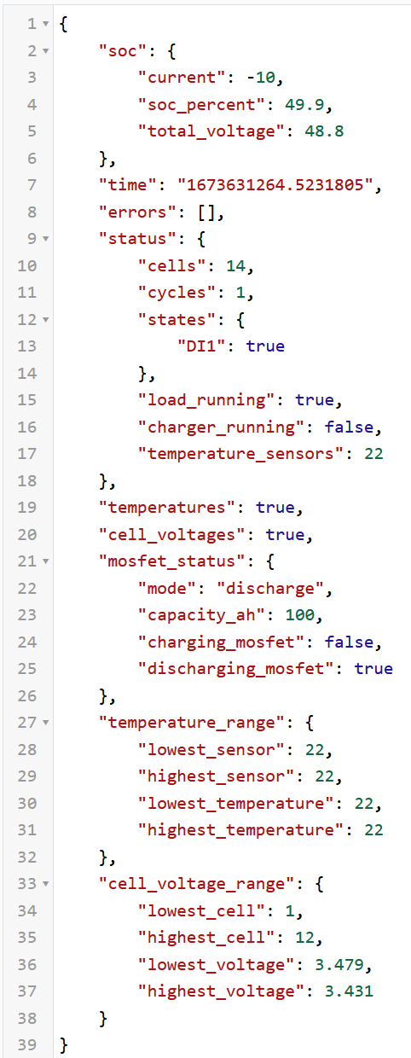
Communication (Local Client)
Serial
The Raspberry Pi connects to the DALY battery management system through Serial UART, and runs fetch commands using a utility called `daly-bms-cli`
MQTT
The Raspberry Pi then sends the data to a centralized server over MQ Telemetry Transport (MQTT)
This is a lightweight messaging protocol that is simple and low-bandwidth dependent, meant for small IoT implementations
The data is encoded in JSON format before being transmitted
COMMAND="daly-bms-cli -d /dev/ttyUSB0 --all --retry 100"
OUTPUT=$($COMMAND)
mosquitto_pub -h $IPADDRESS -u $USER -P $PASS -t "daly_bms/$SERIAL/$COUNTER" -m "$OUTPUT"
Notes:
Explain Serial
MQTT

Slide 5

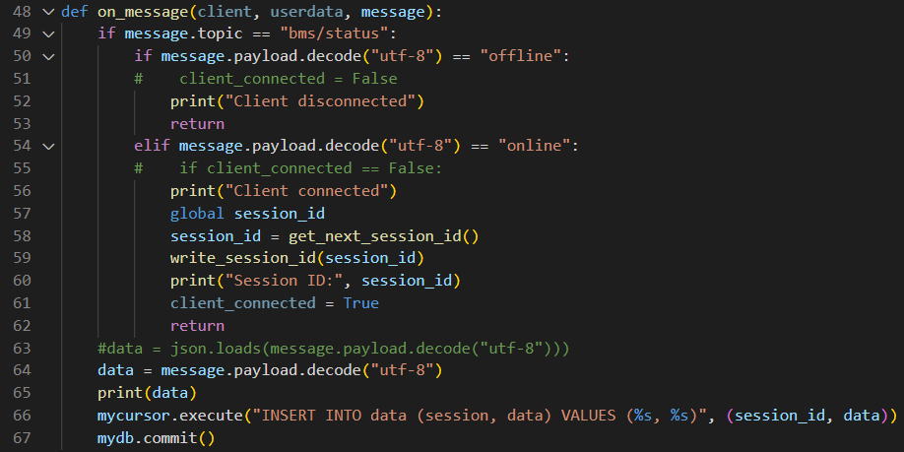
API (Centralized Server)
Python Script
Watches the MQTT server for new publishes from clients
Decodes and uploads data to a MySQL Database
Notes:
Explain how the API watches the MQTT server and when one is online, it checks if serial number is already there and adds it, then starts writing data info every new publish of the connected device

Slide 6
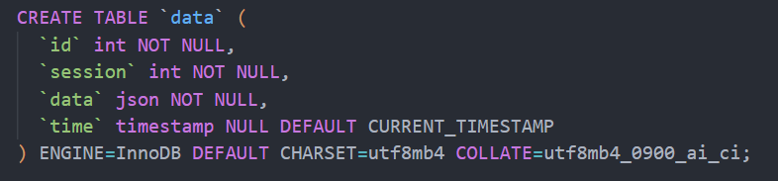

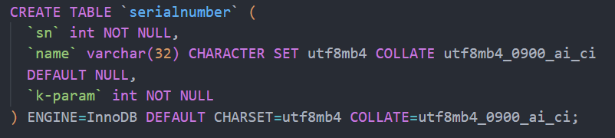
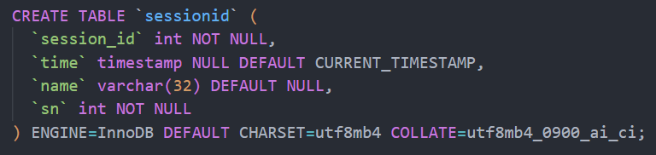


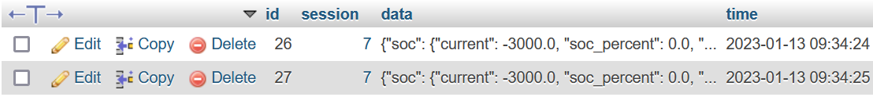
Database
MySQL
3 different tables total
Serial Number
Session ID
Data
Notes:
There are probably faster, better databases to use, but we chose MySQL due to familiarity and integration with myPHPadmin for easier and quicker deployment
Talk about the schema, how one relates to another
k-param shows amongst the cache batteries which is closest to

Slide 7
Thank You!
More information can be found at
https://github.com/Matp101/CloudDatabase

