Slide 1

Going Online! Analyses of the New Push-to-Web Approach of the Social Survey Austria Matthias Penker, Anja Eder, Markus Hadler
Funding: "Digitize! - Computational Social Sciences in der digitalen und sozialen Transformation.“ Federal Ministry of Education, Science and Research
Notes:
Hauptbotschaft hier

Slide 2

Social Survey Austria (SSA)
Austrian ISSP (International Social Survey Programme) surveys are conducted together with the national Social Survey Austria (SSA) since the 1980s
Country comparative survey programme to monitor attitudes, value orientations and behaviors (12 different Modules)
SSA is conducted in a cooperation of the Universities of Graz, Linz, Salzburg & Vienna & and was fielded in 1986, 1993, 2003, 2016, 2018, 2021 & 2023

Slide 3
Social Survey Austria (SSA)
Random samples with 1000+ respondents representative of the population (above 16 years)
1986-2018 face-to-face mode (PAPI, CAPI)
2021-2023 different modes were used (CAPI, CATI, CAWI, Mail).

Slide 4
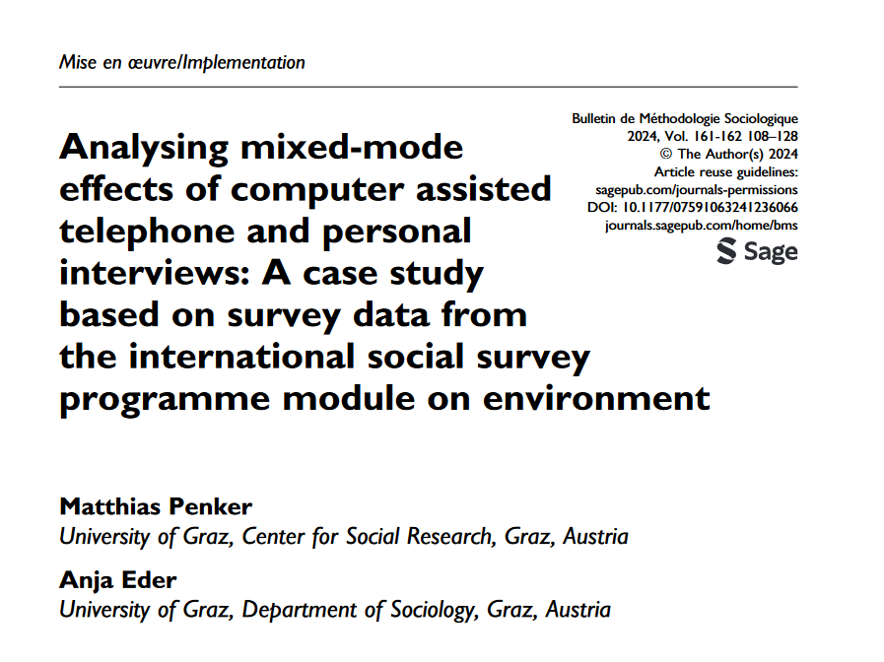

Slide 5
1) Mixed Mode Designs: Strengths and Weaknesses

Slide 6
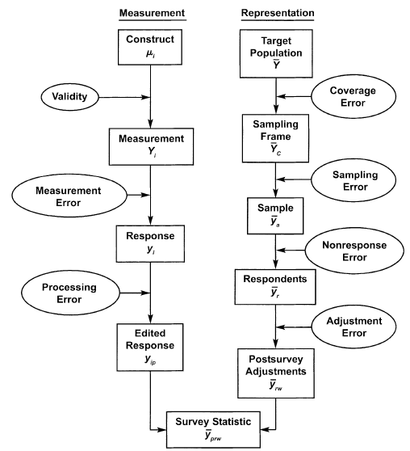
Source: Figure Grooves et al., (2004): p.48;

Slide 7



Mode
(Non-)
Response Pattern
Measurement Effect
Selection Effect
Respondent Characteristics

Slide 8
Long story short:
We want different modes to attract different people (desired selection effects); while the mode has no (substantial) effect on survey responses (undesired measurement effects).

Slide 9
2) SSA: Push to Web - Design

Slide 10
Push-to-Web
 | SSA 2023 | SSA 2024
Period | 01.-03.2023 | 01.-03.2024
Mode | Push-to-Web (CAWI and Mail)
Topic | ISSP Family & Gender Roles, ISSP National IdCitizenship (120 ticks) Social Survey Austria (25 ticks) Sociodemographics (42 ticks) 187 questions | ISSP Digital Societies, ISSP Health Modul (120 ticks) Social Survey Austria (30 ticks) Sociodemographics (40 ticks) 190 questions

Slide 11
Sampling Procedures and MM-Design
 | SSA 2023 | SSA 2024
Population | Households: 16+ | Individuals: 16+
Sample | Austrian post address data Stratified random sample | Central population register Simple random sample
Incentive | Non-conditional 5€ (cash) + conditional 10€ (Sodexo-voucher)
Sequence | +8 days → first reminder +21 days → second reminder incl. paper questionnaire
Sample size | Gross = 4,150; net = 1,146 CAWI = 909; Mail = 237 RR: 27% | Gross = 3,800; net = 1,546 CAWI = 1,270; Mail = 276 RR: 40.7%
Notes:
RR before deleting 2023: 33%
RR before deleting 2024: 43%

Slide 12
3) Results: Selection Effects

Slide 13
Selection Effects: Gender
 | SSA 2023 |  |  | SSA 2024 |  |  | Statistik Austria
 | CAWI n=909 | Mail n=237 | MM n=1,146 | CAWI n=1,270 | Mail n=276 | MM n=1,546
Male | 45.0% | 30.4% | 42.0% | 49.1% | 46.4% | 48.6% | 49.3%
Female | 54.9% | 67.9% | 58.0% | 50.2% | 52.5% | 50.6% | 50.7%
Sources: SSA 2023, SSA 2024; unweighted data

Slide 14
Selection Effects: Age
 | SSA 2023 |  |  | SSA 2024 |  |  | Statistik Austria
 | CAWI n=909 | Mail n=237 | MM n=1,146 | CAWI n=1,270 | Mail n=276 | MM n=1,546 | Statistik Austria
18-29 | 14.7% | 4.6% | 12.7% | 18.9% | 5.8% | 16.5% | 17.0%
30-44 | 27.0 % | 11.4% | 23.7% | 25.7% | 14.5% | 23.7% | 24.8%
45-59 | 28.2 % | 21.9% | 26.9% | 27.4% | 22.5% | 26.5% | 26.2%
60-74 | 24.0% | 38.4% | 27.0% | 21.8% | 29.7% | 23.2% | 20.5%
75-high | 6.2% | 22.2% | 9.5% | 6.1% | 24.3% | 9.4% | 11.4%
Sources: SSA 2023, SSA 2024; unweighted data

Slide 15
Selection Effects: Education
 | SSA 2023 |  |  | SSA 2024 |  |  | Statistik Austria
 | CAWI n=909 | Mail n=237 | MM n=1,146 | CAWI n=1,270 | Mail n=276 | MM n=1,546 | Statistik Austria
Compulsory, Apprentices, middle school | 43.8% | 66.7% | 48.5% | 43.9% | 68.8% | 48.4% | 69.1%
Secondary | 23.1% | 18.1% | 22.1% | 24.6% | 13.0% | 22.6% | 15.6%
Tertiary | 30.4% | 13.1% | 26.8% | 29.6% | 15.9% | 27.2% | 15.3%
Sources: SSA 2023, SSA 2024; unweighted data

Slide 16
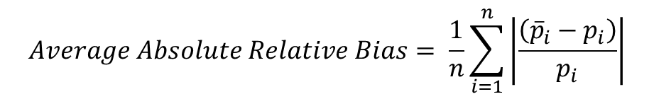
Selection Effects: Bias
$$Average Absolute Relative Bias= \frac{1}{n}\sum_{i=1}^{n}{\left|\frac{\left({\overline{p}}_{i}−p_{i}\right)}{p_{i}}\right|}$$
SSA 2018 | SSA 2023 |  | SSA 2024
CAPI 1,197 | CAWI n=909 | MM 1,146 | CAWI 1,270 | MM 1,546
0.082 | 0.293 | 0.258 | 0.261 | 0.192
Sources: SSA 2018, SSA 2023, SSA 2024; unweighted data
Notes: Calculated for Sex, Age, Education

Slide 17
4) Results: Measurement Effects on Response distribution

Slide 18
Short Reminder:
Mode
(Non-)
Response Pattern
Measurement Effect
Selection Effect
Respondent Characteristics

Slide 19
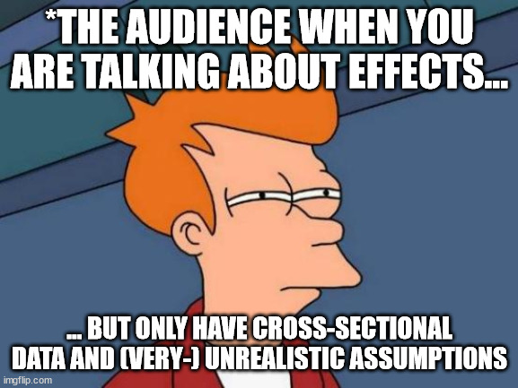

Slide 20
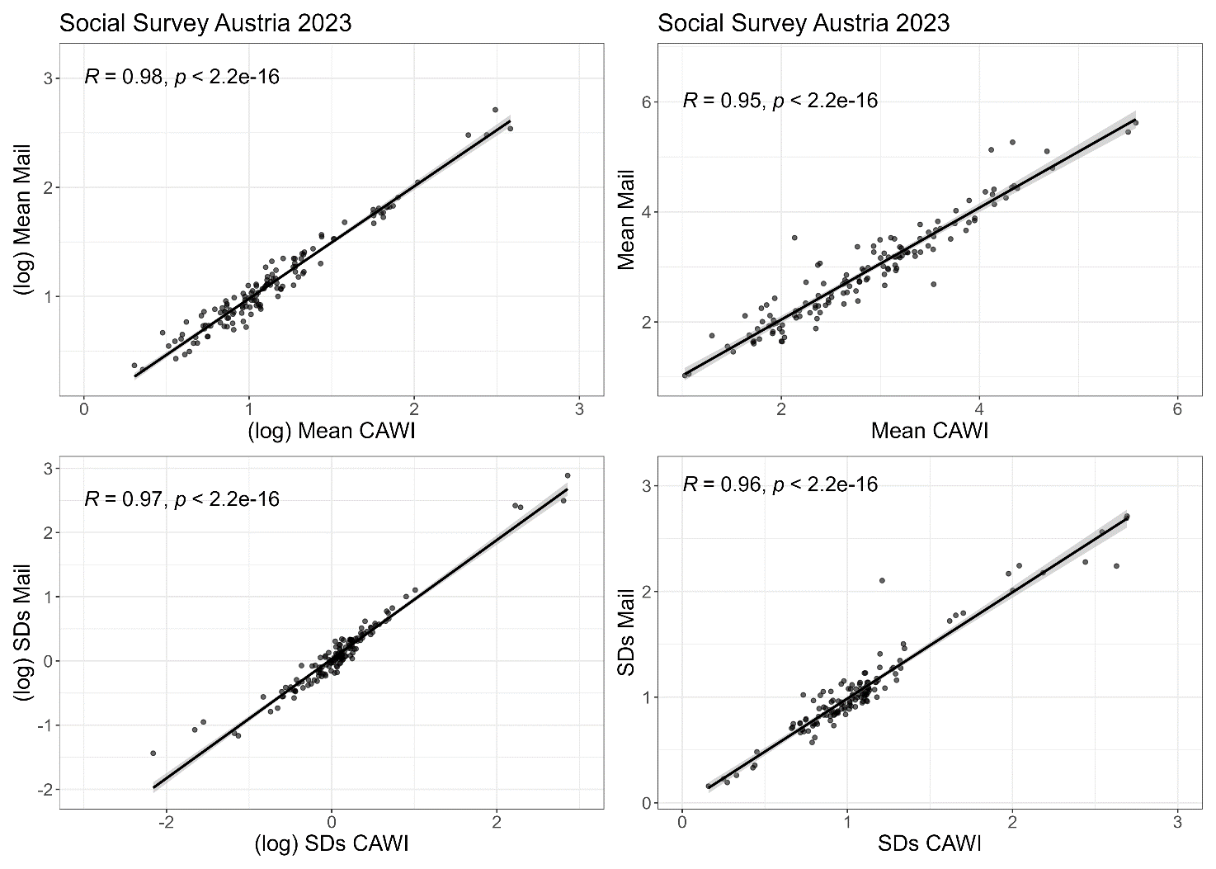
Mode Differences: Total

Slide 21
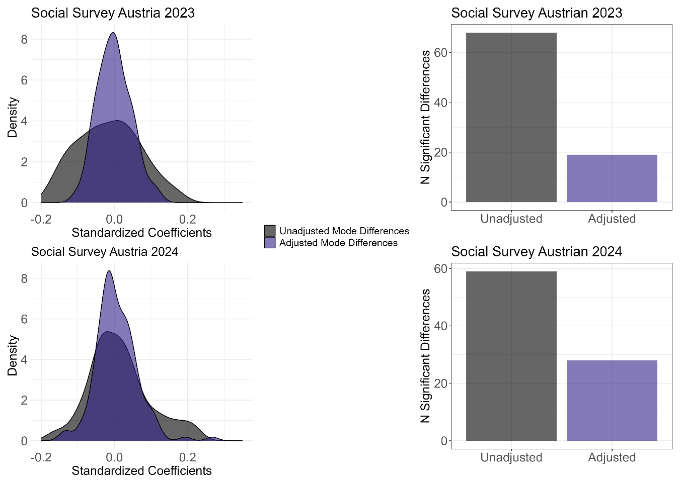
Mode Differences: Covariate Adjusted
Note: 137 Regressions in 2023; 138 Regressions in 2024; Adjusted for gender, education, age, party preference, residence, Internet use, Work-Status, Religious affiliation

Slide 22
Mode Differences = Mode Effects (?)
Significant differences between CAWI and Mail are systematic
SSA 2023: Mail sample has more conservative gender role images, stronger nationalistic attitudes, higher concerns, more critical towards the government, positions itself lower in the social strata of society.
SSA 2024: Mail sample is less digitally literate, has less access to and uses the internet less frequently, higher concerns, more politically right-wing orientated respondents

Slide 23
Mode Differences = Mode Effects (?)
Potential explanations
Measurement differences are actually selection effects
Omitted variable bias
(Partially) “true" mode effects
…

Slide 24
5) Results: Measurement Effects on Item non-Response

Slide 25
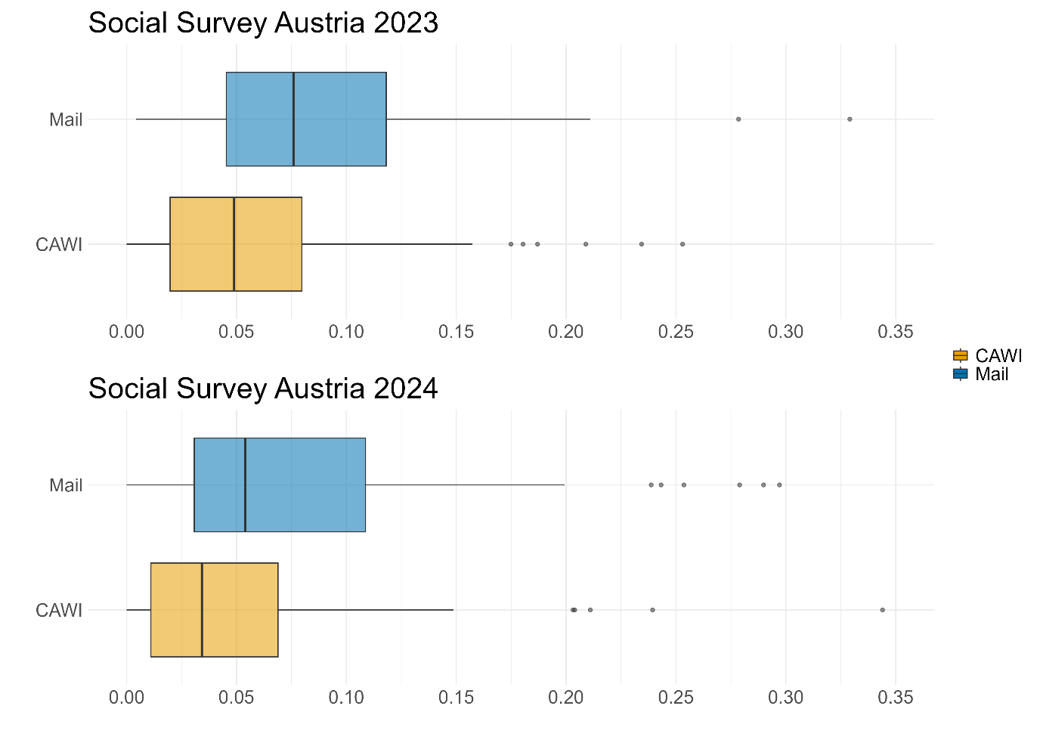
Mode Differences: Item Non-Response

Slide 26
Mode Differences: Item Non-Response
 | SSA 2023 |  | SSA 2024
 | Mail | CAWI | Mail | CAWI
Mean | 8.7 | 5.8 | 8.5 | 5.1
Cohen‘s d | -0.54*** [-0.78; -0.29] |  | -0.47*** [-0.70; -0.24]

Slide 27
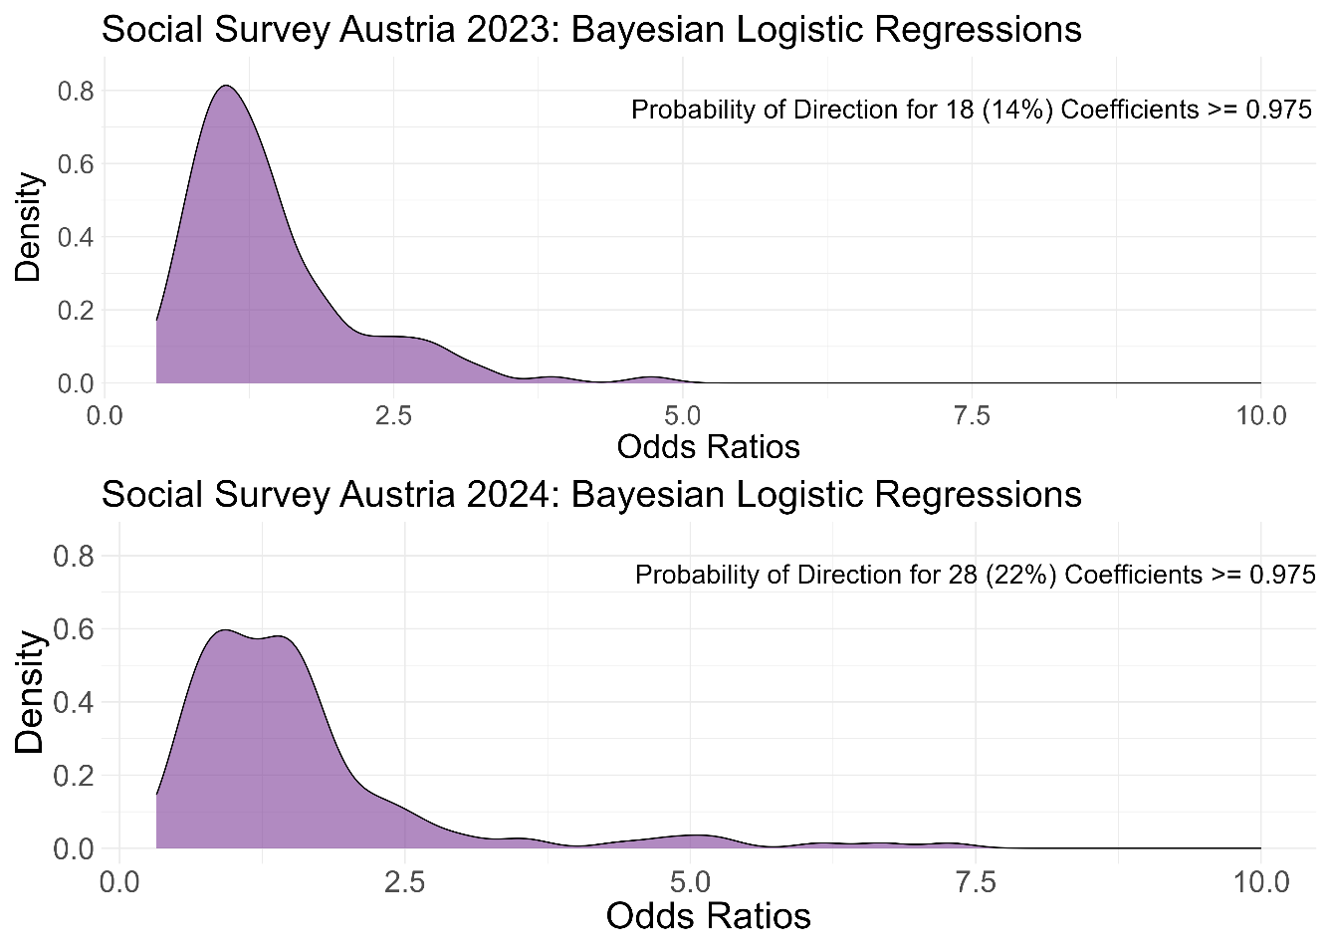
Mode Differences: Item Non-Response
Note: Adjusted for gender, education, age, party preference, residence, Internet use, Work-Status, Religious affiliation

Slide 28
Wrap up: Design
Transitioned from sampling households to sampling individuals due to inconsistencies from the 'last birthday' selection method.
15 Euro incentive (5 unconditional, 10 Euro conditional) worked well.
Sampling: – maybe change to stratified random sample and over-sampling lower of educated individuals
Sequential design: room for improvement → maybe maybe switch to tailored design (Asomov & Blom, 2024).
Only CAWI in the future? Yes, in the mid and long term (but not now: despite high Internet coverage rate still ~ 8% indicating themselves as non-Internet users; strong educational bias).

Slide 29
Wrap up: Design
Good representation for gender and age → CAWI promising for young demographic.
Bad Representation for education, biased towards highly educated.
Notably, the inclusion of mail as a secondary mode has positively improved sample composition by engaging older individuals and those with lower education levels.

Slide 30
Wrap up: Mode Differences/Effects
Minor differences in response distributions after adjusting for sample compositions
Item-nonresponse rates varied strongly, with mail responses being particularly problematic.
Covariate based adjustment of MM-Effects not optimal in cross-sectional settings; other options like “front-door models” (Vannieuwenhuyze et al., 2014; Cernat, 2015) promising

Slide 31
Code and Data Availability
https://github.com/Matpen92/Penker_Gesis_SurveyMethods_2024_SSA_mixedMode_replication.git
https://aussda.at/sozialer-survey-oesterreich/

Slide 32
Thank you for your attention!
Contact details:
Matthias Penker matthias.penker@uni-graz.at

Slide 33
Appendix

Slide 34
Measurement Effects
Homogenous
Heterogenous
M
Y
M
Y
X
X
M = Mode
X = Characteristics of Respondent
Y = (non-) response pattern
Liedl & Steiber (2024)
Notes:
The idea of heterogeneity in measurement effects was introduced some time ago (see, e.g. Wright et al. 1998) and has recently been investigated under this label by Liedl and Steiber (2024).

Slide 35
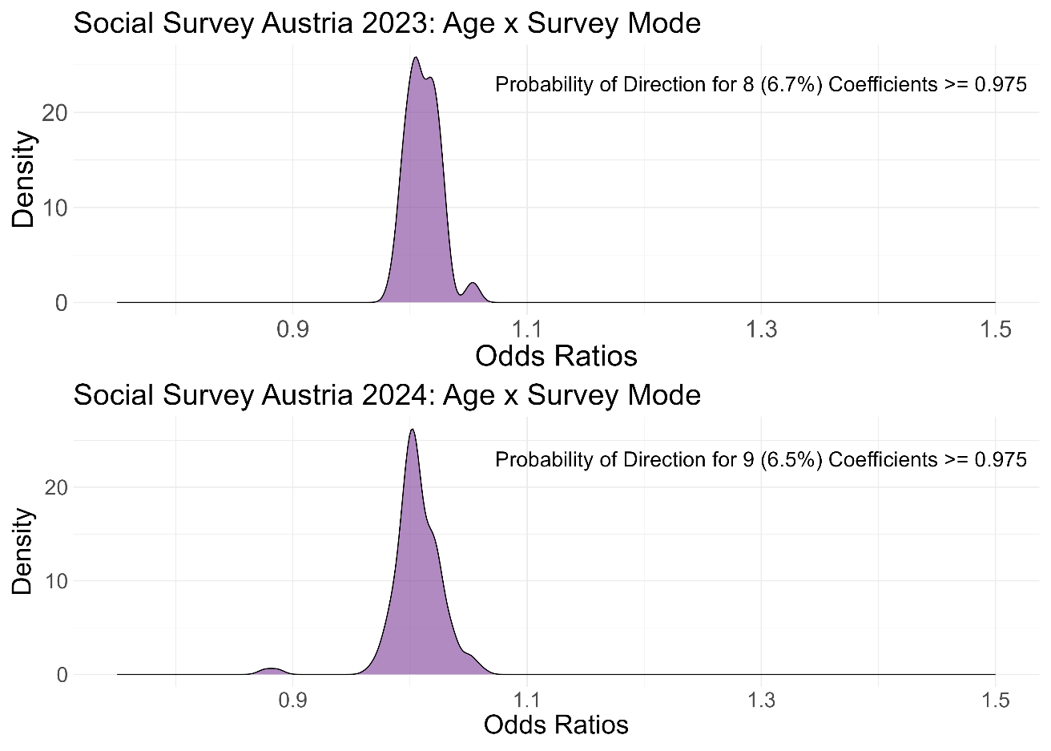
Mode Differences: Item Non-Response
Note: Adjusted for gender, education, age, party preference, residence, Internet use, Work-Status, Religious affiliation

Slide 36
Literature (selection)
Blom, A. G., Bosnjak, M., Cornilleau, A., Cousteaux, A.‑S., Das, M., Douhou, S., & Krieger, U. (2016). A Comparison of Four Probability-Based Online and Mixed-Mode Panels in Europe. Social Science Computer Review, 34(1), 8–25. https://doi.org/10.1177/0894439315574825
Bosnjak, M. (2017). Mixed-Mode Surveys and Data Quality. Meta-Analytic Evidence and Avenues for Future Research. In Eifler, S., & Faulbaum, F. (Ed.), Methodische Probleme von Mixed-Mode-Ansätzen in der Umfrageforschung. (pp. 11–27). Springer Fachmedien Wiesbaden.
Carpenter, B., Gelman, A., Hoffman, M. D., Lee, D., Goodrich, B., Betancourt, M., Brubaker, M. A., Guo, J., Li, P., & Riddell, A. (2017). Stan: A Probabilistic Programming Language. Journal of Statistical Software, 76. https://doi.org/10.18637/jss.v076.i01
Cernat, A. (2015). Using equivalence testing to disentangle selection and measurement in mixed modes surveys. Understanding Society Working Paper Series, (2015-01), 113.
Cornesse, C., & Bosnjak, M. (2018). Is there an association between survey characteristics and representativeness? A meta-analysis. Advance online publication. https://doi.org/10.18148/srm/2018.v12i1.7205 (1-13 Pages / Survey Research Methods, Vol 12, No 1 (2018)).
de Leeuw (2018). Mixed-Mode: Past, Present, and Future. Advance online publication. https://doi.org/10.18148/srm/2018.v12i2.7402 (75-89 Pages / Survey Research Methods, Vol 12, No 2 (2018)).
de Leeuw, E. & de Heer, W. (2002). Trends in household survey nonresponse: a longitudinal and international comparison. In Groves, D. Dillman, J. Eltinge, & R. Little (Ed.), Survey nonresponse (pp. 41–54). Wiley.
de Leeuw, E., Dillman, D., & Hox, J. (2008). Mixed mode surveys: when and why. In de Leeuw, E., Dillman, D., & Hox, J. (Ed.), International handbook of survey methodology (pp. 299–316). Taylor and Francis.
de Leuuw (2005). To mix or not to mix data collection modes in surveys. Journal of Official Statistics, 21(2), 235–255.
de Leeuw, E., Suzer-Gurtekin, Z., & Hox, J. [2018). The design and implementation of mixed mode surveys. In Advances in comparative survey methodology [chap. 18). Hoboken, NJ: Wiley & Sons.

Slide 37
Dillman, D. A. (2017). The promise and challenge of pushing respondents to the web in mixed-mode surveys. Survey Methodology, 43(1), 3–30.
Eifler, S., & Faulbaum, F. (2017). Methodische Probleme von Mixed-Mode-Ansätzen in der Umfrageforschung. Springer Fachmedien Wiesbaden. https://doi.org/10.1007/978-3-658-15834-7
Garnier-Villarreal, M., & Jorgensen, T. D. (2020). Adapting fit indices for Bayesian structural equation modeling: Comparison to maximum likelihood. Psychological Methods, 25(1), 46–70. https://doi.org/10.1037/met0000224
Goodrich, B., Gabry, J [J.], Ali, I., & Brilleman, S. (2022). rstanarm: Bayesian applied regression modeling via Stan.: R package version 2.21.3. https://mc-stan.org/rstanarm/
Hadler, M., Höllinger, F., Eder, A., Aschauer, W., Bacher, J., & Prandner, D. (2022). Social Survey Austria 2021 (SUF edition). https://doi.org/10.11587/S9D7HG
Hox, J., de Leuuw, & Klausch, T. (2017). Mixed-Mode Research: Issues in Design and Analysis. In P. P. Biemer, E. de Leeuw, S. Eckman, B. Edwards, F. Kreuter, L. E. Lyberg, N. C. Tucker, & B. T. West (Eds.), Total Survey Error in Practice (pp. 511–530). John Wiley & Sons, Inc.
Hox, J. J., Leeuw, E. D. de, & Zijlmans, E. A. O. (2015). Measurement equivalence in mixed mode surveys. Frontiers in Psychology, 6, 87. https://doi.org/10.3389/fpsyg.2015.00087
Klösch, B., Wardana, R., & Hadler, M. (2021). Impact of the COVID-19 pandemic on the willingness to sacrifice for the environment: The Austrian case. OZS, Osterreichische Zeitschrift Fur Soziologie, 46(4), 457–469. https://doi.org/10.1007/s11614-021-00464-x
Kruschke, J. K. (2015). Doing Bayesian data analysis: A tutorial with R, JAGS, and Stan (2nd edition). Academic Press. https://ebookcentral.proquest.com/lib/kxp/detail.action?docID=5754481
Leitgöb, H. (2017). Ein Verfahren zur Dekomposition von Mode-Effekten in eine mess- und eine repräsentationsbezogene Komponente. In S. Eifler & F. Faulbaum (Eds.), Leitgöb, H. (2017). Ein Verfahren zur Dekomposition von Mode-Effekten in eine mess-und eine repräsentationsbezogene Komponente. Methodische Probleme von Mixed-Mode-Ansätzen in der Umfrageforschung (pp. 51–95). Springer VS.
Lemoine, N. P. (2019). Moving beyond noninformative priors: why and how to choose weakly informative priors in Bayesian analyses. Oikos, 128(7), 912–928. https://doi.org/10.1111/oik.05985
Lynn, P. (2020). Evaluating push-to-web methodology for mixed-mode surveys using address-based samples. Advance online publication. https://doi.org/10.18148/srm/2020.v14i1.7591 (19-30 Pages / Survey Research Methods, Vol 14 No 1 (2020).

Slide 38
Liedl, B. & Steiber, N. (2024). Führen Online-Befragungen zu anderen Ergebnissen als persönliche Interviews? Eine Schätzung von Moduseffekten am Beispiel eines Mixed-Mode Surveys, Österreichische Zeitschrift für Soziologie, 49, 1-22.
Tourangeau, R. (2017). Mixing Modes. In P. P. Biemer, E. de Leeuw, S. Eckman, B. Edwards, F. Kreuter, L. E. Lyberg, N. C. Tucker, & B. T. West (Eds.),
Total Survey Error in Practice (pp. 115–132). John Wiley & Sons, Inc. https://doi.org/10.1002/9781119041702.ch6
van de Schoot, R., Lugtig, P., & Hox, J. (2012). A checklist for testing measurement invariance. European Journal of Developmental Psychology, 9(4), 486–492. https://doi.org/10.1080/17405629.2012.686740
Vandenberg, R. J., & Lance, C. E. (2000). A Review and Synthesis of the Measurement Invariance Literature: Suggestions, Practices, and Recommendations for Organizational Research. Organizational Research Methods, 3(1), 4–70. https://doi.org/10.1177/109442810031002
Vannieuwenhuyze, J., Loosveldt, G., & Molenberghs, (2010). A Method for Evaluating Mode Effects in Mixed-mode Surveys. Public Opinion Quarterly, 74(5), 1027–1045. https://doi.org/10.1093/poq/nfq059
Vannieuwenhuyze, J. (2013). On the Relative Advantage of Mixed-Mode versus Single-Mode Surveys. Advance online publication. https://doi.org/10.18148/srm/2014.v8i1.5500 (31-42 Pages / Survey Research Methods, Vol 8, No 1 (2014).
Vannieuwenhuyze, J. T., Loosveldt, G. & Molenberghs, G. (2014). Evaluating Mode Effects in Mixed-Mode Survey Data Using Covariate Adjustment Models. Journal of Official Statistics, 30(1), 1–21. https://doi.org/10.2478/jos-2014-0001
Vehovar, V., & Manfreda, K. L. [2017). Overview: online surveys. The SAGE handbook of online research methods, 143-161.
Vehtari, A., Gelman, A., & Gabry, J [Jonah] (2017). Practical Bayesian model evaluation using leave-one-out cross-validation and WAIC. Statistics and Computing, 27, 1413–1432.
Vehtari, A., Gelman, A., Simpson, D., Carpenter, B., & Bürkner, P.‑C. (2021). Rank-Normalization, Folding, and Localization: An Improved Rˆ for
Assessing Convergence of MCMC (with Discussion). Bayesian Analysis, 16(2).
Wright, Debra L., William S. Aquilino, und Andrew J. Supple. 1998. A comparison of computer-assisted and paper-and-pencil self-administered questionnaires in
a survey on smoking, alcohol, and drug use.The Public Opinion Quarterly 62:331–353

