Slide 1
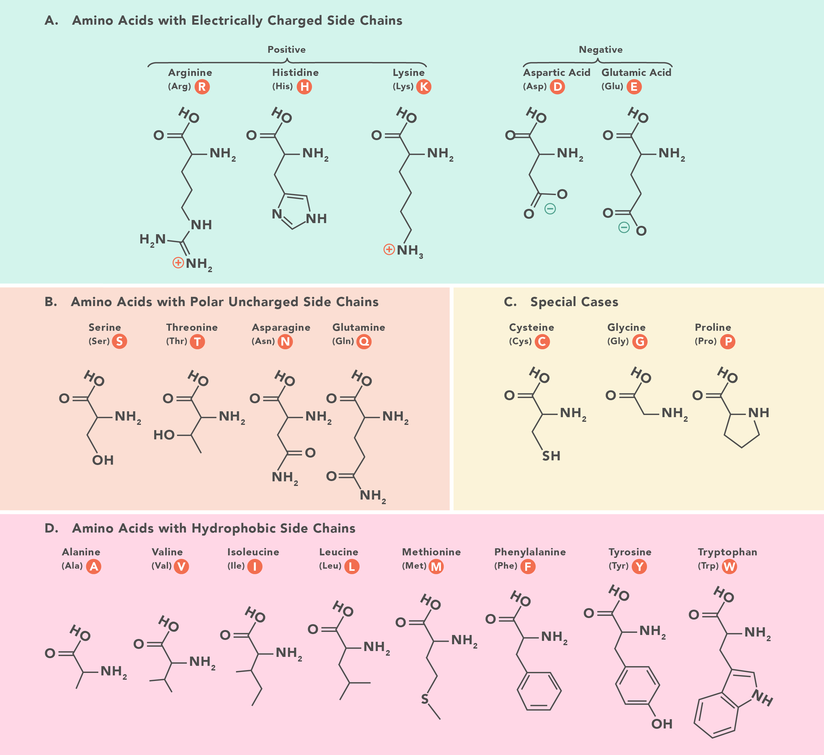
GC-balanced optimal codon
Unique codons per aa

