Slide 1
SPORTZONE
Sports Equipment & Apparel E-Commerce System
CIT6224 — Web Application Development | Group 16 (TC2L)
Hadi Abdulla (242UC243PP)
Ahmed Mahmoud Mohamed (243UC245XT)
Osman Omer Gumaa (243UC245R0)
Mohamed Tarek (242UC2435F)
Notes:
[HADI] Good day. We are Group 16 and our project is SportZone, a sports equipment and apparel e-commerce website built with HTML, CSS, JavaScript, PHP and MySQL on XAMPP. I'm Hadi and I'll start with the business concept.

Slide 2
Executive Summary
• SportZone is a Business-to-Consumer (B2C) online sports store
• Sells equipment, apparel and fitness gear across five categories
– Football, Basketball, Running, Gym, Sportswear
• Customers browse, search, wishlist, add to cart, checkout and track orders
• Admins manage products, orders, users and messages from a dashboard
• Built with HTML, CSS, JavaScript, PHP and MySQL on XAMPP
Notes:
[HADI] SportZone is a direct-to-consumer sports store. It removes the limits of a physical shop: it is open 24/7, shows real-time stock, and keeps everything in one place. Customers can browse, search and filter products, save favourites, check out and track their orders, while admins manage the whole catalogue and orders from a dashboard.

Slide 3
Problem & Target Users
• Traditional sports retail has real limitations:
– Limited stock and shelf space; fixed opening hours
– No price transparency or real-time stock visibility
• Target users: students, athletes, gym-goers, casual players, sports clubs
• Their needs: convenience, product info & reviews, quick search, order tracking
Notes:
[HADI] We looked at the gaps in traditional sports retail — limited stock, fixed hours, and no easy way to compare or check availability. Our target users are students, athletes, gym-goers and clubs who want a convenient way to find and buy gear, read reviews, and track their orders.

Slide 4
Project Objectives
• Build a fully functional B2C e-commerce platform
• Secure registration and role-based authentication (customer / admin)
• Product browsing with search, filtering and sorting
• Shopping cart, wishlist and multi-step checkout with order tracking
• Administrative tools and a fully responsive design
Notes:
[HADI] Our objectives were to build a complete, secure store with role-based logins, full product browsing, a cart, wishlist and checkout, order tracking, admin tools, and a responsive design that works on phone and desktop. I'll now hand over to Mohamed for the technical design.

Slide 5
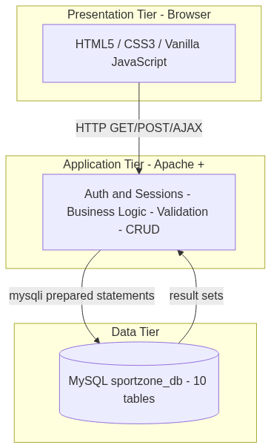
System Architecture
• Classic three-tier architecture
• Browser: HTML, CSS, JS
• Server: PHP on Apache
• Data: MySQL database
• Reusable PHP includes keep code DRY
Notes:
[MOHAMED] SportZone uses a classic three-tier architecture. The browser handles presentation with HTML, CSS and vanilla JavaScript; PHP on Apache handles the logic and validation; and MySQL stores the data. Shared PHP includes — header, footer, config, database and helper functions — keep the code consistent and easy to maintain.

Slide 6
Technology Stack & Constraints
• Front end: HTML5, custom CSS3, vanilla JavaScript
• Back end: PHP | Database: MySQL | Server: XAMPP
• Constraint met: NO UI frameworks (no Bootstrap / Tailwind)
– All CSS is hand-written; the sales chart is drawn on HTML5 canvas
• Tools: VS Code, phpMyAdmin, Git/GitHub
Notes:
[MOHAMED] The stack is HTML, hand-written CSS, vanilla JavaScript, PHP and MySQL on XAMPP. A key constraint was no UI frameworks like Bootstrap or Tailwind — so every bit of CSS is our own, and even the admin sales chart is drawn manually on an HTML5 canvas with JavaScript.

Slide 7
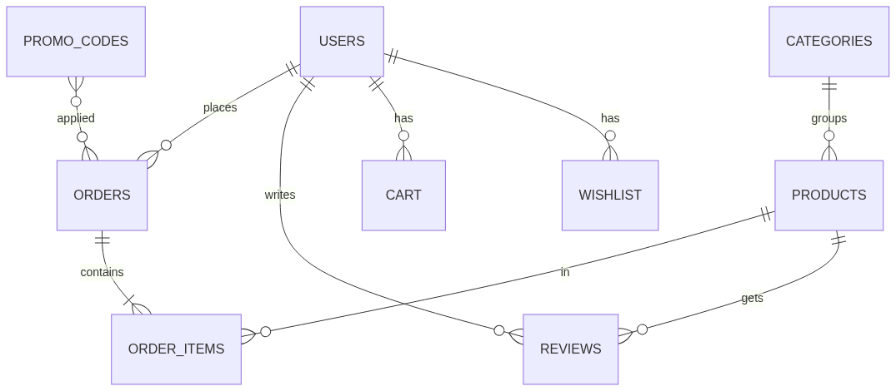
Database Design
• 10 normalised tables (3NF)
• Foreign keys + a CHECK on ratings
• Order items keep a price snapshot
• Users, products, orders, reviews,
• cart, wishlist, promo codes, messages
Notes:
[MOHAMED] The database has ten normalised tables in third normal form, with foreign keys enforcing integrity. One design decision worth noting: order items store the product name and price at purchase time, so past orders stay accurate even if a product later changes or is removed.

Slide 8
Customer Features
• Search, category / brand / price filters, sorting and pagination
• Product details with verified-purchase reviews and star ratings
• Wishlist with an AJAX heart toggle
• Persistent shopping cart
• Multi-step checkout with promo codes
• Order history, tracking and cancellation
Notes:
[AHMED] On the customer side we have full product browsing — search, filters by category, brand and price, plus sorting and pagination. Each product page has reviews that only verified buyers can leave. Customers get a wishlist, a persistent cart, a multi-step checkout with promo codes, and full order tracking. We'll show all of this in the live demo shortly.

Slide 9
Admin Features
• Dashboard: live statistics + a sales chart + low-stock alerts
• Product management — full CRUD with image upload
• Order management — update status (Pending → Delivered)
• User management and category management
• Contact messages inbox
• All admin pages are role-protected
Notes:
[AHMED] On the admin side there's a dashboard with live stats, a sales chart and low-stock alerts. Admins can create, edit and delete products with image upload, manage orders and update their status, manage users and categories, and read contact messages. Every admin page is protected so only an admin role can reach it.

Slide 10
Design Decisions
• Custom CSS — full control and meets the no-framework rule
• Mobile-first responsive layout (hamburger nav, fluid grids)
• Clean black / white / red brand theme; prices in RM
• Real-time client-side validation + server-side validation
• Reusable includes and a single money() helper for currency
Notes:
[AHMED] A few key design decisions: we wrote custom CSS for full control and to meet the no-framework rule; the layout is mobile-first and responsive; we used a clean black, white and red theme with prices in Ringgit; and we validate forms both on the client for instant feedback and again on the server for safety. Mohamed will cover how we secured it.

Slide 11
Security
• SQL injection — prepared statements on every query
• XSS — all output escaped with htmlspecialchars
• Passwords hashed with bcrypt (password_hash)
• Sessions + role checks protect every restricted page
• CSRF tokens on all state-changing forms
Notes:
[MOHAMED] Security was built in from the start. Every database query uses prepared statements to stop SQL injection, all output is escaped to prevent cross-site scripting, passwords are hashed with bcrypt, pages are protected by session and role checks, and every form that changes data carries a CSRF token. Now, over to the live demonstration.

Slide 12
Live Demonstration
A walkthrough of the SportZone system
Notes:
[DEMO PRESENTER] Switch to the browser now. Follow the demo script (see SPEAKER_NOTES.md). Keep it to about 4-5 minutes, narrating each step as you click.

Slide 13
Team Contributions
• Hadi Abdulla — Authentication & user management (login, register, profile)
• Ahmed Mahmoud Mohamed — Product catalog (home, listing, product details)
• Osman Omer Gumaa — Cart, checkout and order processing
• Mohamed Tarek — Admin dashboard, product & order management
• Each member built 3 pages and 3 features
Notes:
[OSMAN] To summarise contributions: Hadi built authentication and user management; Ahmed built the product catalog pages; I built the cart, checkout and order processing; and Mohamed built the admin panel. Each of us delivered three pages and three features.

Slide 14
Conclusion & Future Work
• Delivered a complete, secure, responsive B2C e-commerce system
• Met all core requirements + extra features (wishlist, promo codes, reviews)
• Future: online payment gateway, email notifications,
– product recommendations, sales reports with export
• Thank you — any questions?
Notes:
[OSMAN] In conclusion, we delivered a complete, secure and responsive e-commerce system that meets all the core requirements plus extras like the wishlist, promo codes and verified reviews. In future we'd add an online payment gateway, email notifications and product recommendations. Thank you for watching — we're happy to take any questions.

