Slide 1
GLM法律行业大模型挑战赛

Slide 2
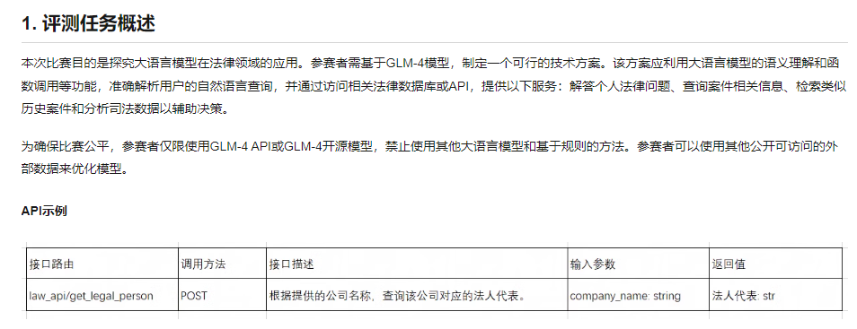

Slide 3
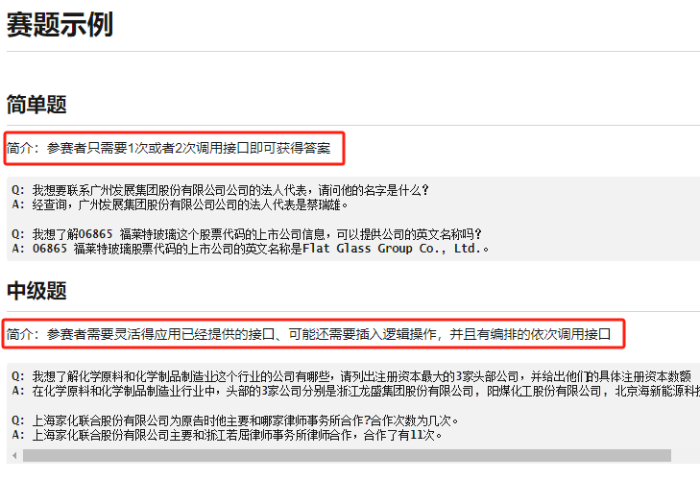

Slide 4
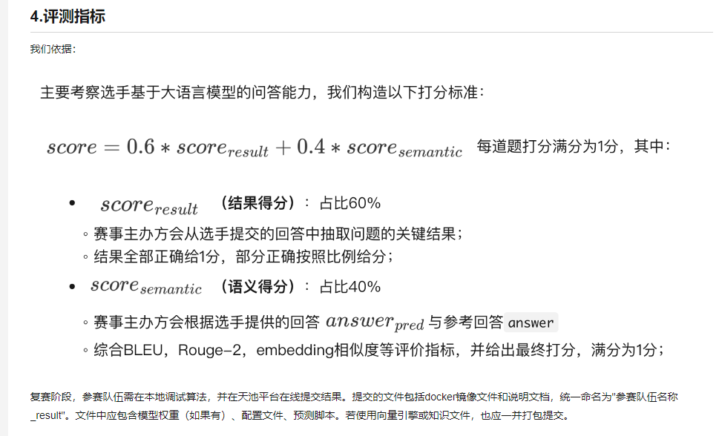

Slide 5
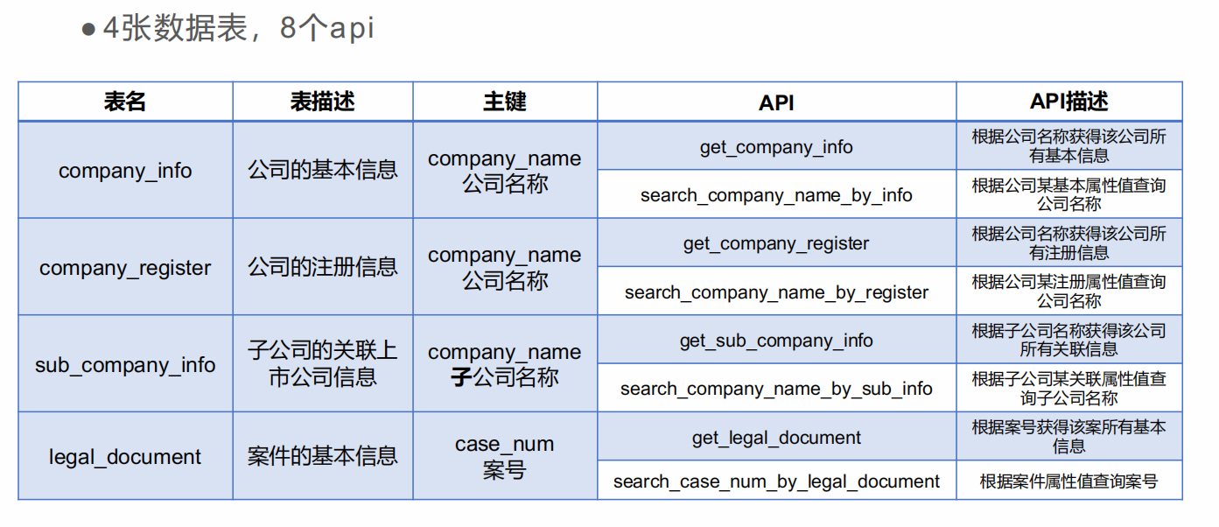

Slide 6
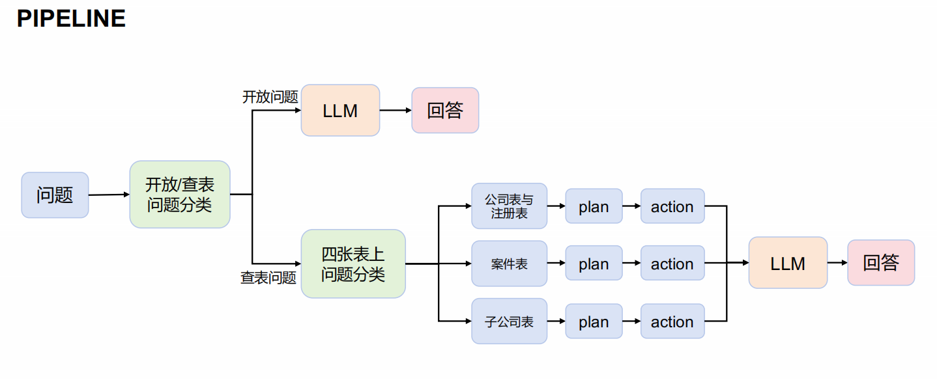

Slide 7
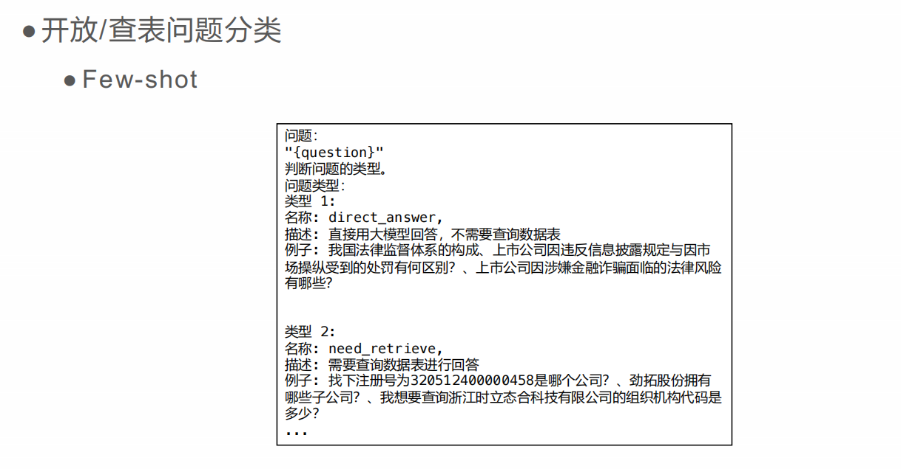

Slide 8
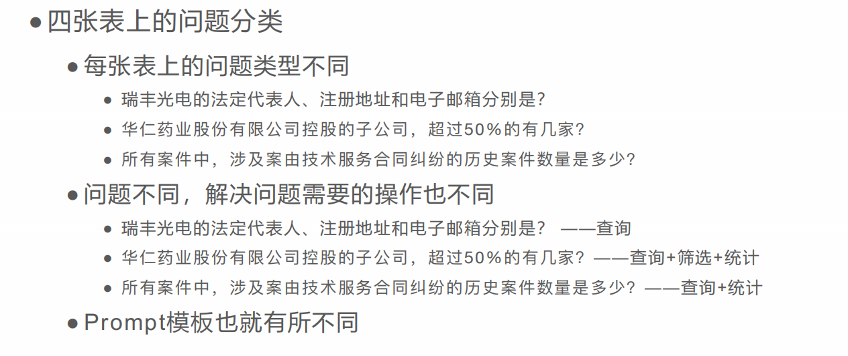

Slide 9
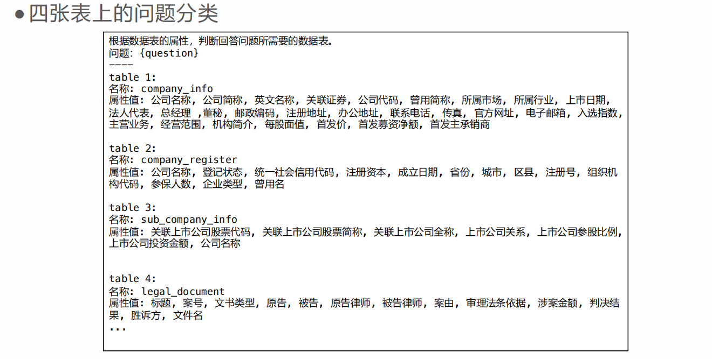

Slide 10
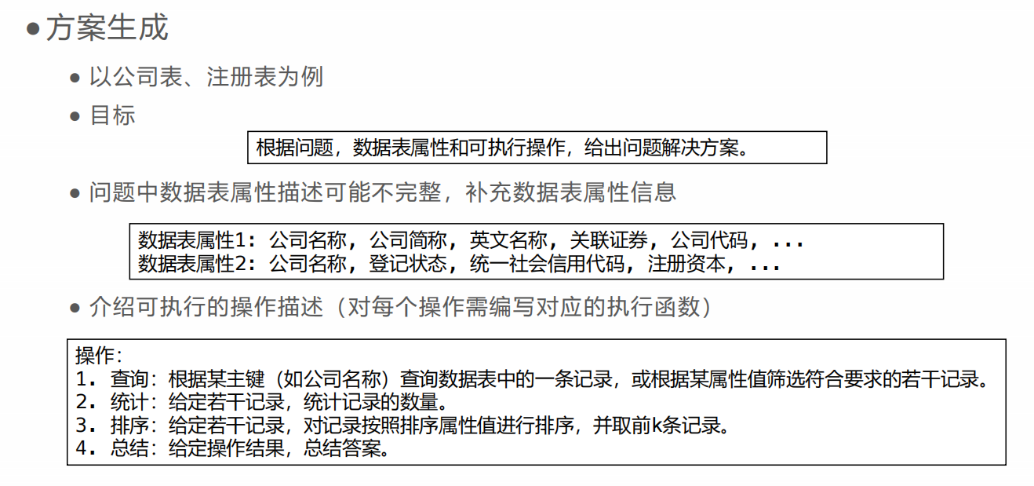

Slide 11
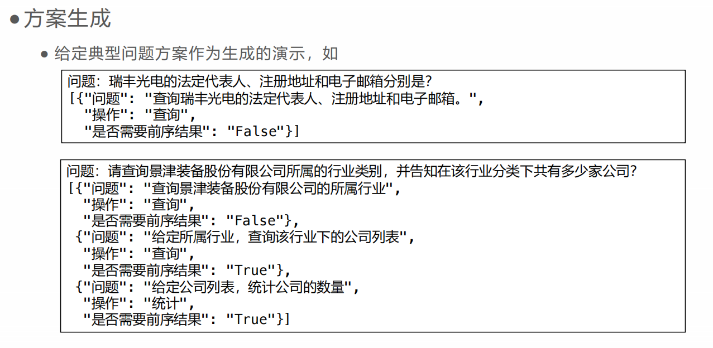

Slide 12
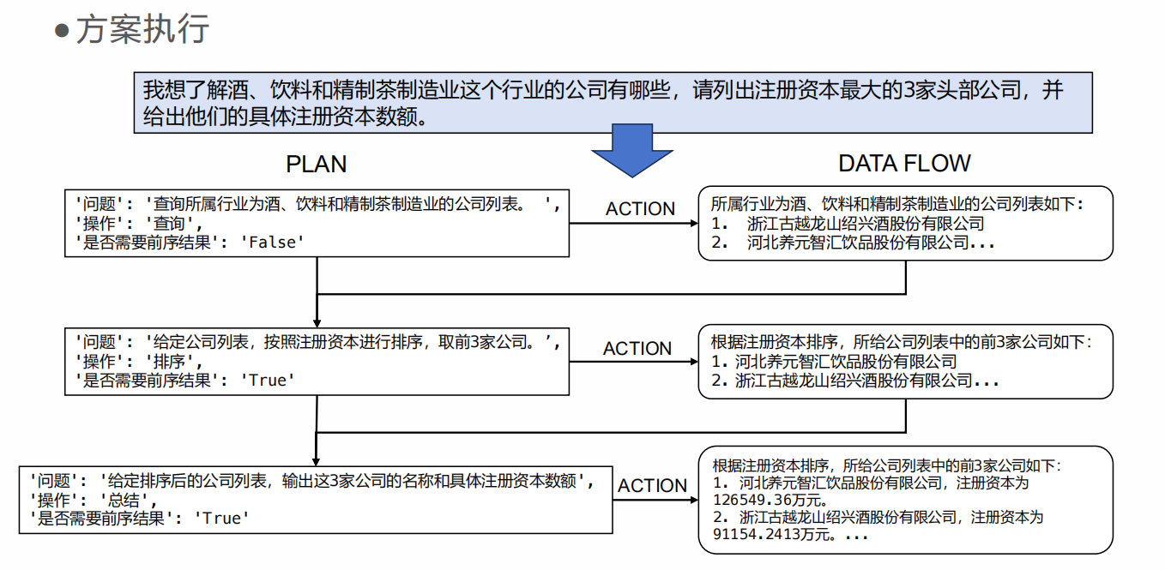

Slide 13
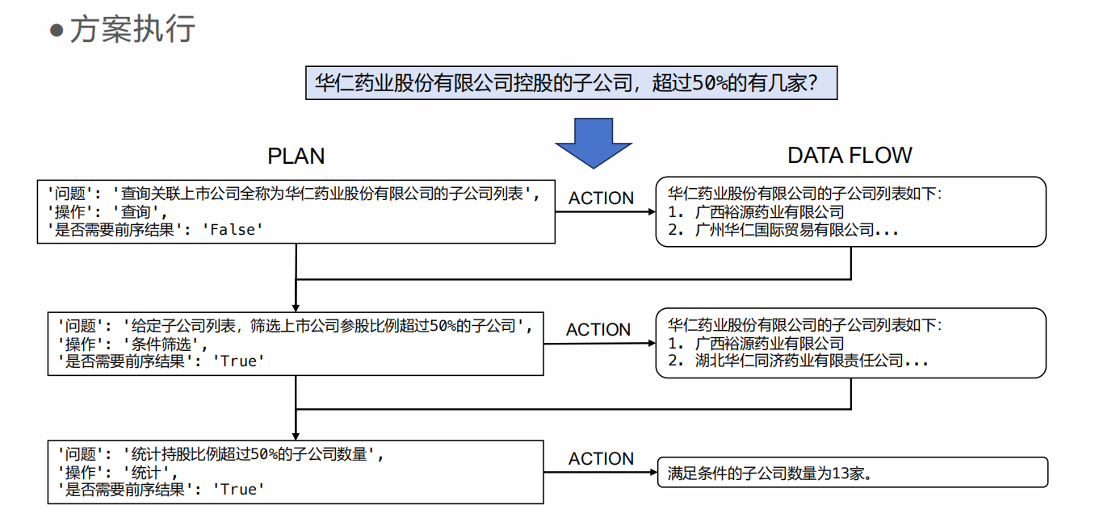

Slide 14
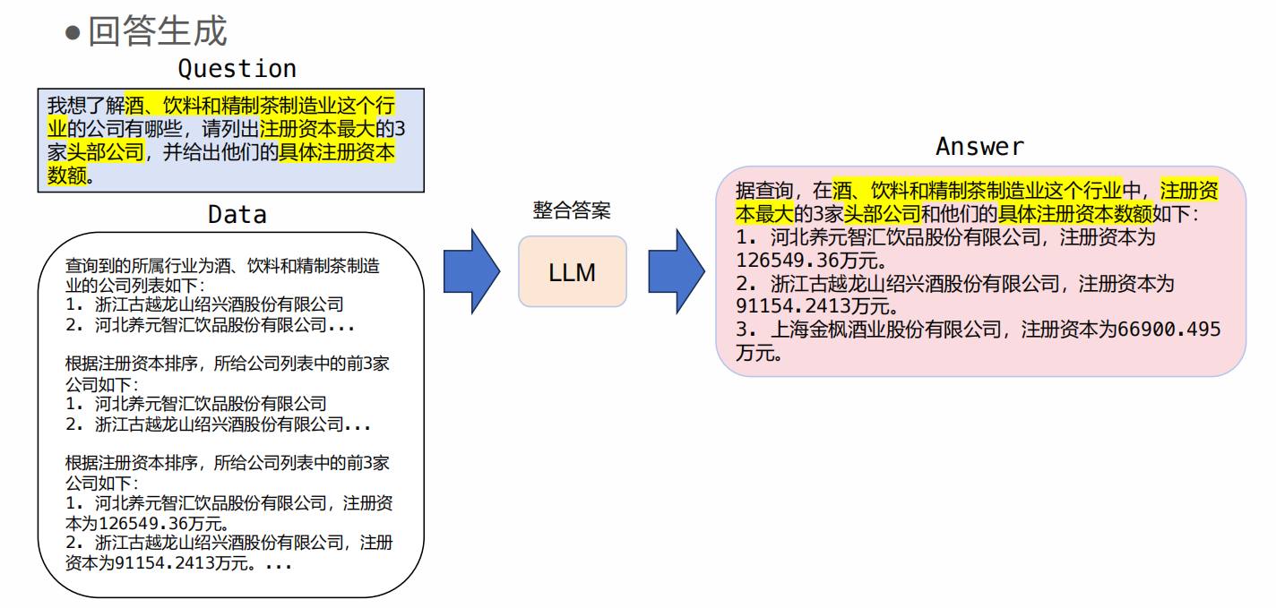

Slide 15
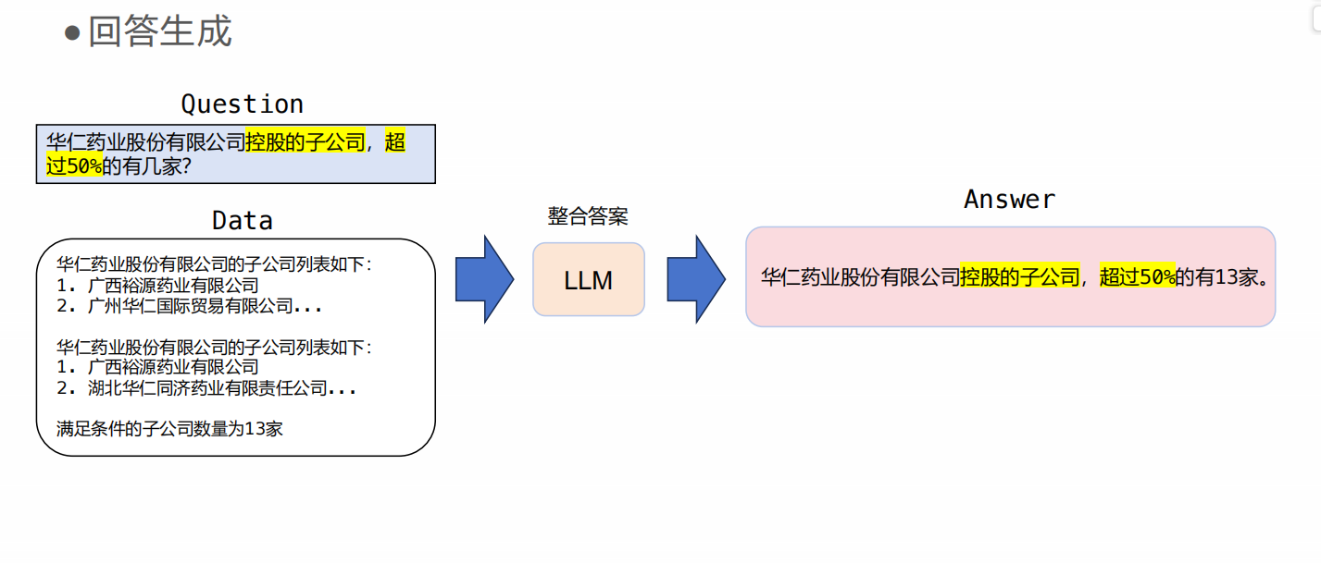

Slide 16
PPT：
- https://pan.baidu.com/s/1ybtLOj2X5PdYkWw78oHzFQ?pwd=dvqs 提取码: dvqs
代码：
- 法外张三：https://github.com/hehaha68/law_glm_baseline
- 伍柒：https://gitee.com/wu-qi-360/law_glm_baseline
回放：
- https://www.bilibili.com/video/BV1HT421a7so

Slide 17
Can Generalist Foundation Models Outcompete Special-Purpose Tuning? Case Study in Medicine
（1） Dynamic Few-shot
when available, the task training set can serve as an inexpensive, high-quality source for few-shot examples. If the training set is sufficiently large, we can select different few-shot examples for different task inputs. We refer to this approach as employing dynamic few-shot examples.

Slide 18
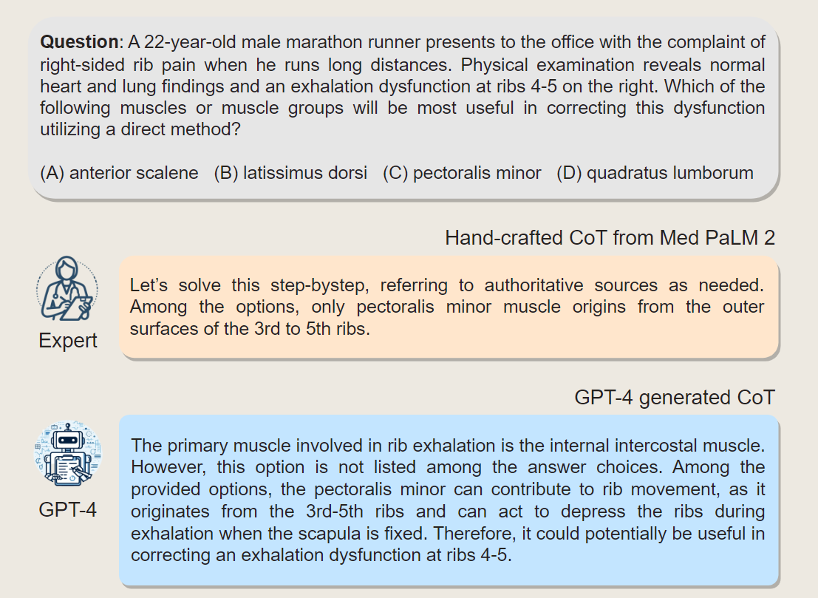
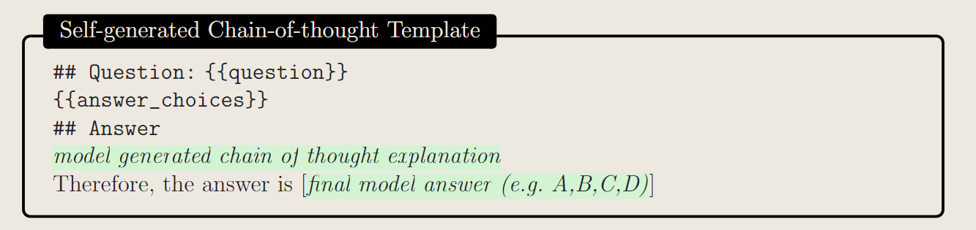
（2） Self-Generated Chain of Thought
Rather than rely on human experts, we pursued a mechanism to automate the creation of chain-of-thought examples.

Slide 19
（3） Choice Shuffling Ensemble
While less severe than other foundation models, GPT-4 can exhibit a propensity to favor certain options in multiple choice answers over others (regardless of the option content), i.e., the model can show position bias.
To reduce this bias, we propose shuffling the choices and then checking consistency of the answers for the different sort orders of the multiple choice.
we shuffle the choices some number of times and generate a CoT for each variant. We only keep the examples with the correct answer.

Slide 20
