Slide 1


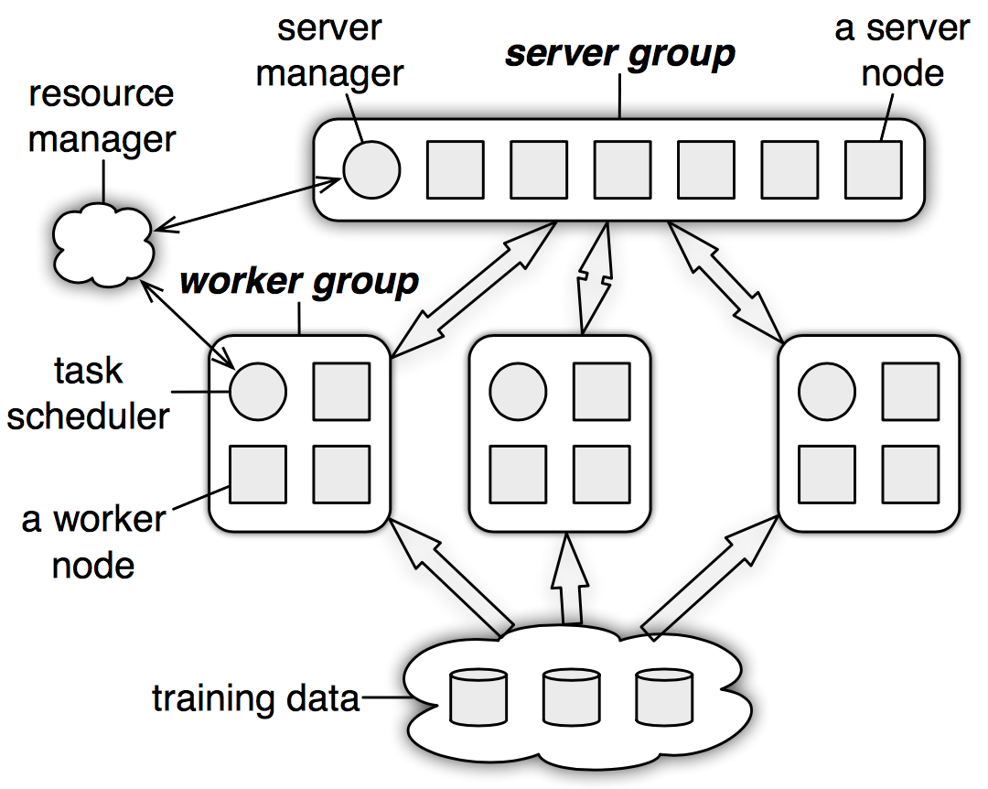
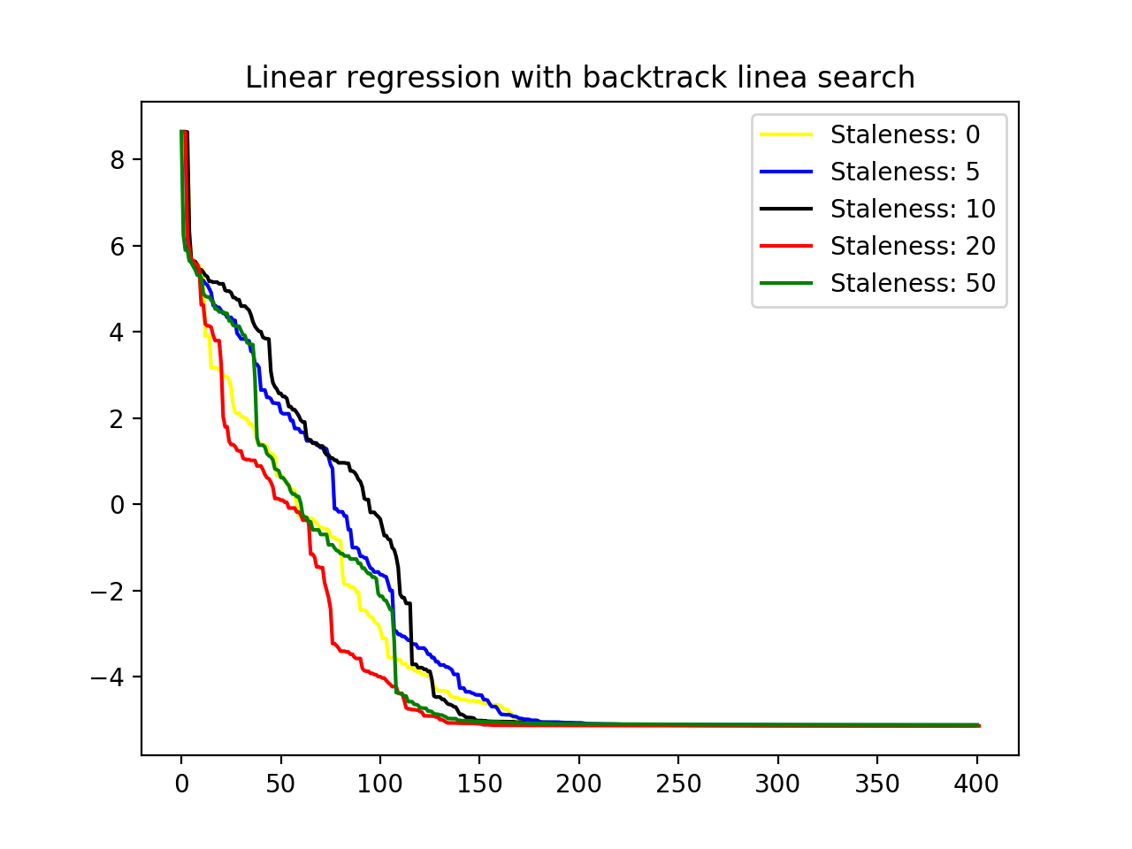
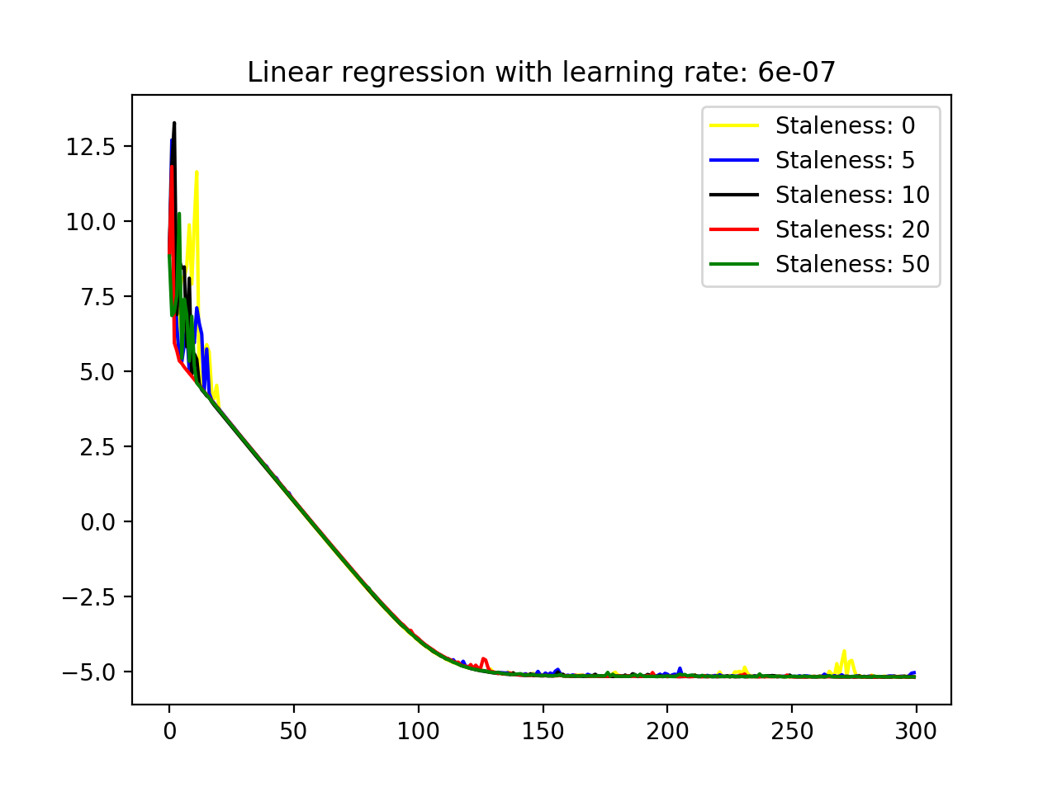
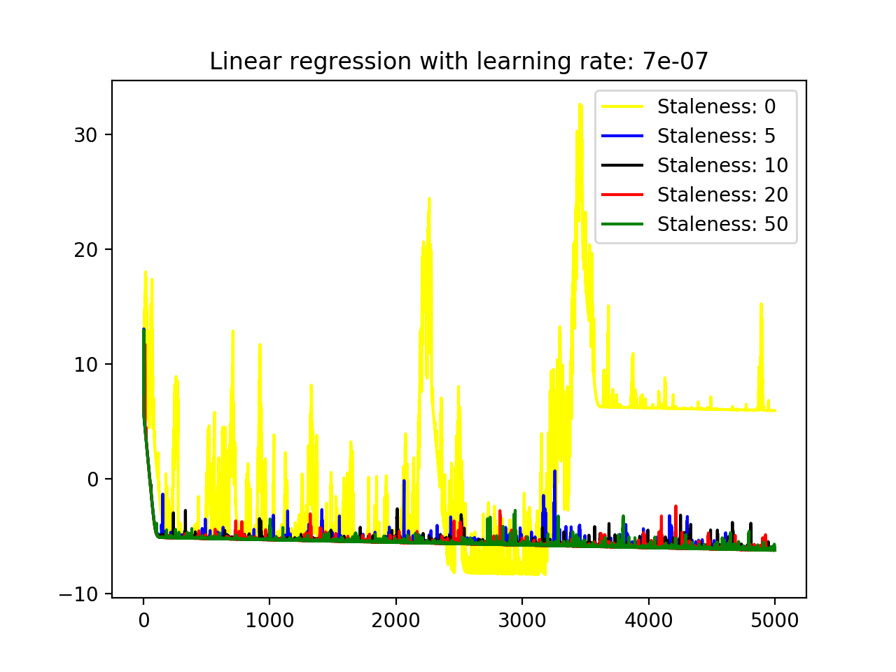
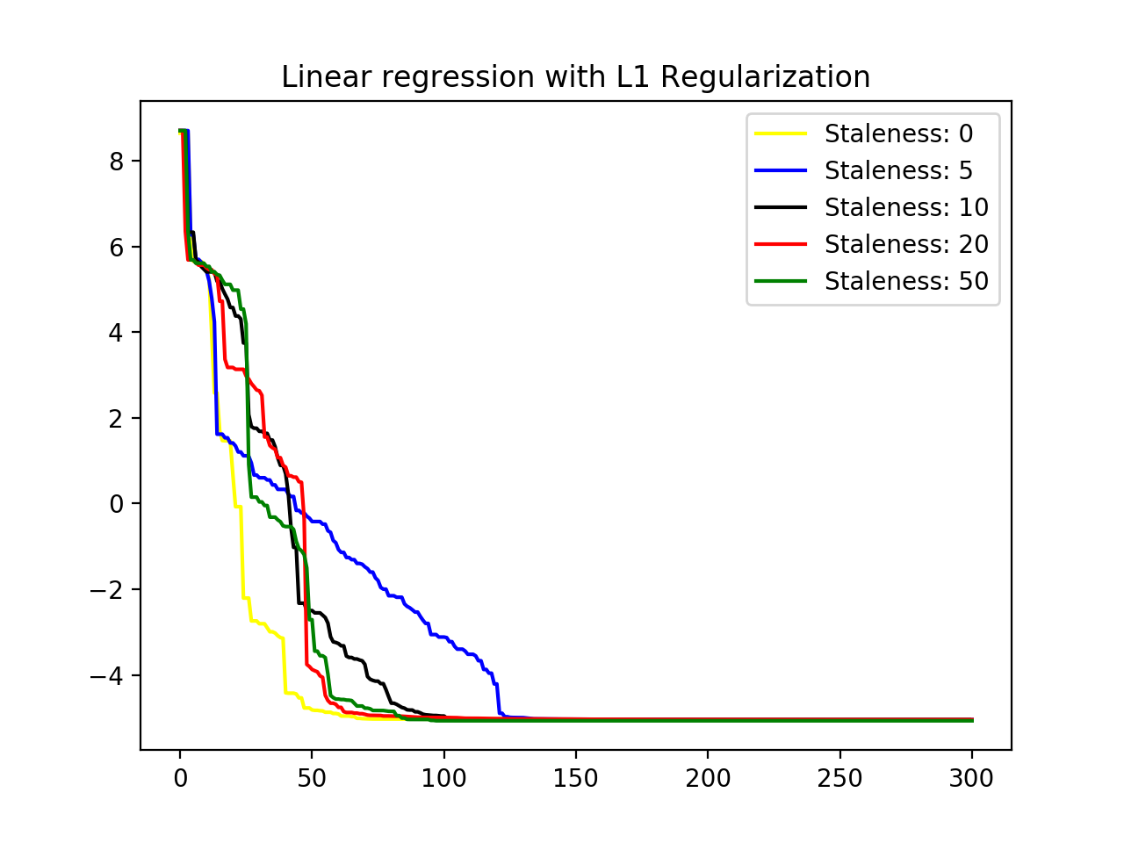
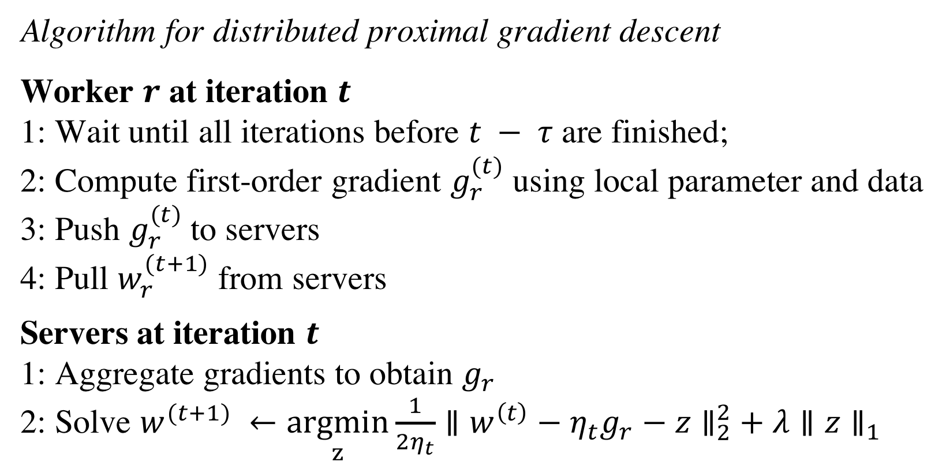
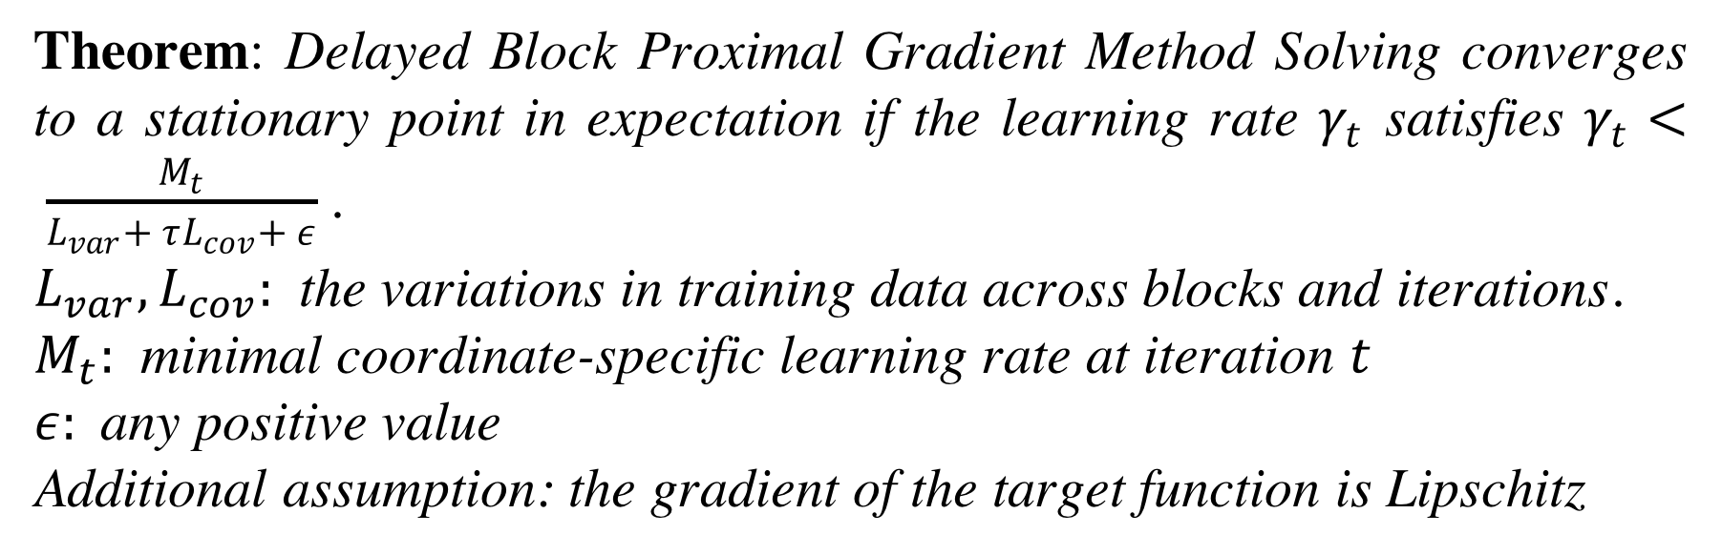
Investigating the effect of staleness in Parameter Server
Wei Cui, Zhixun Tan
Department of Computer Science, Carnegie Mellon University
Abstract
Theoretical Results
We implemented a light-version of the parameter server framework applied widely in large scale distributed machine learning. Using our implementation, we further investigated the effect of parameter staleness of different gradient-based optimization algorithms, with some common problems in machine learning, including linear regression (with and without regularization), logistic regression and SVM. Our experiment results indicate that gradient-based optimization algorithms are quite robust against staleness, as long as the learning rate is chosen properly.
Theorem: Delayed Block Proximal Gradient Method Solving converges to a stationary point in expectation if the learning rate $γ_{t}$ satisfies $γ_{t}< \frac{M_{t}}{L_{var}+ τL_{cov}+ ε}$.
$L_{var}, L_{cov}:$ the variations in training data across blocks and iterations.
$M_{t}:$ minimal coordinate-specific learning rate at iteration $t$
$ε:$any positive value
Additional assumption: the gradient of the target function is Lipschitz
Parameter Server
The above theorem has a lot of strong assumptions and is problem specific. In general we do not have a nice theorem provides guaranteed convergence for parameter-server-like computation with stale data.
Methodology
Problem selected: linear regression, linear regression with regularization, logistic regression and support vector machine.
Dataset: self-generated data for linear regression, MNIST for logistic regression, dataset from convex optimization course for SVM.
Reference solution: implemented single threaded version of (proximal) gradient descent to find the optimal solution.
Investigating effect of staleness:
Method 1: We implemented a lite-version of parameter server and run our code with it.
Method 2: Simulation. We observe that on the server side, every event is processed sequentially and those events are push/pull requests from workers. We write a sequence generator that obeys the staleness requirement and write programs to process those requests as per problem.
Both method produce similar results.
Architecture of parameter server.
Parameter Server is a powerful framework for solving engineering challenges common in large scale machine learning and optimization problems, such as efficient communication, flexible consistency models, scalability and fault tolerance. The framework is motivated by the observation that most problems have parameters in the form of vectors/matrices/tensors, and each worker node need access only part of the parameters. Shared parameters are stored in the server group, and the schedulers assign tasks to each worker. Workers will do computation locally, mostly gradient-related calculations, and push the computation results to servers, and then pull the parameters from server to start the next iteration of computation. Server groups aggregate updates from workers and answer the pull requests from workers with the aggregated parameters. A sample usage of parameter server is listed as below.
Experiment Results
Discussion
From our experiment results, we discovered that
1. Staleness does not necessarily have an adverse affect convergence. In most cases, the algorithm converges with the same rate with or without staleness.
2. Sometimes staleness can even accelerate convergence. We suspect that staleness effectively introduce momentum similar to accelerated gradient descent.
3. Learning rate is still the most crucial hyper-parameter in iterative optimization algorithms.
Algorithm for distributed proximal gradient descent
Worker $r$ at iteration $t$
1: Wait until all iterations before $t − τ$ are finished;
2: Compute first-order gradient $g_{r}^{(t)}$ using local parameter and data
3: Push $g_{r}^{(t)}$to servers
4: Pull $w_{r}^{(t+1)}$ from servers
Servers at iteration $t$
1: Aggregate gradients to obtain $g_{r}$
2: Solve $w^{(t+1)} ←\underset{z}{argmin}{\frac{1}{2η_{t}}}∥w^{\left(t\right)}−η_{t}g_{r}{− z∥}_{2}^{2}+ λ∥z∥_{1}$
Bibliography
[1] Mu Li, Li Zhou, Zichao Yang, Aaron Li, Fei Xia, David G Andersen, and Alexander Smola. Parameter server for distributed machine learning. In Big Learning NIPS Workshop, volume 6, page 2, 2013.
[2] Mu Li, David G Andersen, Jun Woo Park, Alexander J Smola, Amr Ahmed, Vanja Josifovski, James Long, Eugene J Shekita, and Bor-Yiing Su. Scaling distributed machine learning with the parameter server. In OSDI, volume 1, page 3, 2014.

