Slide 1
Bézier Curves!
In Haskell!
Harold Cooper

Slide 2
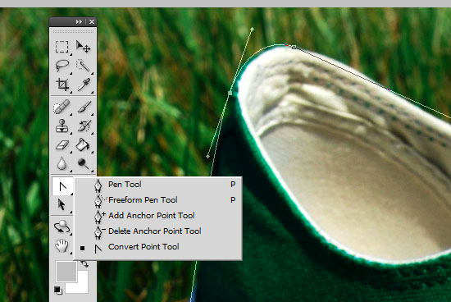

Slide 3


Slide 4
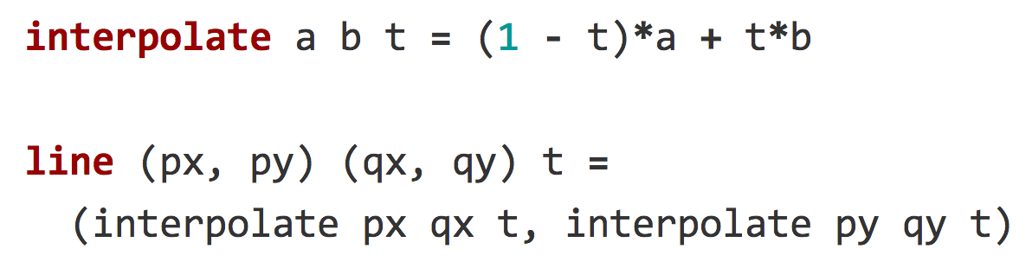
Parametric Lines

Slide 5
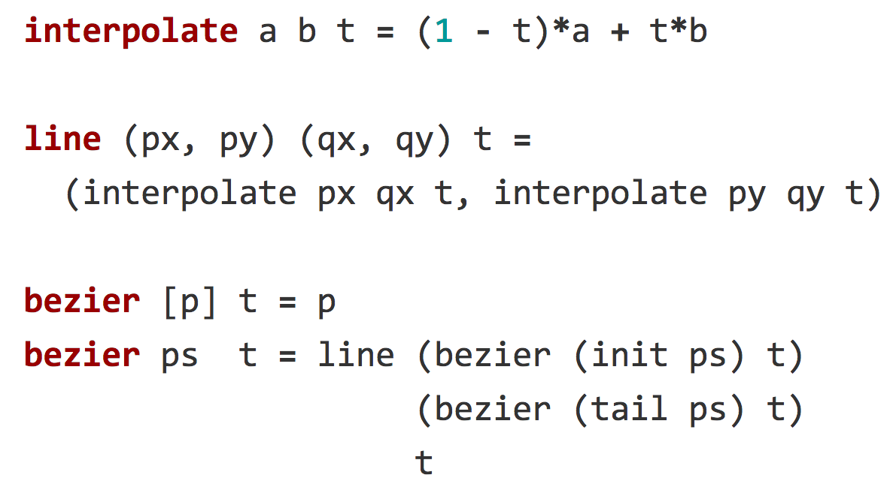

Slide 6
github.com/hrldcpr/Bezier.hs

