Slide 1
Tesk2

Slide 2
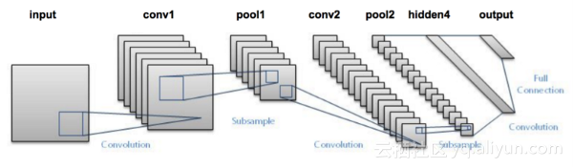
数字检测

Slide 3
model = models.Sequential()
model.add(layers.Conv2D(32, (3, 3), activation='relu', input_shape=(28, 28, 1)))
model.add(layers.MaxPooling2D((2, 2)))
model.add(layers.Conv2D(64, (3, 3), activation='relu'))
model.add(layers.MaxPooling2D((2, 2)))
model.add(layers.Flatten())
model.add(layers.Dense(64, activation='relu'))
model.add(layers.Dense(10, activation='softmax'))
model.compile(optimizer='rmsprop', loss='categorical_crossentropy', metrics=['accuracy'])
model.fit(train_images, train_labels, epochs=10 batch_size=64)

Slide 4
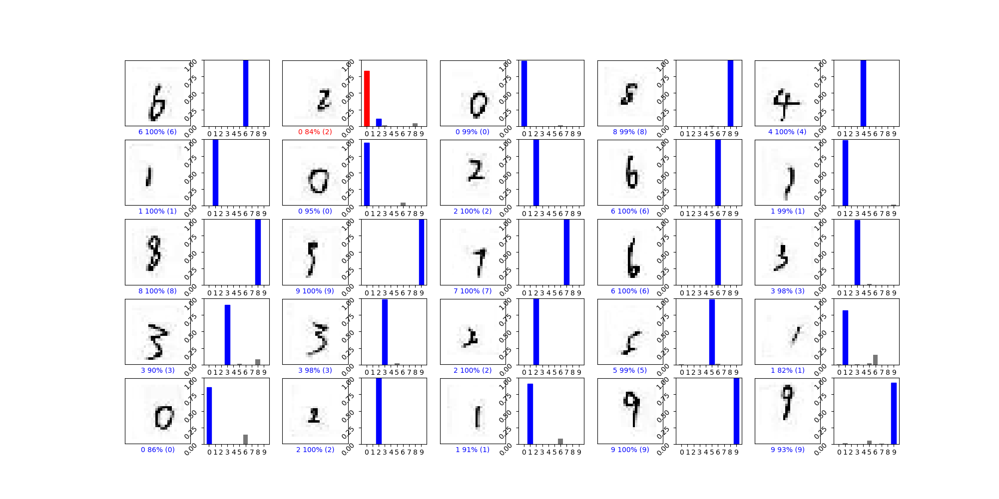

Slide 5
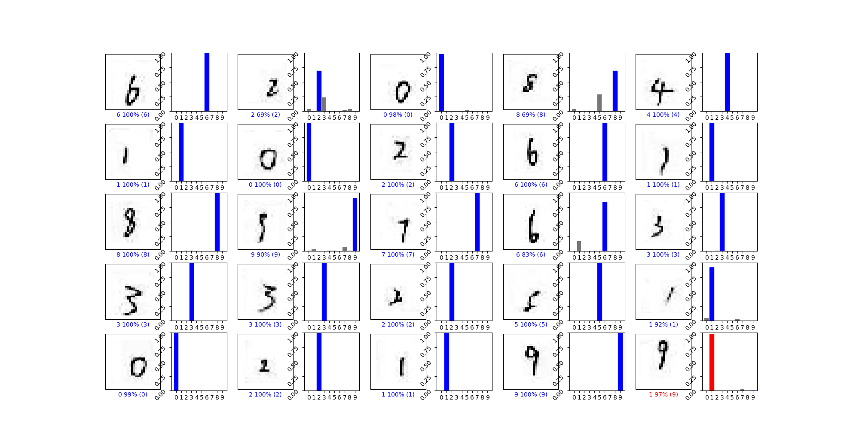

Slide 6
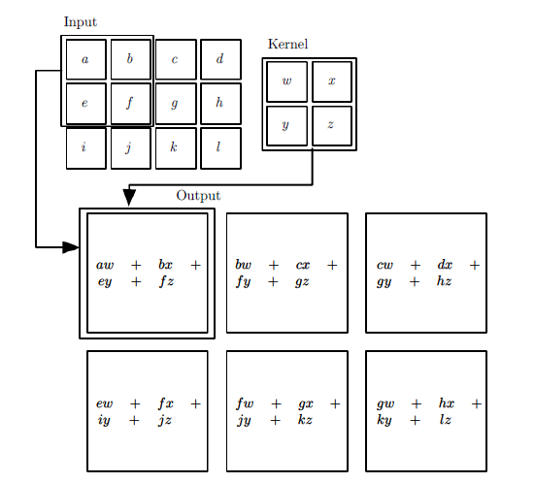
s(i,j)=(X∗W)(i,j)=∑m∑nx(i−m,j−n)w(m,n)

Slide 7
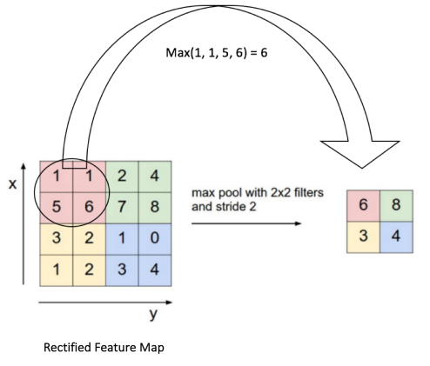

Slide 8
尝试用numpy实现CNN
做了多个数字识别的尝试
尝试实现SVM

