Slide 1
ArtViz
Tool for visualizing Artist LOD

Slide 2
Summary
Challenge
Use cases
The data set
Technologies
Functionalities
What’s next?

Slide 3
Challenge
Context: ART
Data available in multiple LOD sources: DBPedia, ULAN (Getty), WikiData
Incomplete data separately – better when aggregated
Interactive visualization for big data sets
Discovery of new data through recommendation systems
Natural language querying for unexperienced users

Slide 4
Use Cases
John, the student
Write a school essay, but has only the movement (e.g. Cubism) as a starting point
Jane, the teacher
Wants to present her art lessons in an interactive way
Mark, the businessman
While on a business trip, he wants to visit local museums and artworks

Slide 5
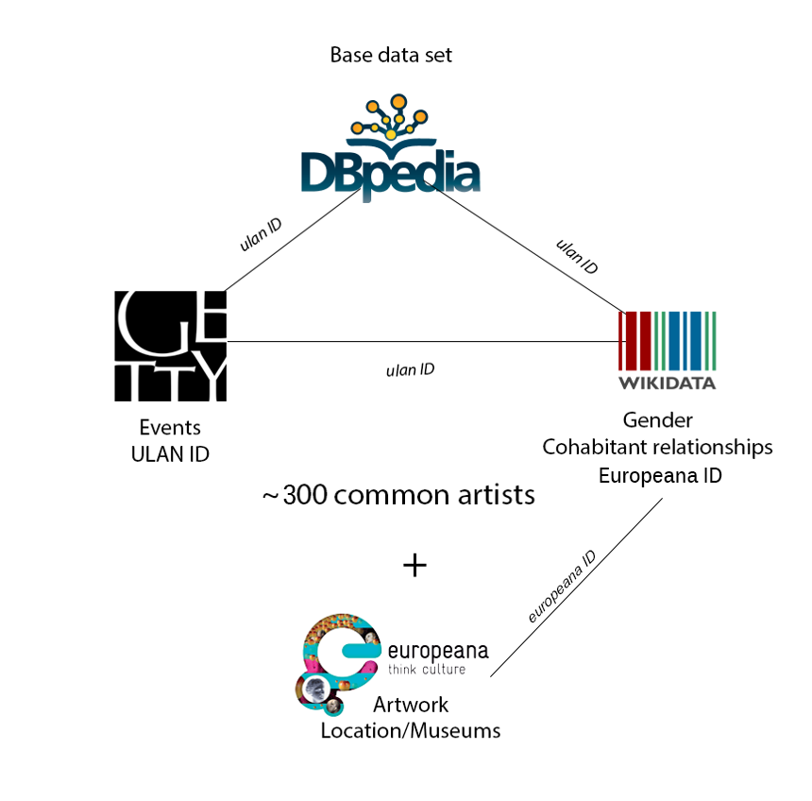
The data set
Wikipedia – NLP for relationship extraction
results not satisfying (e.g. “property Pablo Ruiz y Picasso / had acquired/ 1958 “)
Data filtration - social network analysis

Slide 6
Technologies and resources
SPARQL & SPARQL endpoints : DBPedia, Wikidata, ULAN
Stanford CoreNLP
Parsing Wikipedia text
Web Technologies : Javascript (jQuery, Bootstrap, D3, sparql.js) / HTML / CSS
Social Network Analysis: Python (networkx)
Question Answering System: Python (Quepy framework, NLTK)
Web Service: Python (Bottle)

Slide 7
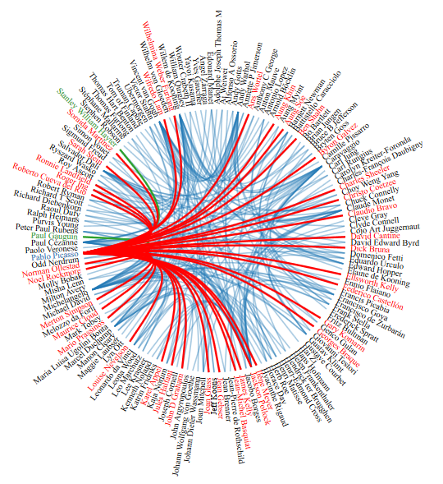
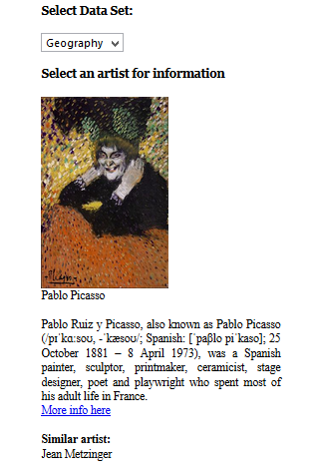
Functionalities (1)
1. Artist dependencies : geography, movement, influence
Hover:
Green - was influenced by …
Red- has influenced …
Click:
Additional information about the
Selected artist (picture, abstract, etc.)

Slide 8
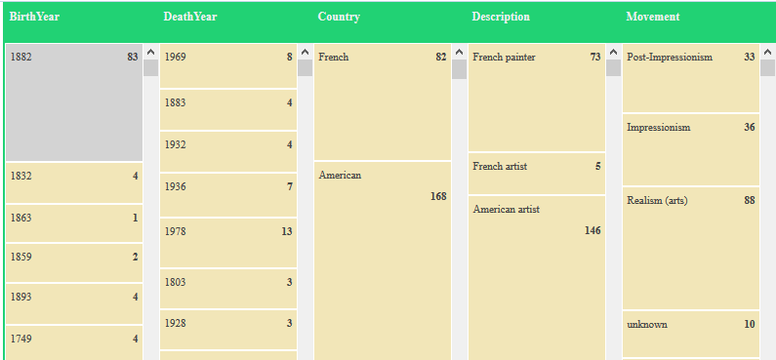
Functionalities (2)
2. Faceted browser: birth/death year, nationality, movement, field, gender, etc.
Easy to see artist distribution within specific criteria
Additional information

Slide 9
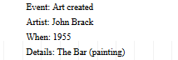
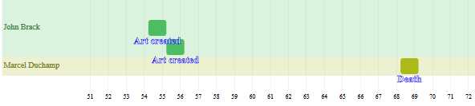
Functionalities (3)
3. Timeline view: birth/death events, artwork year creation
Easy to see artist life-events distribution within a timeline
Additional information and external links

Slide 10
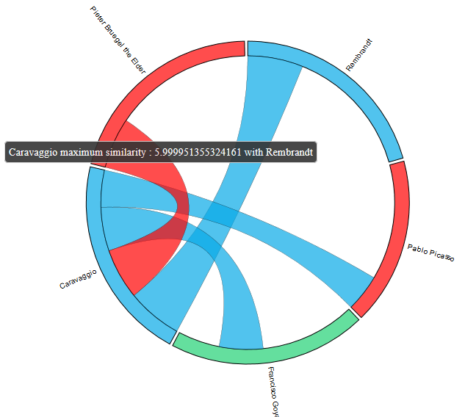
Functionalities (4)
4. Similarity Diagram: degree of similarity between two artists
Easy to see similarity index between two artists
Similarity criteria customizable (birth year, location, movement, field)

Slide 11
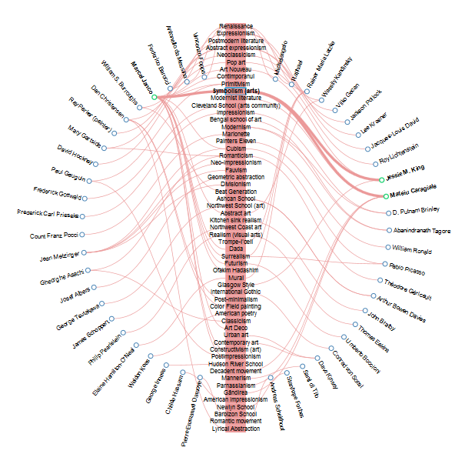
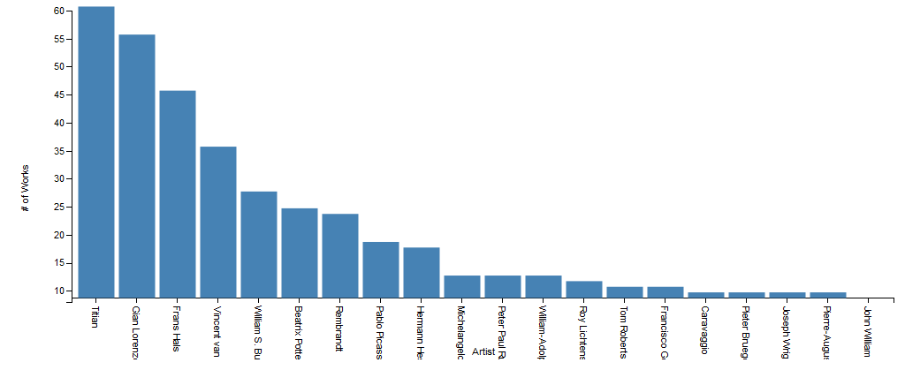
Functionalities (5)
5. Concept Map: relationship visualizer
6. Artist Bar chart: quantitative visualizer

Slide 12
What’s next?
Improve the question answering system
Better UI/UX

Slide 13
artLODviz working flow

Slide 14
Thank you!

