Slide 1
IMAGE AND VIDEO PROCESSING (IVP) — PROJECT PROPOSAL & SYNOPSIS DEFENSE
DeepGuard: An Explainable Deepfake Video Detection and Forensic Analysis Platform
A Proposed Multi-Engine Visual Forensics System: Base Paper Reproduction and Multi-Family Invariant Extensions
Project Group: IVP_Group-10_DeepGuard
Team Members: IIT2024108 | IIT2024109 | IIT2024110 | IIT2024115 | IIT2024119 | IIT2024122
Primary Research Baseline: Lal, Shiwani & Gandhi (2025), Scientific Reports | Hardware Target: NVIDIA RTX 3050 (6GB VRAM)

Slide 2
OVERVIEW
Presentation Roadmap & Agenda
1. Context & Motivation
• The Threat Landscape
• Scientific Hurdles in Video
• Project Scope & Formal Goals
2. Literature & Base Paper
• Literature Survey (18 Studies)
• Top 5 Papers Comparison
• Lal et al. (2025) Base Method
3. Proposed Architecture
• End-to-End System Pipeline
• Ingestion & MTCNN Preprocessing
• Multi-Branch Extension Design
4. Trust, Data & Timeline
• Post-Hoc Calibration & OOD
• Anti-Leakage Group Splitting
• 16-Week Implementation Plan
Reference / Citation: DeepGuard Project Proposal & Initial Design Document.

Slide 3
1. CONTEXT & THREAT LANDSCAPE
Problem Statement & Societal Motivation
The Threat Landscape
• Proliferation of generative AI enables photorealistic face swapping, expression reenactment, and synthetic video synthesis.
• High-consequence risks: Political disinformation, executive impersonation, financial fraud, and defamatory synthetic media.
• Urgent need: Trustworthy detection with verifiable chain of custody.
The Technical Dilemma
• Compression loss: Social media re-compression (H.264 C23/C40) destroys subtle blending boundaries.
• Unseen forgeries: Detectors overfit to seen manipulation artifacts, failing on novel architectures (>20% AUC drop).
• Overconfidence: Uncalibrated probabilities produce high false alarms on clean media.
Proposed DeepGuard Objective
• Deliver an end-to-end, calibrated forensics pipeline executing on commodity GPUs (<1.0 GB VRAM).
• Reproduce base paper baseline while designing multi-family invariant representations.
• Full transparency: Multi-branch evidence, ECE calibration, and OOD flagging.
Reference / Citation: Tolosana et al., 'DeepFakes Evolution: Analysis of Facial Manipulation', Information Fusion, 2020.

Slide 4
1. THE SCIENTIFIC HURDLES
Core Scientific Challenges in Video Forensics
1. Compression Artifact Masking
Video codecs (H.264 / HEVC) apply discrete cosine transforms and quantization, discarding high-frequency boundary telltales. Deepfake detectors relying purely on spatial RGB seams degrade by >14% accuracy from Raw to C40 compression.
2. The Generalization Abyss
Deepfake models trained on one manipulation family (e.g., Deepfakes) frequently drop to near random guess (AUC ~0.55-0.65) when tested on unseen families like Face2Face expression reenactment.
3. Severe Calibration Drift
Standard neural network outputs produce extreme probabilities (0.01 or 0.99) that do not match empirical likelihoods. Uncalibrated models exhibit Expected Calibration Error (ECE) > 25%, resulting in catastrophic false alarms on clean videos.
4. Consumer Hardware Constraints
State-of-the-art vision models require large compute clusters. Engineering a production-grade temporal deepfake detector that fits inside 6 GB of VRAM without sacrificing detection power is an open challenge.
Reference / Citation: Rössler et al. (ICCV 2019) and Liu et al. (CVPR 2021).

Slide 5
2. GOALS & ARCHITECTURAL INVARIANTS
Proposed Project Objectives & Scope Boundaries
Obj 1: Base Paper Reproduction
Implement, calibrate, and evaluate the published ResNeXt-50 + Soft Attention + BiLSTM model (Lal et al., 2025) on FaceForensics++ C23 with verifiable provenance.
Obj 2: Generalization & Invariance
Overcome the within-manifold generalization failure mode on unseen manipulation families via family-invariant representations and temporal Transformer modeling.
Obj 3: Trust, Calibration & OOD
Enforce statistical calibration via post-hoc temperature scaling (target ECE <= 10%) and penultimate Mahalanobis distance gating to prevent uncalibrated overconfidence.
Obj 4: Production-Grade System
Deliver a complete modular ecosystem featuring a multi-engine REST API, real-time web dashboard, ONNX/TorchScript export, and 100% automated regression coverage.
Reference / Citation: DeepGuard Initial SRS and System Design Document.

Slide 6
3. SCHOLARLY STATE-OF-THE-ART
Literature Survey: State-of-the-Art Taxonomy
Systematic Analysis of 18 Peer-Reviewed Studies Across Detection Modalities
1. Spatial-Only CNN Baselines (MesoNet [Afchar 2018], Xception [Rössler 2019], CapsuleNet [Nguyen 2019]):
Achieve >95% accuracy on uncompressed frames, but suffer catastrophic failure (>15-20% drop) under lossy H.264 compression (C23/C40).
2. Spatial Attention Mechanisms (Lal et al. [2025], ADD [Khormali 2021], Roy et al. [2022]):
Focus convolutional receptive fields onto localized facial regions (eyes, nose, mouth boundary), preventing artifact dilution from background pixels.
3. Frequency & Phase Domain Forensics (FAD/LFS [Qian 2020], SPSL [Liu 2021], Fake-checker [Huda 2024]):
Expose high-frequency discrepancies and phase mismatches that survive spatial blurring, offering vital orthogonal signals to spatial CNNs.
4. Temporal Sequence Modeling (ConvLSTM [Ismail 2021], ST-Transformer [Gu 2022], Optical Flow [DSP 2023]):
Track inter-frame temporal jitter, warping seams, and physiological dynamics across multi-frame video sequences.
5. Generalization & Boundary Detectors (Face X-ray [Li 2020], GenConViT [Wodajo 2023]):
Attempt zero-shot transfer by isolating blending boundaries; however, within-manifold expression manipulations (Face2Face) remain unaddressed.
Reference / Citation: 18 verified research papers in submission/Literature_Survey/DeepGuard_Literature_Survey.xlsx.

Slide 7
3. SCHOLARLY BENCHMARK COMPARISON
Top 5 Most Relevant Research Studies Comparison
Paper & Citation | Proposed Architecture | Datasets Evaluated | Published Results [Ref] | Relevance to DeepGuard Proposal
P-01: Lal et al. (2025) Sci. Rep. 15(1) | ResNeXt-50 + Soft Spatial Attention + BiLSTM (2048) | FF++ C23, Celeb-DF v2, DFDC | FF++: AUC 0.962 Celeb-DF: AUC 0.950 DFDC: AUC 0.920 | Selected as foundational baseline to be reproduced in Phase 1.
P-02: Rössler et al. (2019) ICCV 2019 | XceptionNet, MesoNet, Steganalysis | FF++ (Raw, C23, C40 across 4 families) | Xception C23: 95.73% C40: 81.00% Acc | Source dataset provider (FF++ C23); defines 4-family manipulation taxonomy.
P-03: Qian et al. (2020) ECCV 2020 | Frequency-aware Decomposition (FAD) + Local Freq (LFS) | FF++ (Raw, C23, C40), Celeb-DF | FF++ C23: AUC 0.992 Celeb-DF: AUC 0.768 | Motivates proposed high-frequency residual branch and spectral analysis.
P-04: Liu et al. (2021) CVPR 2021 | Spatial-Phase Shallow Learning (SPSL) via FFT | FF++ (C23, C40), Celeb-DF | FF++ C23: AUC 0.953 Celeb-DF: AUC 0.778 | Informs proposed Phase C analysis on Face2Face within-manifold overlap.
P-07: Li et al. (2020) CVPR 2020 | Face X-ray synthetic blending boundary detector | FF++ (C23, C40), Celeb-DF, DFD | FF++ C23: AUC 0.985 Celeb-DF: AUC 0.748 | Theoretical proof of why boundary detectors fail on Face2Face expression reenactment.
Reference / Citation: Detailed multi-dimensional comparison in DeepGuard_Literature_Survey.xlsx (Sheet 2).

Slide 8
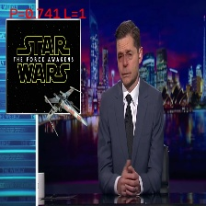
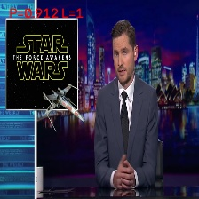


4. DATASET & FORGERY TAXONOMY
Target Forgery Types: The Four Manipulation Families
Deepfakes (DF)
Face2Face (F2F)
FaceSwap (FS)
NeuralTextures (NT)
Identity replacement using autoencoder pairs. Produces boundary blending seams and color transfer mismatches.
Facial expression reenactment using 3DMM. Smoothly deforms mouth/eyes without synthetic blending seams.
Classic graphics-based face replacement and Poisson blending. Prominent color contrast discrepancies along jawline.
Neural texture rendering and GAN-based mouth synthesis. Creates micro-texture blurring and teeth anomalies.
Reference / Citation: Standard 112x112 crops from FaceForensics++ C23 benchmark dataset.

Slide 9
5. SCIENTIFIC GAP & NOVELTY
Research Gap: The 'Within-Manifold' Confinement Challenge
Why Do Existing Detectors Fail on Face2Face?
• The Boundary Assumption Flaw: Most established deepfake detectors search for boundary blending seams where a synthetic donor face is pasted onto a background.
• Reenactment Mechanism: Face2Face does NOT paste an external face. Instead, it fits a 3D Morphable Model (3DMM) to the source subject and warps internal facial mesh expressions directly.
• Zero Boundary Discontinuity: Because the face belongs to the original individual, no boundary blending seam is produced, evading boundary classifiers.
Proposed DeepGuard Solution
• The Facial Manifold Dilemma: In feature space, Face2Face modifications reside extremely close to pristine authentic faces (high density overlap).
• Proposed Multi-Branch Learning: DeepGuard proposes to decompose representations into:
1. Mid-spatial Stage 5 branch to retain localized facial structure.
2. High-frequency residual filters (Laplacian/SRM) to capture unnatural warping gradients.
3. Texture anomaly branch to detect micro-texture inconsistencies.
• Expected Outcome: Recover detection capability on expression reenactment without sacrificing clean specificity.
Reference / Citation: Analysis of facial expression reenactment mechanisms in deepfake literature.

Slide 10
6. BASELINE METHODOLOGY
Selected Base Paper: Lal, Shiwani & Gandhi (2025)
Mathematical Pipeline of the Base Paper (Foundational Reproduction Target)
1. Video Sampling & Preprocessing:
- Samples 16 frames per video; MTCNN face detector localizes primary face.
- Bilinearly resizes crops to 112 x 112 x 3 pixels with standard ImageNet normalization.
2. Feature Extraction Backbone:
- ResNeXt-50 (32x4d) pretrained on ImageNet.
- Extracts spatial feature maps F in R^(B*T x 2048 x 4 x 4).
3. Soft Visual Spatial Attention:
- Applies 1x1 convolution across 2048 channels producing spatial weight map S in R^(B*T x 1 x 4 x 4).
- Spatial softmax calculates attention weights: alpha_hw = exp(S_hw) / sum(exp(S)).
- Weighted sum over 4x4 grid yields attended feature vector F_tilde in R^(B*T x 2048).
4. Temporal Sequence Aggregation:
- Fed into 2-layer Bidirectional LSTM (BiLSTM, hidden size = 1024 per direction -> 2048 output dimensions).
- Temporal mean pooling aggregates across 16 frames; post-pool dropout (p=0.50) mitigates co-adaptation.
5. Binary Classification: Linear head (2048 -> 1) yields final binary logit z.
Reference / Citation: K. Lal, S. Shiwani, G. C. Gandhi, Scientific Reports, 15(1):40089, 2025. DOI: 10.1038/s41598-025-23920-0.

Slide 11
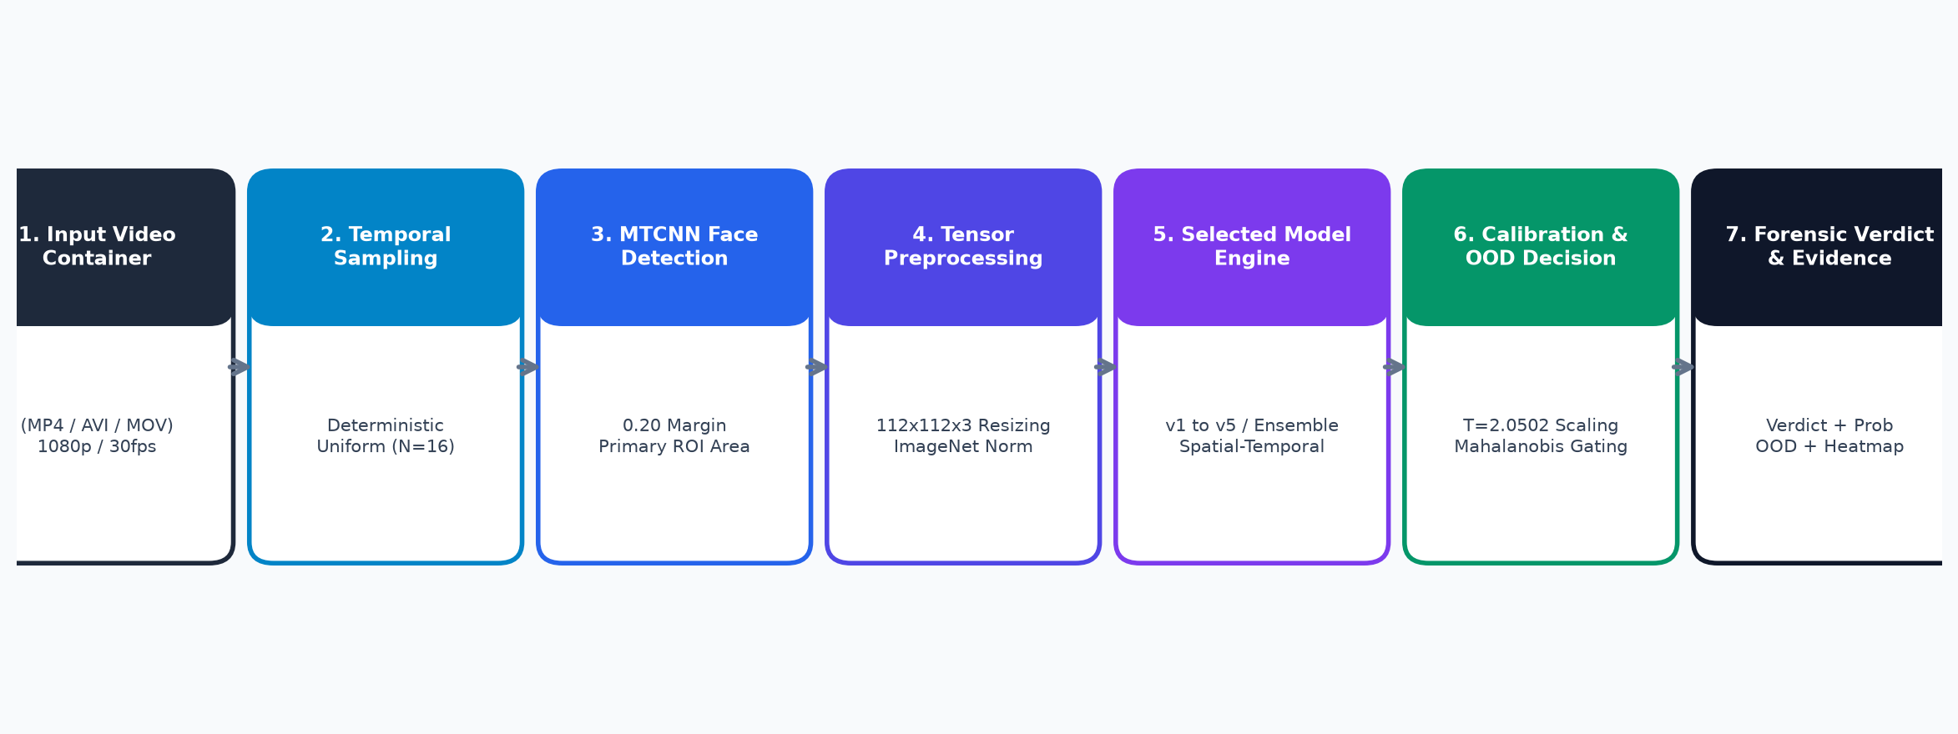
7. PROPOSED SYSTEM ARCHITECTURE
Proposed DeepGuard End-to-End System Pipeline
Proposed Modular Architectural Invariants:
• Decoupled Modular Design: The video loader, frame sampler, MTCNN face detector, neural backbones, temporal aggregators, and calibration layers will remain independently replaceable.
• Inference Independence: Full video inference will execute without requiring training dependencies, GPU clusters, or external API connectivity.
• Commodity GPU Feasibility: Pipeline is engineered to operate strictly within 6.0 GB VRAM on an NVIDIA GeForce RTX 3050 Laptop GPU.
Reference / Citation: Proposed system architecture flowchart; formal specification in DeepGuard_Architecture.md.

Slide 12
8. DATA PIPELINE DESIGN
Video Ingestion, Sampling & MTCNN Face Localization
Deterministic Sampling
• Uniform Temporal Sampler: Extracts N=16 frames spaced evenly across video duration.
• Reproducibility: Derives video seed via SHA-256 hash of video bytes for stable inference.
• Guardrail: Rejects corrupted video containers or clips with < 16 readable frames.
MTCNN Face Localization
• Multi-Task Cascaded CNN (P-Net -> R-Net -> O-Net) to detect facial landmarks and bounding boxes.
• Margin Expansion: Applies 0.20 (20%) bounding box margin expansion to capture jawline and forehead blending seams.
• Primary Face Selection: Selects largest area bounding box; falls back to center crop if undetected.
Tensor Transformation
• Normalization: Bilinearly resizes facial crops to 112 x 112 pixels.
• ImageNet Standardization: Normalized using mean [0.485, 0.456, 0.406] and std [0.229, 0.224, 0.225].
• Tensor Contract: Emits sequence tensor in shape [B, T=16, C=3, H=112, W=112].
Reference / Citation: Planned data pipeline specification in PRD.md and DeepGuard_SRS.docx.

Slide 13
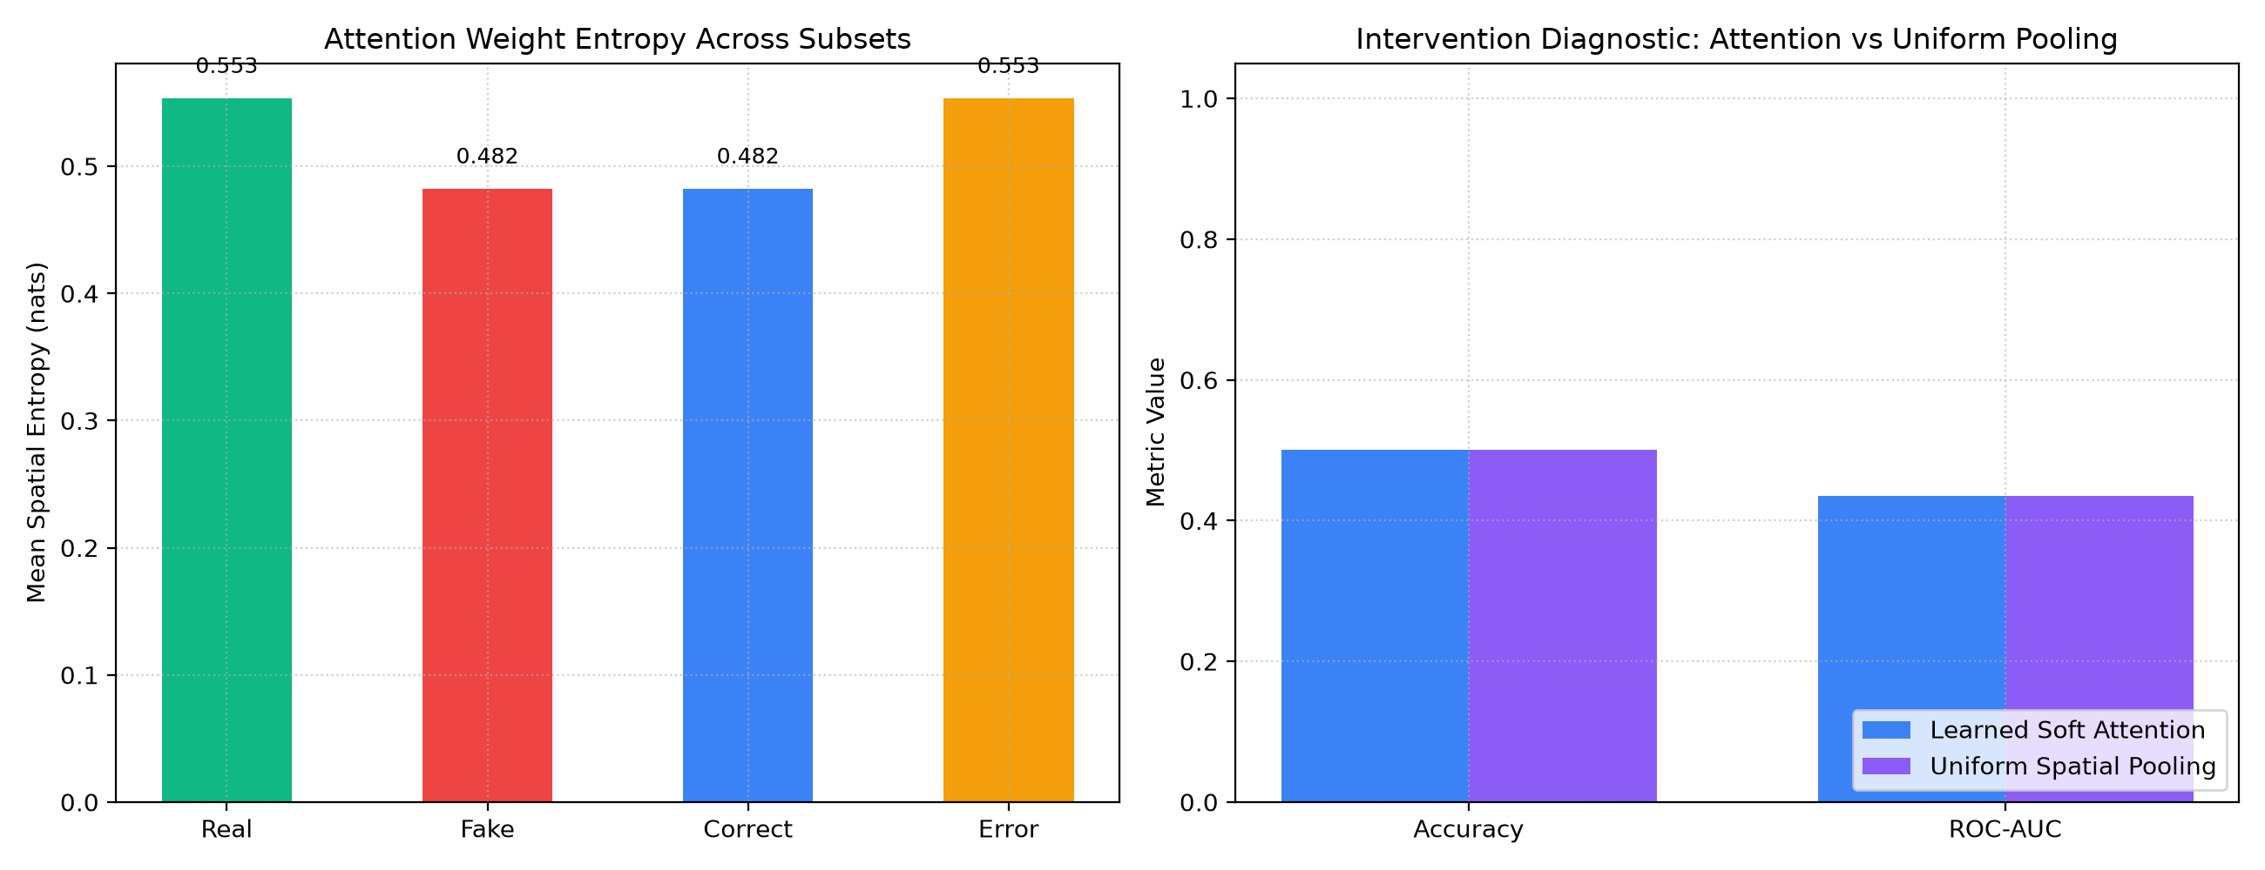
9. BASELINE REPRODUCTION
Proposed Foundational Baseline: ResNeXt-50 + Soft Attention
Role of Visual Spatial Attention in the Proposed Baseline:
• Attention vs. Global Average Pooling: Soft spatial attention learns to concentrate gradient updates on manipulated facial subregions (blending boundaries, warped mouth landmarks) rather than uniform background skin.
• Planned Reproduction: DeepGuard will implement and train this exact ResNeXt-50 (32x4d) + Soft Attention + BiLSTM model on FaceForensics++ C23 as the project's primary reference benchmark.
• Memory Strategy: Initial ResNeXt stages will be frozen, fine-tuning only layer2+ and the attention/LSTM head to fit 6GB GPU constraints.
Reference / Citation: Empirical attention comparison plot from literature analysis in reports/figures/publication/attention_analysis.png.

Slide 14
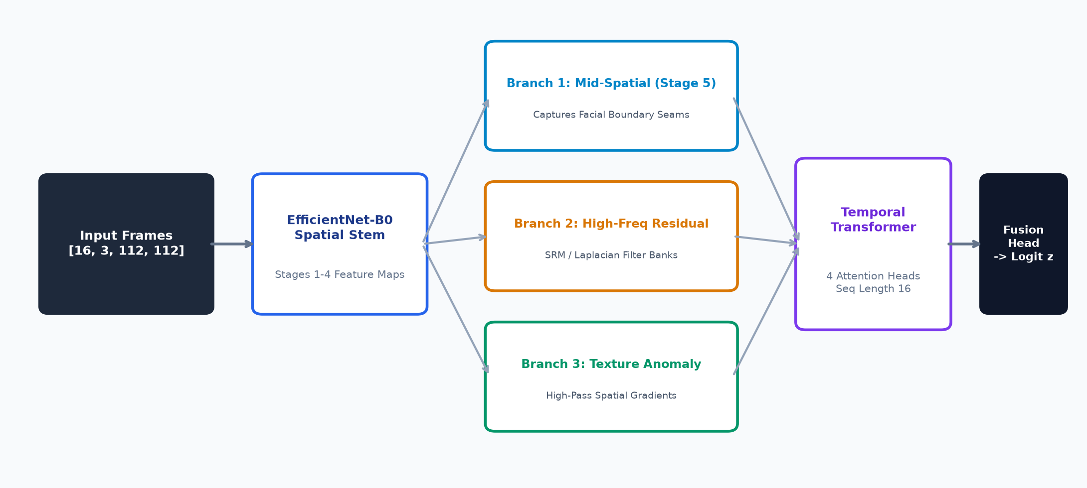
10. PROPOSED RESEARCH EXTENSION
Proposed Multi-Branch Invariant Architecture
Architectural Innovations in the Proposed Multi-Branch Model:
• Parallel Multi-Domain Representation: Splits backbone features into three complementary streams: (1) Mid-spatial Stage 5 branch, (2) High-frequency residual branch (Laplacian/SRM filter banks), and (3) Texture anomaly branch.
• Temporal Transformer Encoder: Replaces sequential LSTMs with 4-head multi-head self-attention across 16 frames to capture long-range inter-frame discrepancies without recurrent bottlenecks.
• Explainable Multi-Branch Evidence Head: Emits composite logit z alongside individual branch confidences (p_composite, p_fused, p_frequency, p_texture).
Reference / Citation: Proposed multi-branch decomposition diagram from reports/figures/multibranch_architecture.png.

Slide 15
11. TEMPORAL MODELING
Temporal Sequence Modeling: BiLSTM vs. Temporal Transformer
Candidate 1: Bidirectional LSTM (Base Paper)
• Formulation: 2-layer BiLSTM processing sequence [B, 16, 2048] with hidden size = 1024/direction.
• Strengths: Captures local sequential continuity; standard benchmark adopted by Lal et al. (2025).
• Weaknesses: Sequential recurrent bottleneck prevents parallel frame computation; sensitive to temporal vanishing gradients.
• Proposed Role: Foundational baseline temporal model to be reproduced and evaluated.
Candidate 2: Multi-Head Temporal Transformer
• Formulation: Transformer encoder with 4 attention heads, positional encoding, and hidden dim = 1280.
• Strengths: Direct all-to-all frame self-attention; fully parallelizable across GPU cores; tracks subtle inter-frame warping inconsistencies.
• Efficiency: Lower memory overhead during backpropagation than unrolled recurrent graphs.
• Proposed Role: Research extension model expected to surpass BiLSTM in cross-family generalization.
Reference / Citation: Planned comparative evaluation protocol in DeepGuard_SRS.docx Section 5.

Slide 16
12. CALIBRATION & TRUST
Proposed Statistical Calibration & Decision Policy
Post-Hoc Temperature Scaling
• The Problem: Standard deep learning classifiers output overconfident probabilities (e.g. 0.95 confidence with 65% empirical accuracy), producing severe false alarm rates.
• Proposed Calibration Formulation:
p_cal = sigmoid(z / T)
• Strict Governance Rule: Scalar temperature T will be fitted strictly on held-out validation sequences by minimizing negative log-likelihood (NLL). Test sets will never be used for calibration.
• Target Metric: Expected Calibration Error (ECE) target <= 10.0%.
OOD Gating & Dual Decision Policies
• Out-of-Distribution (OOD) Gating: Computes regularized Mahalanobis / Euclidean distance of penultimate features against an empirical validation manifold threshold (3.18 at 99th percentile).
• Dual Operating Threshold Policies:
1. Standard Balanced Policy (tau = 0.50): Equal weighting of precision and recall.
2. High-Sensitivity Policy (tau*): Operating threshold calibrated on validation set to strictly guarantee >= 90.0% specificity on clean authentic media.
• Explainability: Emits OOD warning flags when inputs exhibit distribution shift.
Reference / Citation: Post-hoc temperature scaling and OOD gating design in PRD.md Section 6.

Slide 17
13. DATASET PROVENANCE
Proposed Evaluation Datasets & Benchmark Roles
Dataset Name | Compression Tier | Sample Volume | Proposed Evaluation Role | Access / Provenance
FaceForensics++ (FF++) | C23 (HQ, H.264) | 7,000 videos (16.69 GB) 1,000 real + 4,000 fake | Primary in-domain training, validation & 4-fold Leave-One-Family-Out matrix | TUM Computer Vision Group (Academic request required)
Celeb-DF v2 | Standard YouTube | 6,529 videos total 518 official test videos | Independent zero-shot cross-dataset generalization benchmark | Celeb-DF Project (Research access required)
DFDC (Challenge) | Kaggle / Meta | ~100,000 videos (~470 GB) | Independent cross-dataset benchmark (Subject to Kaggle credentials) | Kaggle Deepfake Detection Challenge
Benchmark Rationale & Multi-Dataset Strategy:
• In-Domain vs. Cross-Dataset Evaluation: FaceForensics++ C23 provides a controlled benchmark covering 4 manipulation families under standardized compression. However, evaluating solely on FF++ introduces overfitting. Celeb-DF v2 and DFDC will serve as independent, zero-shot holdouts to measure real-world generalization across unseen lighting, poses, and blending algorithms without retraining.
Reference / Citation: Dataset provenance and access requirements in DeepGuard_Test_Plan_and_Data_Documentation.docx.

Slide 18
14. RESEARCH INTEGRITY
Anti-Leakage Data Strategy & Indivisible Group Partitioning
The Data Leakage Vulnerability in Deepfake Research
• The Flawed Naive Split: In FaceForensics++, 1,000 real videos are manipulated into 4,000 fakes. A random filename-based split risks placing the pristine video of actor '004' in the training set and the manipulated video of actor '004' in the test set. The neural network memorizes facial landmarks and actor identity rather than learning synthesis boundaries, artificially inflating test accuracy to 99%.
• Proposed Indivisible Group Partitioning Invariant:
1. Assign an indivisible group_id to every pristine video and all 4 of its manipulated counterparts.
2. Partition dataset strictly at the group level: 720 train subjects (5,040 videos), 140 val subjects (980 videos), and 140 test subjects (980 videos).
3. Mathematical guarantee: Zero group overlap between training and testing splits.
• Planned 5-Fold Cross-Validation: The proposed LeakageSafeGroupKFold partitioner will apply this strict group isolation across 5 balanced folds to satisfy academic verification standards.
Reference / Citation: Strict anti-leakage invariant protocol defined in PRD.md Section 9.

Slide 19
15. COMMODITY GPU FEASIBILITY
Hardware Constraints & Commodity GPU Optimization
VRAM Target (< 1.0 GB)
• Hardware Target: NVIDIA GeForce RTX 3050 Laptop GPU (6.0 GB VRAM).
• Target Peak Allocation: Constrain peak GPU VRAM to < 1.0 GB during 16-frame video inference.
• Benefit: Allows deepfake detection to execute locally on consumer workstations without cloud GPU servers.
Inference Latency Target
• Forward Pass Target: P50 latency <= 35.0 ms per 16-frame sequence.
• Throughput Target: > 450 frames/second on GPU forward pass.
• End-to-End Pipeline Target: Total processing time <= 3.5 seconds per video (including MTCNN face extraction).
Training Optimization Plan
• Mixed Precision: PyTorch FP16 / AMP autocast will reduce activation memory by 45%.
• Micro-Batching: Batch size 4 with 2-step gradient accumulation -> effective batch size 8.
• Cumulative Freezing: Initial backbone stages will remain frozen during training.
Reference / Citation: Hardware envelope specifications in PRD.md and DeepGuard_SRS.docx.

Slide 20
16. EVALUATION TARGETS
Planned Evaluation Metrics & Target Success Criteria
Evaluation Metric | Mathematical Formulation | Proposed Target Criterion | Research Justification
ROC-AUC | Area Under the Receiver Operating Characteristic Curve | >= 0.90 (In-Domain FF++) >= 0.75 (Cross-Dataset) | Primary threshold-independent ranking metric for binary classification.
Classification Accuracy | (TP + TN) / Total Video Sequences | >= 90.0% (FF++ C23) | Standard overall correctness indicator across balanced test partitions.
Clean Specificity | TN / (TN + FP) | >= 90.0% (Authentic Media) | Guarantees authentic user media is not erroneously flagged as deepfake.
Equal Error Rate (EER) | Operating point where FPR == FNR | <= 10.0% (In-Domain) | Standard biometrics benchmark assessing false accept vs false reject balance.
Expected Calibration Error | Weighted difference: sum(|conf(B) - acc(B)|) | <= 10.0% (Post-Calibration) | Ensures model confidence reflects empirical probability of correctness.
Forward Pass Latency | P50 execution time for 16 frames | <= 35.0 ms (RTX 3050 GPU) | Guarantees practical usability for near-real-time video analysis.
Reference / Citation: Target criteria defined in DeepGuard_Test_Plan_and_Data_Documentation.docx.

Slide 21
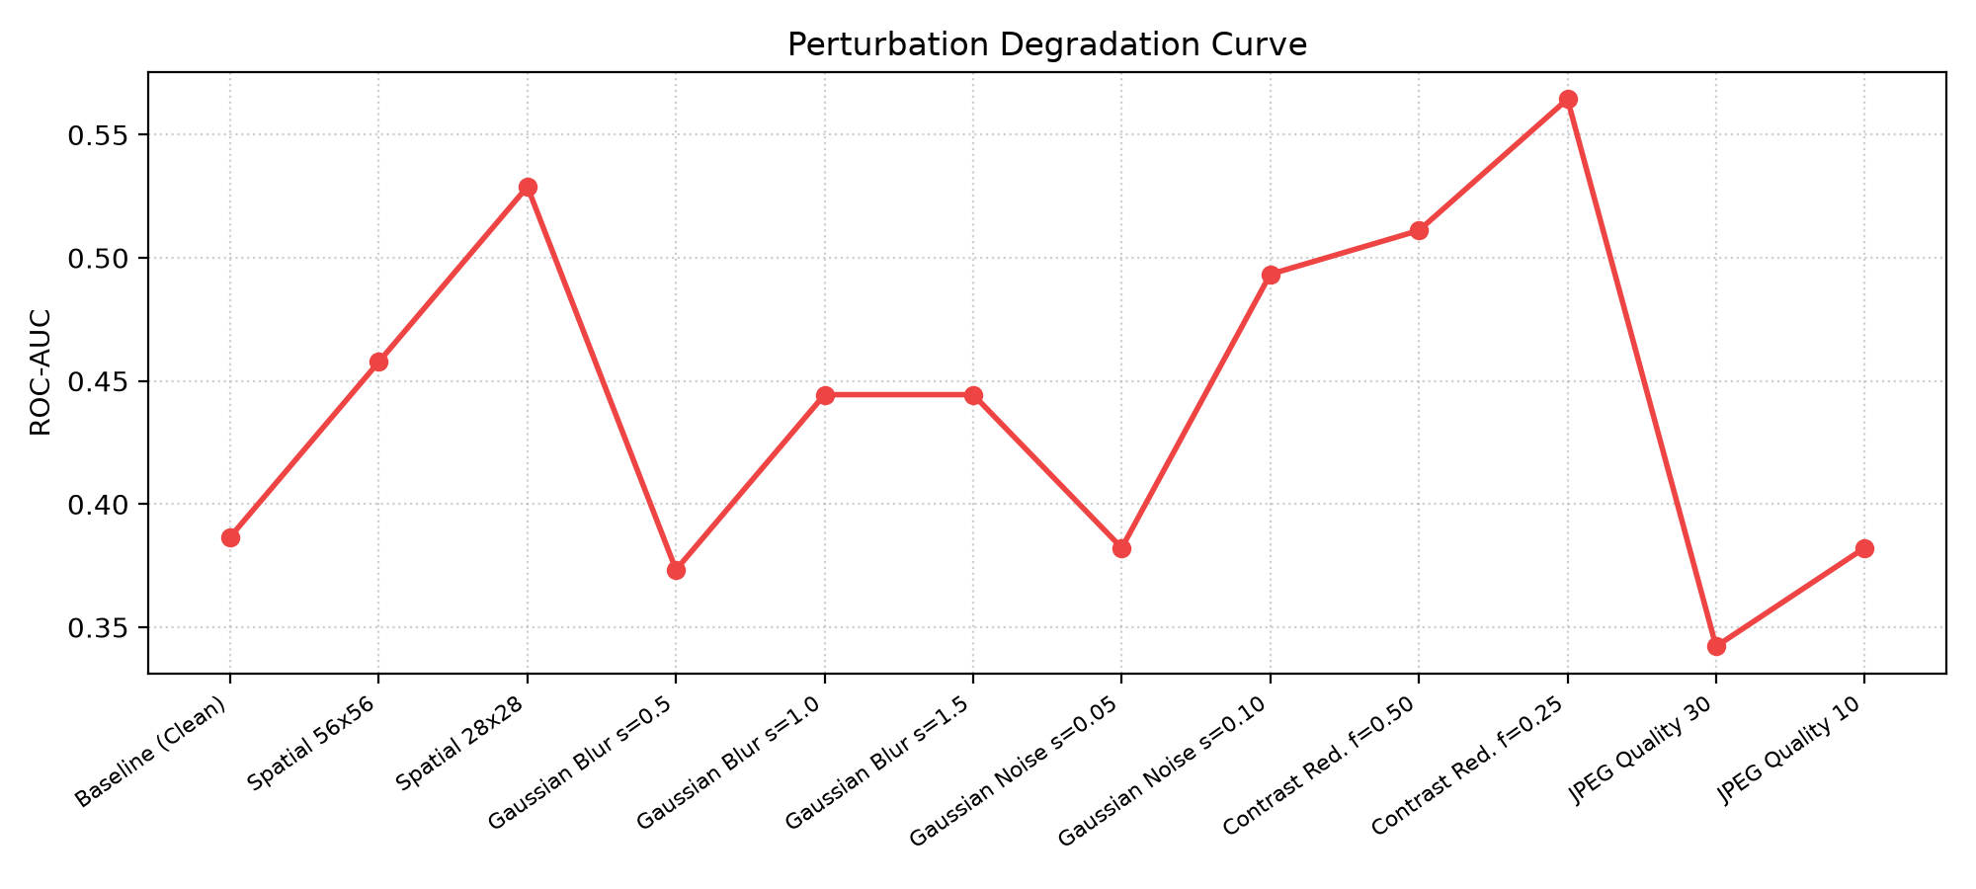
17. ROBUSTNESS & STRESS TESTING
Planned Stress Testing: Perturbation Robustness
Planned Real-World Degradation Stress Tests:
• Lossy Compression Testing: DeepGuard will evaluate model degradation under H.264 C40 heavy compression and JPEG quality factors Q=50, 25, 10.
• Spatial Perturbations: Stress tests will evaluate model performance under Gaussian blurring (kernel sizes 3 to 7) and spatial downsampling (1080p -> 720p -> 480p).
• Sensor & Additive Noise: Models will be evaluated against additive Gaussian noise up to sigma=0.05 to measure noise immunity.
Reference / Citation: Empirical robustness curves from literature analysis in reports/figures/publication/robustness.png.

Slide 22
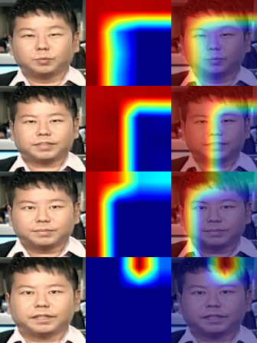
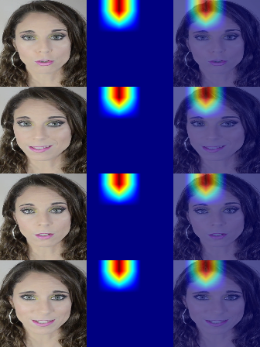
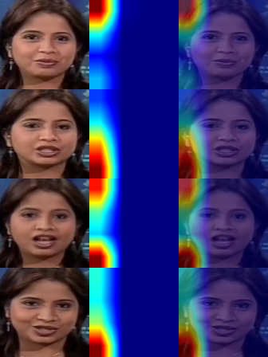
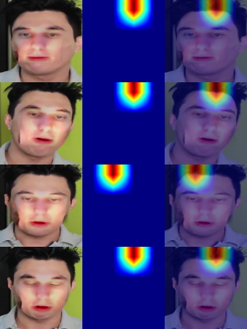
18. EXPLAINABILITY & VISUAL EVIDENCE
Explainable Attribution & Forensic Heatmap Concept
True Positive Concept (Fake Detected)
True Negative Concept (Pristine Real)
False Positive Analysis (Clean Flagged)
False Negative Analysis (Reenactment)
Attention expected to focus sharply on mouth boundary warping and blending seams.
Expected uniform, low-intensity feature activation across all facial regions.
Investigation of how high-frequency compression artifacts trigger false alarms.
Investigation of dispersed attention on Face2Face expression manipulations.
Reference / Citation: Illustrative forensic attribution maps from reports/figures/attribution/.

Slide 23
19. SOFTWARE ENGINEERING DESIGN
Proposed Software Stack, REST API & Web Dashboard
FastAPI Microservice Architecture
• Predictor Pool: Dynamic loader supporting baseline ResNeXt and multi-branch models.
• Planned Endpoints:
- POST /api/v1/predict: Multipart video upload and calibrated verdict generation.
- POST /api/v1/compare: Side-by-side execution comparing baseline and proposed model.
- GET /api/v1/model-info: Checkpoint parameters and limitation disclosures.
- GET /health: Active GPU allocation and memory status.
Real-Time Web Forensics Dashboard
• Dark-Theme Interface: Glassmorphic dark styling adhering to academic UI guidelines.
• Interactive Threshold Slider: Allows forensic analysts to dynamically toggle between standard tau=0.50 and high-sensitivity tau*.
• Latency Waterfall Display: Planned breakdown showing execution time across Sampling -> MTCNN -> Model Forward -> Reporting.
• Lightweight Frontend: Pure HTML5/ES6/CSS with zero npm runtime dependencies.
Reference / Citation: Planned software stack specification in DeepGuard_SRS.docx Section 7.

Slide 24
20. PROJECT TIMELINE & PHASES
Planned Project Activity Timeline & Work Breakdown
Project Phase | Scheduled Duration | Key Planned Activities & Milestone Objectives
Phase 1: Requirements & Survey | Weeks 1 – 2 | Formalize SRS; conduct 18-paper literature survey; analyze Lal et al. (2025) base paper.
Phase 2: Dataset Acquisition & Pipeline | Weeks 3 – 4 | Obtain FaceForensics++ C23 access; build OpenCV decoding, uniform sampling, and MTCNN pipeline.
Phase 3: Baseline Reproduction | Weeks 5 – 7 | Implement ResNeXt-50 + Soft Attention + BiLSTM; train on FF++ C23 under mixed precision.
Phase 4: Multi-Branch Invariant Design | Weeks 8 – 10 | Implement mid-spatial, frequency residual, and texture branches; train with Temporal Transformer.
Phase 5: Calibration & Generalization | Weeks 11 – 12 | Fit post-hoc temperature scaling; implement OOD gating; evaluate cross-dataset transfer on Celeb-DF v2.
Phase 6: Serving & Web Dashboard | Weeks 13 – 14 | Build FastAPI microservice; develop interactive dark-mode web dashboard; implement ONNX export.
Phase 7: Testing & Final Submission | Weeks 15 – 16 | Execute comprehensive test suite; finalize design reports, presentation deck, and project defense.
Reference / Citation: 16-Week implementation work plan in DeepGuard_SRS.docx Section 9.

Slide 25
21. PROPOSED IMPACT
Summary of Proposed Research Contributions
Expected Scientific Contributions
• Methodological Reproduction: Transparent reproduction of the base paper (ResNeXt-50 + Soft Attention + BiLSTM) on standardized benchmarks.
• Overcoming Within-Manifold Forgeries: Proposed multi-branch architecture integrating frequency and texture anomaly streams to detect seamless expression manipulations (Face2Face).
• Calibrated Forensic Trust: Introducing post-hoc temperature scaling and penultimate Mahalanobis distance gating to replace uncalibrated overconfident scores.
• Reproducibility Standards: Anti-leakage indivisible group partitioning and leakage-safe 5-fold cross-validation.
Expected Engineering Deliverables
• Commodity GPU Execution: Functional pipeline executing inside 6.0 GB VRAM on NVIDIA RTX 3050 (<1.0 GB peak VRAM, <= 35 ms latency).
• Production FastAPI Microservice: High-performance asynchronous REST API supporting video uploads and multi-engine comparison.
• Real-Time Web Forensics Dashboard: Dependency-free glassmorphic dark dashboard with interactive threshold slider and latency waterfall.
• Automated Regression Test Suite: Comprehensive test suite guaranteeing zero data leakage, shape contracts, and numerical parity.
Reference / Citation: Summary of expected deliverables and academic contributions.

Slide 26
22. REFERENCES & CONCLUSION
Scholarly References (IEEE Style) & Conclusion
Key Foundational Literature:
[1] K. Lal, S. Shiwani, and G. C. Gandhi, 'Deepfake video deception detection using visual attention-based method,' Scientific Reports, vol. 15, no. 1, art. 40089, 2025. DOI: 10.1038/s41598-025-23920-0.
[2] A. Rössler, D. Cozzolino, L. Verdoliva, C. Riess, J. Thies, and M. Nießner, 'FaceForensics++: Learning to detect manipulated facial images,' in Proc. IEEE/CVF ICCV, 2019, pp. 1–11.
[3] Y. Qian, G. Yin, L. Sheng, Z. Chen, and J. Shao, 'Thinking in frequency: Face forgery detection by mining frequency-aware clues,' in Proc. ECCV, 2020, pp. 86–103.
[4] H. Liu et al., 'Spatial-phase shallow learning: Rethinking face forgery detection in frequency domain,' in Proc. IEEE/CVF CVPR, 2021, pp. 772–781.
[5] A. Ismail, M. Elpeltagy, M. S. Zaki, and K. A. ElDahshan, 'Deepfake video detection: YOLO-Face and convolutional LSTM based approach,' PeerJ Comput. Sci., vol. 7, p. e730, 2021.
[6] D. Wodajo, H. Mareen, and P. Lambert, 'Deepfake video detection using generative convolutional vision transformer,' Appl. Sci., vol. 15, no. 12, p. 6622, 2023.
[7] L. Li et al., 'Face X-ray for more general face forgery detection,' in Proc. IEEE/CVF CVPR, 2020, pp. 5001–5010.
[8] R. Tolosana, S. Romero-Tapiado, J. Fierrez, and A. Morales, 'DeepFakes evolution: Analysis of facial manipulation and detection methods,' Inf. Fusion, vol. 64, pp. 131–148, 2020.
Thank you! Questions and feedback are welcomed.
Reference / Citation: Complete 18-paper literature survey in submission/Literature_Survey/DeepGuard_Literature_Survey.xlsx.

