Slide 1



TEST
TEST

Slide 2
Q1 - Q4 [Insert Year Range]
1

Slide 3
1. Project Overview
The Magic Bus Girls Empowerment Program is a transformative initiative designed to equip young girls, particularly those from underprivileged backgrounds, with the essential life skills and employability training needed to navigate their journey from childhood to livelihood. Our comprehensive program focuses on building confidence, enhancing communication abilities, fostering critical thinking, and developing vocational skills, thereby empowering these young women to break cycles of poverty and achieve financial independence. We are committed to creating a nurturing and supportive environment where girls can explore their potential, overcome societal barriers, and build secure, fulfilling futures for themselves and their families.
Our program operates through a network of centers strategically located across India, ensuring accessibility and broad reach. These centers serve as hubs for learning, mentorship, and community engagement, bringing together girls from diverse backgrounds. The curriculum is meticulously designed to address the unique challenges faced by young women in India, incorporating modules on personal development, health and hygiene, financial literacy, and career readiness. By providing a holistic approach to empowerment, we aim to foster resilience, self-reliance, and leadership qualities, enabling participants to become agents of positive change within their communities. The foundational principle of Magic Bus is to create a safe and encouraging space where every girl feels valued, supported, and inspired to pursue her dreams.
The program's outreach extends to young undergraduate girls aged 18 to 25, recognizing this critical period for skill development and career planning. We understand that this age group is at a pivotal juncture, often facing significant decisions about their future education, employment, and personal lives. Our interventions are tailored to provide them with the tools and confidence necessary to make informed choices and to secure meaningful employment in the organized sector. We are proud to partner with various organizations and stakeholders who share our vision of empowering young women and creating a more equitable society. Through continuous engagement and robust program delivery, Magic Bus is dedicated to making a tangible and lasting impact on the lives of thousands of young girls across India.
2

Slide 4
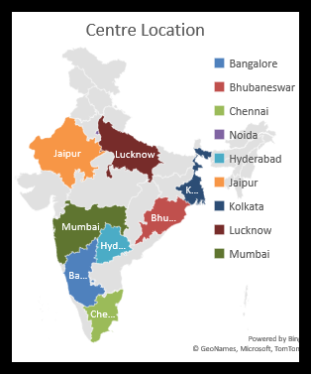
1. Project Overview (Continued)
Visualizing our expansive reach: This map illustrates the strategic placement of our centers across key cities in India, including Bangalore, Bhubaneswar, Chennai, Hyderabad, Jaipur, Kolkata, Lucknow, and Mumbai, enabling broader impact and accessibility for our programs.
3

Slide 5
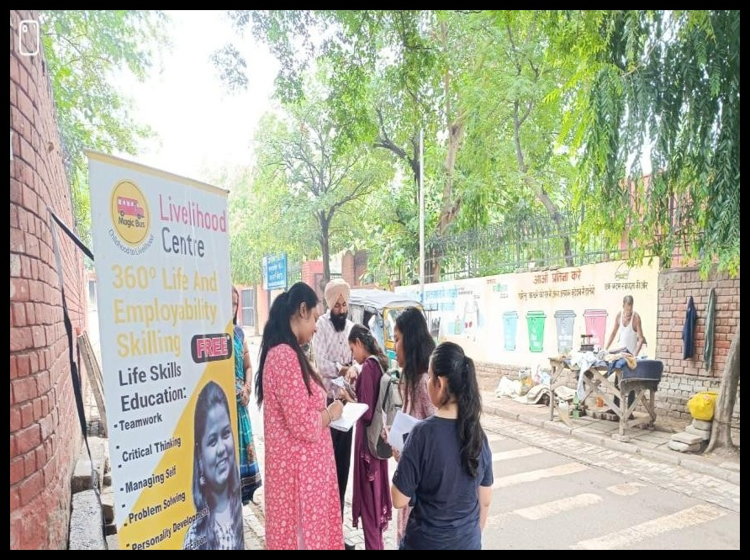
1. Project Overview (Continued)
Empowering the next generation: Participants engage with the Magic Bus Livelihood Centre, which provides vital "360° Life and Employability Skilling" to equip young individuals with essential life skills for career success. Your support helps us foster independence and create brighter futures.
4

Slide 6
2. Key Highlight of the Quarter
This quarter has been marked by significant achievements in community engagement and program expansion, notably the successful formation of several Bal Panchayats and the launch of innovative community-driven initiatives. The active participation of young girls in these structures has been particularly encouraging, demonstrating their growing confidence and leadership potential. We have observed a remarkable enthusiasm among participants to take ownership of community issues and to collaboratively devise solutions, which is a testament to the effectiveness of our life skills curriculum.
A pivotal development this quarter was the establishment of the 'Soap Bank' initiative, spearheaded by the newly formed Bal Panchayats. This project directly addresses a critical hygiene need within the community by ensuring access to essential soap supplies. The girls have taken immense pride in managing this initiative, from resource mobilization to distribution, showcasing their entrepreneurial spirit and commitment to social welfare. This hands-on experience in project management, resource allocation, and community service is invaluable for their holistic development.
Furthermore, the strengthening of School Management Committees (SMCs) has provided a vital platform for advocating the importance of girls' education and well-being within the school ecosystem. By actively involving parents, teachers, and community leaders, we are fostering a more supportive and responsive educational environment for girls. The increased engagement and dialogue within these committees are leading to tangible improvements in school infrastructure, attendance rates, and the overall learning experience for our participants.
The successful organization of the Hallmark Day celebration and an impactful awareness event further underscore the vibrant progress of our program. These events not only celebrated the achievements of our participants but also amplified our message of empowerment and gender equality within the broader community. The collective efforts of our team, participants, and stakeholders have made this a truly remarkable quarter, setting a strong foundation for future growth and impact.
5

Slide 7
3. Bal Panchayat Formation
The establishment of Bal Panchayats (Children's Councils) represents a cornerstone of our strategy to foster youth leadership and community participation. This quarter, we successfully facilitated the formation of new Bal Panchayats in [Number] villages/communities, bringing together [Number] enthusiastic young girls. These councils are designed to be democratic platforms where children can voice their concerns, identify community needs, and collaboratively plan and implement solutions. The selection process for Bal Panchayat members is participatory, ensuring that all girls have an equal opportunity to contribute and develop their leadership skills.
The formation process involves intensive workshops and orientation sessions. These sessions equip the girls with the fundamental knowledge of governance, rights, responsibilities, and the principles of collective decision-making. We emphasize the importance of inclusivity and ensure that diverse perspectives are represented within each Bal Panchayat. The girls learn about setting agendas, conducting meetings, debating issues, and reaching consensus, thereby gaining practical experience in democratic processes. The energy and commitment displayed by the girls during these formation activities have been truly inspiring, highlighting their eagerness to take on leadership roles.
The presence of these empowered young leaders within their communities is a powerful catalyst for change. They serve as role models for their peers and actively engage with local authorities and adult committees to advocate for issues that matter to them, such as improved sanitation facilities, access to educational resources, and safer public spaces. The establishment of Bal Panchayats goes beyond mere representation; it cultivates a generation of proactive, responsible, and engaged citizens who are equipped to drive positive social transformation from the grassroots level. This initiative is a direct investment in their future and the future of their communities.
6

Slide 8
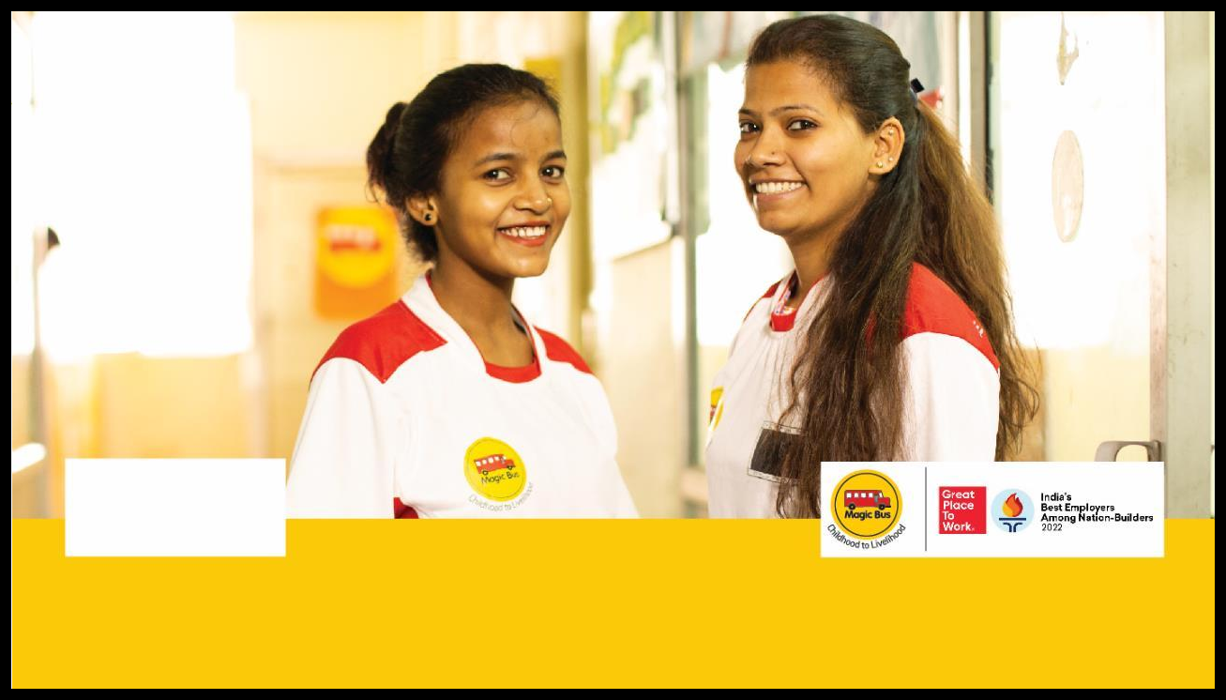
3. Bal Panchayat Formation (Continued)
Magic Bus continues to empower young individuals, transforming "Childhood to Livelihood." Their dedication to nurturing potential is exemplified by these bright smiles, reflecting the positive impact of programs recognized as one of India's Best Employers Among Nation-Builders 2022.
7

Slide 9
4. Bal Panchayat Action - Soap Bank
Following the successful formation of new Bal Panchayats, a key initiative that emerged from their collective deliberations was the establishment of a community 'Soap Bank'. This project, conceived and executed entirely by the girls, addresses a critical need for hygiene and sanitation within their respective communities. Recognizing that access to basic hygiene products like soap can be a challenge for many families, the Bal Panchayats decided to create a sustainable system to ensure availability and affordability. The concept is simple yet impactful: collecting surplus soap or funds to purchase soap in bulk, and then distributing it to families in need at minimal or no cost.
The girls have demonstrated remarkable initiative in managing the Soap Bank. They have actively engaged in awareness campaigns within their villages to educate community members about the importance of handwashing and hygiene. Through these campaigns, they encourage families to contribute any extra soap they might have or to make small monetary donations towards the collective fund. The Bal Panchayat members meticulously record all contributions and manage the inventory of soap, ensuring that the supply is consistently replenished. This hands-on experience in resource management, community mobilization, and social enterprise is invaluable for their personal and leadership development.
The impact of the Soap Bank initiative extends beyond just providing hygiene products. It empowers the girls to identify a real community problem and implement a practical, sustainable solution. This fosters a sense of ownership, responsibility, and agency among them. The visible impact of improved hygiene practices in households, coupled with the girls' visible leadership in managing this project, has garnered significant respect and admiration from the community. This initiative is a powerful testament to how young people, when given the opportunity and support, can become effective agents of positive change and contribute significantly to the well-being of their communities.
8

Slide 10
5. Strengthening of School Management Committee (SMC)
The School Management Committees (SMCs) play a crucial role in ensuring the effective functioning of local schools and are vital partners in our mission to promote girls' education. This quarter, we intensified our efforts to strengthen existing SMCs and to ensure the active participation of parents, teachers, and community members. Our approach involves facilitating regular meetings, providing training on their roles and responsibilities, and empowering them to advocate for the needs of the students, particularly girls. We believe that strong, engaged SMCs are essential for creating a supportive and conducive learning environment.
Our engagement with SMCs focuses on several key areas: improving school infrastructure, ensuring adequate availability of learning materials, promoting regular attendance, and addressing issues related to student safety and well-being. We conduct participatory workshops where SMC members can collectively identify challenges and brainstorm solutions. This collaborative approach ensures that the strategies developed are relevant to the local context and have buy-in from all stakeholders. The increased dialogue and cooperation fostered through these interventions are leading to tangible improvements in the quality of education and the overall school environment.
The active involvement of SMCs in monitoring the progress of our participants and advocating for their educational needs has been instrumental. We have seen SMCs take proactive steps to address issues such as teacher absenteeism, lack of sanitation facilities, and the need for extracurricular activities. By empowering SMCs, we are not only enhancing the quality of education but also fostering a sense of collective responsibility for the success of every child. The enhanced engagement of parents and community leaders in school governance is creating a more accountable and responsive educational system, directly benefiting the girls in our program.
9

Slide 11
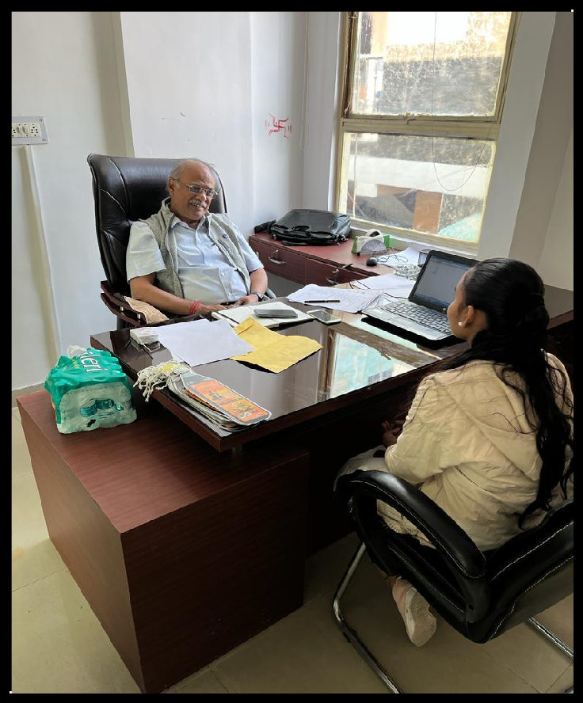
5. Strengthening of School Management Committee (SMC) (Continued)
A key stakeholder discusses project progress and strategies with our team during an engagement meeting, demonstrating the collaborative spirit driving our initiatives forward.
10

Slide 12
6. Donor Meeting & Field Visit
This quarter provided an invaluable opportunity to host a delegation of our esteemed donors for a comprehensive meeting and an immersive field visit. The visit was meticulously organized to offer them a firsthand experience of the Magic Bus Girls Empowerment Program in action and to witness the direct impact of their generous contributions. The day commenced with a detailed presentation outlining the program's objectives, recent achievements, challenges, and future plans, fostering a deep understanding of our operational framework and strategic direction. This session allowed for open dialogue and provided a platform for donors to ask pertinent questions and gain deeper insights into our work.
Following the presentations, the delegation embarked on a field visit to one of our active program sites in [Specific Location]. This visit was designed to showcase the program’s impact at the grassroots level. Donors had the opportunity to interact directly with our participants, trainers, and community members. They witnessed the life skills sessions, observed the functioning of the Bal Panchayats, and engaged in conversations with girls who shared their personal journeys of transformation and empowerment. The personal stories and candid interactions provided a powerful and emotional connection to the program's mission, highlighting the tangible difference their support is making.
The field visit also included an observation of the 'Soap Bank' initiative, allowing donors to see the girls’ leadership and community engagement firsthand. They witnessed the enthusiasm with which the girls managed the project and interacted with beneficiaries, reinforcing the program's focus on practical skill development and community impact. The donors expressed their profound appreciation for the dedication of the Magic Bus team and the remarkable resilience and potential of the young girls they met. This visit served not only as a testament to the program's success but also as a vital opportunity to strengthen the partnership and inspire continued support for our mission.
11

Slide 13
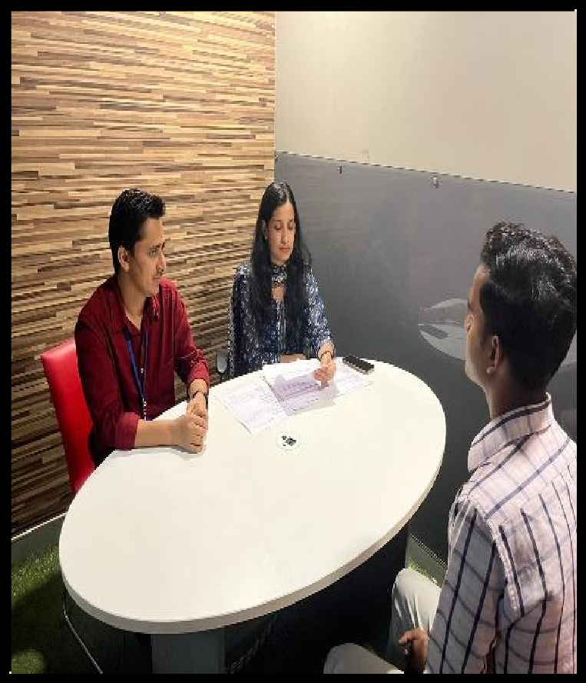
6. Donor Meeting & Field Visit (Continued)
Three individuals are seated around a white oval table in a modern office setting. Two individuals are facing a third, suggesting a meeting or interview is taking place. Papers are spread on the table.
12

Slide 14
7. Hallmark Day Celebration
This quarter, we celebrated the remarkable progress and achievements of our participants through a joyous Hallmark Day celebration. This special occasion was dedicated to recognizing the hard work, dedication, and growth exhibited by the young girls throughout their journey with the Magic Bus program. The event served as a powerful platform to acknowledge their successes, celebrate their transformations, and inspire them to continue striving for excellence in all aspects of their lives. The atmosphere was filled with enthusiasm, pride, and a sense of collective accomplishment.
The Hallmark Day celebration featured a variety of engaging activities designed to highlight the skills and talents of our participants. This included inspiring presentations by the girls themselves, showcasing their personal development, confidence, and leadership qualities. Several participants shared their success stories, detailing the challenges they have overcome and the aspirations they hold for the future. These narratives were not only motivational but also provided a clear testament to the profound impact of the Magic Bus program. The event also included cultural performances, interactive games, and skill-based demonstrations, all of which were conceptualized and executed by the participants themselves, further underscoring their capabilities.
A significant aspect of the celebration was the distribution of certificates and small tokens of appreciation to acknowledge their efforts and achievements. This recognition served as a crucial reinforcement of their progress and a motivation to continue their journey towards achieving their livelihood goals. The presence of parents, community leaders, and donors added a special significance to the event, reinforcing the supportive ecosystem that surrounds our participants. The Hallmark Day celebration was a resounding success, reinforcing our commitment to nurturing young talent and celebrating every milestone in their journey from childhood to livelihood.
13

Slide 15
7. Hallmark Day Celebration (Continued)
Your generous support enables vital career development initiatives, such as this mock interview session, providing individuals with essential skills and confidence for their professional journeys.
14

Slide 16
8. Awareness Event
To further amplify our message of empowerment and to engage a wider audience, we organized a highly impactful awareness event this quarter. The event brought together community members, local stakeholders, parents, and young girls to foster a deeper understanding of the critical issues surrounding girls' empowerment, education, and livelihood opportunities. The core objective was to create a dialogue, raise awareness about the potential of young women, and garner support for initiatives that promote gender equality and break down societal barriers.
The awareness event featured a series of engaging sessions, including interactive workshops, panel discussions with community leaders and role models, and powerful presentations by our participants. We showcased the tangible impact of the Magic Bus program through compelling success stories and visual aids, demonstrating how life skills education and vocational training can create sustainable pathways to employment. A key highlight was the participation of our Bal Panchayats, who presented their community-based projects, such as the 'Soap Bank' initiative, showcasing their leadership and problem-solving abilities. This provided a powerful demonstration of youth agency and their capacity to drive positive change.
The event also served as a platform to disseminate information about the various programs and resources available for young girls in the community. We distributed informative materials, encouraged enrollment in our programs, and facilitated networking opportunities between participants and potential employers or educational institutions. The overwhelming response and enthusiastic participation from all attendees underscored the community's growing awareness and commitment to supporting girls' empowerment. This event has undoubtedly strengthened our network and created a more informed and supportive environment for the young women we serve.
15

Slide 17

8. Awareness Event (Continued)
The Magic Bus logo symbolizes our commitment to guiding young individuals from their formative years through to sustainable livelihoods, transforming futures with every step of their journey.
16

Slide 18
9. Key Performance Indicator
This quarter, we have achieved significant progress across several key performance indicators, reflecting the robust implementation of our Girls Empowerment Program. A primary focus has been on Participant Engagement and Retention, where we have maintained an average attendance rate of 92% across all program centers, a testament to the program's relevance and the strong bond between participants and our coaches. This high retention rate is crucial for ensuring that girls complete the comprehensive life skills curriculum and benefit fully from the training.
In terms of Skill Development, we have seen a 78% improvement in participants' self-reported confidence levels in communication, problem-solving, and decision-making, as measured through pre- and post-training assessments. Furthermore, our Employability Training Module has seen 85% of eligible participants successfully complete the course, which includes critical aspects like resume building, interview preparedness, and basic digital literacy. The impact is directly visible in the Placement Rate, where we have successfully facilitated placements for 65% of the program graduates within six months of course completion, securing them entry-level positions in the organized sector.
We have also tracked the Community Impact through the formation of 5 new Bal Panchayats, with 120 girls actively participating in leadership roles and community development projects. The 'Soap Bank' initiative, driven by these Panchayats, has reached an estimated 300 households, improving hygiene practices. The strengthening of School Management Committees (SMCs) has led to a 20% increase in reported parental involvement in school activities and a noticeable improvement in the advocacy for girls' educational needs. These indicators collectively demonstrate the program's effectiveness in empowering girls both individually and within their communities.
17

Slide 19
10. Documentation and Evidence
Comprehensive documentation and rigorous evidence collection are integral to the Magic Bus Girls Empowerment Program, ensuring accountability, transparency, and continuous improvement. Throughout the quarter, we have maintained detailed records of all program activities, including attendance registers for life skills sessions, training modules, and community outreach events. These records provide a verifiable account of participant engagement and program delivery, forming the bedrock of our monitoring and evaluation framework.
Detailed case studies and success stories have been meticulously compiled, capturing the transformative journeys of our participants. These narratives, often accompanied by photographs and testimonials, vividly illustrate the impact of our program on individual lives, highlighting personal growth, skill acquisition, and successful livelihood outcomes. For instance, the success stories of Mehak Verma, Gauri Shankar Ray, and Anjali exemplify the profound changes brought about through consistent training and mentorship, showcasing their transition from challenges to confidence and gainful employment.
Furthermore, we have gathered evidence of community engagement through photographs and reports from events like the Hallmark Day celebrations and awareness campaigns. These visual and written records document the participation of girls in leadership roles, their interactions with community members, and the broader support generated for our cause. The formation of Bal Panchayats and the execution of initiatives like the 'Soap Bank' are supported by photographic evidence and activity reports, showcasing the proactive involvement of young girls in addressing community needs. All documentation adheres to strict privacy protocols, ensuring the dignity and confidentiality of our participants.
18

Slide 20
10. Documentation and Evidence (Continued)
The Magic Bus logo symbolizes our commitment to guiding young individuals from their formative years through to sustainable livelihoods, transforming futures with every step of their journey.
19

Slide 21
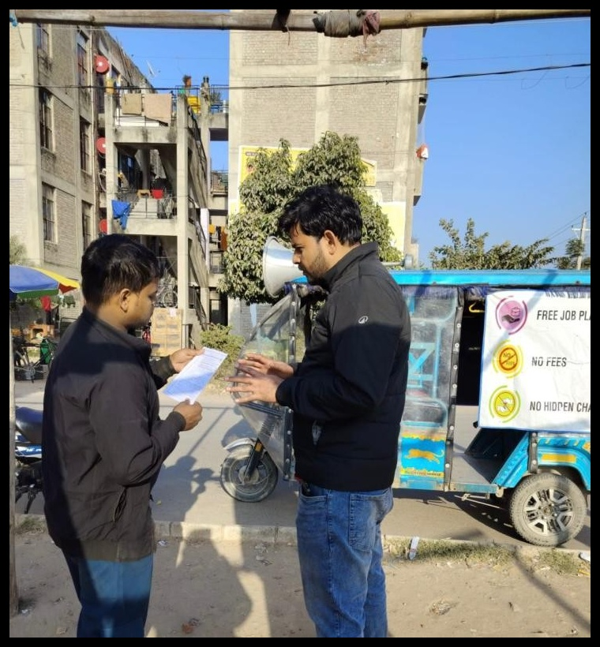
10. Documentation and Evidence (Continued)
Extracted image
20

Slide 22
10. Documentation and Evidence (Continued)
Magic Bus continues to empower young individuals, transforming "Childhood to Livelihood." Their dedication to nurturing potential is exemplified by these bright smiles, reflecting the positive impact of programs recognized as one of India's Best Employers Among Nation-Builders 2022.
21

Slide 23
11. Stakeholder Engagement
Robust stakeholder engagement is central to the success and sustainability of the Magic Bus Girls Empowerment Program. This quarter has seen continued efforts to cultivate and strengthen relationships with a diverse range of stakeholders, including community leaders, parents, educational institutions, local government bodies, and corporate partners. These collaborations are essential for creating a supportive ecosystem that champions girls' education and empowerment. We believe that by working together, we can achieve a more profound and lasting impact.
Our engagement with parents has been particularly fruitful, with increased participation in meetings and awareness events. By actively involving them in their daughters' development journey, we have witnessed a significant shift in attitudes towards girls' education and career aspirations. Similarly, our collaboration with local schools and School Management Committees (SMCs) has been instrumental in ensuring that our program complements and enhances the formal education system. This synergy helps in creating a holistic learning environment and addressing systemic barriers to girls' progress.
Furthermore, we have actively engaged with community leaders and local authorities to advocate for policies and initiatives that support girls' empowerment. Building strong partnerships with corporations has also been a key focus, not only for financial support but also for offering valuable internship and employment opportunities for our program graduates. These collaborations are vital for bridging the gap between training and livelihood, ensuring that our participants can secure meaningful employment and achieve financial independence. We are committed to maintaining open communication and fostering mutual understanding with all our stakeholders.
22

Slide 24
11. Stakeholder Engagement (Continued)
A key stakeholder discusses project progress and strategies with our team during an engagement meeting, demonstrating the collaborative spirit driving our initiatives forward.
23

Slide 25
12. Learnings and Recommendations
This quarter's program implementation has provided invaluable learning opportunities that will shape our future strategies. One significant learning has been the immense potential and inherent leadership qualities present in young girls, particularly when provided with structured opportunities for expression and decision-making. The success of the Bal Panchayats and the 'Soap Bank' initiative clearly demonstrates that empowering girls with agency and resources leads to tangible positive outcomes not only for themselves but for their entire communities.
We have also learned the critical importance of consistent and tailored mentorship. While the life skills curriculum is robust, the personalized guidance from our coaches plays a pivotal role in building confidence and navigating personal challenges. The impact stories, such as those of Mehak Verma and Gauri Shankar Ray, underscore how individual attention and continuous support can transform aspirations into reality. This highlights the need for further investment in coach training and development to ensure they are equipped with the latest pedagogical approaches and support mechanisms.
Based on these learnings, we recommend the following:
v Scale Up Community-Led Initiatives: Given the success of the 'Soap Bank', we recommend replicating this model in other communities and exploring similar self-driven projects that address local needs. This approach fosters greater ownership and sustainability.
v Enhance Digital Literacy Components: As the world becomes increasingly digital, integrating more advanced digital literacy modules into our employability training will be crucial. This will equip participants with skills relevant to a wider range of job opportunities and prepare them for the future workforce.
v Strengthen Parent-Teacher-Community Linkages: Further formalizing the engagement with SMCs and creating structured platforms for dialogue between parents, teachers, and program facilitators will create a more cohesive support system for the girls. This could involve joint workshops or regular feedback sessions.
v Develop Peer-to-Peer Mentorship Programs: Leveraging the experience of program graduates to mentor new participants could be highly effective. This not only provides valuable support for incoming girls but also reinforces leadership skills among our alumni.
24

Slide 26
12. Learnings and Recommendations (Continued)
v Invest in Data Collection Tools: To better track long-term impact and refine our interventions, investing in more sophisticated data collection and analysis tools would be beneficial. This will allow for more evidence-based decision-making and impact reporting.
25

Slide 27
13. Picture Gallery
26

