Slide 1
Chromatic Polynomial in Small Space
Algorithmic Engineering Aspects of Fast Zeta Transform-based Graph Colouring Algorithms

Slide 2
This presentation
Introduction and theory
  Graphs & algorithms
  The BHKK algorithm
  The Fast Zeta Transform
My work
Results
Questions
  There are no silly ones.

Slide 3
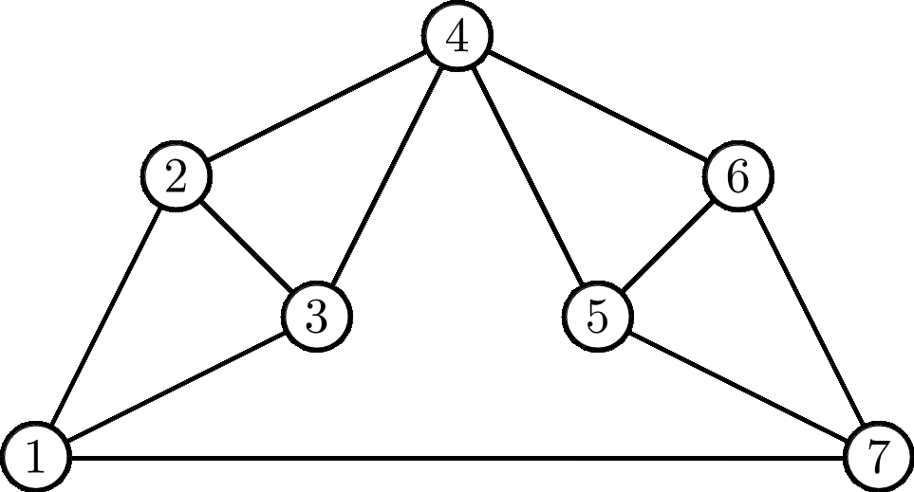
Introduction, graphs
What is a graph?
  Vertices, V
    Order n
  Edges, E
    Size m
The Moser Spindle graph

Slide 4
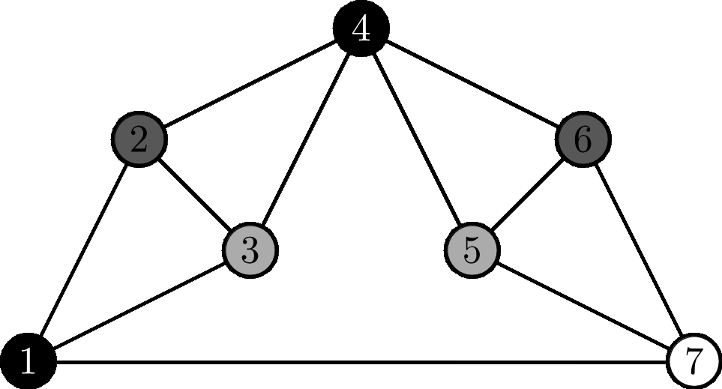
Introduction, graphs
What is a graph?
  Vertices, V
  Edges, E
How can we colour it?
  Optimally
  Counting
The Moser Spindle graph

Slide 5
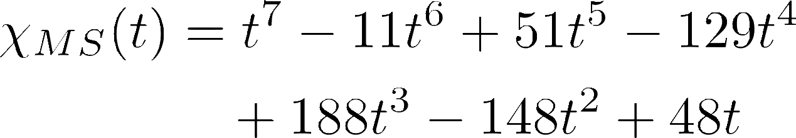
Introduction, graphs
What is a graph?
  Vertices, V
  Edges, E
How can we colour it?
  Optimally
  Counting
What is the Chromatic Polynomial?
  What does it look like?
The Moser Spindle graph

Slide 6
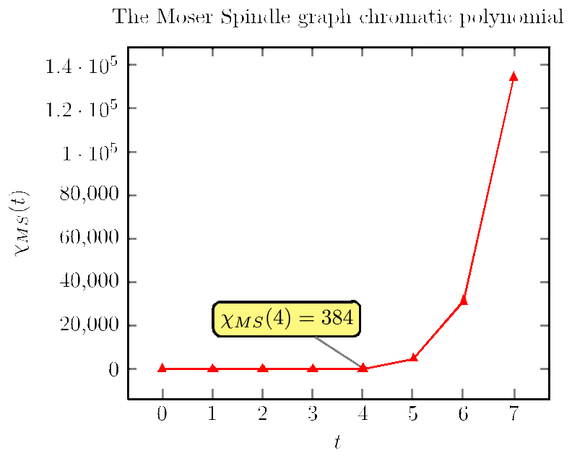
Introduction, graphs
What is a graph?
  Vertices, V
  Edges, E
How can we colour it?
  Optimally
  Counting
What is the Chromatic Polynomial?
  What does it look like?

Slide 7
Introduction, algorithms
What is an algorithm?
Stone: ”A set of rules that precisely define a sequence of operations.”
Wikipedia: ”A step-by-step procedure for calculations.”
Example:
  Initialize data structures.
  Magic
  ...
  Profit.

Slide 8
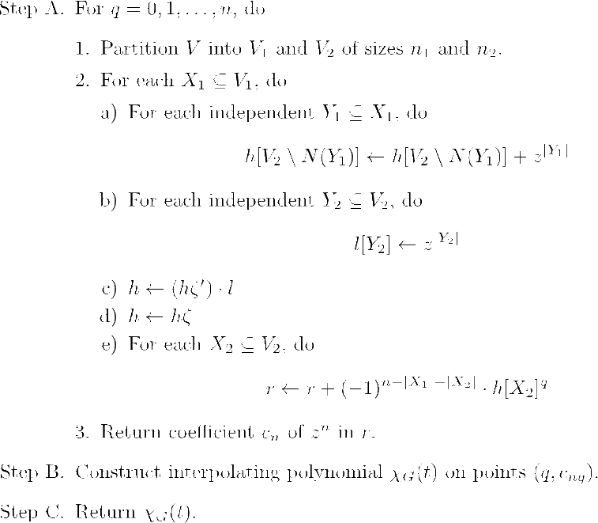
Introduction, algorithms

Slide 9
The BHKK Algorithm
Björklund, Husfeldt, Kaski, Koivisto = BHKK
Computes the Chromatic Polynomial
  time
  space
    Main improvement
  Principle of inclusion-exclusion
  Iteration over independent subsets
Fast Zeta Transform

Slide 10
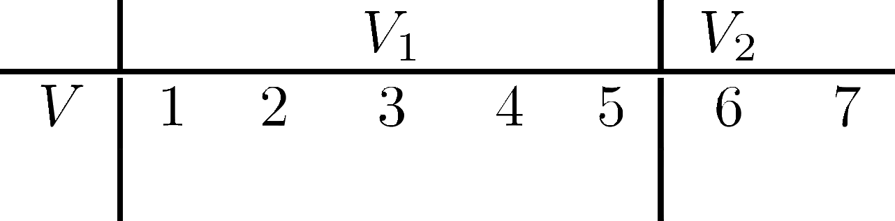
The Fast Zeta Transform
Split V into V1 and V2

Slide 11
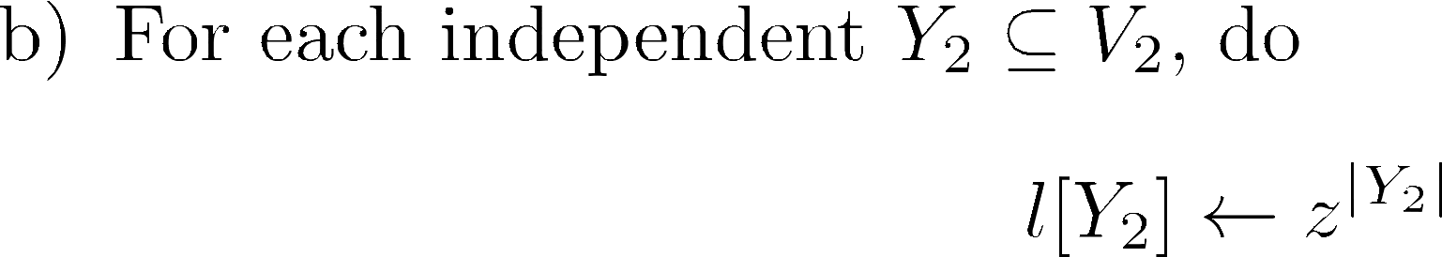
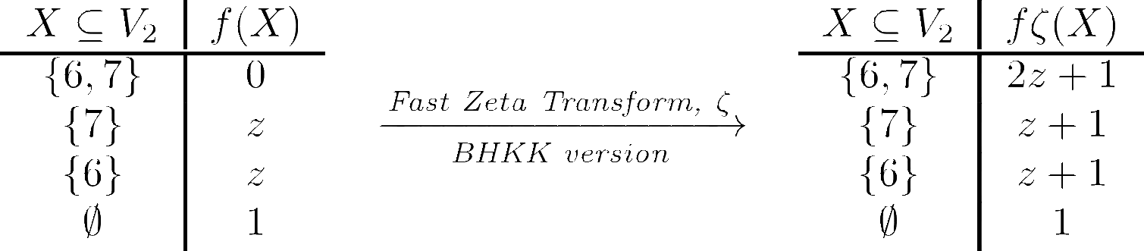
The Fast Zeta Transform

Slide 12
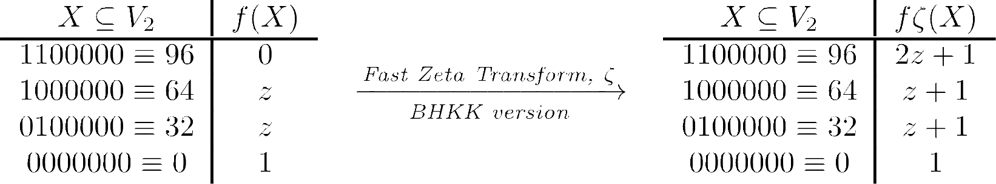
The Fast Zeta Transform
Sets are encoded as integers (= bitsets). 1 in position i means element i is in the set (i = 1,...,n)

Slide 13
My work
Implement the BHKK algorithm
  Polynomial arithmetic externalized
  Parallelization
Run simulations, compare to competition
  Haggard, Pearce, Royle = HPR algorithm
    Deletion-contraction, dynamic programming
  Random graphs
  Optimizations

Slide 14
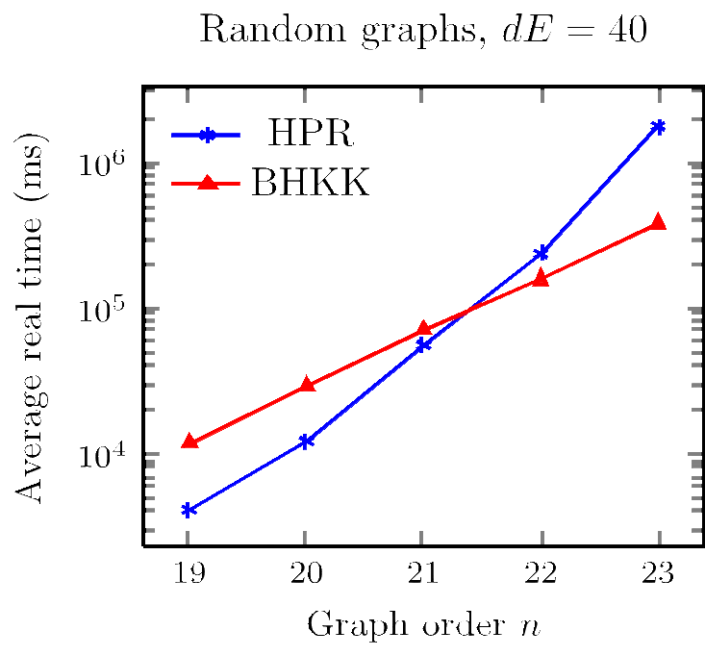
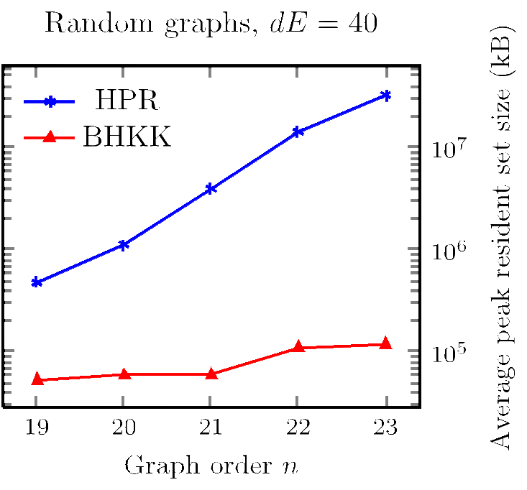
Results, complexity

Slide 15
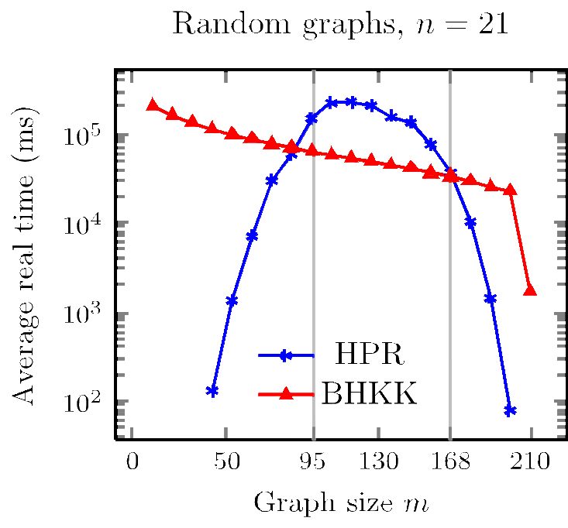
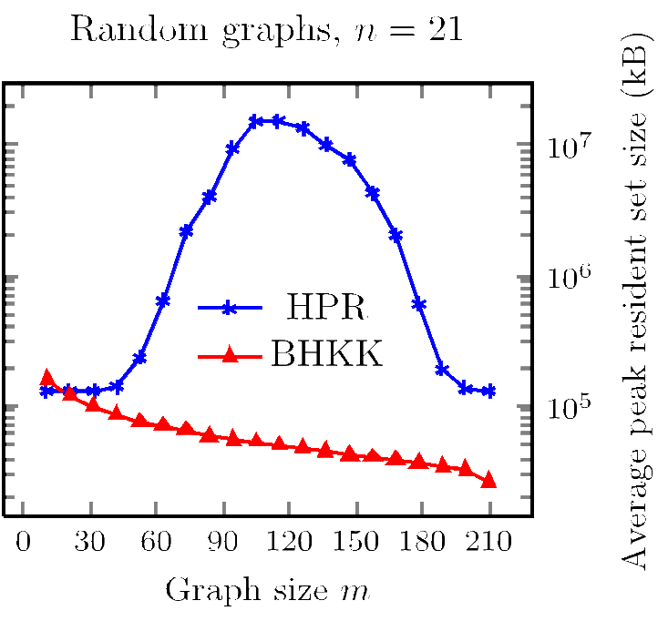
Results, size dependency

Slide 16
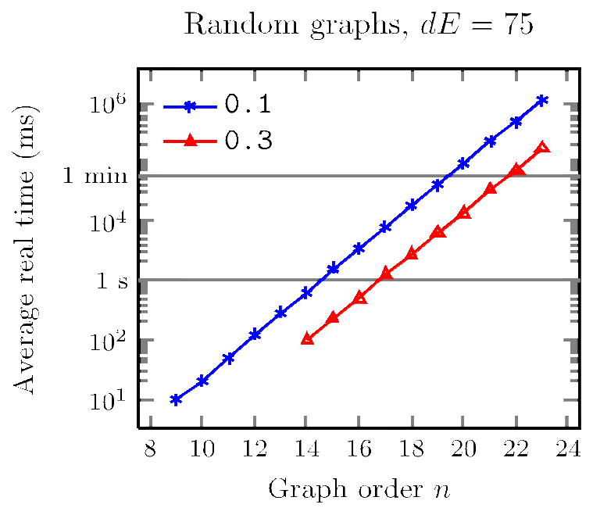
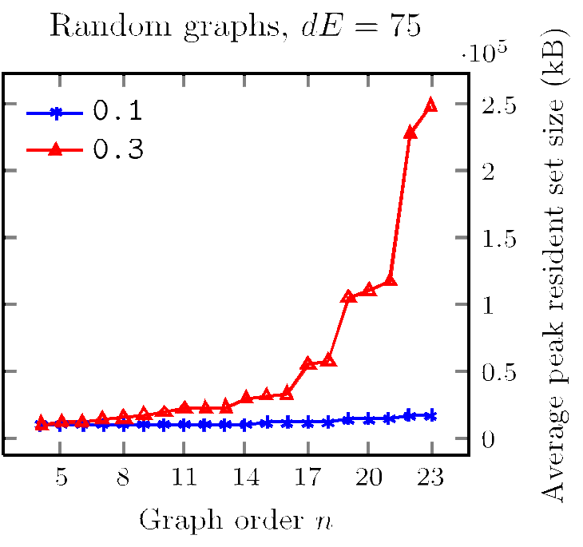
Results, parallelization

Slide 17
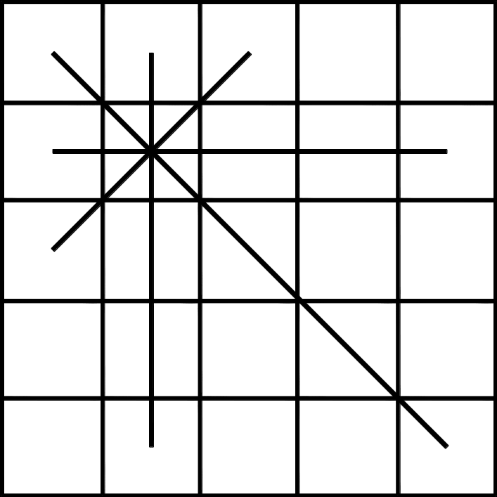
Results, Queen graph
5x5 Queen graph
Order 25
Size 160
Chromatic nbr 5

Slide 18
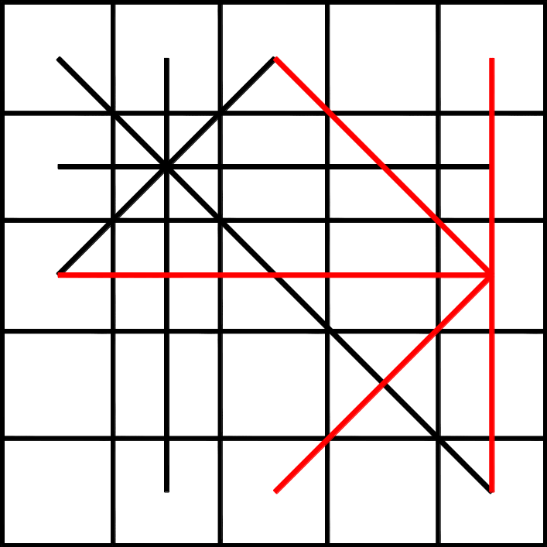
Results, Queen graph

Slide 19
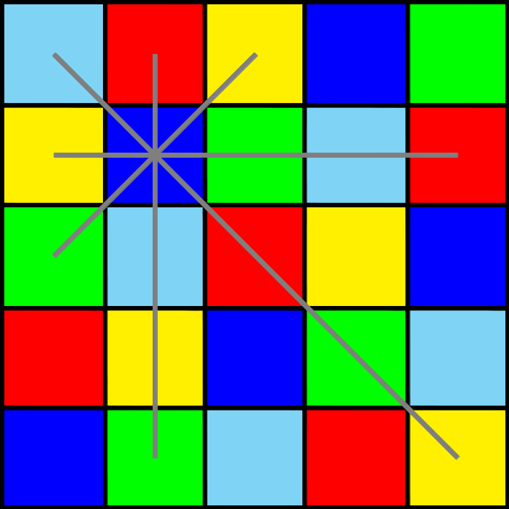
Results, Queen graph
5x5 Queen graph
Order 25
Size 160
Chromatic nbr 5

Slide 20
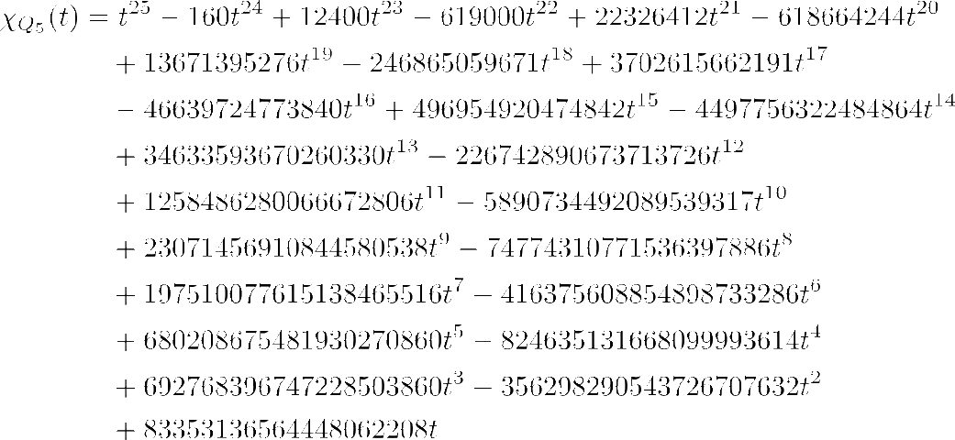
Results, Queen graph

Slide 21
Results, Queen graph
$ bins/chr_pol_pari input/adjm/dimacs/dim_36_290 12
Evaluating x(0)... = 0
Evaluating x(1)... = 0
Evaluating x(2)... = 0
Evaluating x(3)... = 0
Evaluating x(4)... = 0
Evaluating x(5)... = 0
Evaluating x(6)... = 0
Evaluating x(7)... = 100800
Evaluating x(8)... = 539993341440
Evaluating x(9)... = 28523818425553920
Evaluating x(10)... = 168848393250572582400
Evaluating x(11)... = 242888062409233489987200
Evaluating x(12)... = 125418745435123389172492800
Evaluating x(13)... = 29561851852939196036141575680
Evaluating x(14)... = 3746380075607039378376563735040
Evaluating x(15)... = 287237024180965294490230843867200
...

Slide 23
Open questions
How fast can we run on exponential amount of threads?
  One subset per thread.
  ”Worst” subset is the one with most independent ”secondary” subsets.
  Requires ~33 million CPUs for Queen 5x5.
How fast can we run if actively separating ”bad” subsets?
  We group subsets into 12 groups (or some other constant).
  If we are unlucky, we might get all ”bad” subsets in one group.

