Slide 1


2.4 GHz vs 868 MHz
II – Management and Performance Analysis Sensor Networks
Mats De Meyer & Quentin Van Ravels

Slide 2
Introduction
2.4 GHz Wi-Fi, Bluetooth, 802.15.4 Much interference Less propagation | 868 MHz Less commonly used Less interference Better propagation ➔ Good potential!

Slide 3
Goal
Compare Latency, Throughput and Power Consumption of 2.4 GHz and 868 MHz bands

Slide 4
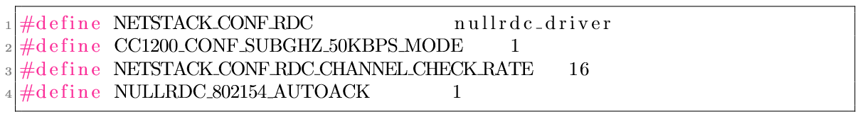
Setup
Radios:
cc1200 for 868 MHz
cc2538 for 2.4 GHz
Contiki
nullrdc
CSMA
rime
Receiver address 2d:c8
Sender address 2d:f9

Slide 5
Power Consumption
Method

Slide 6
Power Consumption
C Program based on send-unicast.c
sends 300 messages
one message every second
10 second delay to avoid startup anomalies
payload: string of 5 characters
On the receiving node, receive-unicast.c

Slide 7
Power Consumption
Two types of measurements:
Energest
KeySight N6705B DC Power Analyzer

Slide 8
Energest
Contiki module for software-based energy estimation
Tracks time of different modes: CPU, LPM, IRQ, TRANSMIT, LISTEN
ticks converted to seconds (32768 ticks = 1 sec)
Convert logs with python script for readability and ease of use
calculate charge: multiply cumulative time value by current (Q = I * t)
calculate energy: multiply by Volt (E = Q * V)
Convert to mWh

Slide 9
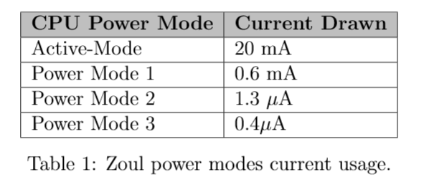
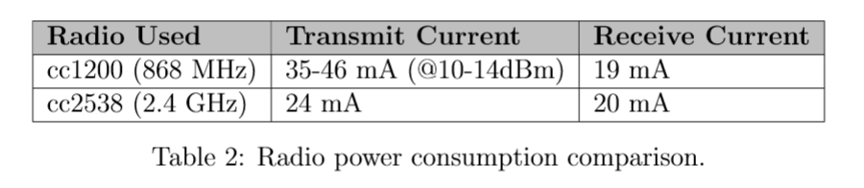
Energest

Slide 10
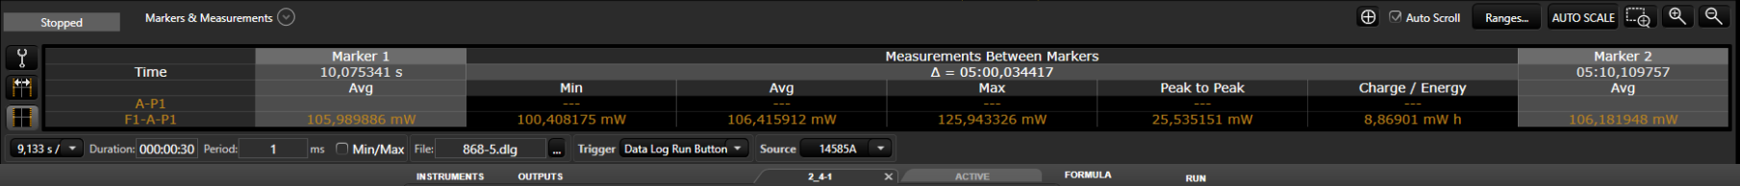
KeySight DC Power Analyzer
Powers the motes at 3.7V
single run of 5 min and 30 seconds (x 10)
export to csv and clean with python script
But data is power, voltage and current per timestamp
→ Get cumulative charge / energy for comparison

Slide 11
Power Consumption
Results

Slide 12
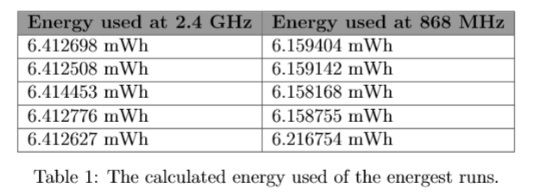
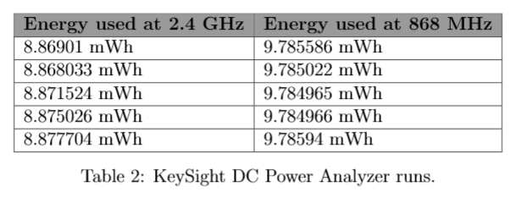
Energest

Slide 13
Latency
Method

Slide 14
Latency
Same logic, packet counter now sent as payload
→ run 5 times for each radio
→ print modified timestamp at sender and receiver
Python script
→ use pandas package to calculate timestamp difference of 1500 packages
→ plot confidence intervals

Slide 15
Latency
Results

Slide 16
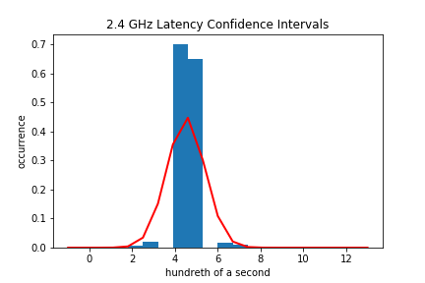
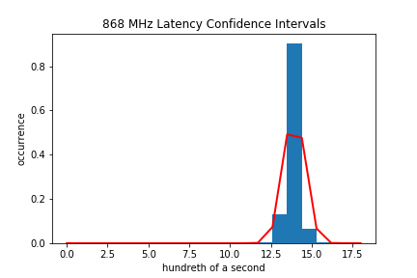
Latency

Slide 17
Packet Delivery Ratio
Method & Results

Slide 18
PDR
Check latency results
→ send and receive with address and packet number
→ 100% (1500/1500) on both frequencies

Slide 19
Conclusion

Slide 20
Conclusion
868 MHz higher latency due to lower data rate and frequency
PDR 100% because of high delay between packages (1 second) and acks
Power Consumption inconclusive, but same order of magnitude
Both feasible options, trade offs have to be made

