Slide 1

CatBoost: Gradient Boosting for data with both numerical and text features
Anna Veronika Dorogush,
Head of CatBoost team
Notes:
Представление

Slide 2


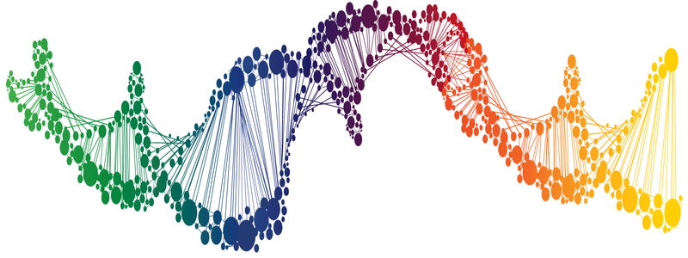

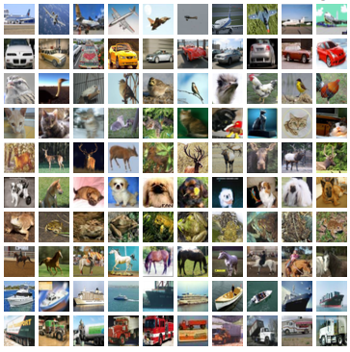
Applied ML (supervised learning)
Applications
Data at hand
Tool
DNA
Text
    Linear models
    Neural nets
    Decision trees
    GBDT
    etc
Medicine
Finance
+
+
Sales prediction
Images
Music
Notes:
CatBoost is a library that solves supervised learning task
Here on a slide is a rough illustration of what supervised learning consist of of:
we have some application where we want to apply ML techniques
We have some data at hand, that could be used to solve our problem. This data contains samples and for each samples we have associated label. The task is to predict label based on sample in some optimal way. Applications defines what the optimal way is. And to predict in this optimal way we optimise some loss function, that, directly or indirectly, search for optimal model
Finally, we have bunch of libraries that could be used to solve the problem
This libraries, usually, generalise well for different applications. Linear models, GBDT, Decision tress — all this could be used for different types of predictions problems: classification, regression, ranking — just select the proper loss function
But, different tools work well with different data
For examples, for images CNN are the best choice
For speech recognition recurrent neural networks provides great results

Slide 3
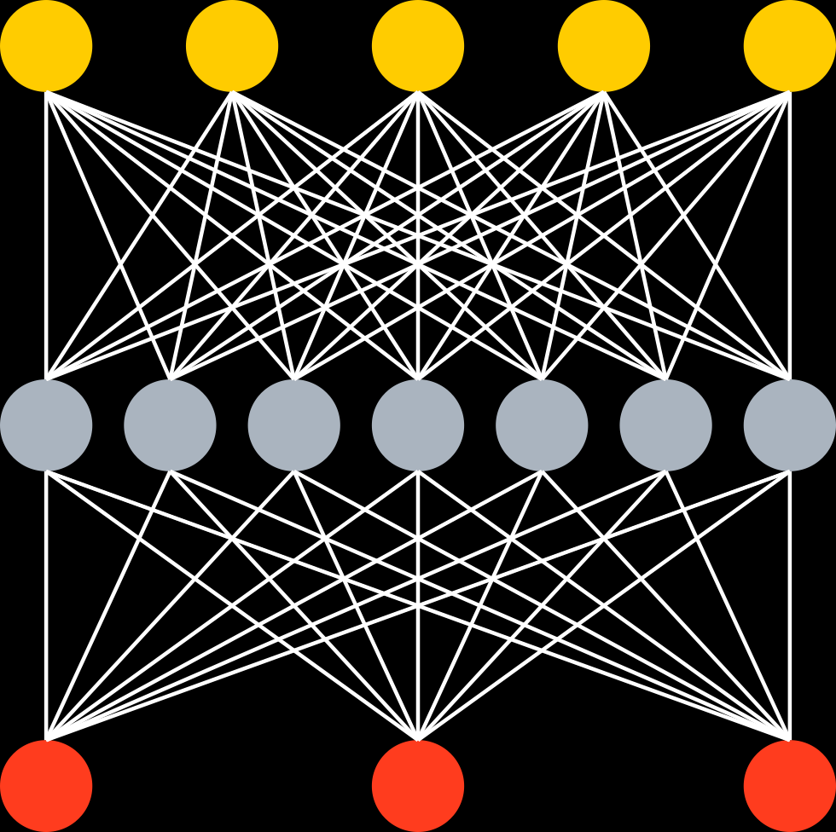
Data at hand
Tabular (or structured) data
Unstructured data
Well engineered features
^{Music track length} | ^{Year} | ^{Rating} | ^{Label}
² | ¹⁹⁹⁰ | ³ | ¹
³ | ¹⁹⁵⁰ | ⁵ | ⁰
¹⁵ | ¹⁹⁷⁰ | ⁴ | ¹
Music
DNA
Images
Text
End2End with Deep NN
GBDT
+
+
+
+
…
Big error
Better
Ship it
Notes:
Here you can seen one way to classify type of data used to solve practical problems today
Firstly, we have so-called unstructured data, like images, were deep learning techniques shows the great result
Secondly, we have tabular, or structured data: well-engineered features are used to describe sample we use to make predictions.Each sample is just a row of float numbers in table. Plus a label that we need to predict.
For this type of data the state-of-the-art results are achieve by GBDT
This is power technique that builds an ensemble, or linear combination, of decision trees. And builds it in a greedy way. Method starts with just one tree, this tree usually have big error and we iteratively and a new tree is learned to corrects errors performed by previous ones
This technique is very easy to use, that’s almost no parameter that need to be carefully tuned, like neural network architecture. For GBDT is’t often enough to use just 3 parameters: maximum depth of tree, number of trees you want to train and learning rate which is some kind of regularizations. And thats all, you could spend the rest of time working with the data, not the machine learning model. And dealing with the data is the most important part.
Gradient boosting works well on small datasets and could be scaled for big ones

Slide 4
Tabular data? Decision trees!
Animal?
No
Yes
Not a cat
Have whiskers?
No
Yes
Not a cat
Purrs?
No
Yes
Cat!
Not a cat

Slide 5
Gradient boosted decision trees
  State-of-the-art quality on tabular data
  Easy to use, no sophisticated parameter tuning
  Works well with small data and scales for big data problems
+
+
+
+
…
Big error
Better
Ship it
Notes:
GBDT is powerful and easy-to-use technique, its

Slide 6
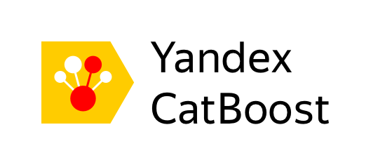


Main Boosting libraries
LightGBM
LightGBM
Notes:
Today we have several highly efficient implementation of this technique: XGBoost, CatBoost and LigthGBM

Slide 7
CatBoost advantages
    Good quality with default parameters
    Sophisticated categorical and text features support
    Model analysis tools
    Set of tools to make GBDT usage easier

Slide 8
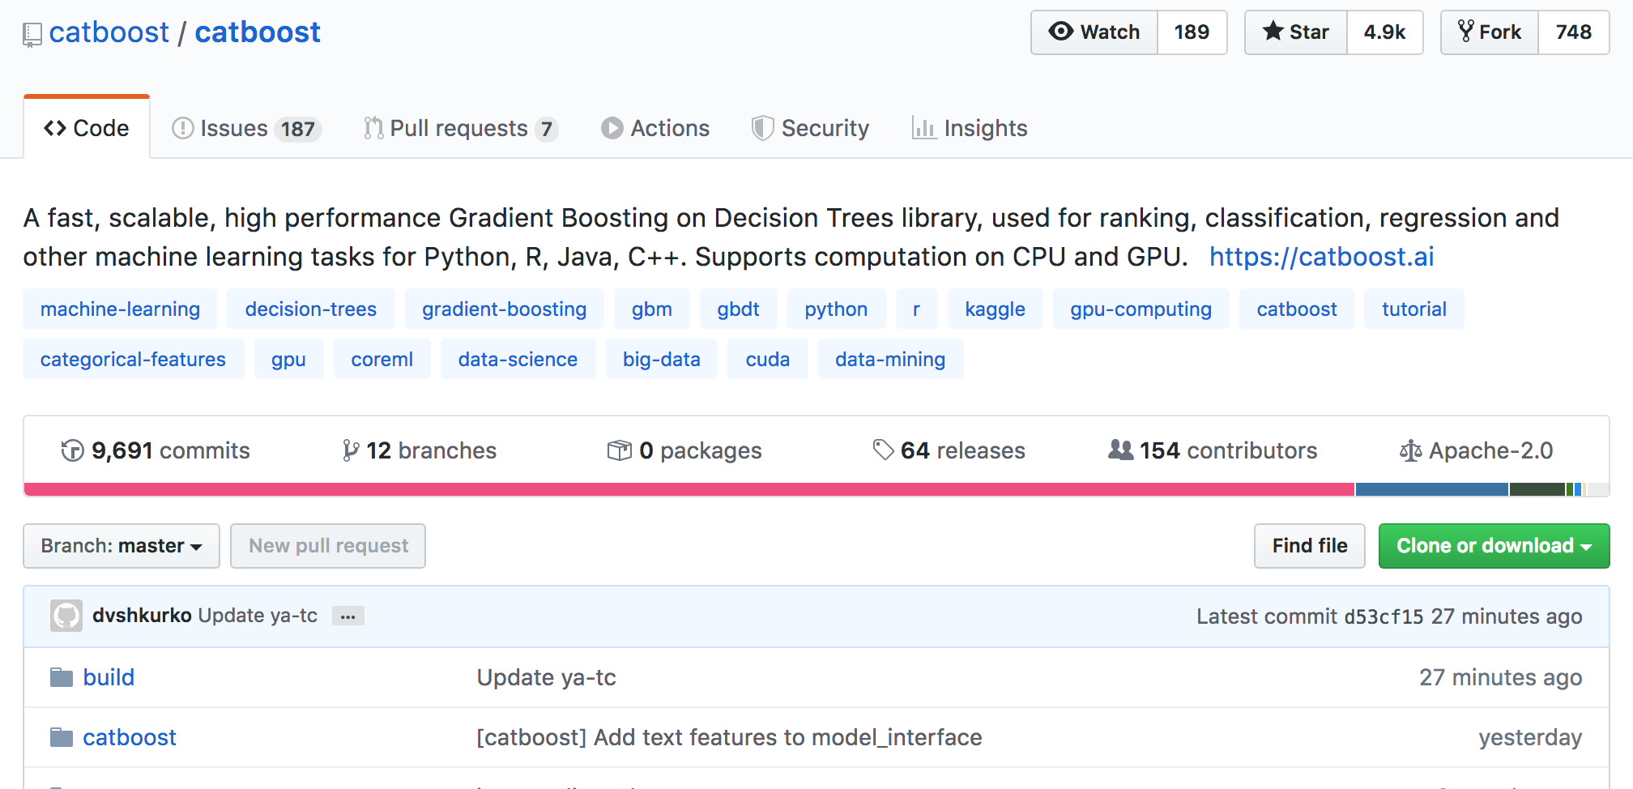
CatBoost
50K pip installs per week
4.9 stars on github
64 releases

Slide 9

CatBoost in Yandex
  Yandex.Zen
  Yandex.Music
  Yandex.Self-Driving Cars
  Yandex.Search
  Yandex.Ads
  Yandex.Weather
  Yandex Alice
  Practically everywhere!

Slide 10
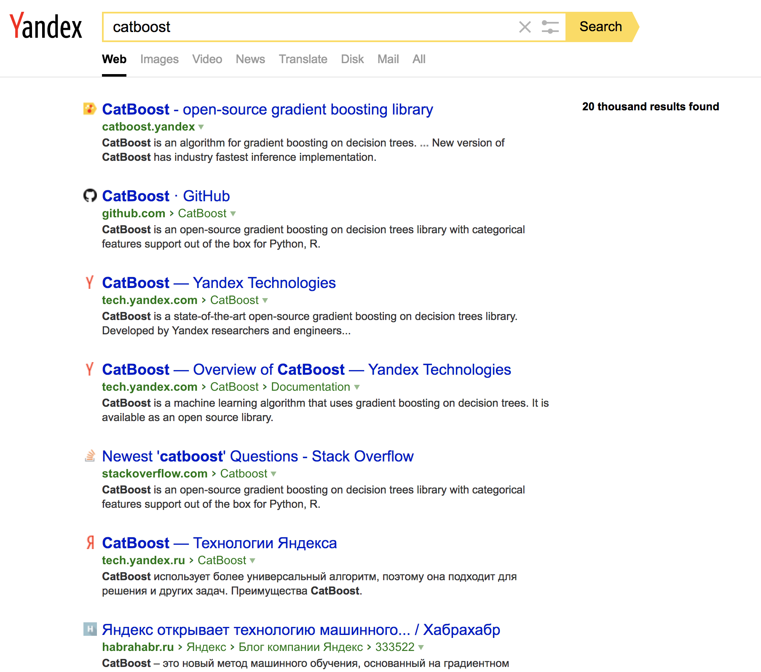
Yandex.Search
  Task?
    Search document order prediction
  Task type: ranking
  Dataset features:
    Classic features (PageRank, BM25 and others)
    Neural Networks output
  CatBoost features used:
    YetiRankPairwise target
    Distributed GPU training
    Model blending
    Feature importance analysis
    Ranking analysis

Slide 11
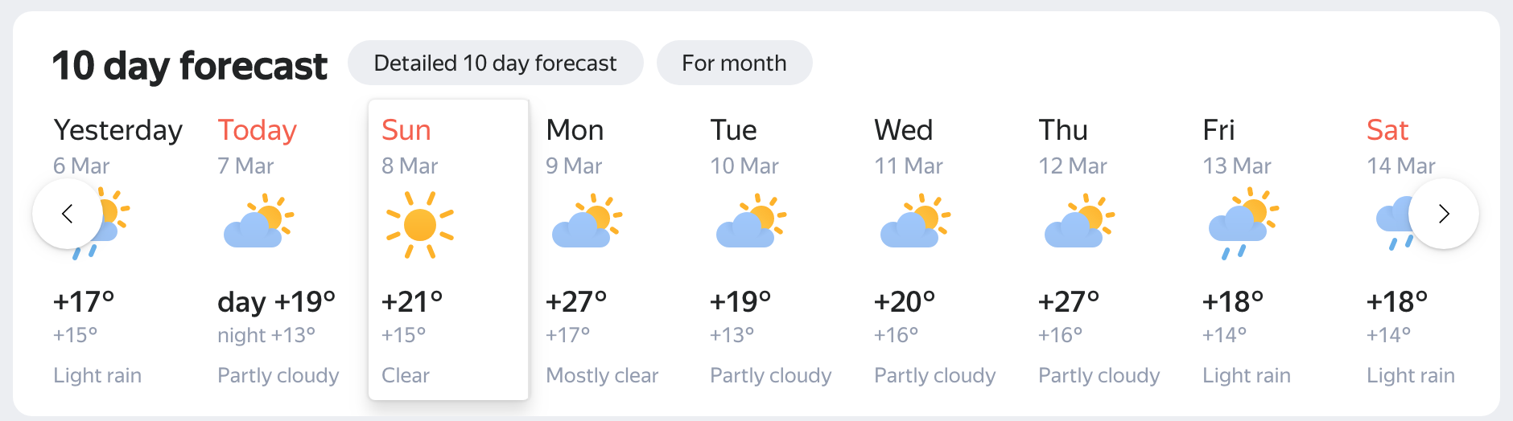
Yandex.Weather
  Task?
    Cloudiness type and temperature prediction
  Task type: multiclassification and regression
  Dataset features
    Physical weather model output
    Neural network output
    Online-data from weather stations
    Weather historical data
  CatBoost features used:
    Multiclassification target and RMSE (for temperature)
    GPU training
    Feature importance analysis
    Training process visualization

Slide 12
Yandex.Alice
  Task?
    Intent classification
    Select answer in chit chat mode
  Task type: classification, ranking
  Dataset features:
    Features based on dialog context
    Features based on suggested answer
  CatBoost features used:
    GPU training
    Feature importance analysis
    Training process visualization
    Have you seen the movie “Her”?
    Is it very scary?
    It is very kind and nice
    I should watch it then

Slide 13






CatBoost in the Wild
    Recommendations at Netflix
    Hotel ranking in Aviasales
    Protection against bots in CloudFlare
    Particle classification in CERN
    Medical research at University of NSW Sydney
    Destination prediction in Careem taxi service
    ML competitions on Kaggle

Slide 14
Numerical features
Yes
Salary > 30 000
No
Notes:
Категориальные фичи

Slide 15
Categorical features
Engineer
Categorical data
Designer
Occupation
Writer
Manager
HR
Notes:
Категориальные фичи

Slide 16

Categorical features handling
Genre
One-hot encoding
Jazz
Rock
Blues
Statistics based on category
Muse
AC/DC
Tool
Category-based
Label based:
calculated “online”
Greedy search for combinations
Artist
Notes:
For such conversion you could use one-hot-encodings . It is simple and efficient technique, but works only if categorical feature cardinality is low. In reality, many categorical features has a huge number of different values. As a result, it’s hard to build an ensemble of decision trees with help of this technique.
So, to wok with such features one usually makes some feature engineering instead of one hot encoding. And feature engineering is based on problem domain knowledge.

Slide 17
Online features for categories
    For every sample “online” feature is calculated using objects with the same category before this one
SDE
1
SDE
1
SDE
0
PR
i
SDE
1
PR
1 + 1 + 0
i
3
Notes:
Категориальные фичи

Slide 18

Text features
BM25
at first i was afraid i was petrified kept thinkin i could never live without you by my side
[0, 1, 2, 3, 4, 2, 3, 5, 6, 7, 2, 8, 9, 10, 11, 12, 13, 14, 15]
Naïve Bayes
Bag-of-Words
…
Dictionary
Notes:
Эмбеддинг,=и используем нескоклько перестановок при подсчете фичей, за счет чего выигрываем по качеству у наивного подхода (невозможно повторить снаружи от CatBoost обучения)
Бывает часто когда рядом с текстом есть некоторое количество фичей, (rotten tomatoes)

Slide 19
Text features examples
    Rotten Tomatoes: movie review
    Numerical
        runtime
        box_office – amount of money raised by ticket sales
    Categorical
    critic - name of reviewer
    publisher - journal where the review was published
    Text
    review - review of a movie, that was written by a critic
    genres - list of genres that are suitable for this film
review
One very long, dark ride.
genres
Action and Adventure | Art House and International | Drama | Mystery and Suspense
Notes:
Эмбеддинг,=и используем нескоклько перестановок при подсчете фичей, за счет чего выигрываем по качеству у наивного подхода (невозможно повторить снаружи от CatBoost обучения)
Бывает часто когда рядом с текстом есть некоторое количество фичей, (rotten tomatoes)

Slide 20
Profit from text features
Accuracy on Rotten Tomatoes
Numerical + Caterogical
0.4592
+ BOW
0.4616
+ Online Text Features
0.4714
Notes:
Эмбеддинг,=и используем нескоклько перестановок при подсчете фичей, за счет чего выигрываем по качеству у наивного подхода (невозможно повторить снаружи от CatBoost обучения)
Бывает часто когда рядом с текстом есть некоторое количество фичей, (rotten tomatoes)

Slide 21

Text features in Training
    Tokenization
    Building dictionaries
    Building “online” features
Input text
Tokenizing
Creating dictionary
Applying feature
These computed
estimators
features are passed
to training procedure
Notes:
Эмбеддинг,=и используем нескоклько перестановок при подсчете фичей, за счет чего выигрываем по качеству у наивного подхода (невозможно повторить снаружи от CatBoost обучения)
Бывает часто когда рядом с текстом есть некоторое количество фичей, (rotten tomatoes)

Slide 22
Preprocessing stage
    Split into words
    Process numbers and punctuation
    Build letter and word dictionaries
    Build ngram dictionaries or BPE
Notes:
Эмбеддинг,=и используем нескоклько перестановок при подсчете фичей, за счет чего выигрываем по качеству у наивного подхода (невозможно повторить снаружи от CatBoost обучения)
Бывает часто когда рядом с текстом есть некоторое количество фичей, (rotten tomatoes)

Slide 23
Bag of Words
    Default: word unigrams + word bigrams
    For a given dictionary (set of tokens)– is this token present in text?
Dictionary 1:
yesterday, petrified
Dictionary 2:
at+first, i+am
at first i was afraid i was petrified kept thinkin i could never live without you by my side
Feature values:
0,1,1,0
Notes:
Эмбеддинг,=и используем нескоклько перестановок при подсчете фичей, за счет чего выигрываем по качеству у наивного подхода (невозможно повторить снаружи от CatBoost обучения)
Бывает часто когда рядом с текстом есть некоторое количество фичей, (rotten tomatoes)

Slide 24
Naïve Bayes
    For every class a new feature P(Class|Text)
    P(Class|Text) is replaced with P(Class) * Пi P(wordi | Class)
    Most importantly: calculate it “online”
Notes:
Эмбеддинг,=и используем нескоклько перестановок при подсчете фичей, за счет чего выигрываем по качеству у наивного подхода (невозможно повторить снаружи от CatBoost обучения)
Бывает часто когда рядом с текстом есть некоторое количество фичей, (rotten tomatoes)

Slide 25
BM-25 for MultiClass
    A new numerical feature for every class of multi-classification
    TF – frequency of a word in text
    IDF – inverted frequency of a word in a “document”, where
    “document” is a concatenation of all texts in this class
    Most importantly: calculate it “online”
Notes:
Эмбеддинг,=и используем нескоклько перестановок при подсчете фичей, за счет чего выигрываем по качеству у наивного подхода (невозможно повторить снаружи от CatBoost обучения)
Бывает часто когда рядом с текстом есть некоторое количество фичей, (rotten tomatoes)

Slide 26
Text processing in CatBoost
    catboost.Tokenizer
    catboost.Dictionary
    Advantages:
    Fast
    Customizable
    Production-ready
    Can be used with other libraries, including Neural Networks
Notes:
Эмбеддинг,=и используем нескоклько перестановок при подсчете фичей, за счет чего выигрываем по качеству у наивного подхода (невозможно повторить снаружи от CatBoost обучения)
Бывает часто когда рядом с текстом есть некоторое количество фичей, (rotten tomatoes)

Slide 27
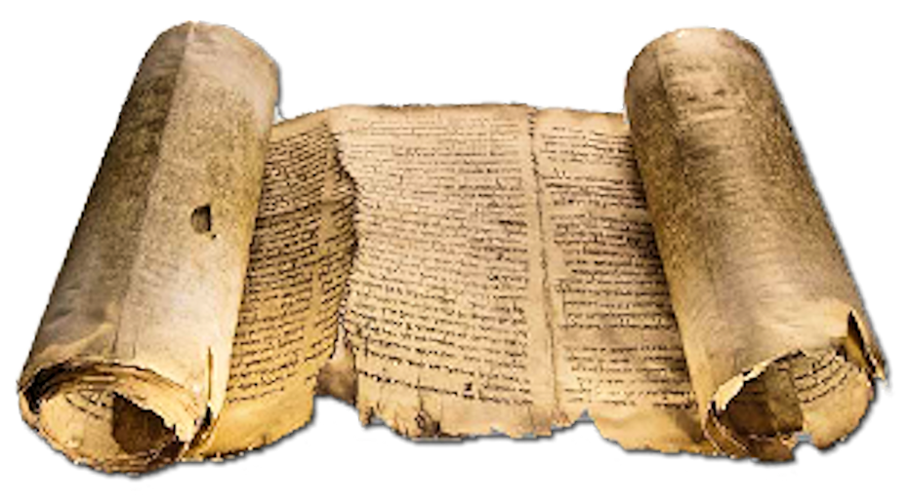
Text features handling
Bag of Words
Light models based on text and labels
    Distance for "mean" embedding in class
    Distance to NN
    …
+
Features based
on embeddings
Word2Vec, FastText,
etc
Notes:
For such conversion you could use one-hot-encodings . It is simple and efficient technique, but works only if categorical feature cardinality is low. In reality, many categorical features has a huge number of different values. As a result, it’s hard to build an ensemble of decision trees with help of this technique.
So, to wok with such features one usually makes some feature engineering instead of one hot encoding. And feature engineering is based on problem domain knowledge.

Slide 28
Other new features in CatBoost
^
Notes:
Эмбеддинг,=и используем нескоклько перестановок при подсчете фичей, за счет чего выигрываем по качеству у наивного подхода (невозможно повторить снаружи от CatBoost обучения)
Бывает часто когда рядом с текстом есть некоторое количество фичей, (rotten tomatoes)

Slide 29
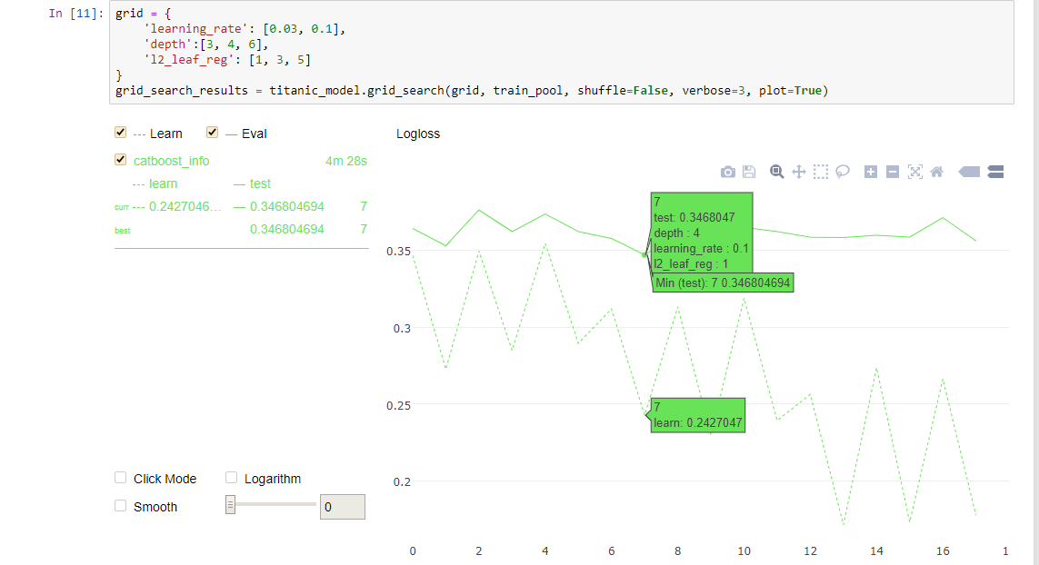
Parameter tuning out of the box

Slide 30
Parameters with effect on quality
    Automatic leaning rate selection
    Different tree growing strategies
    Separate quantization for “golden” features
    Improved sampling “MVS”
    Exact calculation for leaf values in some modes
^
Notes:
Эмбеддинг,=и используем нескоклько перестановок при подсчете фичей, за счет чего выигрываем по качеству у наивного подхода (невозможно повторить снаружи от CatBoost обучения)
Бывает часто когда рядом с текстом есть некоторое количество фичей, (rotten tomatoes)

Slide 31
Training on Large Data
    Local Quantization:
    Compressing huge dataset to quantized form
    Training on a single machine with 8 Volta GPUs on hundred gigabyte datasets
    Most datasets fit to memory of one machine
^
Notes:
Эмбеддинг,=и используем нескоклько перестановок при подсчете фичей, за счет чего выигрываем по качеству у наивного подхода (невозможно повторить снаружи от CatBoost обучения)
Бывает часто когда рядом с текстом есть некоторое количество фичей, (rotten tomatoes)

Slide 32
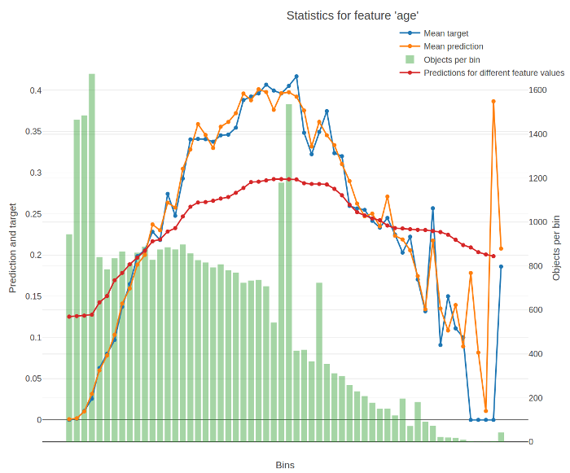
New Model Analysis tools
    Per feature model analysis charts
    New types of feature importance
    Tree visualization
    Ranking analysis
^
Notes:
Эмбеддинг,=и используем нескоклько перестановок при подсчете фичей, за счет чего выигрываем по качеству у наивного подхода (невозможно повторить снаружи от CatBoost обучения)
Бывает часто когда рядом с текстом есть некоторое количество фичей, (rotten tomatoes)

Slide 33










Integration in production

Slide 34
Speedups
    Huge speedups of preprocessing
    Sparse data support
    Up to 20x speedups of different modes
    Huge speedups for small datasets
^
Notes:
Эмбеддинг,=и используем нескоклько перестановок при подсчете фичей, за счет чего выигрываем по качеству у наивного подхода (невозможно повторить снаружи от CatBoost обучения)
Бывает часто когда рядом с текстом есть некоторое количество фичей, (rotten tomatoes)

Slide 35
Questions?
    catboost.ai
    github.com/catboost
    twitter.com/CatBoostML
    t.me/catboost_en, t.me/catboost_ru
    ods.ai => slack (40k people community) => tool_catboost chanel
Anna Veronika Dorogush
Head of CatBoost team

