Slide 1
I_{ele}
V = 0
I_{ref}
Electrode
R_{ref} (1MΩ)
1 kHz
-
+

Slide 2
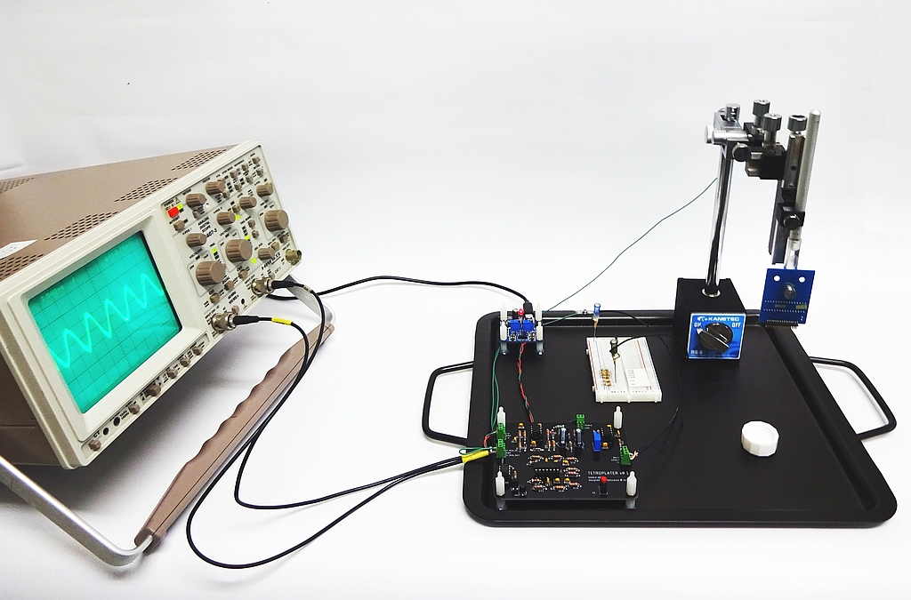
3
7
2
6
1
4
5

