Slide 1
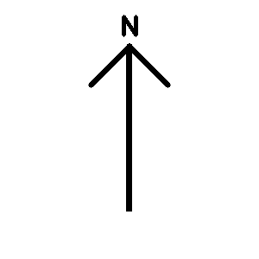
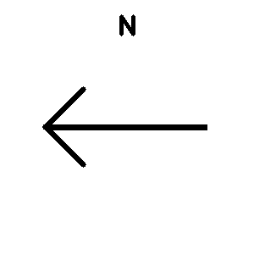
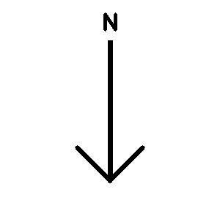
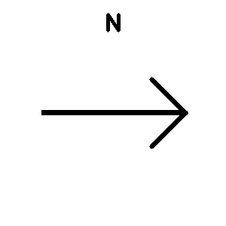
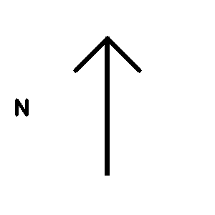
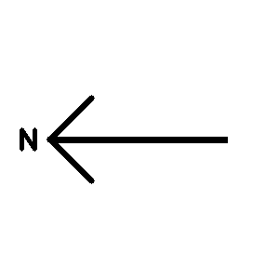
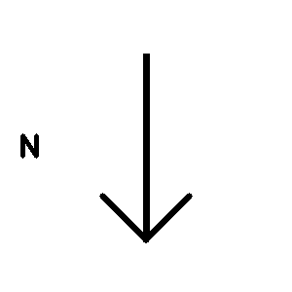
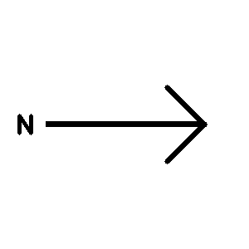
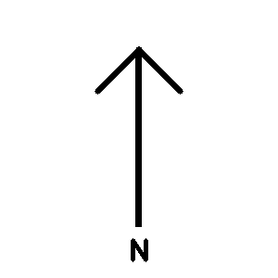
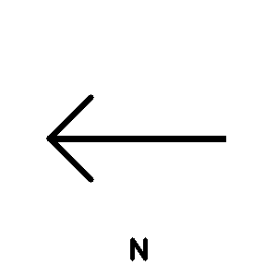
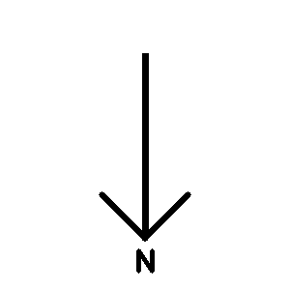
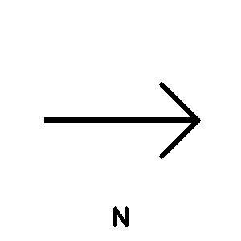
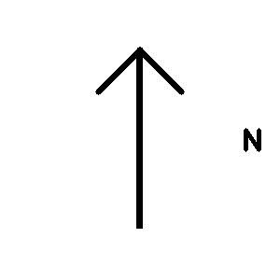
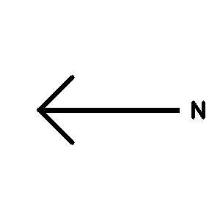
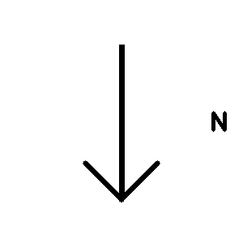
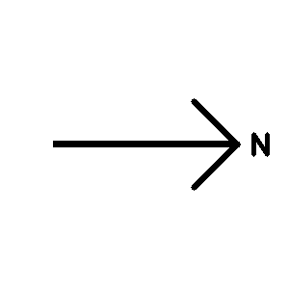
The Compass Problem
Image Set Details:
16 images
4 directions
300x300 pixels
4 “correct” images
12 “incorrect” images

Slide 2
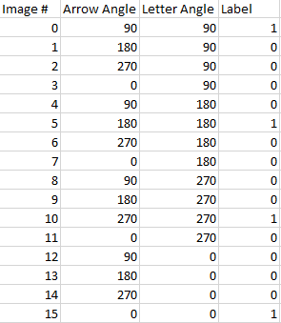
Feature Extraction
Summarize 90000 features (300x300) down to 2 by manually creating features
90
180
0
270

Slide 3
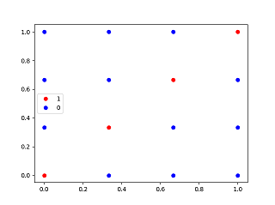
Grid
Note: This is the grid, but divided by 270

Slide 4
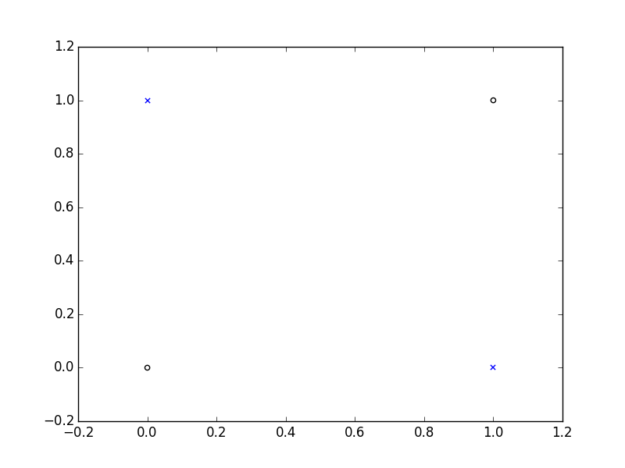
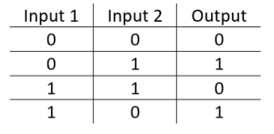
XOR Problem

Slide 5
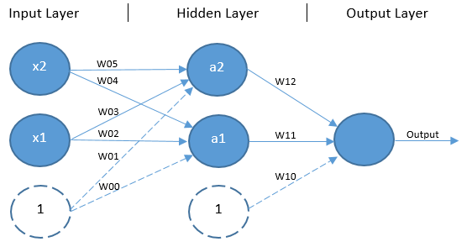
XOR Neural Network

Slide 6
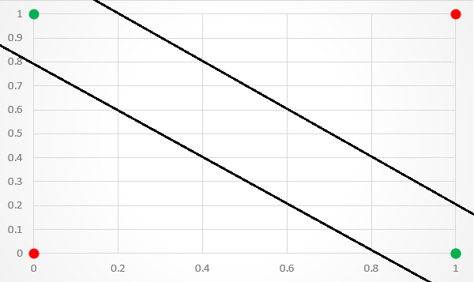
After Training NN on XOR Points

Slide 7
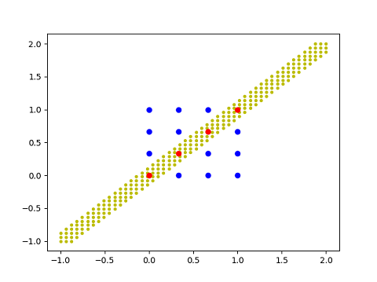
Problem: Training set = entire data set
Result: Perfect classification since we’re using the entire data set

Slide 8
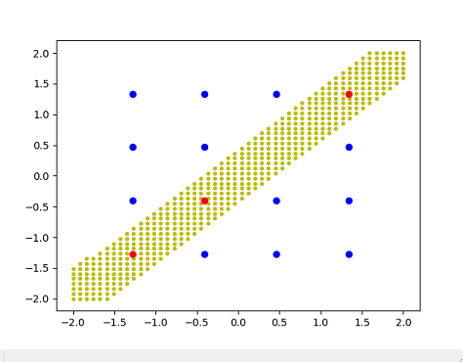
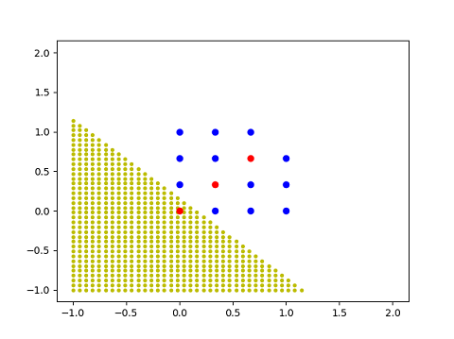
Let’s start using a test set
Test set = 1 point
Almost always converges to a good solution (Cost: <0.01)
Example of a bad solution (Cost: ~0.30)

Slide 9
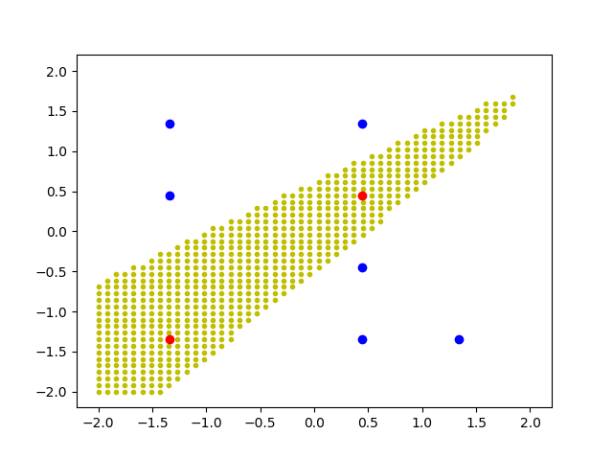
Lucky for us, we know the desired cost for a good solution because we trained on the full grid
Write a program that will scrap bad solutions (Cost > .01) and will retrain a new NN until we get one that is global minima (good solution)
Setup: 50% train set, 50% test set
Result: Correctly guessed 7 of 8 test points

Slide 10
Full Pipeline
Feature Extraction
Data Preprocessing
Train Set
Split Data Set
XOR ANN
Train NN
When it reaches desired cost
Test Set
Test it

Slide 11
Takeaways From NN Approach
Proof of Concept
We can train a NN to look at new images, and for the most part correctly guess whether there is a labeling “bug” or not
Issues with this approach
The only reason we successfully converged is because we knew the desired cost. This is not known in most situations, so we typically get stuck in a local minima
We manually created features to mimic XOR problem. This is not possible in most situations
Next step
Use automatic feature extraction instead of manual

