Slide 1
IMDb Graph Reconstruction Using Expectation Maximization Algorithm based Link Prediction
Matthew Halligan
Graph Analytics Spring 2025
April 28, 2025
Dr. Cetin Savkli

Slide 2
Agenda
Introduction to the Problem
Goal for this project
Initial Dataset analysis
Expectation Maximization (EM) algorithm
Actor-Genre Preference Results
Link Prediction Methods
Link Prediction Results
Future Work
References

Slide 3
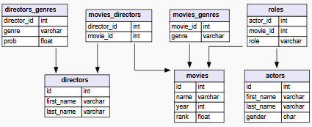
Introduction to the problem
The IMDb dataset is a relational database which exhibits a many to one relationship between the roles actors play and the actors and movies they are in.
The schema does not enable direct connection between actors and genres
This database is liable to have noise from:
  missing data about which roles were played by actors
  inaccurate movie genre classifications
  or actors with data that is limited

Slide 4
Goal of this Project
Reconstruct missing or predict uncertain relationships about actors and the movies they likely had a role in
The reconstruction is based on the genre and other directors that they commonly worked with.
This is a link prediction problem where given a genre, an actor, a movie, and a director, what is the probability that the actor will have a role in this movie that is, what is P(role | genre, actor, movie, director)?

Slide 5
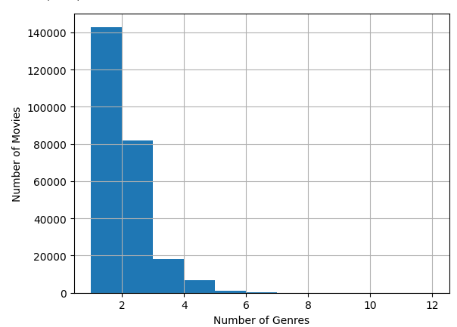
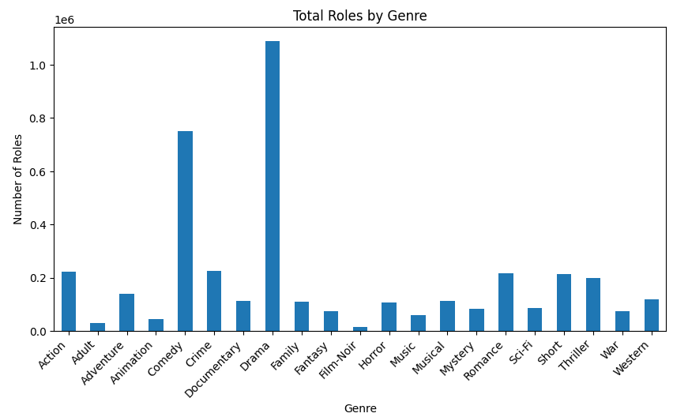
About the IMDb Dataset
Sum of rows in all tables: 4,082,117
Quantity of unique actors: 679,410
Quantity of Unique Genres: 21
Quantity of unique actor-genre pairs: 4,082,117

Slide 6
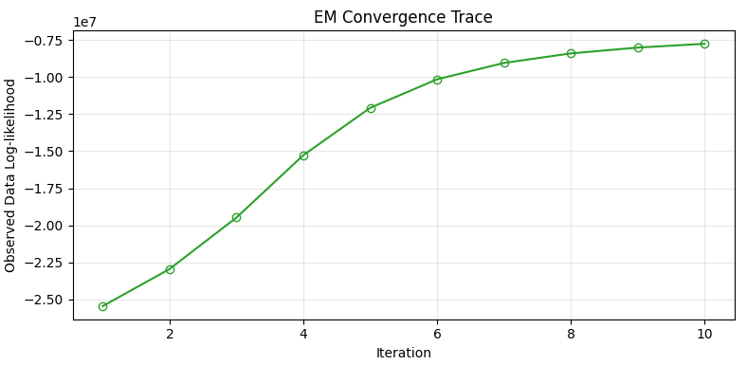

Expectation Maximization (EM) Algorithm
Introduced in “Networks” [5] chapter 9.3 provides the computational procedures for implementing the Method of Maximum Likelihood to identify error in graph structure measurements.
Takes an iterative approach defined concisely in [3]:
Start with initial guesses for the parameters ${\hat{θ}}^{(0)}$
Expectation Step: at the jth step, compute
  $$Q\left(θ^{′},{\hat{θ}}^{\left(j\right)}\right)=E(l_{0}(θ^{′};T)|Z,{\hat{θ}}^{(j)})$$
Maximization Step: determine the new estimate${\hat{ θ}}^{(j+1)}$as the maximizer of $Q\left(θ^{′},{\hat{θ}}^{\left(j\right)}\right)$ over $θ′$
Iterate steps 2 and 3 until convergence
Observed Delta of Log-Likelihood convergence starting with random distributions and converging

Slide 7
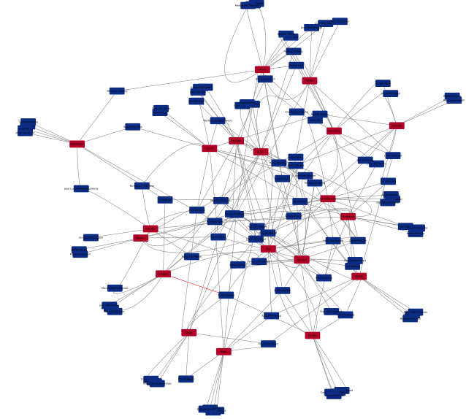
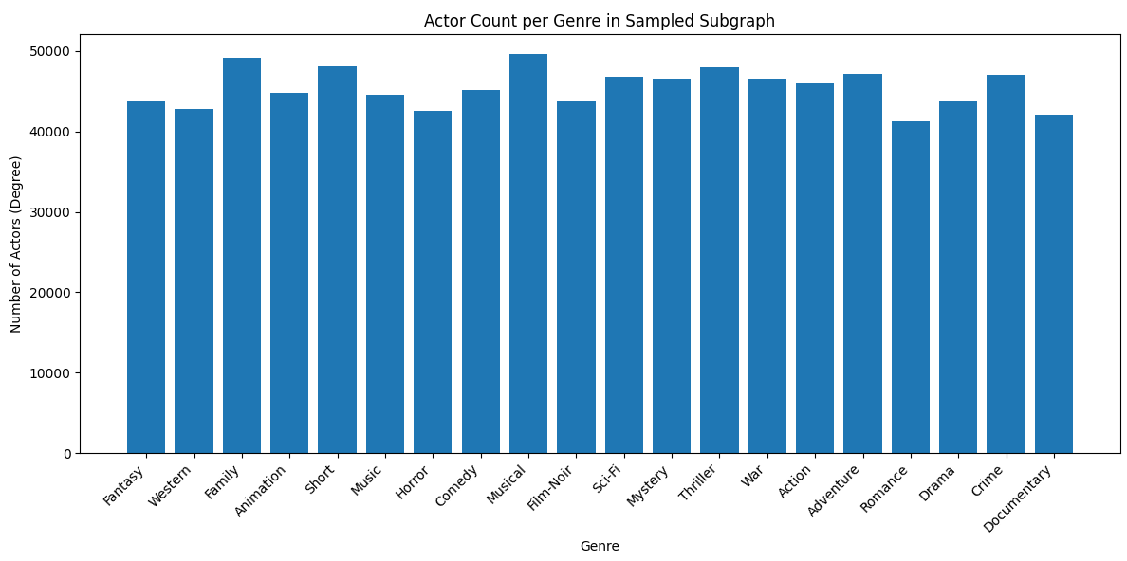
Actor-Genre Preference Results
Randomly sampled the network
Leaf nodes show actors(blue) who show preference to a single genre(red)
A subset of actor nodes worked across genres during their career
This random sampling does not match the expected preferences shown by role count.
  Likely a result of parameter choice such the sampling threshold is too low

Slide 8
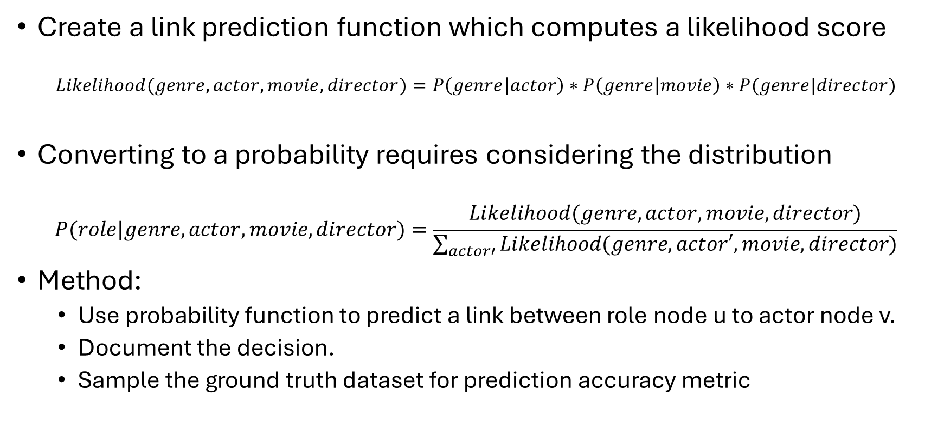
Link Prediction Method
Create a link prediction function which computes a likelihood score
$$Likelihood(genre,actor, movie, director)=P\left(genre | actor\right)∗P\left(genre | movie\right)∗P(genre|director)$$
Converting to a probability requires considering the distribution
$$P(role|genre, actor, movie, director)=\frac{Likelihood(genre,actor, movie,director)}{\sum_{actor′}{Likelihood(genre,actor′, movie,director)}}$$
Method:
  Use probability function to predict a link between role node u to actor node v.
  Document the decision.
  Sample the ground truth dataset for prediction accuracy metric

Slide 9
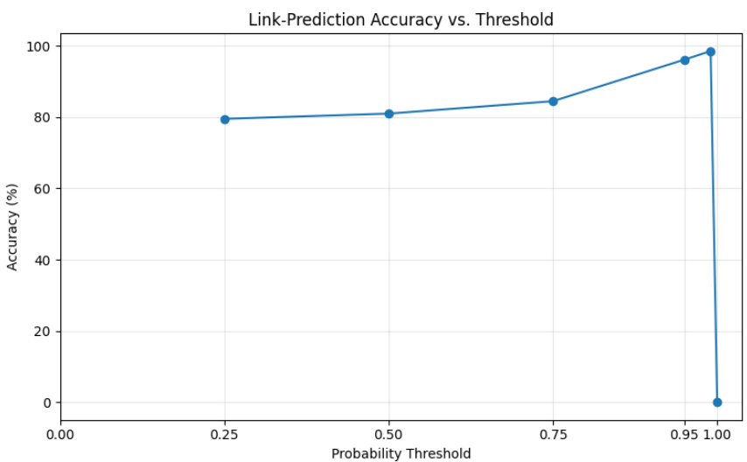
Link Prediction Parameter Tuning Results
Sample size of “likelihood scored” tuples: 116,000
Probability Threshold | Predicted Edges | Correctly Predicted Edges | Accuracy (%)
0.25 | 40,984 | 32,571 | 79.47%
0.50 | 38,982 | 31,553 | 80.94%
0.75 | 36,992 | 31,230 | 84.42%
0.95 | 32,280 | 31,008 | 96.06%
0.99 | 31,386 | 30,907 | 98.47%
1.00 | 77 | 0 | 0.00%

Slide 10
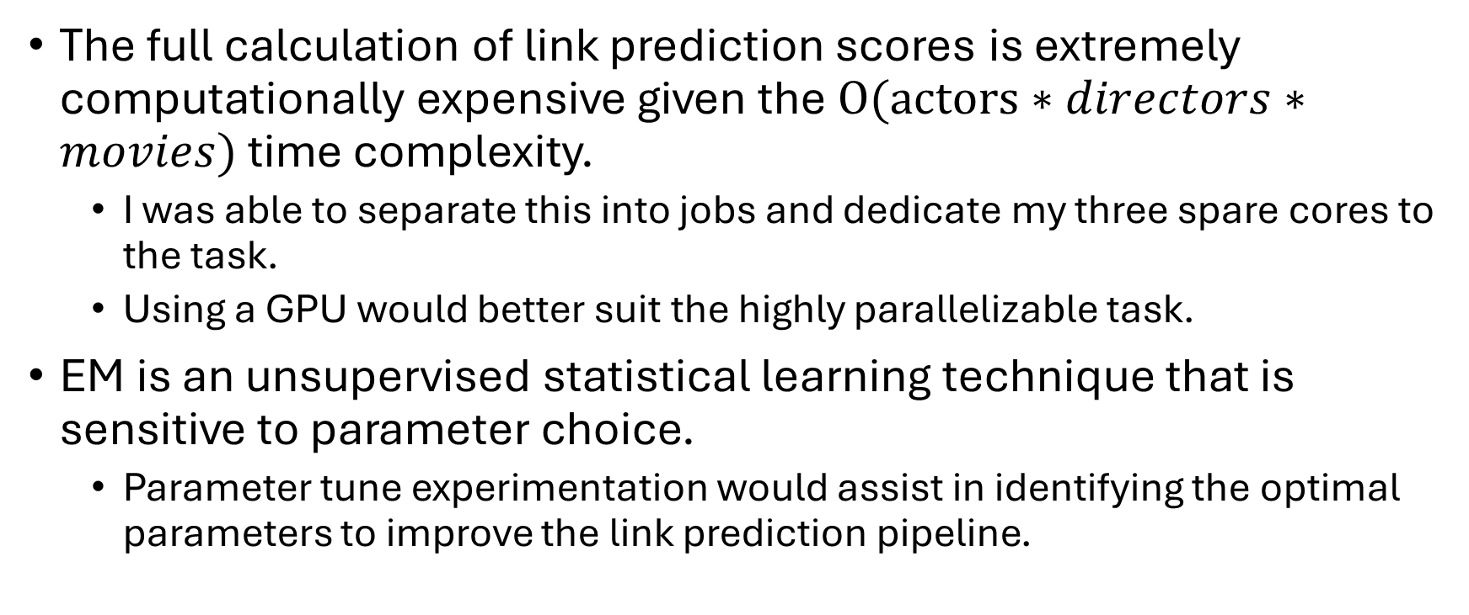
Future Work
The full calculation of link prediction scores is extremely computationally expensive given the$O(actors∗directors∗movies)$ time complexity.
  I was able to separate this into jobs and dedicate my three spare cores to the task.
  Using a GPU would better suit the highly parallelizable task.
EM is an unsupervised statistical learning technique that is sensitive to parameter choice.
  Parameter tune experimentation would assist in identifying the optimal parameters to improve the link prediction pipeline.

Slide 11
References
[1] M. Collins, "The Naive Bayes Model, Maximum-Likelihood Estimation, and the EM Algorithm," [Online]. Available: https://www.cs.columbia.edu/~mcollins/em.pdf. [Accessed: 14-Apr-2025].
[2] T. Ma and A. Ng, "CS229 Lecture Notes," Stanford University, 13-May-2019. [Online]. Available: https://cs229.stanford.edu/notes2022fall/cs229-notes8.pdf. [Accessed: 14-Apr-2025].
[3] T. Hastie, R. Tibshirani, and J. Friedman, The Elements of Statistical Learning: Data Mining, Inference, and Prediction, 2nd ed. New York, NY, USA: Springer, 2009.
[4] A. Sri (author at Towards Data Science), "Implementing Expectation Maximisation Algorithm From Scratch With Python," Towards Data Science, 2019. [Online]. Available: https://towardsdatascience.com/implementing-expectation-maximisation-algorithm-from-scratch-with-python-9ccb2c8521b3/. [Accessed: 14-Apr-2025].
[5] M. E. J. Newman, Networks, 2nd ed. Oxford, U.K.: Oxford Univ. Press, 2018.

