Slide 1


Slide 2
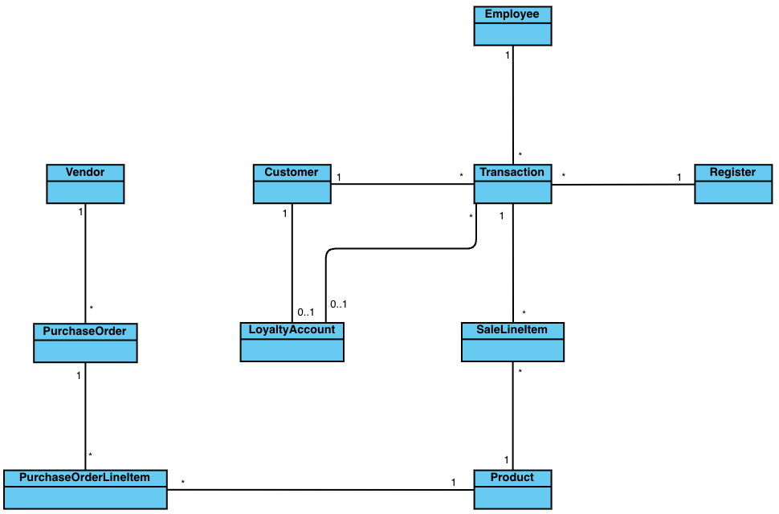
Canonical Data Model

Slide 3
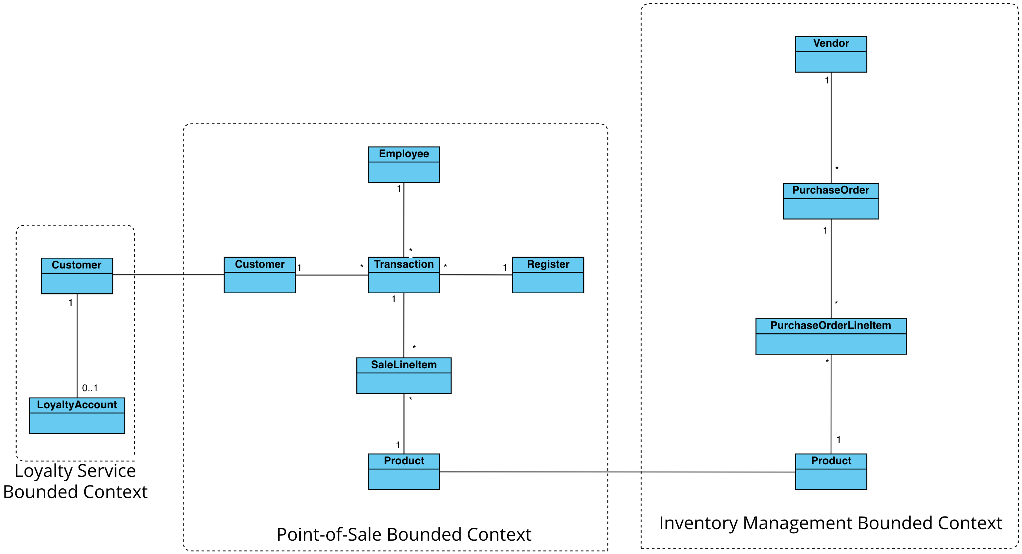
Context Map

Slide 4
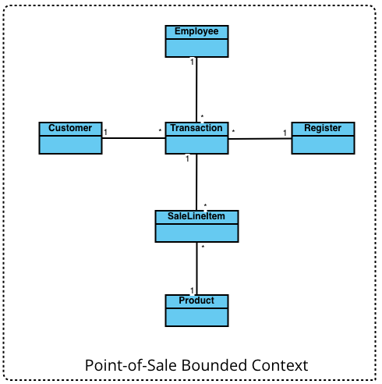
Point of Sale Bounded Context

Slide 5
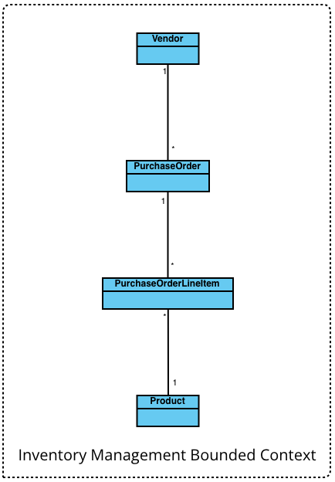
Inventory Management Bounded Context

Slide 6
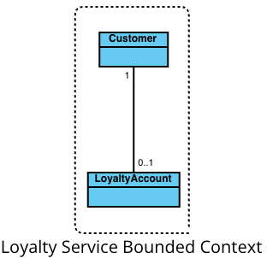
Loyalty Service Bounded Context

