Slide 1
Point of Sale Microservices
A Cloud-Native Microservices Application
Matthew Hays
Joshua Wellman

Slide 2
Project Theme
Modern point of sale (POS) system.
Designed for retail transactions and inventory management.
Supports seamless customer loyalty integration.
Microservice architecture
Inventory Service: Manages products, vendors, and purchase orders.
Loyalty Program Service: Tracks customer loyalty accounts and rewards.
Point of Sale (POS) Service: Handles retail transactions, registers, employees, and customer transaction history.

Slide 3
Project Theme
Scalability and Maintainability
Decoupled service for independent scaling and updates.
Supports future expansion with additional services.
Cloud Native and Containerized
Uses Spring Boot and Spring Cloud for microservices.
Deployed via Docker and managed with Docker Compose.

Slide 4
Project Theme
Centralized Configuration Management
Spring Cloud Config Server ensures consistent settings across environments.
Configuration stored in a dedicated Git repository for version control.
Real-World Application
Designed for businesses needing robust transaction, inventory, and customer loyalty solutions.
Flexible and extensible for diverse retail environments.

Slide 5
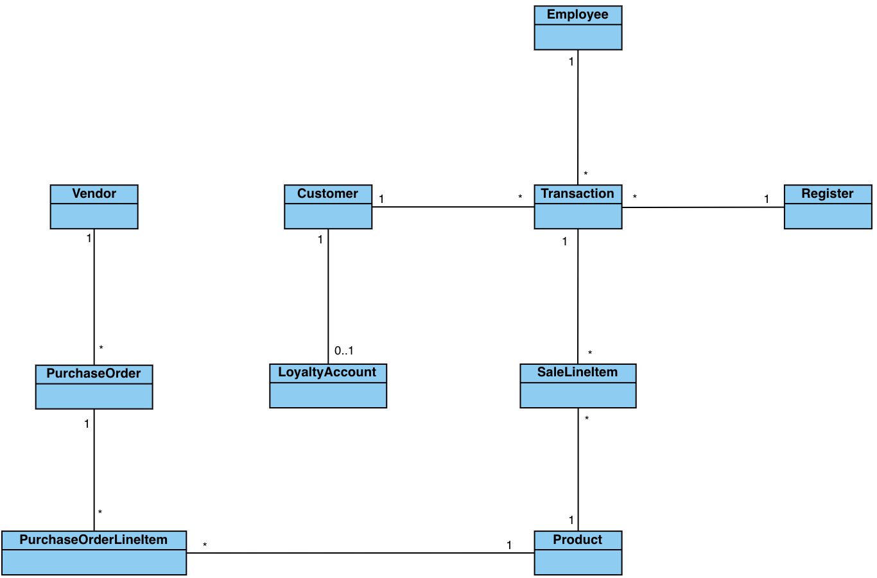
Canonical Model

Slide 6
Canonical Model
The canonical model was analyzed against business functions to develop the bounded contexts of the application:
Identified business functions
Retail transactions and management
Inventory management and vendor management
Loyalty and rewards tracking
Can be extended to add additional features, such as targeted marketing communications

Slide 7
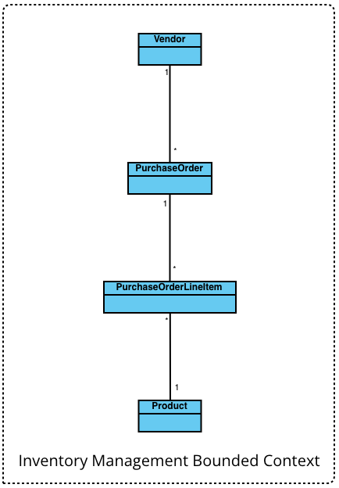
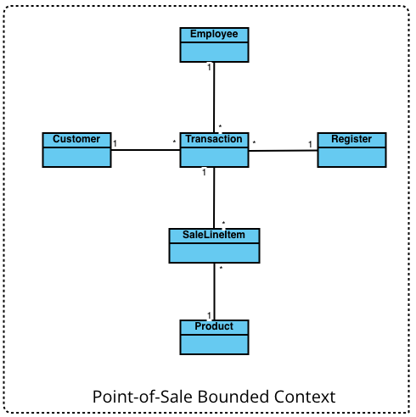
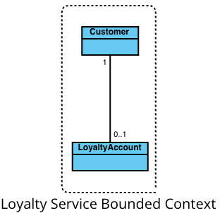
Bounded Contexts

Slide 8
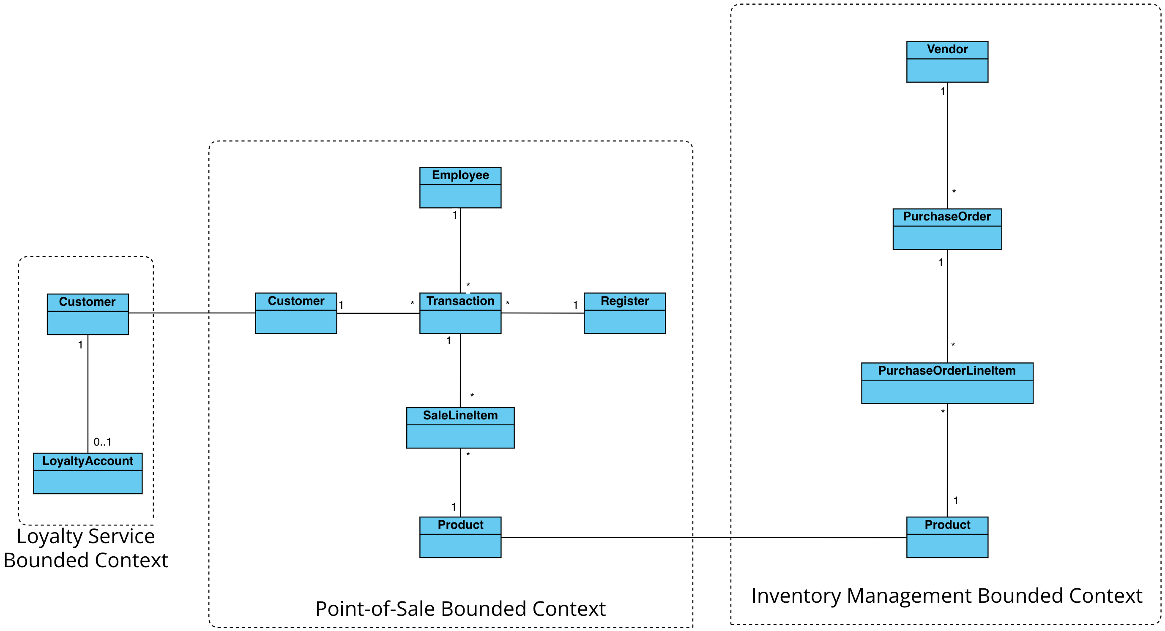
Context Map

Slide 9
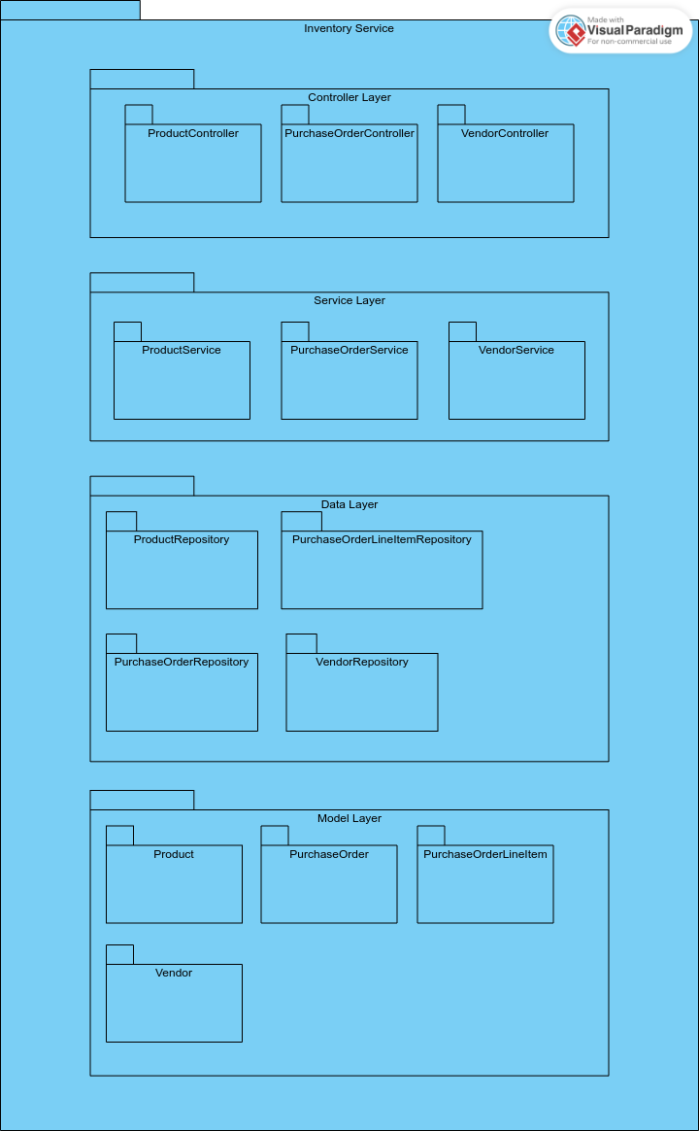
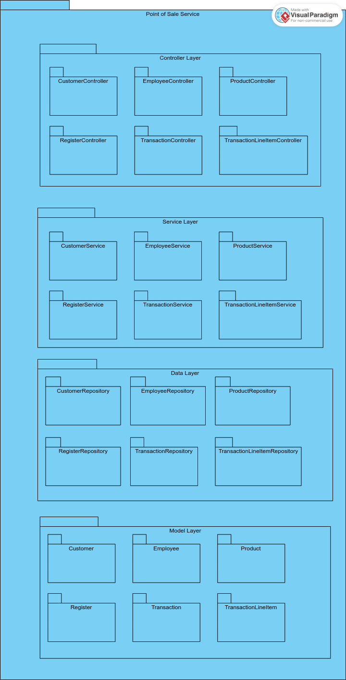
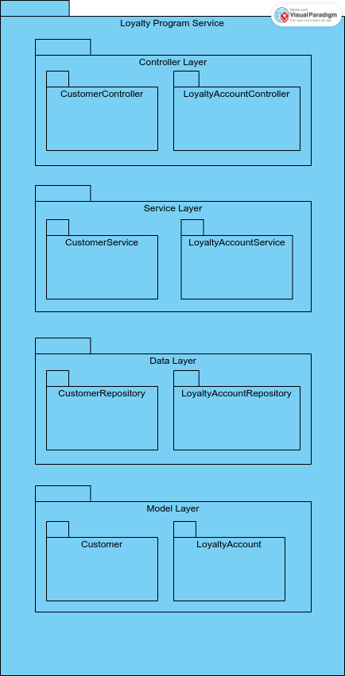
Package Diagram

Slide 10
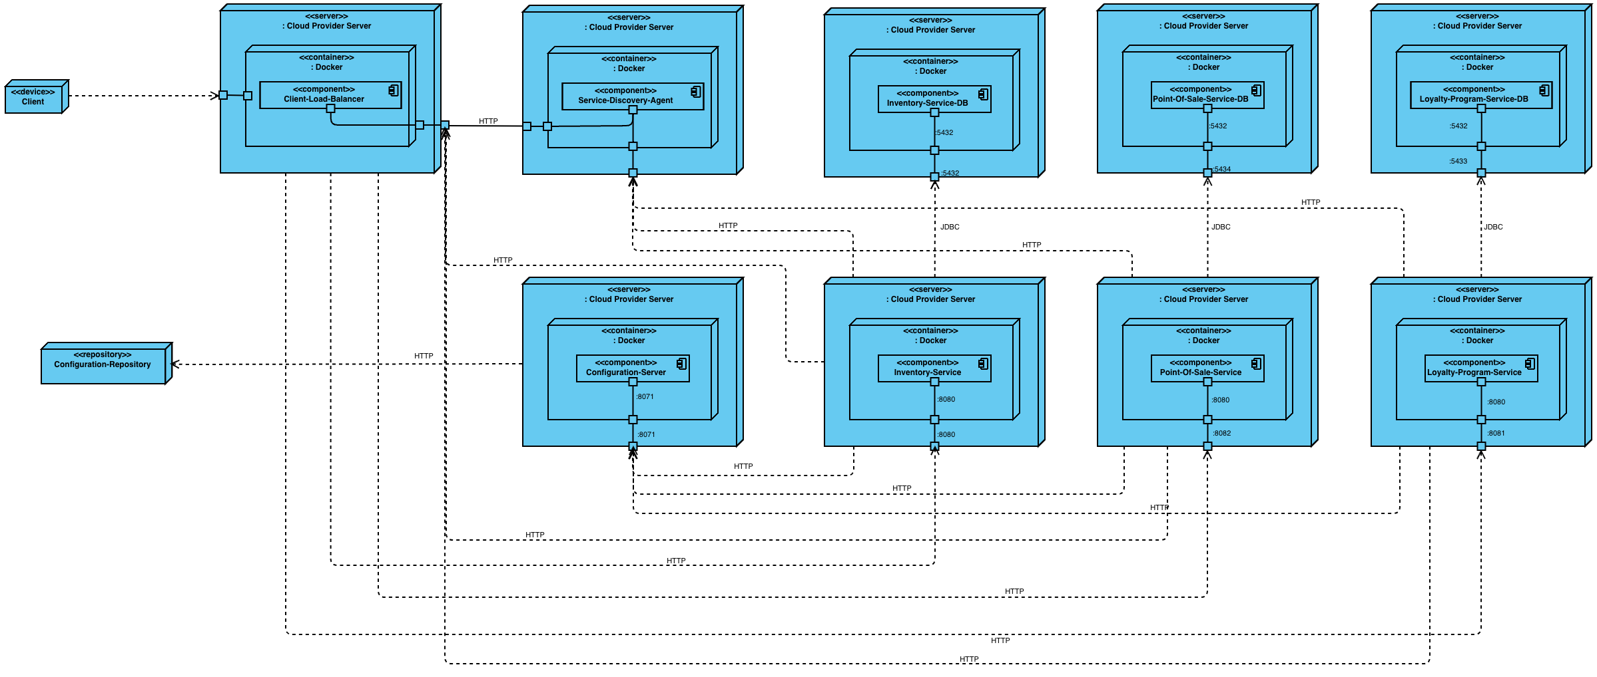
Deployment Diagram

Slide 11
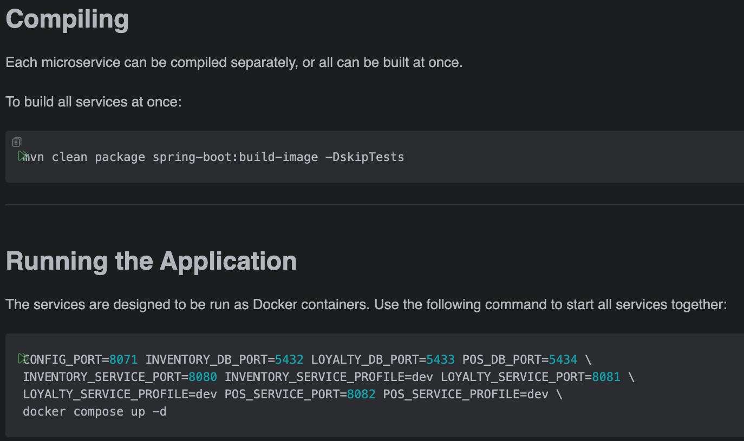
Running the Application
Visit https://github.com/Matt-Hays/csi-5347-course-project for more information.

Slide 12
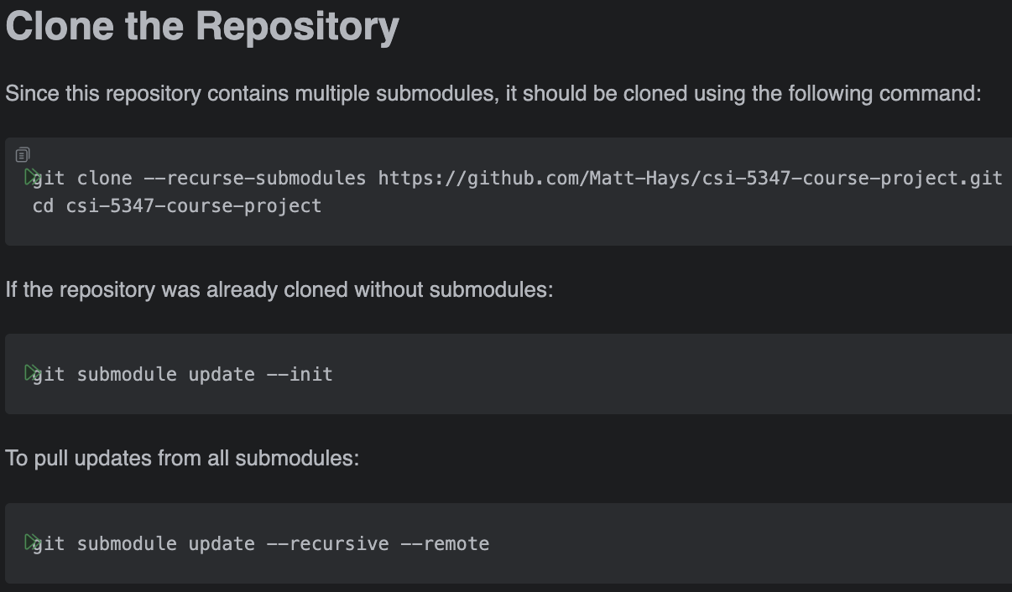
Codebase
https://github.com/Matt-Hays/csi-5347-course-project
Each service consists of a single, isolated codebase.

Slide 13

Demonstration

Slide 14
Next Steps
Implement the Service Discovery Agent for registration and query of services
Ensure services can query for other services
Implement a load balancer for the services
Finish implementing calls between services
Implement resiliency patterns between services
Improve payment methodologies
Implement centralized logging with ELK or Prometheus/Grafana
Implement security with Spring Security and Keycloak

Slide 15
Thanks

