Slide 1

Predicting Pitcher Performance Post Tommy John Surgery
Matthew Heinen
Bellevue University
DSC 630: Predictive Analytics
Professor Hua
2/22/2025

Slide 2
Problem Introduction
Pitcher Injury Increasing.
MLB requires pitchers to throw max effort more often.
35.3% of active MLB pitchers had undergone Tommy John in 2019 (American Medical Association).
29% increase from 2016 season (American Medical Association).
“Will I require Tommy John surgery?” -> “When will I require Tommy John Surgery?”

Slide 3
Solution and Project Goal
Can MLB front offices predict pitcher performance upon returning from Tommy John.
Pitcher performance (effectiveness in offense suppression).
Durability.
Competitive advantage over rival clubs.
Better allocation of contract salary.

Slide 4
Dataset and Features
Statcast (Pitcher Performance Data)
Tommy John Surgery List
Grouped by pitcher season.
Contains 71 different features.
Pitch mechanic data.
Offensive suppression data.
Grouped by pitcher and injury.
Contains 42 different features.
Demographic Information.
Injury/Surgery Information.

Slide 5
Models Built
Regression (Predicting XWOBA)
Classification (Durability)
XWOBA = expected weighted On base average.
Predicting pitchers XWOBA upon return from Tommy John Surgery.
Front office value: performance and effectiveness.
Will a pitcher throw more than 500 pitches after returning from Tommy John surgery.
MLB median value among all pitchers 504 pitches per season.
Front office value: durability.

Slide 6
Data Preparation
Handle missing values.
Merge Statcast and Tommy John Surgery List data.
On pitcher name and season.
Separate on pre and post Tommy John seasons.
Summarize by each player assigning appropriate aggregate function.
Merge data back together (one record per player) .
Apply train test split 80% train, 20% test.

Slide 7
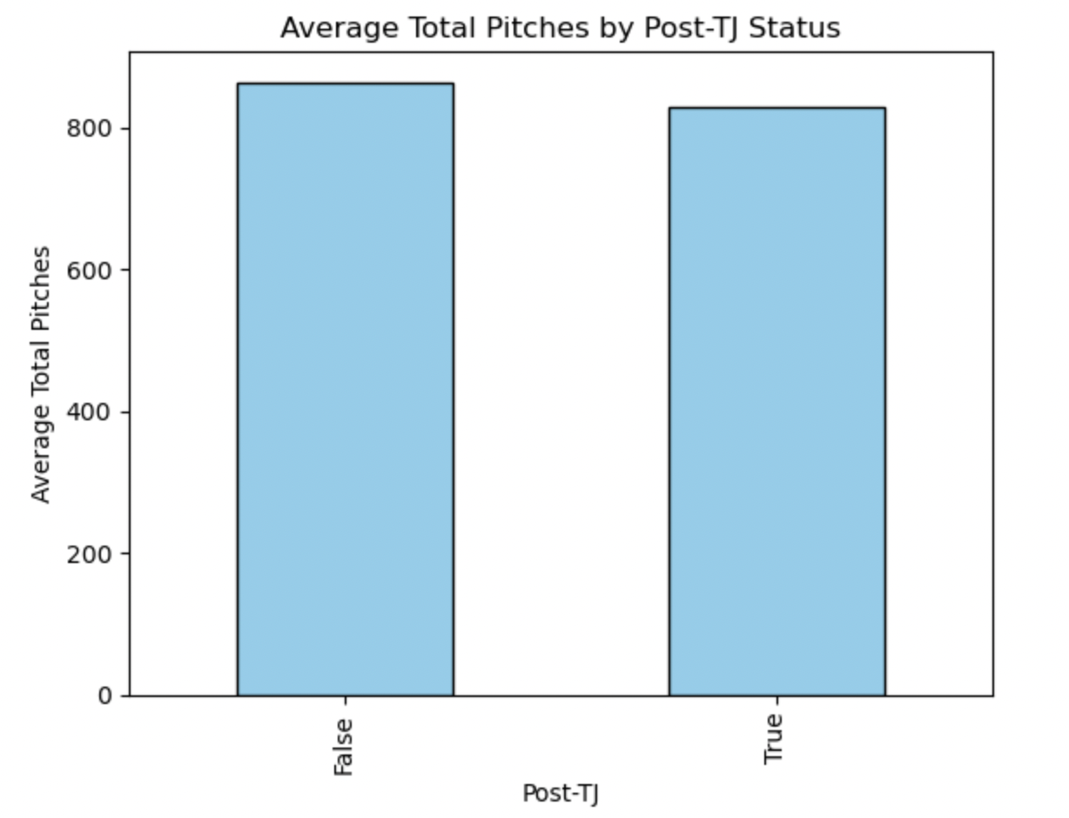
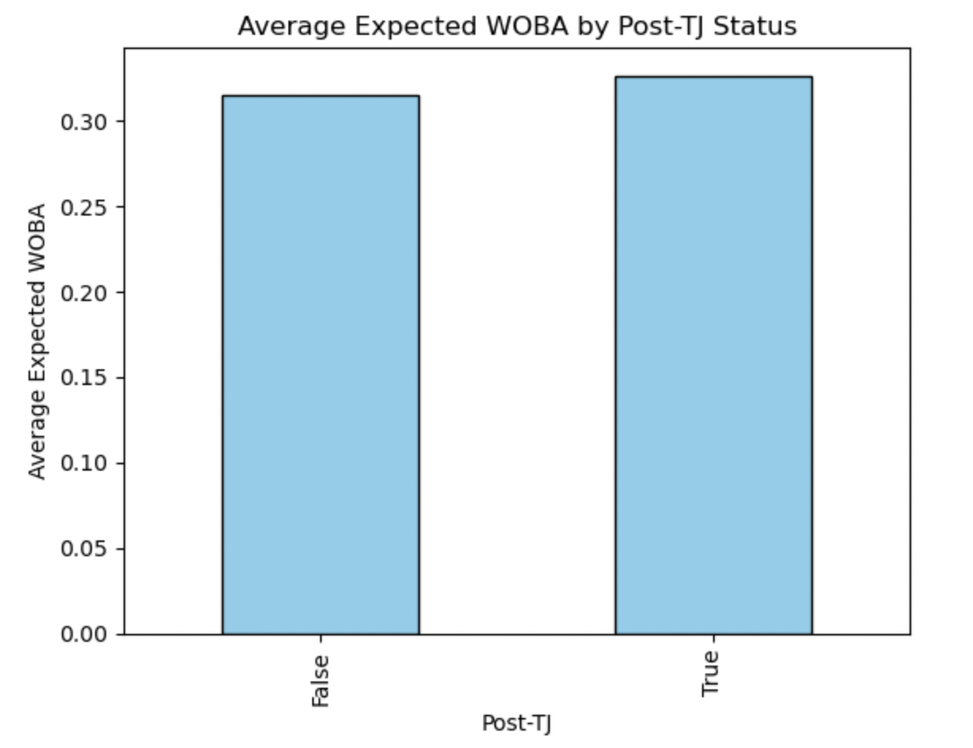
Exploratory Data Analysis
No statistical difference of means in number of pitched thrown pre and post Tommy John
P-Value = 0.56
Statistically significant difference between means of XWOBA pre and post Tommy John
P-Value= 0.01

Slide 8
Regression Model Predicting XWOBA
Backwards stepwise regression (p-value 0.05)
Overfitting (72 features)
Model memorizing demographic information from surgery dataset.
Backwards stepwise regression (p-value 0.05) no demographic information.
Performed much better mitigated much overfitting
Recursive Feature elimination no demographic information.
Best fitting model.

Slide 9
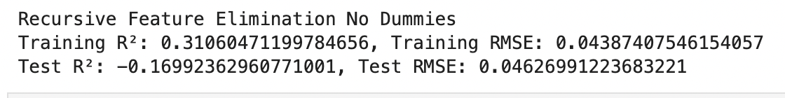
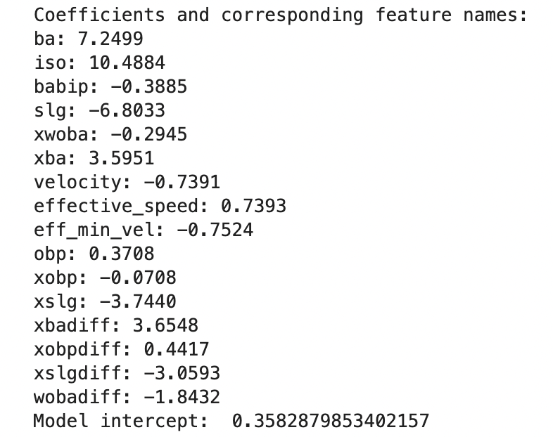
Recursive Feature Elimination Model Evaluation
Strong predictors:
Batting average
ISO (power stat)
Slugging percentage

Slide 10
Durability Classification Model Will a pitcher throw over 500 pitches upon return from Tommy John?
5 Different models trained
Logistic regression
Random forest
Decision Tree
Bagging(bootstrap aggregation)
Boosting
Gradient boosting
Grid Search Cross Validation (5 folds)
Balances the bias variation tradeoff and minimizes the effects of overfitting.
Model Selected: Gradient Boosting
Iterative process.
Strong accurate models with complex datasets.

Slide 11
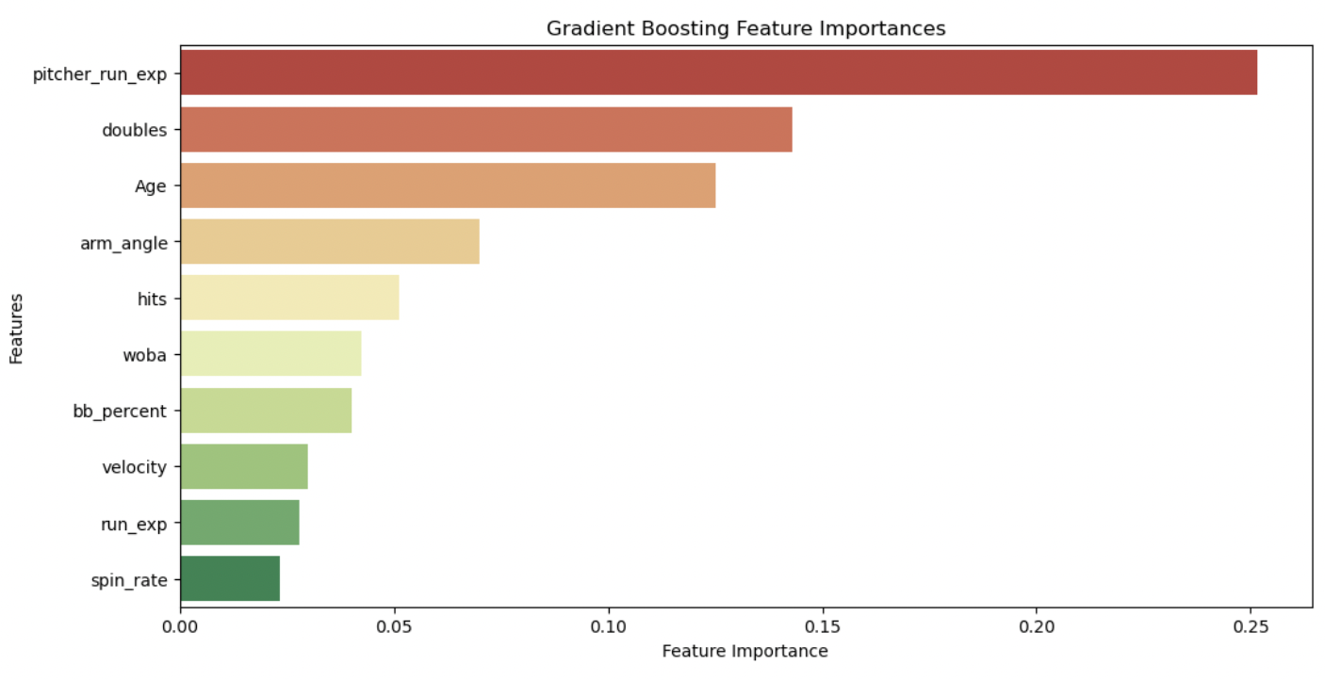
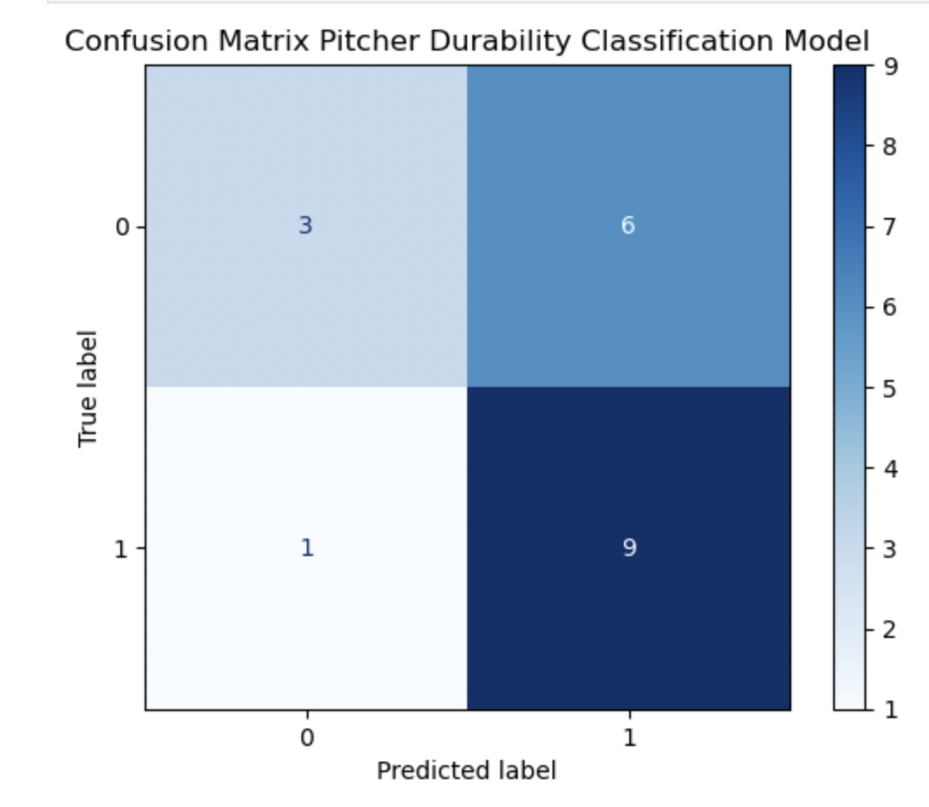
Classification Model Evaluation.
63% accuracy on test set.
Tendency to predict false positives.

Slide 12
Implementation Recommendations XWOBA Regression Model
Implementation
Improvement
Not strong enough to be sole decision maker.
Signs of overfitting.
Model can be used as part of conversation combined with more traditional scouting metrics.
Retrain models on larger dataset.
Only 91 MLB pitchers have pre and post Tommy John surgery data.
Expand dataset to include minor league and amateur stats.
Reduce overfitting.
Stronger model.

Slide 13
Implementation Recommendations. Durability Classification Model
Implementation
Improvement
More confident in this model.
63% accuracy.
Predictions should be used as part of conversation with player acquisition.
Great tool for quick trade deadline acquisitions.
Retrain models on larger dataset.
Only 91 MLB pitchers have pre and post Tommy John surgery data.
Expand dataset to include minor league and amateur stats.
More records may improve accuracy.

Slide 14
Ethical Considerations
Models could discriminate based on demographic information.
High school or college team information.
Pitcher livelyhoods effected.
Poor model projection.
Decreased career opportunities for players with few skills outside of baseball.

Slide 15
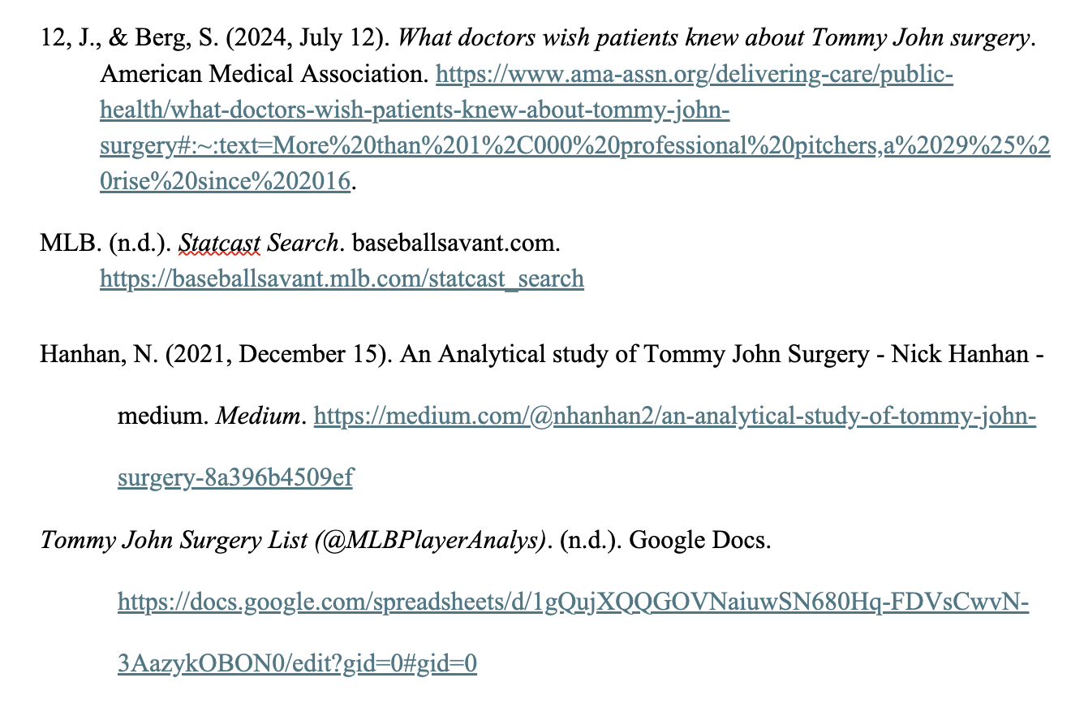
Resources

