Slide 1
RELAXIA® Scientific Platform
NOTE:
For DSCP demonstration purposes only.
This platform describes an imaginary product. Any real or perceived resemblance to existing products is coincidental.

Slide 2
Communication Objectives

Slide 3
Communication Objectives
Position RELAXIA® as a novel, innovate, first-in-class treatment that addresses the root cause of ADHD by restoring the brain’s natural ability to increase synaptic neurotransmitter levels without the need for stimulant-based medications.
Define the unmet need in patients who cannot use stimulant-based treatments due to tolerability issues and comorbidities.
Highlight the non-inferiority of RELAXIA® to dexamphetamine in order to differentiate from current, less effective non-stimulant medications on the market.
Raise awareness of the dangers of stimulant-based medications, such as prescription-drug diversion and illicit use, and the potential difficulties patients may face when travelling with their medications due to their status as controlled substances.

Slide 4
Scientific Statements

Slide 5
RELAXIA® Scientific Platform Core Statements
1
Disease burden and unmet need
ADHD has a high prevalence worldwide and is associated with poor school/work performance, other mental disorders and substance abuse. Current stimulant-based treatments are associated with cardiovascular risk, abuse risk and growth suppression. There is a high unmet need for effective, non-stimulant treatments.
Mechanism of disease
The primary symptoms of ADHD are inattention and hyperactivity, caused by functional impairments of the brain’s dopamine and norepinephrine neurotransmitter systems that project to the prefrontal cortex and striatum and modulate executive function, motivation and reward perception.
2
3
Diagnosis and treatment
A diagnosis of ADHD requires the presence of six or more symptoms of inattention and hyperactivity that interfere with daily functioning. A combined or primarily inattentive / hyperactive subtype can be diagnosed. The current standard of care is with the stimulant-based medications methylphenidate and amphetamine.
4
Pharmacological characteristics
RELAXIA® is a novel gene therapy for ADHD that addresses the root cause of ADHD by selectively reducing expression of dopamine and norepinephrine transporters in axon terminals in the prefrontal cortex and striatum, increasing synaptic transmission without the risk factors associated with stimulant-based treatments.
5
Clinical evidence
RELAXIA® provided sustained reduction in symptoms while demonstrating a favorable safety profile and high treatment satisfaction throughout 6 months of treatment in children and adult patients with ADHD.
6
Real-world evidence
Real-world studies support the efficacy of RELAXIA® observed in clinical trials, wit no new safety signals being detected (ASPIRATIONAL)
7
Value story
RELAXIA® has demonstrated non-inferiority to dexamphetamine and may be a first choice for new patients and patients who do cannot use stimulant-based medications due to tolerability or contraindications.

Slide 6
ADHD has a high prevalence worldwide and is associated with poor school/work performance, other mental disorders and substance abuse. Current stimulant-based treatments are associated with cardiovascular risk, abuse risk and growth suppression. There is a high unmet need for effective, non-stimulant treatments.
1
Disease burden and unmet need
1.1 The worldwide prevalence of childhood ADHD is estimated at 7.2% and has been increasing in recent years. It is typically recognized and diagnosed in childhood and occurs more frequently in boys than girls. Most patients with ADHD have other psychiatric comorbidities that may complicate diagnosis.
1.2 Untreated ADHD can have a significant social impact, with impulsivity and inattention causing disruption at school, work and in relationships that impair quality of life and can result in substantial personal economic hardships. The high prevalence of ADHD means the socioeconomic impact of lost productivity is extensive.
1.3 ADHD is typically treated with stimulant drugs including methylphenidate and amphetamine. Although effective, they are associated with growth suppression and cardiovascular side effects that limit tolerability and preclude use in patients with comorbid risk factors such as hypertension and arrythmias.
1.4 Abuse and misuse of stimulant-based treatments is common, creating a substantial risk of prescription-drug diversion and illicit use, and they are contraindicated in individuals with a history of substance abuse. Their status as controlled substances can also create hurdle for patients who carry medication when travelling.
1.5 Alternative non-stimulant medications are available for patients in whom tolerability or comorbidities prevent the use of stimulants, but these are associated with substantially lower efficacy compared with stimulant-based treatments.
1.6 Current alternatives to stimulant-based medications are associated with low clinical efficacy; there remains a high unmet need for effective, non-stimulant treatments for ADHD.

Slide 7
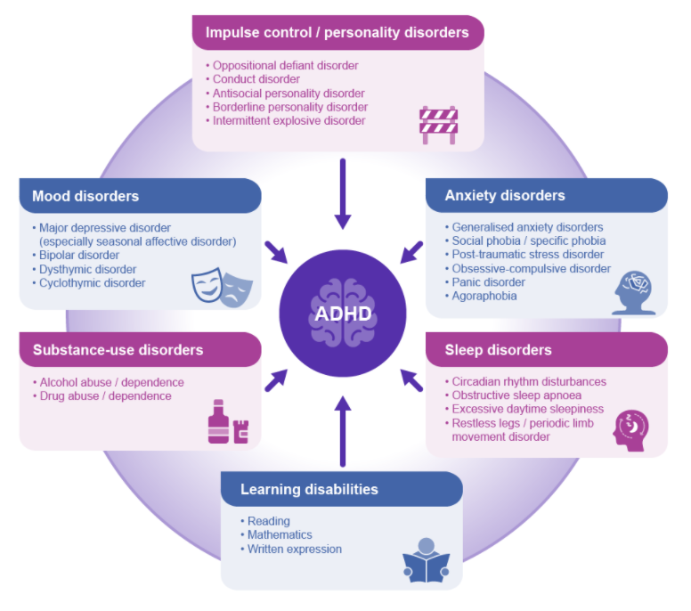
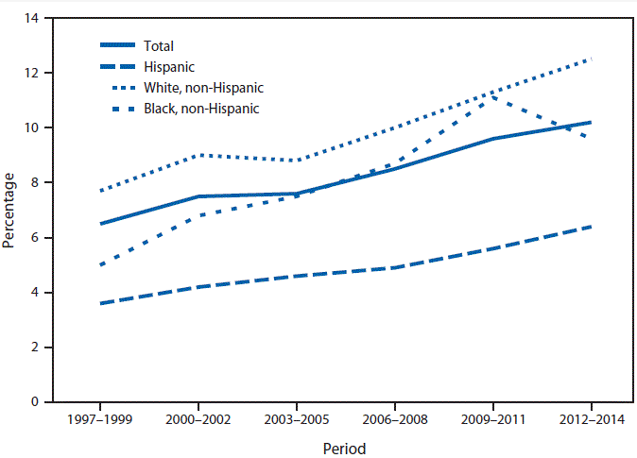
Disease burden and unmet need The worldwide prevalence of ADHD in children is estimated at 7.2% and has been increasing in recent years. It is typically recognized and diagnosed in childhood and occurs more frequently in boys than girls. Most patients with ADHD have other psychiatric comorbidities that may complicate diagnosis.
1.1
SUPPORTING EVIDENCE
A meta-analysis of 175 research studies worldwide on ADHD prevalence in children aged 18 and under found an overall pooled estimate of 7.2% (Thomas et al. 2015). The prevalence of ADHD in children is higher in boys than girls (Table 1); there is also a notable difference in prevalence between ethnicities, with the highest prevalence reported in non-Hispanic white children, followed by non-Hispanic black children and with Hispanic children showing the lowest prevalence (Figure 1) (Pastor et al. 2015, Xu et al. 2018). There has been a notable increase in the prevalence of ADHD in the past decades (Table 1, Figure 1) (Pastor et al. 2015, Xu et al. 2018). Table 1: ADHD prevalence overall and by gender (Xu et al. 2018) | A myriad of comorbid conditions such as impulse-control/personality, anxiety, mood, substance use, learning, and sleep disorders overlap with ADHD. Furthermore, several such conditions have symptoms that can mimic those of ADHD, including hyperactivity, impulsivity, inattention, and disruption of circadian rhythms, adding to the complexity of recognition and diagnosis of ADHD (Figure 2) (Kooij et al. 2012). Figure 2: Main comorbid psychiatric disorders in adult ADHD (reproduced from Kooij et al 2012)
Figure 1: ADHD prevalence by ethnicity (Pastor et al. 2018)
Year | Overall | Boys | Girls
2015-2016 | 10.2 | 14.0 | 6.3
2013-2014 | 9.4 | 12.8 | 5.8
2011-2012 | 9.6 | 13.6 | 5.4
2009-2010 | 9.0 | 12.2 | 5.7
2007-2008 | 8.1 | 11.3 | 4.8
2005-2006 | 7.5 | 10.6 | 4.2
2003-2004 | 7.3 | 10.2 | 4.3
2001-2002 | 7.2 | 10.3 | 4.0
1999-2000 | 6.5 | 9.4 | 3.4
1997-1998 | 6.1 | 9.0 | 3.1
References:
Kooij, JJ Sandra, et al. "Distinguishing comorbidity and successful management of adult ADHD." Journal of attention disorders 16.5_suppl (2012): 3S-19S.
Pastor, Patricia N., C. Duran, and C. Reuben. "Quickstats: Percentage of children and adolescents aged 5-17 years with diagnosed attention‐deficit/hyperactivity disorder (ADHD), by race and Hispanic ethnicity-National Health Interview Survey, United States, 1997-2014." Morbidity and Mortality Weekly Report 64.33 (2015): 925.
Thomas, Rae, et al. "Prevalence of attention-deficit/hyperactivity disorder: a systematic review and meta-analysis." Pediatrics 135.4 (2015): e994-e1001.
Xu, Guifeng, et al. "Twenty-year trends in diagnosed attention-deficit/hyperactivity disorder among US children and adolescents, 1997-2016." JAMA network open 1.4 (2018): e181471-e181471.

Slide 8
Scientific Summary

Slide 9
Scientific Summary
ADHD characterized by symptoms of inattention and hyperactivity caused by impairments in the synaptic levels of dopamine and norepinephrine in the prefrontal cortex and striatum. Stimulant-based medications such as dexamphetamine increase synaptic catecholamine levels and are associated with high clinical efficacy but are limited by side effects, tolerability and contraindications.
RELAXIA® is a first-in-class gene therapy for ADHD that selectively reduces the expression of dopamine and norepinephrine transporters on axon terminals in the prefrontal cortex and striatum, producing targeted elevation of synaptic catecholamines in therapeutically relevant brain regions without the side effects associated with stimulant-based treatments.
In a Phase 3 study, RELAXIA® resulted in a mean improvement in ADHD symptoms versus placebo by 74% over a 6-month period. In a head-to-head study, RELAXIA® demonstrated non-inferiority to dexamphetamine, making it the first-ever non-stimulant medication to demonstrate an efficacy equivalent to that of stimulant-based medications.

Slide 10
Lexicon

Slide 11
Lexicon
Term | Alternatives / abbreviations | Avoid | Explanation / notes
Amphetamines | Dexamphetamine Mixed amphetamine salts Extended-release amphetamine formulations AMPH D-AMPH | Brand names of amphetamine-based products (e.g., Adderall, Evekeo, Adzenys) | Use when referring to any type of amphetamine-based medication. Can be specified further by alternative terms.
Attention deficit hyperactivity disorder | ADHD | Attention deficit disorder (ADD); refer to instead as ADHD inattentive subtype | Depending on symptoms, a predominantly inattentive, hyperactive-impulse or combined subtype can be diagnosed
Methylphenidate | MPH Extended-release methylphenidate formulations | Brand names of methylphenidate-based products (e.g., Ritalin, Concerta) | Use when referring to any type of methylphenidate-based medication. Can be specified further by alternative term.
Dopamine | DA | 3,4-dihydroxyphenethylamine Brand names of therapeutic dopamine products (e.g., Revivan, Intropin) | Use to refer to endogenous dopamine
Norepinephrine | NE | Noradrenaline NA Brand names of therapeutic norepinephrine (e.g., Levarterenol, Levophed) | Use to refer to endogenous dopamine

Slide 12
Lexicon
Term | Alternatives / abbreviations | Avoid | Explanation / notes
Stimulant-based treatments | Stimulant-based medications Stimulants Amphetamines and methylphenidate Central nervous system (CNS) stimulants |  | Use to refer to the group of therapeutics that include all methylphenidate and amphetamine formulations, including extended-release formulations
Non-stimulant treatments | Non-stimulant medications Subclass-specifying terms (e.g., norepinephrine reuptake inhibitors) Generic names of specific drugs (e.g., atomoxetine) | Brand names of specific drugs (e.g., Strattera, Qelbree) | Use to refer to any ADHD medication that does not belong to the class of stimulant-based treatments; when referring to a specific type, use appropriate class or generic drug name
Norepinephrine transporter | NET | Noradrenaline transporter (NAT)
Dopamine transporter | DAT | Dopamine active transporter
Catecholamine | Dopamine and norepinephrine | Serotonin | Use to refer to the group of neurotransmitters that include dopamine and norepinephrine; note that serotonin is not a catecholamine

Slide 13
Related content

Slide 14
Related Content
RELAXIA® Core Materials
Click here to access RELAXIA® core materials including product monograph, core slide deck, FAQ and objection handler
RELAXIA® Internal Training Hub
Click here to access the RELAXIA® internal training hub, which offers a wide variety of resources such as videos and slide deck with detailed background information on ADHD disease state, pathophysiology, treatments and RELAXIA® clinical trial data
RELAXIA® Publications
Click here to access a repository of all RELAXIA® scientific publications and congress abstracts, posters and oral presentations

