Slide 1
Agile Presentation
Matthew Oliphant
CS-250 Software Development Lifecycle
Southern New Hampshire University
June 20, 2021

Slide 2
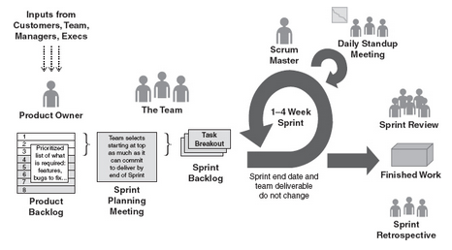
The Scrum-Agile Approach
Fig. 3.1 Scrum Framework (Cobb, 2015)
The scrum framework begins with the Product Owner and Customers meeting to discuss requirements. The Product Owner then puts together the product backlog. Sprint planning meeting occurs with the entire team. The sprint begins with daily scrums and continues until the product is delivered. The process is concluded when the Product Owner delivers the product to the Customers in the Sprint Review and the team conducts the Sprint Retrospective.

Slide 3
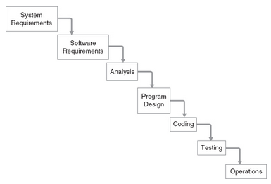
The Waterfall (Traditional) Approach
Fig. 2.1 Scrum Framework (Cobb, 2015)
The traditional management approach is rigid, due to a very high level of initial planning for the software development lifecycle. Unlike the agile approach, the traditional approach is top-down, meaning it’s very hard to back up. System and software requirements, along with analysis, are in the beginning of the traditional approach, meaning any changes the customer wants requires a redesign. This forces the customer to pay a lot more money to implement a change. Coding and testing are also separated so there is less accountability and responsibility than with an agile approach.

Slide 4
Roles on a Scrum-Agile Team
Product Owner: The Product Owner is ultimately responsible for delivering the final product to the customer(s). They organize the product backlog and supervise every step along the way to ensure they will be able to deliver what they promised.
Scrum Master: The Scrum Master acts as both a leader and follower. They help the Product Owner attending meetings and helping with organizing the product backlog. They help the development team by removing roadblocks that lead to bottlenecking and help coach or teach anyone that needs it.
Developers: The developers are responsible for creating the code that satisfy user story requirements by meeting the definition of done. They work alongside the other team roles to ensure they are able to deliver user stories, but must remain open to change.
Testers: The testers also work alongside the other team roles to ensure that user stories have criteria for completeness. When deciding on the necessary criteria, the tester often asks the Product Owner about what the customer(s) desire. This helps ensure that the developers have direction and know what is expected of them.

Slide 5
Software Development Lifecycle (SDLC - Agile)
Planning and Requirement Analysis: This is when the Product Owner and Scrum Master meet with customers, business analysists, and other outside consultants to plan the project and quality assurance requirements.
Defining Requirements: A Software Requirement Specification (SRS) document consists of all the product requirements to be designed and developed during the lifecycle.
Designing the Product Architecture: Possibly multiple architectures are developed and documented in a Design Document Specification (DDS). The DDS is sent to the customers, stakeholders, and others until one is agreed upon. The proposed architecture must be clearly defined in detail.
Building or Developing the Product: Product code is generated according to the DDS which is easier to generate with detailed and organized design. Developers follow coding guidelines defined by their organization and production tools to create the final product.
Testing the Product: Testing activities are involved in each stage of the SDLC. Testing for defects is essential and reporting, tracking, fixing, and retesting until the product reaches quality standards is the best practice.
Deployment in the Market Maintenance: Products may be released in stages according to business strategies, but after it is released, it may be improved with feedback on suggested enhancements. Either way, maintenance is required for the deployed product.

Slide 6
SNHU Travel Using Waterfall Development
Very little project details in the beginning phases would prove to be challenging.
Once the management team understands what it is SNHU Travel wants, the plan to deliver it is in place and becomes rigid.
The customer’s change request came in after the agreed upon product was already created, tested, and delivered. Going back to change the design would be costly to the customer to the point of most likely keeping the original product.
The delivery of the product to SNHU Travel would have been quicker than with the agile approach. However, the customer wouldn’t be very happy because it didn’t meet their desired change of the niche rehab destinations.

Slide 7
Deciding Between Agile and Waterfall Approaches
When the customer knows exactly what they want, the appropriate management style would be the waterfall approach. This is because an extensive amount of planning is able to be conducted. Traditional project management tools include Pert charts, Gantt charts, dependencies, etc. which help to create a final product, using a heavily plan-driven approach (Cobb, 2015). This is the correct approach when the customer is certain on what they want and do not plan on having any changes to the design.
However, it is very common for changes to occur or be planned for when developing software. Sometimes, the customer isn’t even aware of what they are needing and do not know what a final product would look like. In this situation, the agile approach is correct and requires working closely and transparently with the customer throughout the entire SDLC, so they can be empowered to make changes as needed to deliver the desired final product.
Sometimes a hybrid approach may be used that is both waterfall and agile, when neither fits the customer’s needs. Project management can be viewed as a spectrum with total agile on one end and strictly waterfall on the other. Some projects fall somewhere in the spectrum.

Slide 8
Reference(s)
Cobb, C. G. (2015a). The Project Manager’s Guide to Mastering Agile: Principles and Practices for an Adaptive Approach. O’Reilly Online Learning. https://www.oreilly.com/library/view/the-project-managers/9781118991046/00_cover.html

