Slide 1


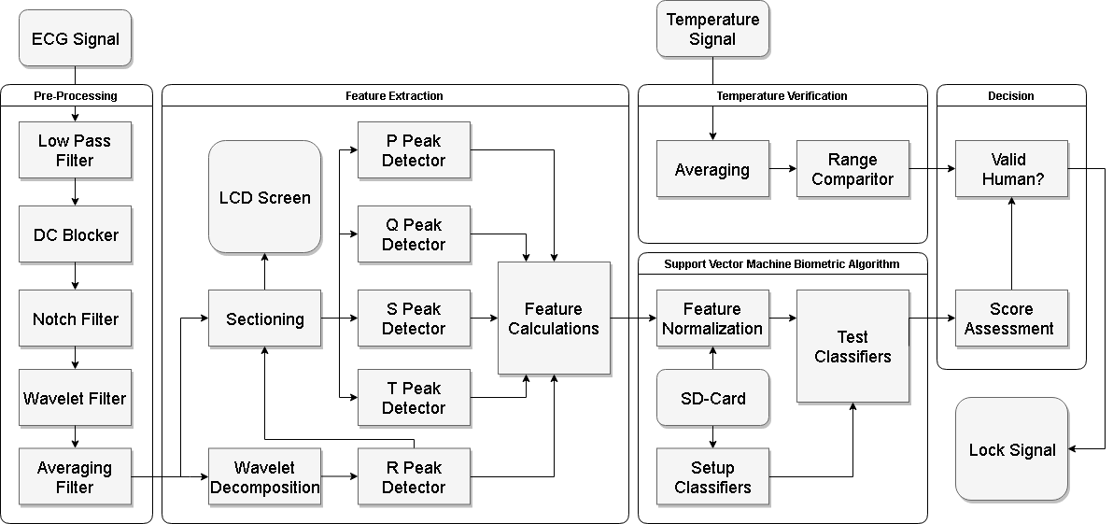
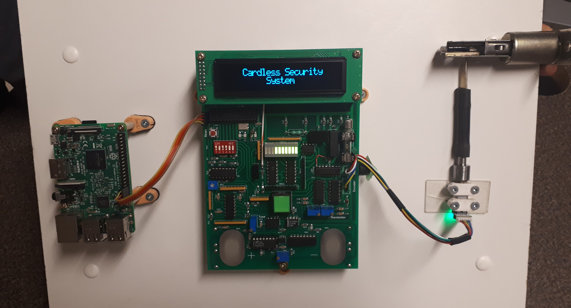
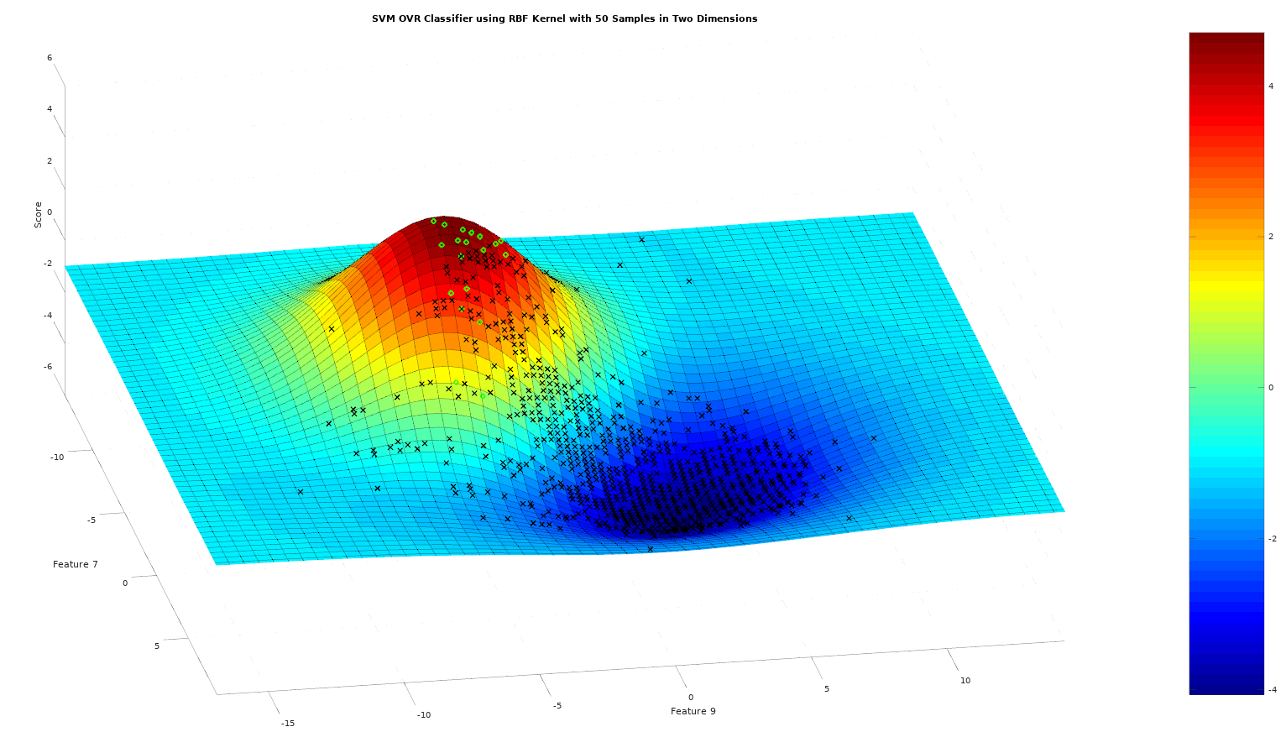
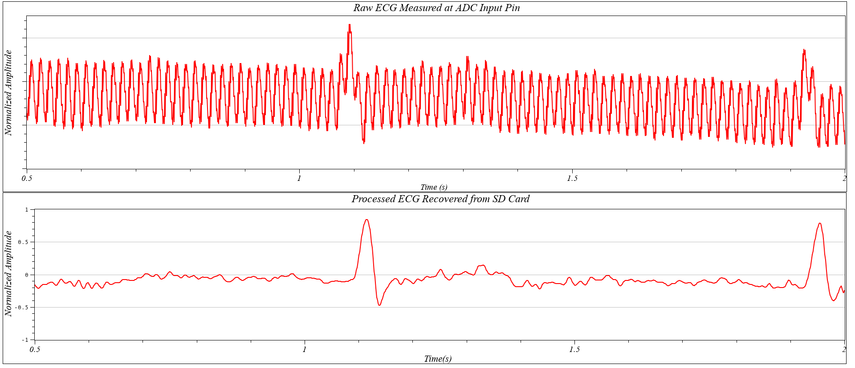
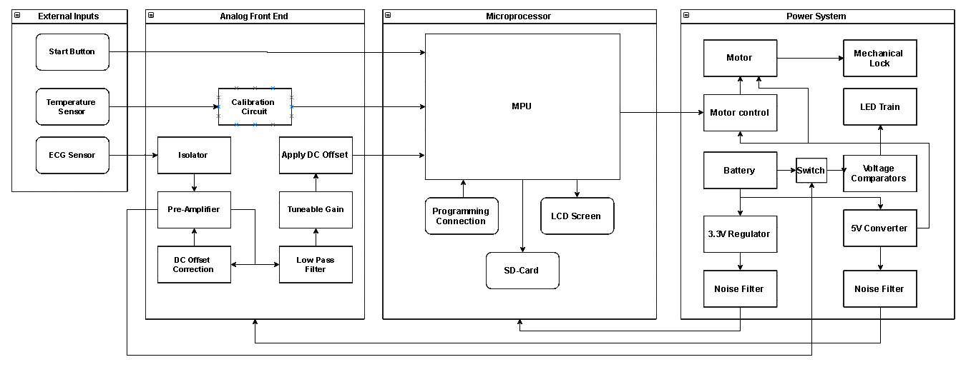
Cardless Security System
Using Electrocardiogram Biometric Identification
Faculty of Engineering Dept. Electrical and Computer Engineering
Group 9 – Zuwei Li, Matthew Santos, Robert Goleberski
Advisors: Dr. Arezoo Emadi, Dr. Mitra Mirhassani
Capstone Project 2018
Motivation
Biometric Algorithm
Final Prototype
Current methods of biometric identification include voice analysis, retina scans, face recognition and the widely popular fingerprint system. The current success of the fingerprint method is owed to its compromise between the level of security offered and the cost of implementation. The remaining methods are still applicable however they generally lean towards either extreme and thus remain niche markets. There is however a new contender entering the industry which also offers a balanced approach. This new system which is still undergoing research, utilizes the measurement of the internal heart signal through an electrocardiogram in an attempt to distinguish individuals. Being an internal signal offers a wide array of benefits including reduced public exposure as well as the inability to modify the access token. Results continue to look promising however there are still many obstacles to overcome before it becomes the new standard.
Introduction
Experiment Results
The aim of this project was to develop a cardless security system based on the principle of ECG biometrics. To facilitate future investments in the field the project was tailored towards the development of a marketable product. In order to accomplish this a more unobtrusive method for ECG acquisition was required as the standard 12 lead system is impractical for everyday use. Instead a two finger based ECG measurement system was proposed using inexpensive dry contact electrodes. As this measurement methodology degrades signal quality the analysis procedure had to be heavily refined through the use of onboard digital signal processing. The biometric algorithm itself also had to be constructed from scratch and was centered around the use of machine learning, more specifically support vector machines. After being processed the resulting biometric determination is then used in conjunction with information gathered from a secondary temperature sensor in order further validate the individual as human and actuate the locking mechanism.
System Requirements
System Architecture
Future Work
System must differentiate between individuals based on electrocardiogram signals
A completely embedded design with a black box emphasis for added security
Incorporate a secure mechanical locking system driven by an electric motor
An affordable solution, specifically an initial prototype budget of less than $350
Present audio and visual indicators regarding the status of execution
Continue to refine the biometric algorithm to improve accuracy
Transition to a surface mount design for smaller form factor
Perform a research study to accurately determine success rate
References
Acknowledgements
Lourenco, Andre & Plácido da Silva, Hugo & Santos, Daniel & Fred, Ana. (2011). Towards a Finger based ECG Biometric System
Lugovaya T.S. (2005). Biometric human identification based on electrocardiogram
Supervisors: Dr. Arezoo Emadi & Dr. Mitra Mirhassani
Special Thanks: Frank Cichello, Dr. Behnam Shahrrava,

