Slide 1
Predator-Prey Modelling in 2 prey multi-predator systems
Matthew Williams

Slide 2


Introduction
With PowerPoint, you can create presentations and share your work with others, wherever they are. Type the text you want here to get started. You can also add images, art, and videos on this template. Save to OneDrive and access your presentations from your computer, tablet, or phone.
24/12/2023
Predator-Prey Modelling in 2 prey multi-predator systems

Slide 3
Agenda
System Description
Existing Models
Adaptation to our system
Analysis of the model and results
24/12/2023
Predator-Prey Modelling in 2 prey multi-predator systems

Slide 4
System Description

Slide 5
Brief Outlined
Prey conditions
Predator Conditions
- Two species
Distinct characteristics:
- Growth rate
- Carrying capacities
- Predation rates
- N number of predators
- Periodic removal of predator species
- Predator removal may only remove so many predators such that 40% of initial predator population remains
Distinct characteristics:
- Predation rates
- Growth from prey consumption
- Death rates
24/12/2023
Predator-Prey Modelling in 2 prey multi-predator systems

Slide 6
Existing Models
Related And Previous Work

Slide 7
Existing work
Lotka-Volterra Competition model
Predicts relationship between one predator and one prey
Based on logistic growth function ODE for the prey
The predator ODE couples to this through a predation term in the prey ODE and the predator grows proportionally to prey population
Modified Lotka-Volterra for 2 prey 1 predator:
https://doi.org/10.1016/0025-5564(94)90059-0
Where K is the number of species in the system
24/12/2023
Predator-Prey Modelling in 2 prey multi-predator systems

Slide 8
Adapting to our system

Slide 9
Adapting Lotka-Volterra
Modified Lotka-Volterra for 2 prey N predator with removal:
Prey equation: Predator equation:
https://doi.org/10.1016/0025-5564(94)90059-0
Where P is the number of predator species in the system
24/12/2023
Predator-Prey Modelling in 2 prey multi-predator systems

Slide 10
Analysis And Results

Slide 11
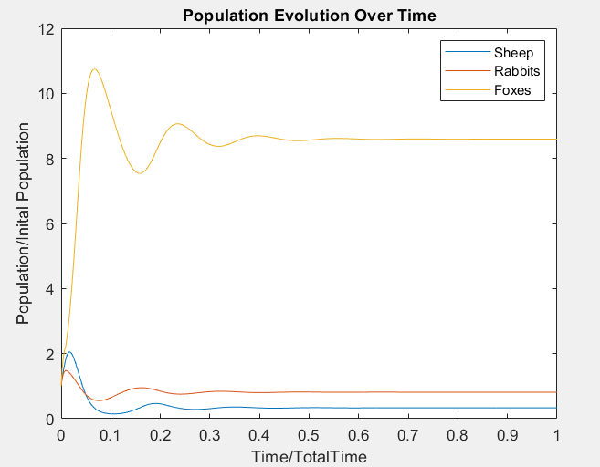
24/12/2023
Predator-Prey Modelling in 2 prey multi-predator systems

Slide 12
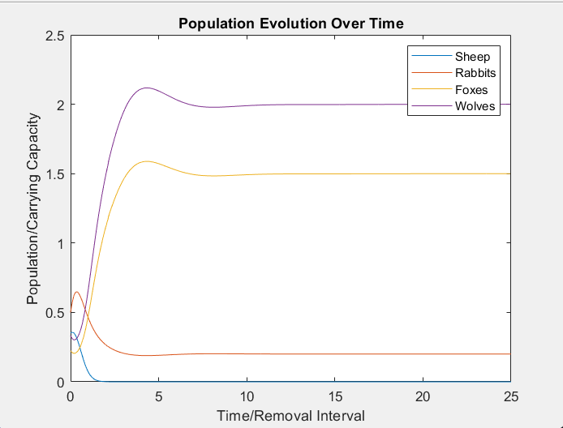
24/12/2023
Predator-Prey Modelling in 2 prey multi-predator systems

Slide 13
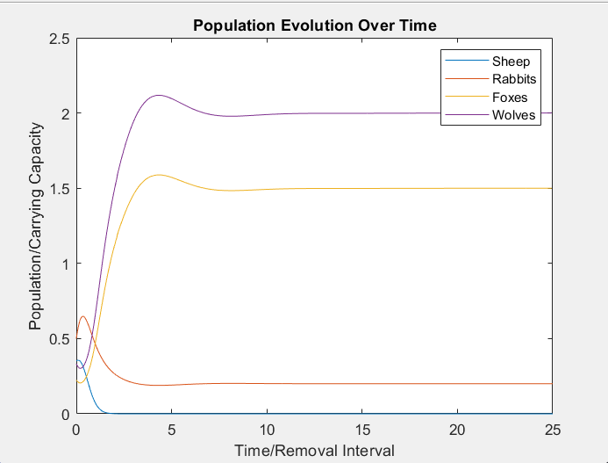
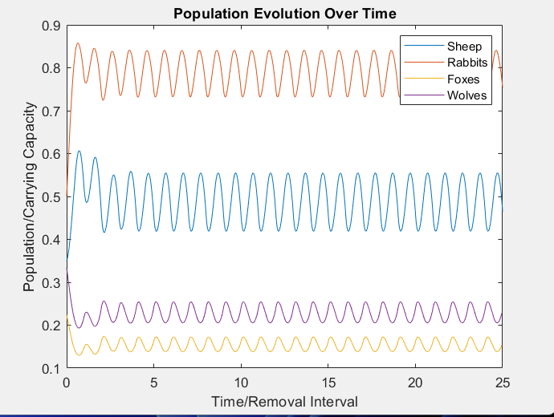
24/12/2023
Predator-Prey Modelling in 2 prey multi-predator systems

Slide 14
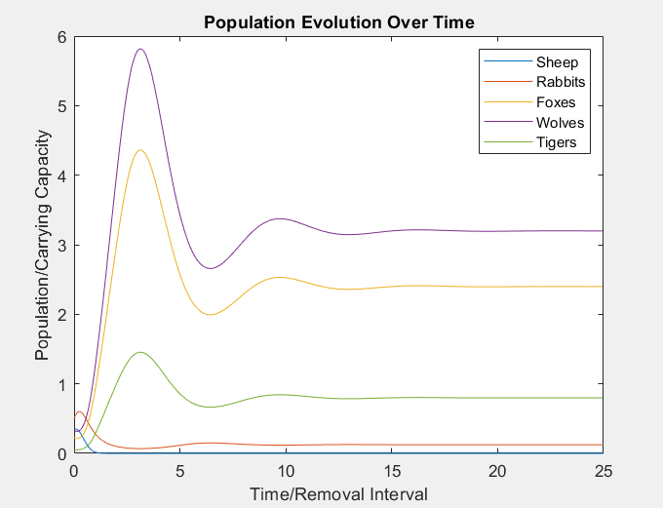
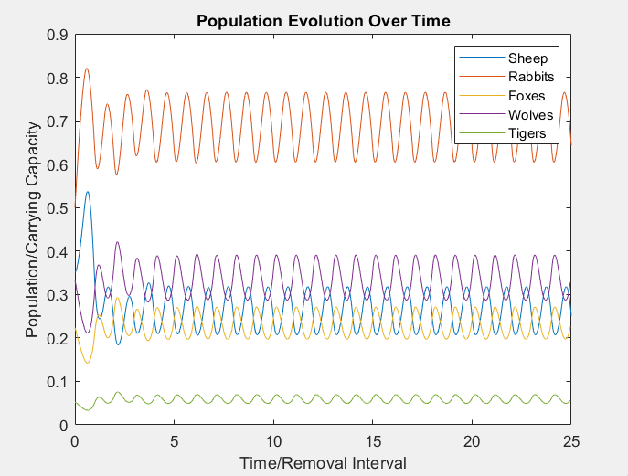
24/12/2023
Predator-Prey Modelling in 2 prey multi-predator systems

Slide 15
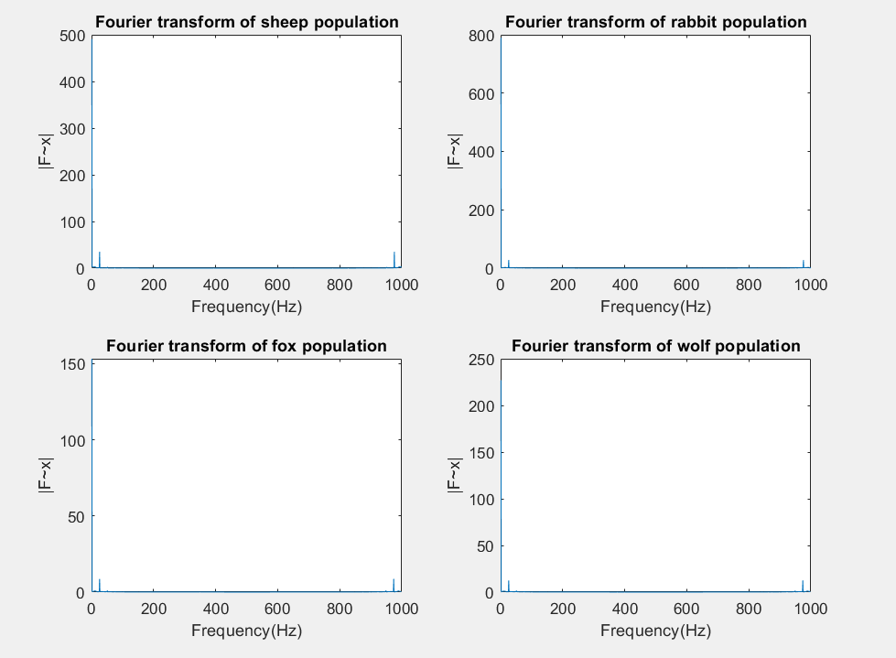
24/12/2023
Predator-Prey Modelling in 2 prey multi-predator systems

Slide 16

The way to get started is to quit talking and begin doing.
Walt Disney
24/12/2023
Predator-Prey Modelling in 2 prey multi-predator systems

Slide 17




Team
Name
Title
Name
Title
Name
Title
Name
Title
9/3/20XX
Presentation Title

Slide 18
Summary
The system becomes less stable with more predator species present though using periodic predator removal we can sustain a stability point for which all species survive with an unbounded upper limit for the number of predator species so long as the total predator population does not go above a critical population.
24/12/2023
Predator-Prey Modelling in 2 prey multi-predator systems

Slide 19
Thank you
Matthew Williams
M.Williams-20@studnet.lboro.ac.uk
24/12/2023
Presentation Title

