Slide 1
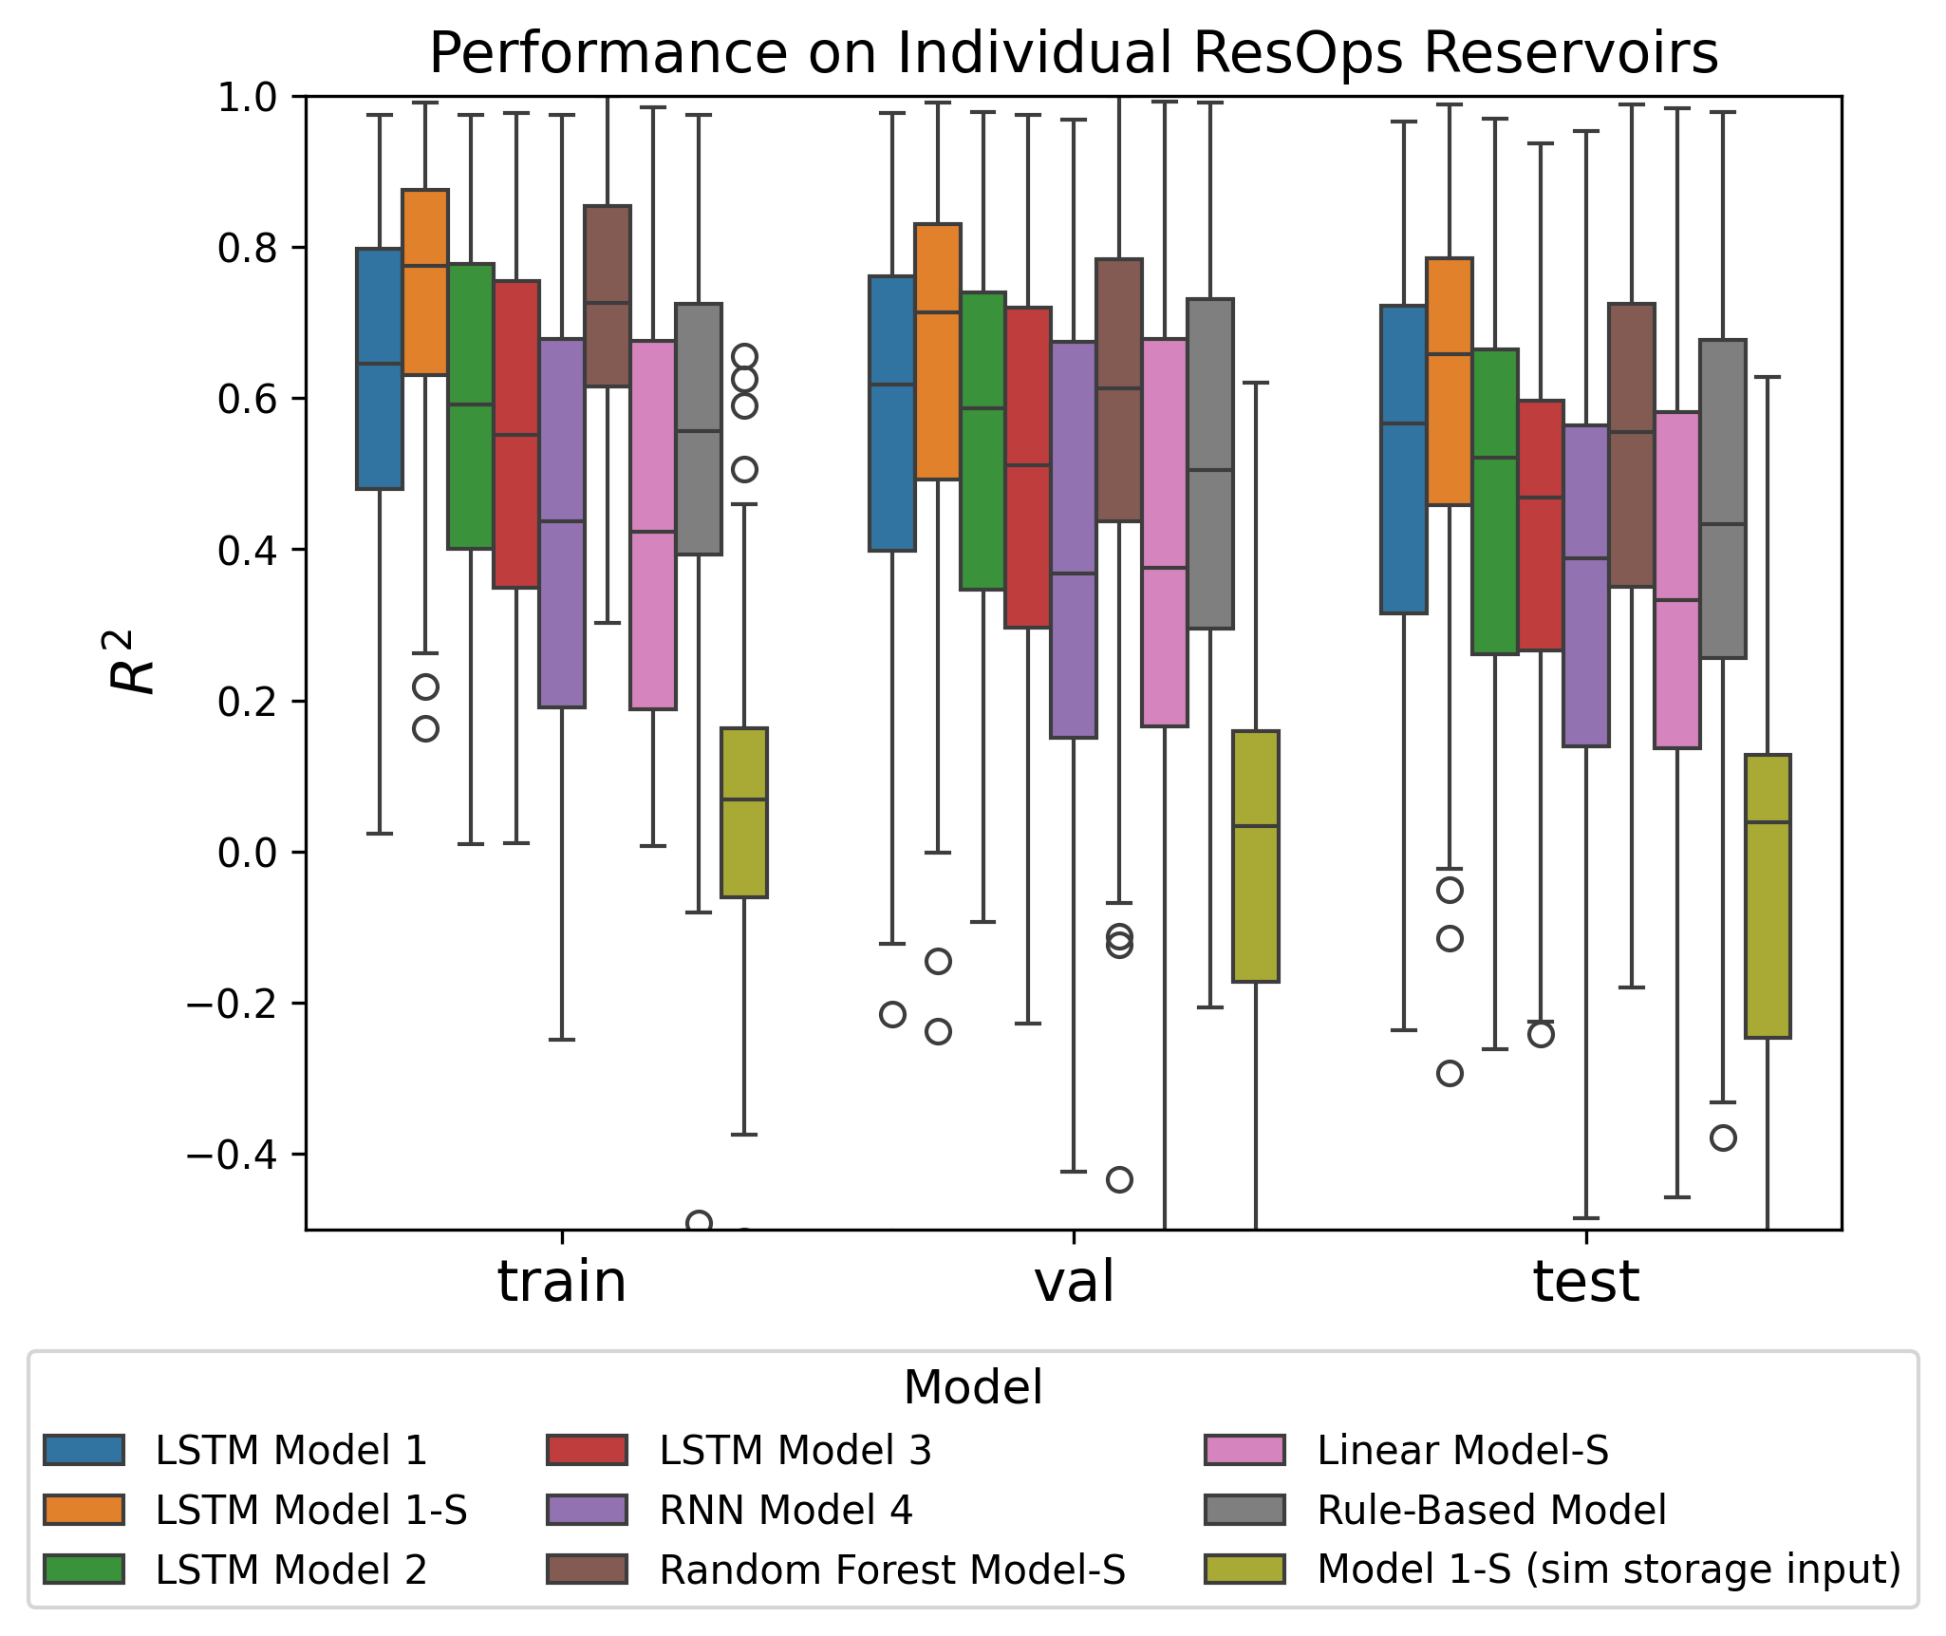
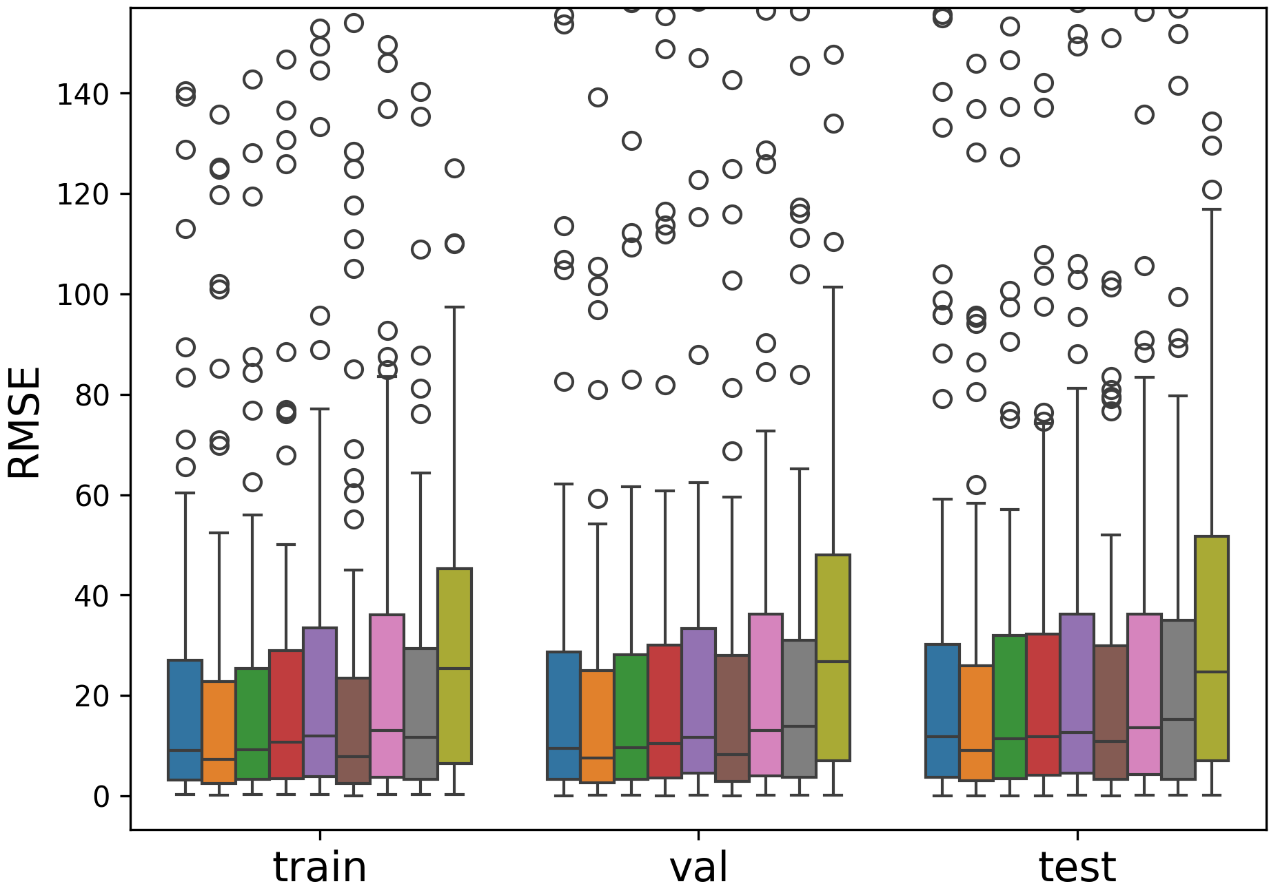
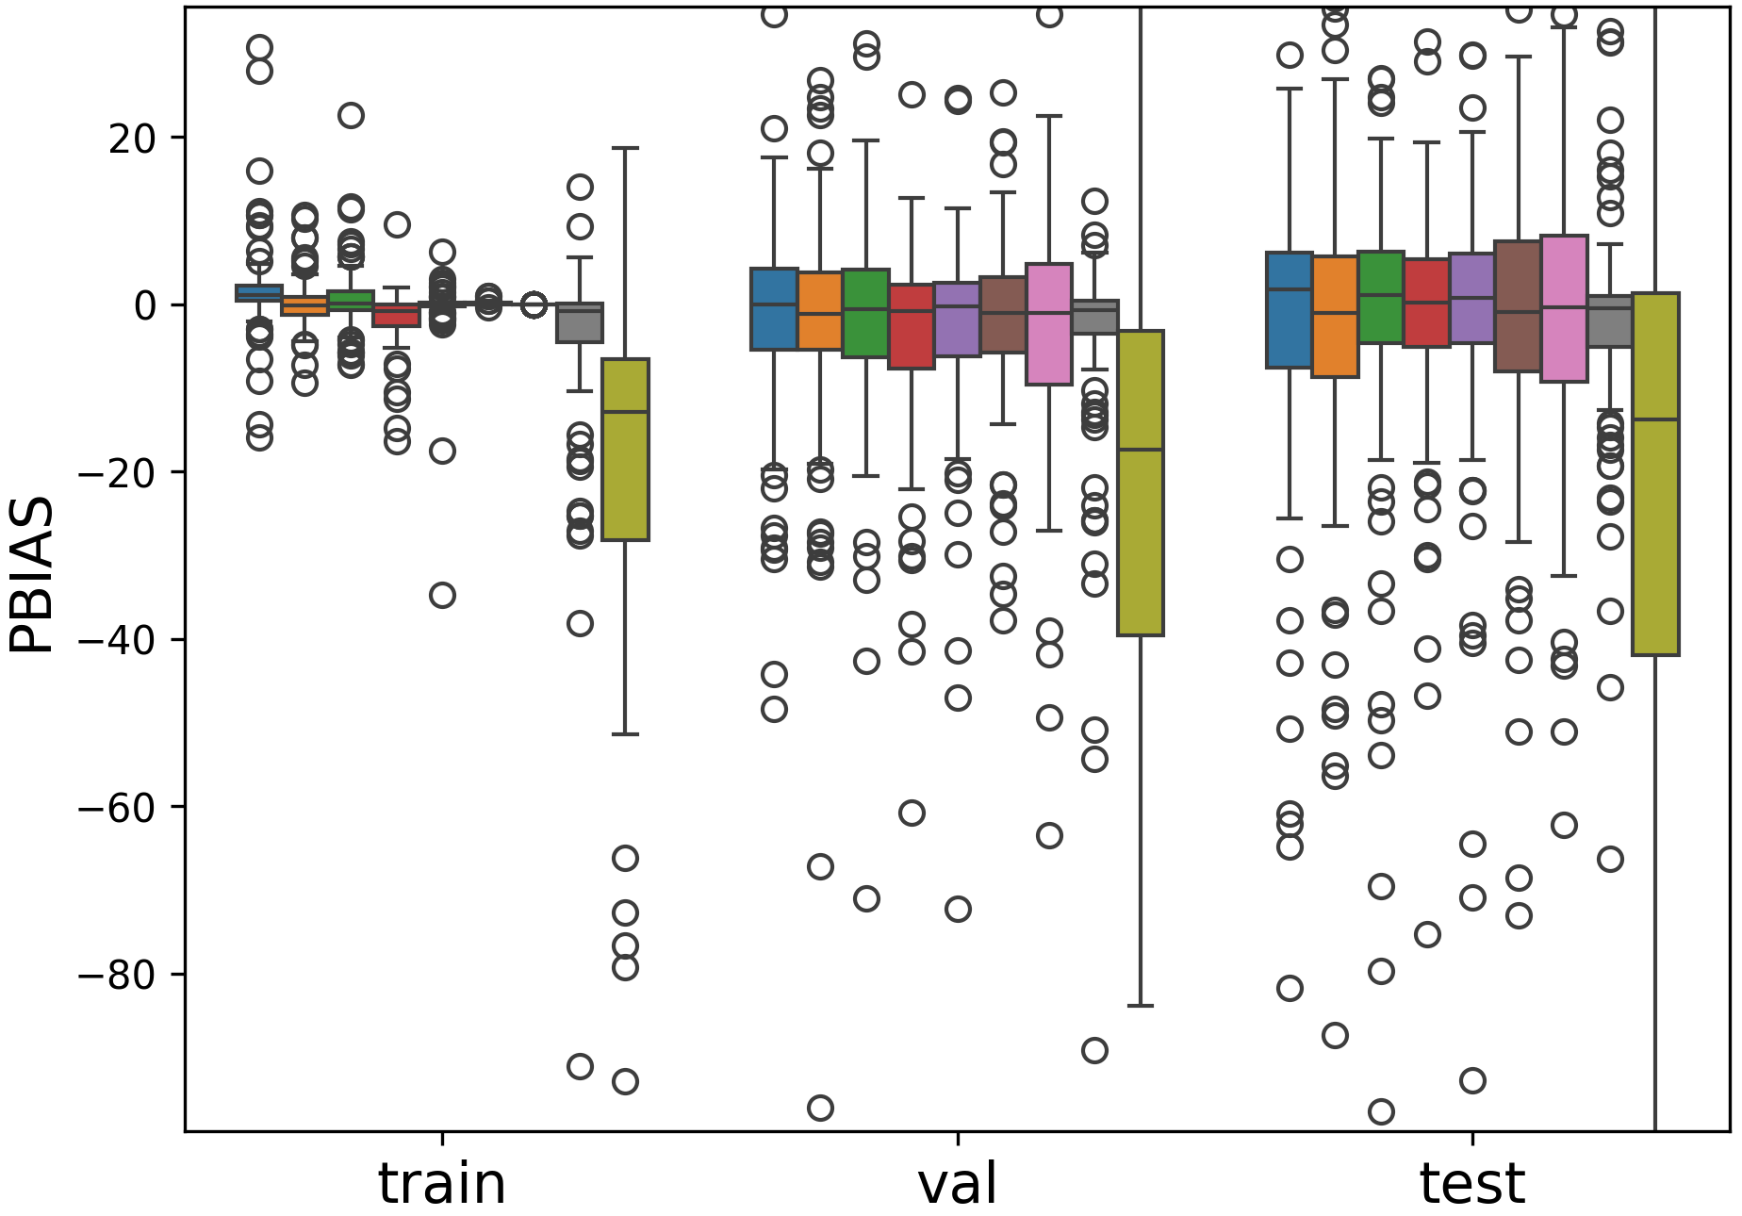
R² ResOPS Performance
RMSE ResOPS Performance
PBIAS ResOPS Performance

Slide 2
