Slide 1
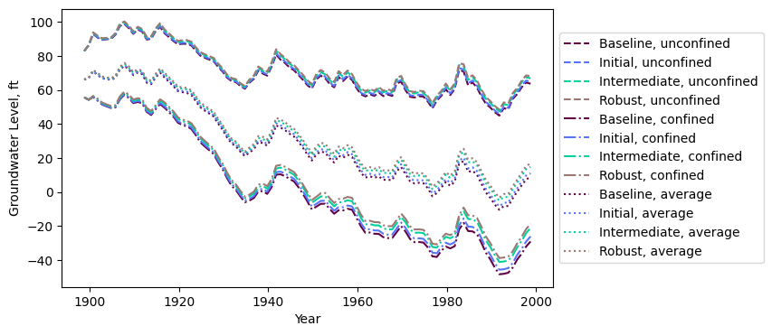
Notes:
Metric: Water supply reliability
Compare all strategies

Slide 2
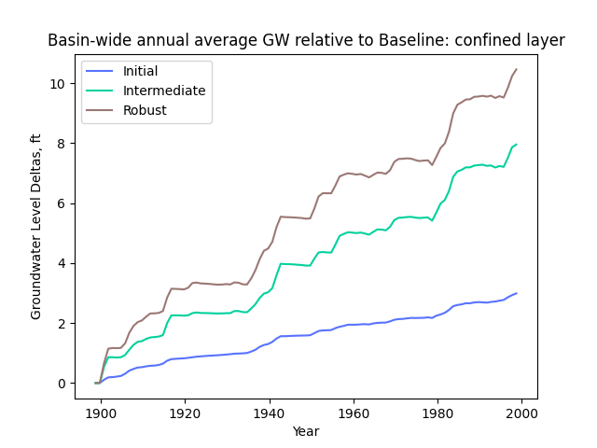
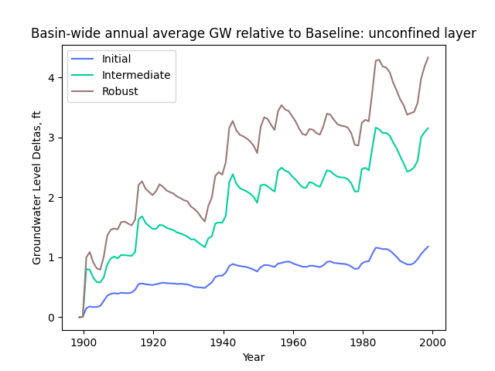

Slide 3
Unconfined
Confined

Slide 4
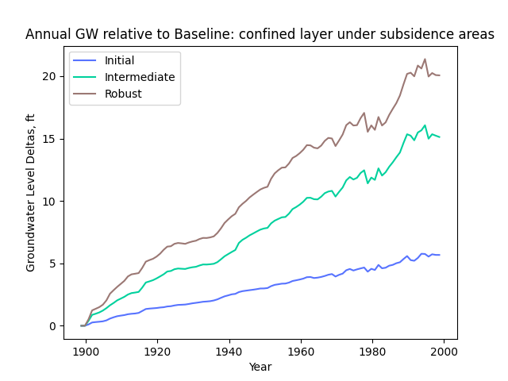
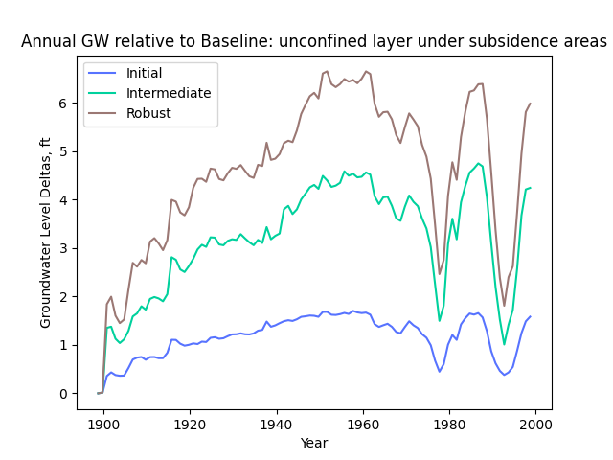
Notes:
Metric subsidence

Slide 5
Unconfined
Confined

Slide 6
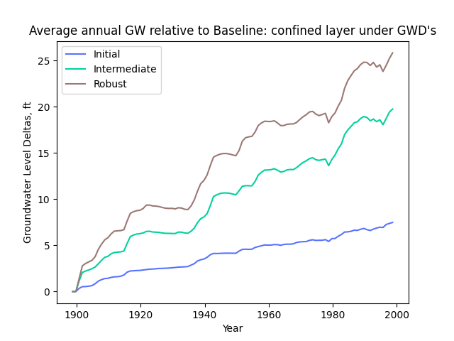
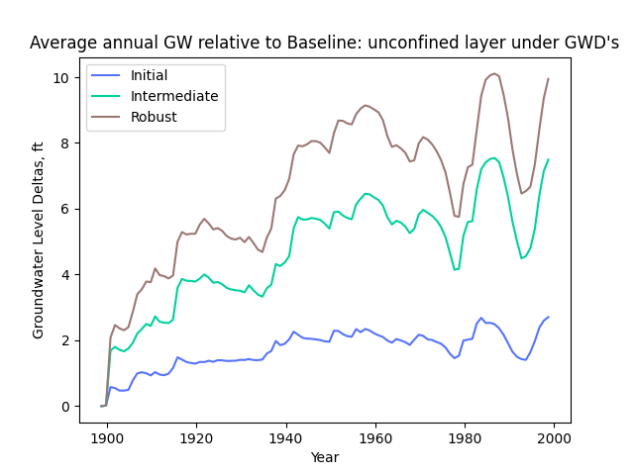
Notes:
Metric GWD

Slide 7
Unconfined
Confined

Slide 8
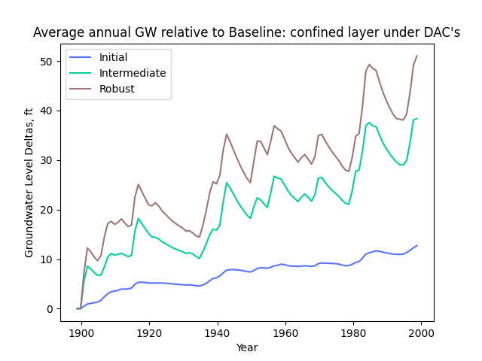
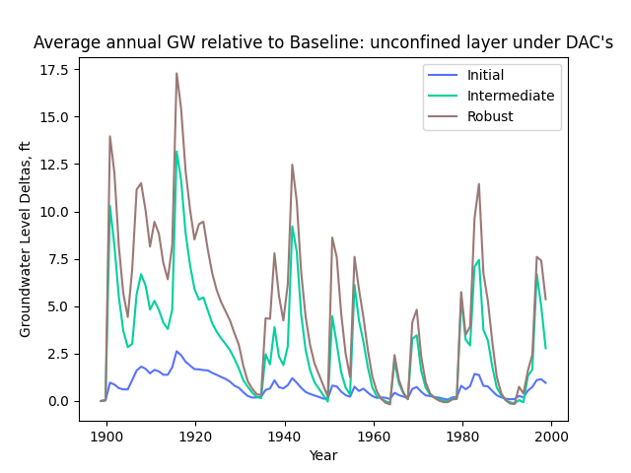

Slide 9
Unconfined
Confined

Slide 10
