Slide 1






















Outputs
$${\hat{y}}^{(1)}$$
$${\hat{y}}^{(2)}$$
$${\hat{y}}^{(3)}$$
$${\hat{y}}^{(T)}$$
$${\hat{y}}^{(t)}=Uh^{(t)}+b_{2}$$
initial hidden
state
$$U$$
$$U$$
$$U$$
$$U$$
$$h^{(0)}$$
$$h^{(1)}$$
$$h^{(2)}$$
$$h^{(3)}$$
$$h^{(T)}$$
Hidden states
$${h^{(t)}=tanh⁡(W_{h}h^{\left(t−1\right)}+W_{e}x}^{(t)}+b_{1})$$
…
$$W_{h}$$
$$W_{h}$$
$$W_{h}$$
$$W_{h}$$
$$W_{h}$$
Inputs
$$W_{e}$$
$$W_{e}$$
$$W_{e}$$
$$W_{e}$$
$$x^{(t)}$$
$$x^{(1)}$$
$$x^{(2)}$$
$$x^{(3)}$$
$$x^{(T)}$$

Slide 2











$$J^{\left(t\right)}(θ)$$
gradient flow
initial hidden
state
$$h^{(0)}$$
$$h^{(1)}$$
$$h^{(2)}$$
$$h^{(3)}$$
$$h^{(t)}$$
$$h^{(t+1)}$$
…
…
$$W_{h}$$
$$W_{h}$$
$$W_{h}$$
$$W_{h}$$
$$W_{h}$$
$$W_{h}$$
$$W_{e}$$
$$W_{e}$$
$$W_{e}$$
$$W_{e}$$
$$W_{e}$$
$$x^{(1)}$$
$$x^{(2)}$$
$$x^{(3)}$$
$$x^{(t)}$$
$$x^{(t+1)}$$

Slide 3




$$x$$
weight layer
ReLU
weight layer
$$F(x)$$
$$+$$
$$F\left(x\right)+x$$

Slide 4
















to output
$$h_{t}$$
forget some content from previous cell
write new content to cell
$$c_{t−1}$$
X
+
$$c_{t}$$
$$c_{t}$$
X
compute input/forget/output gates
output info from cell into hidden
$$f_{t}$$
$$i_{t}$$
$$\tilde{c_{t}}$$
$$o_{t}$$
$$tanh$$
$$σ$$
$$σ$$
$$tanh$$
$$σ$$
$$h_{t−1}$$
X
$$h_{t}$$
$$x_{t}$$

Slide 5



To output
$$h_{t}$$
Forget information from previous cell
Save new information to cell
$$c_{t−1}$$
X
+
$$c_{t}$$
$$c_{t}$$
X
Output information from cell state
Compute input/forget/output gates
$$f_{t}$$
$$i_{t}$$
$$\tilde{c_{t}}$$
$$o_{t}$$
$$tanh$$
$$σ$$
$$σ$$
$$tanh$$
$$σ$$
$$h_{t−1}$$
X
$$h_{t}$$
$$x_{t}$$

Slide 6
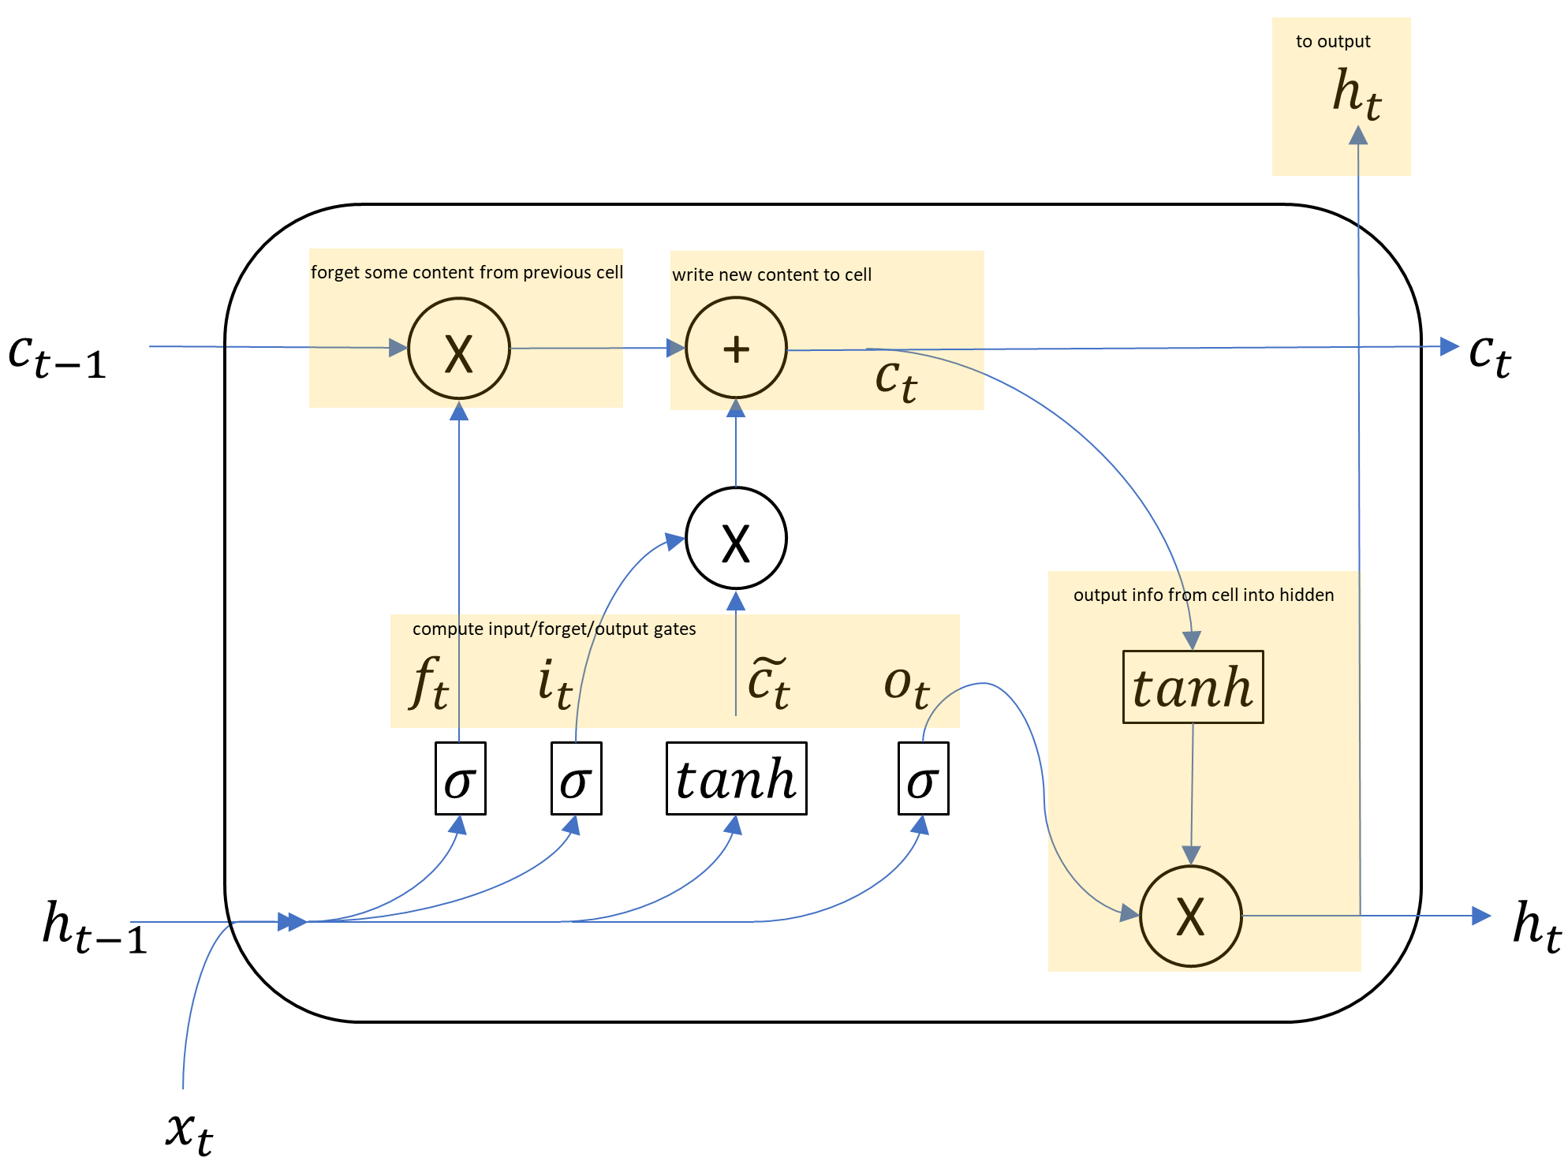



cell state info can be preserved over time
$$t=1$$
$$t=2$$
$$t=3$$

Slide 7
















DECODER RNN
generate decoder sequence, one timestep/word at a time
$$he$$
$$hit$$
$$me$$
$$with$$
argmax
argmax
argmax
argmax
ENCODER RNN
output word distribution given input encoding
output word distribution given input encoding and previous predicted words
$${\hat{y}}^{(1)}$$
$${\hat{y}}^{(2)}$$
$${\hat{y}}^{(3)}$$
$${\hat{y}}^{(4)}$$
…
$$il$$
$$a$$
$$m′$$
$entarte$’
$$<start>$$
$$he$$
$$hit$$
$$me$$
feed the previous output as input for the next timestep

Slide 8


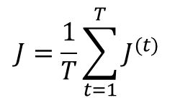











gradient flow
overall loss
$$J=\frac{1}{T}\sum_{t=1}^{T}{J^{(t)}}$$
$$J^{\left(1\right)}(θ)$$
$$J^{\left(2\right)}(θ)$$
$$J^{\left(3\right)}(θ)$$
…
$$J^{\left(T\right)}(θ)$$
$${\hat{y}}^{(1)}$$
$${\hat{y}}^{(2)}$$
$${\hat{y}}^{(3)}$$
…
$${\hat{y}}^{(T)}$$
…
$$<start>$$
$$he$$
$$hit$$
…
$$il$$
$$a$$
$$m′$$
$entarte$’
$$pie$$
Input labels
true target labels

Slide 9




attention output
$$he$$
$${\hat{y}}^{(1)}$$
concat attention output with decoder hidden state to compute output distribution
attention distribution
attention scores
encoder RNN
…
repeat process for next timestep
$$il$$
$$a$$
$$m′$$
$entarte$’
$$<start>$$
first step of decoder RNN

