Slide 1

Synthetic Control Method for Causal Inference
Matthew Chen
Notes:
In my presentation, I will be discussing the synthetic control method.

Slide 2
Problem Statement
In comparative case studies with panel or timeseries data, how do we estimate causal effects for some intervention? Here I present the synthetic control method proposed by (Abadie et al., 2010; Abadie & Gardeazabal, 2003)
For example, if California passed a large-scale tobacco control program, how do we estimate its causal effect on lowering cigarette sales? (more later)
Naively, compare the average of the control group with the average of the treated group
However, the control units may not be comparable to the treated group!
Notes:
The main problem in question that we want to solve here is estimating causal effects for panel or timeseries data for some intervention. To answer this question, I present the synthetic control method proposed by two landmark papers by Alberto Abadie in 2010 and 2003.
An example of a question that we might ask is: given that California has passed a large-scale tobacco control program, can we say that the program significantly lowered cigarette sales? How do we estimate the causal effect? This is a real problem that Abadie studied in his 2010 paper, and I will demonstrate the synthetic control method using this data later on.
So coming back to the question. Naively, we can compare the average of the control group with the average of the treated group and take that difference. However, these results would be unreliable because the control units themselves may not be comparable to the treated group! How do we know the difference is due to the tobacco control program and not because of the inherent differences in the control and treated units. This is where the synthetic control method comes in.

Slide 3


Some Notation
Suppose:
There are J+1 units in the study observed for T timesteps
The intervention occurs at T₀
Only the first unit is treated (without loss of generality) and the rest are controls (donor pool)
Assume no intervention effect before T₀
Let $Y_{it}^{I}, Y_{it}^{N}$ be the potential outcomes (intervention and no intervention) for the i^{th} unit and the t^{th} timestep
Let the intervention effect (i.e. causal effects) can be written as:
$$α_{it}=Y_{it}^{I}−Y_{it}^{N}$$
The goal is to estimate the sequence $α_{1T_{0}+1},…,α_{1T}$, the post-intervention effects for the treated unit
Notes:
Here I define some notation that I will refer to throughout the presentation. So suppose we have J+1 units in our study, and each is observed for T timesteps. Suppose the intervention occurs at T0, and we assume that the intervention has no affect on the outcome before t equals T0. Also, without loss of generality, suppose only the first unit is treated and the rest of the units are in the control group, which we call the donor pool. Finally, we let Y^I and Y_N be the intervention and no intervention potential outcomes, respectively. The double index here represents the ith unit and the tth timestep. After this we can write the intervention effect as follows denoted by alpha. In the framework of this course we can consider these to be the causal effects. Particularly, we care about the intervention effects after the intervention has occurred for the treated unit. Thus, we want to estimate the sequence alpha1, for T0+1 all the way to alpha T.

Slide 4

Universal missing data problem in causal inference – we do not observe both potential outcomes for the same unit
Need to estimate the potential outcome for no intervention on the treated unit
In the synthetic control method – take a weighted average of the donor pool so that the resulting synthetic control is more similar to the treated unit in its covariates and pre-intervention outcomes
Notes:
The universal missing data problem in causal inference becomes immediately obvious. Physically, we simply cannot observe both potential outcomes for the same unit.
In the end, we need a way to estimate the no-intervention outcomes for the treated unit. In the synthetic control method, we take a weighted average of the donor pool so that the resulting synthetic control is more similar to the treated unit, in both its observed covariates and pre-intervention outcomes.

Slide 5

Motivating Model
Assume the following model structure:
$$Y_{it}^{N}=δ_{t}+θ_{t}Z_{i}+λ_{t}μ_{i}+ϵ_{it}$$
$δ$ is an unknown common factor
$θ$ is a vector of unknown parameters, corresponding to observed covariates Z
$λ$ corresponds to unobserved factors with corresponding loadings $μ$
$ϵ$ is a zero-mean error term
Notes:
To motivate his method, Abadie assumes the following factor effects model. I won’t go into too much detail here, but essentially delta represents some unknown common factor, Z corresponds to observed covariates, lamda corresponds to unobserved factors and epsilon is a zero mean error term.

Slide 6

Suppose there exists a vector of weights $\left(w_{2}^{∗},….,w_{J+1}^{∗}\right)$ such that the following are true simultaneously:
$$\sum_{j=2}^{J+1}{w_{j}^{∗}}Y_{jt}=Y_{1t}, t∈1,…,T_{0}$$
$$\sum_{j=2}^{J+1}{w_{j}^{∗}}Z_{j}=Z_{1}$$
Interpretation: a convex combination of the donor pool exists where it matches both the preintervention outcomes and observed covariates in the treated unit
Notes:
Suppose that these two equations on the slide are true, that is, the treated outcomes in preintervention can be expressed as a convex combination of outcomes from the donor pool and similarly the covariates from the treated unit can also be expressed as a convex combination of covariates from the donor pool. Here, the w’s represent the weights on the units from the donor pool. These expressions have to be simultaneously true for every timestep in the pre-intervention period.

Slide 7

Consider the quantity:
$$Y_{1t}^{N}−\sum_{j=2}^{J+1}{w_{j}^{∗}}Y_{jt}$$
Under mild regularity conditions and our assumed model structure, Abadie et al., (2010) showed that under expectation, this quantity is upper-bounded by another quantity that goes to zero
Abadie also showed similar results for more complicated auto-regressive models
This motivates the estimate for no-intervention effects on the treated unit:
$$\hat{α_{1t}}=Y_{1t}−\sum_{j=2}^{J+1}{w_{j}^{∗}}Y_{jt}, t∈{\{T}_{0}+1,…,T\}$$
Notes:
If the conditions from the previous slide are true, then consider the quantity of the difference between the counterfactual for the treated unit and the aforementioned weighted average of the donor pool. Abadie was able to show that under expectation, and with some mild regularity conditions, the quantity tends to zero. I also wanted to point out that Abadie was able to show very similar results for more complicated model structures than the factor effects model we are considering now, including a model with an auto-regressive structure. This is the fundamental motivation for using this weighted average of the donor pool as our final estimator.

Slide 8

Implementation
Let $X_{1}=\left(Z_{1}^{t},Y_{pre,1}^{t}\right)$ where $Z_{1}$ is a vector of observed covariates and $Y_{pre,1}$ are the pre-intervention outcomes for the treated unit J=1
D$efine X_{0}$ a (kxJ) matrix containing the observed covariates and pre-intervention outcomes for the controls
The vector of weights W is solved using the following optimization:
$$W^{∗}=argmin_{W}^{∗}{\left|\left|X_{1}−X_{0}W^{∗}\right|\right|}_{V}$$
The matrix V is a (k x k) positive semi-definite matrix such that:
$${\left|\left|X_{1}−X_{0}W\right|\right|}_{V}=\sqrt{\left({\left(X_{1}−X_{0}W\right)}^{t}V\left(X_{1}−X_{0}W\right)\right)}$$
V weights the importance of the values in X
Abadie et al., 2010 recommends jointly choosing V (diagonal and positive definite) and W s.t. the MSE of predicting the preintervention outcome using the synthetic control is minimized
Notes:
So far we have shown the motivation behind the synthetic control method. Here, I talk briefly about how to implement it. Note that a perfect match between the synthetic control and the treated unit is often not possible, so we want to find weights so that they are as close to each other as possible. Here, we let X1 contain all the observed covariates and pre-intervention outcomes and X0 be a matrix containing the same variables for everyone in the donor pool. Then, our goal is to solve the following optimization problem: we want to find the argument minimum for the difference between X1 and a weighted X0 for some distance defined by V. Note that here the weighting is expressed through a matrix multiplication between W and X0.
The matrix V is simply a positive semi-definite matrix satisfying the following distance formulation. Note that the form is similar to a Mahalanobis distance, except instead of the inverse covariance, V here simply weights the importance of the variables that we put into X.
Abadie recommends jointly choosing V and W where V is diagonal and positive definite, where the mean square error of predicting the preintervention outcome using the synthetic control is minimized.

Slide 9
Inference
Under the null hypothesis of no intervention effect, we want to know how significant are our estimated effects
Inference is done using randomization inference: we randomly select units in the donor pool to be the treated unit and repeat the synthetic control method
Doing so we estimate an empirical null distribution based on which conclusions can be drawn
Notes:
After finding our V and W matricies, how do we draw conclusions from our results. In other words, how do we conduct statistical inference under the null hypothesis of no intervention effects. How significant are our estimated effects? Or is it simply a figment of random chance?
Inference for the synthetic control method is done using randomization inference. As a review, in randomization inference, we randomly select units in the donor pool to be the treated unit and the reconduct the synthetic control method on the placebo. By doing so, we estimate an empirical null distribution from which our conclusions can be drawn.

Slide 10

Data Analysis: Proposition 99
California’s Proposition 99 was the first large-scale statewide tobacco control program in the country
Passed in 1988 and went into effect 1989
Raised the cigarette excise tax by 25 cents per pack and funded a broad range of tobacco prevention programs
Q: Are there significant intervention effects on lowering cigarette sales in California due to Proposition 99?
Notes:
Here I want to demonstrate the use of the synthetic control method with data from Proposition 99. I mentioned this briefly before in the introduction, but Proposition 99 was the first large-scale tobacco control program in the country. The proposition was passed in 1988 and went into effect in 1989. Basically, what happened is Proposition 99 raised the cigarette excise tax by 25 cents per pack and funded a broad range of tobacco prevention programs. The dataset I used has data between the years 1970 and 2000, which gives us a 19 year preintervention period between 1970 and 1988.
I also wanted to note that other states, including Massachusetts, Arizona, Oregon, and Florida also introduced large tobacco control programs following California’s example.
Still other states also introduced increases to the cigarette excise tax. These states are not appropriate to include in the donor pool so they were excluded from the analysis.
In total, this makes a data size of 39 states, with 38 being in the donor pool.

Slide 11
Controlled Covariates
log – GDP per capita
Per capita beer consumption
Proportion of the population between ages 15 and 24
Cigarette retail price
Notes:
These are covariates that we controlled for in the study. Note that Abadie showed that the results are not sensitive to the inclusion of many other state level covariates beyond the ones shown here.
Basically, we control for the log-GDP per capita, the per capita beer consumption, the proportion of the population between the ages 15 and 24, and the cigarette retail price. I want to emphasize that these are state level variables, since we are comparing California to other states with no similar tobacco control program

Slide 12
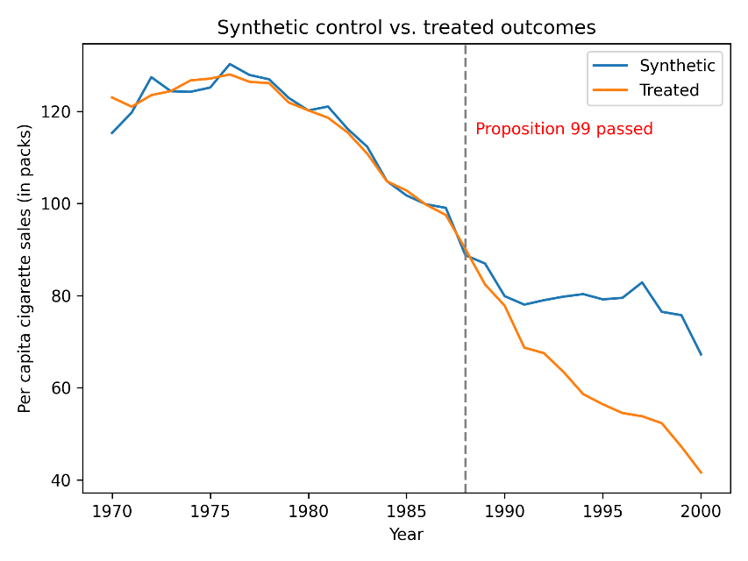
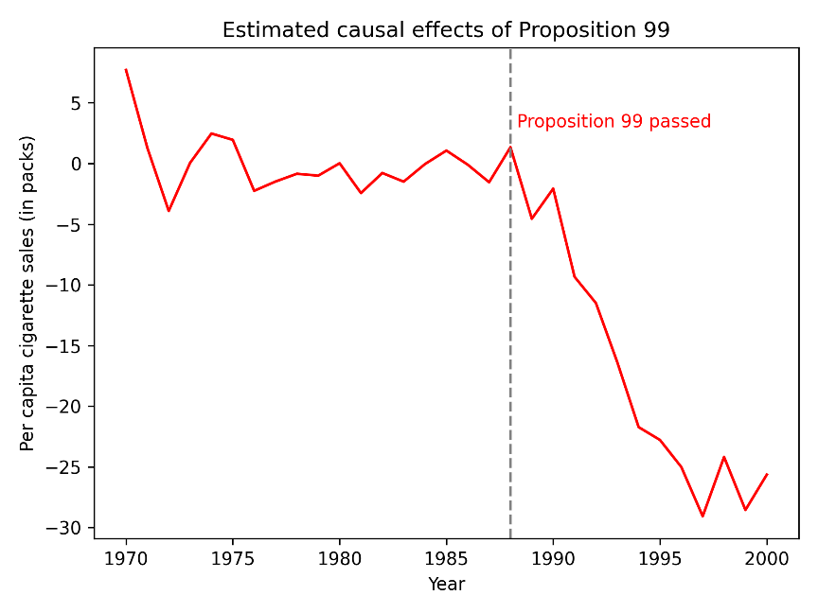
Data Analysis: Results
Notes:
After implementing the synthetic control method, and finding the optimal V and W, we can plot the timeseries of the synthetic control we obtained. There are two main things to note here. First, in the pre-intervention period, the synthetic control matches with the real California reasonably well. Second, after the passing of Proposition 99, we can see that the synthetic control and the real California become noticeably different. After plotting the difference between the two, which recall that these are the estimated intervention effects, we see that our estimate shows that Proposition 99 created a sharp decrease in cigarette sales.

Slide 13
How well did the Synthetic Control fit?
The synthetic California matches the observed covariates reasonably well
The synthetic California matches per capita cigarette sales much better than the average of the control units
Notes:
So how well did the synthetic control do? In this table I compare the preintervention outcome and the covariates between California and the Synthetic California. I also added the average of the control units as a baseline. We see that for each of the variables, the synthetic California is reasonably close to the real California. Additionally, for the per capita cigarette sales, which is the outcome we are interested in, the synthetic California does much better than the average of the control units.
Other than that, the importance column here are simply the diagonals of the matrix V we fitted.

Slide 14
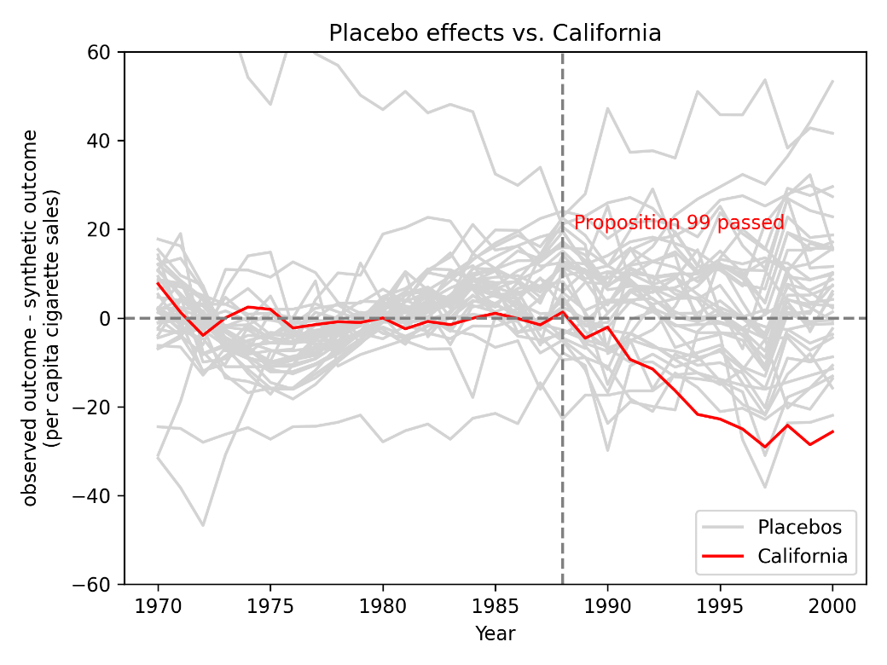
Data Analysis: Inference
In post-intervention, the estimated effects for California are more dramatic than most placebos
Not all placebos had a good fit in pre-intervention (technically, outside of the convex hull of the donor pool)
Should we remove these placebos? Comparing placebos with good fits to those with poor fits do not make sense
This process can be subjective
Notes:
Here, after conducting randomization inference, I plot the placebos for this analysis – the grey trends are the placebos and the red trends represent California. Note that in post-intervention, the estimated effects for California are more dramatic than most of the placebos. However, also note that not all of the placebos were able to have a good fit in the pre-intervention period (point out in the graph). Technically, this mean these placebos were outside of the convex hull of the donor pool. So should we remove these placebos? After all, it doesn’t make sense to compare placebos with good fits to those with poor fits. The problem is, however, deciding which placebos to remove can be subjective. How poor does the fit need to be before we remove it?

Slide 15

Instead, Abadie et al., 2010 proposes analyzing the ratio between the RMSPE (root mean square prediction error) in the post-intervention period and the pre-intervention period
No need to subjectively remove placebos
Notes:
To deal with this problem, Abadie proposes analyzing the ratio of the root mean square prediction error between post-intervention and pre-intervention. Roughly, the idea is if the fit was bad in pre-intervention, it cancels out with the poor fit in post-intervention. This way, we no longer need to subjectively remove placebos.

Slide 16
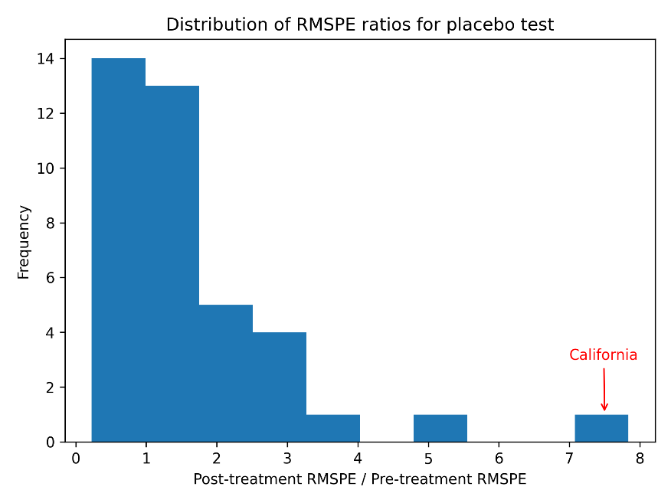
California has the largest RMSPE ratio of all the placebos
The p-value is 1/39 = 0.026
Notes:
In this plot, I demonstrate just that. Note that California here has the largest RMSPE ratio of all the placebos, which results in a p-value of 1/39 or 0.026. We have evidence that Proposition 99 significantly lowered cigarette sales in California.
So what are some problems with this analysis? What about the assumption of no interference?
Specifically, what if the anti-tobacco sentiment in California spread to other states? After all, many other states did also propose tobacco control programs following California’s lead. However, this would only lower smoking rates in the donor pool, and yet our results remain significant.
We can then conclude that the assumption of no interference is not likely to affect our results.

Slide 17
References
Abadie, A., Diamond, A., & Hainmueller, A. J. (2010). Synthetic control methods for comparative case studies: Estimating the effect of California’s Tobacco control program. Journal of the American Statistical Association, 105(490), 493–505. https://doi.org/10.1198/jasa.2009.ap08746
Abadie, A., & Gardeazabal, J. (2003). The Economic Costs of Conflict: A Case Study of the Basque Country.
Siegel, M. (2002). The effectiveness of state-level tobacco control interventions: A review of program implementation and behavioral outcomes. In Annual Review of Public Health (Vol. 23, pp. 45–71). https://doi.org/10.1146/annurev.publhealth.23.092601.095916
Notes:
Here are my references. Thank you for listening through my presentation!

