Slide 1

Detection of nonstationary reservoir system performance
Matthew Chen

Slide 2
When do we detect significant change in reservoir system performance?
Use SSJRB model simulations of reliability and upstream flood volume objectives on Northern California reservoir system
01
Detect changes using nonparametric Mann Whitney U (MWU) significance test – null hypothesis is that both X and Y come from the same distribution
02
Run MWU on 30-year rolling windows in model objectives against the historical period (1951-2000)
03

Slide 3
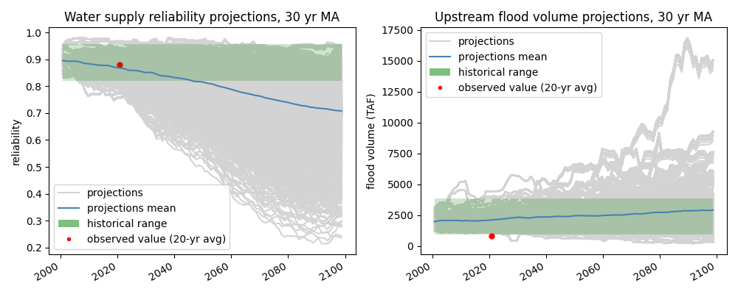
Scenario ensemble
Reliability objective: volumetric water demand met against median historical delta pumping
Flooding objective: cumulative overflow of reservoir system relative to safe release capacity
Observed objectives within historical range for reliability, not for flooding. Flooding predictions are biased wet

Slide 4
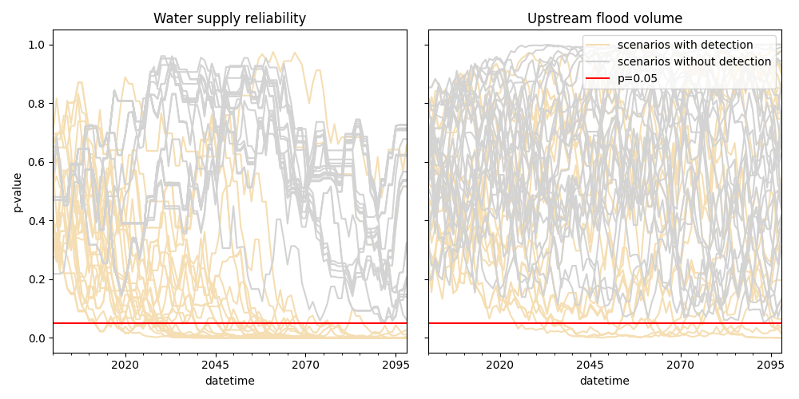
Detection confidence
Water supply reliability detects long term change; low risk of false detections
Flooding detections are essentially random, driven by natural variability
We find nonstationarity with water supply reliability

Slide 5
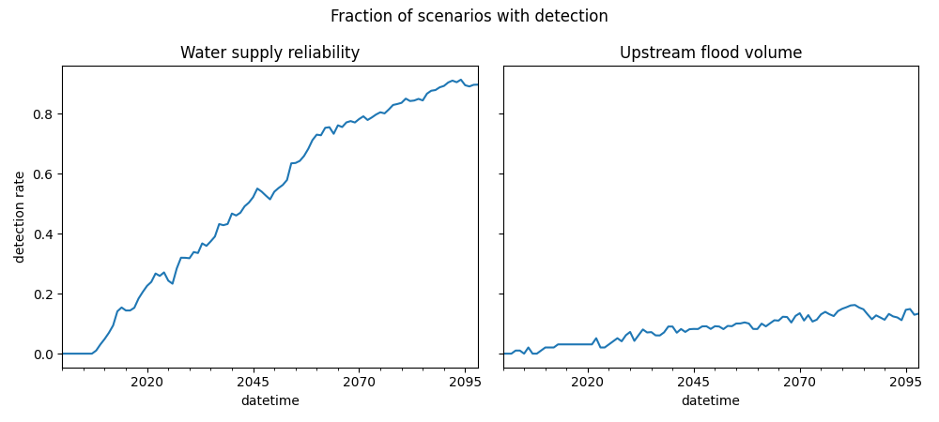
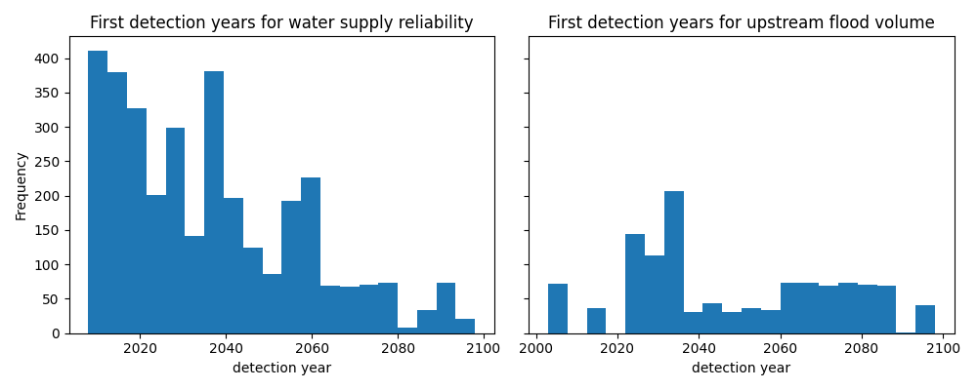
Individual and ensemble
detections
At the end of the projection period: 89.8% of scenarios were significant in water supply and only 13.3% were significant for flooding
Water supply scenarios are more likely to be detected earlier than later
There is little pattern in when flooding scenarios are first detected

Slide 6
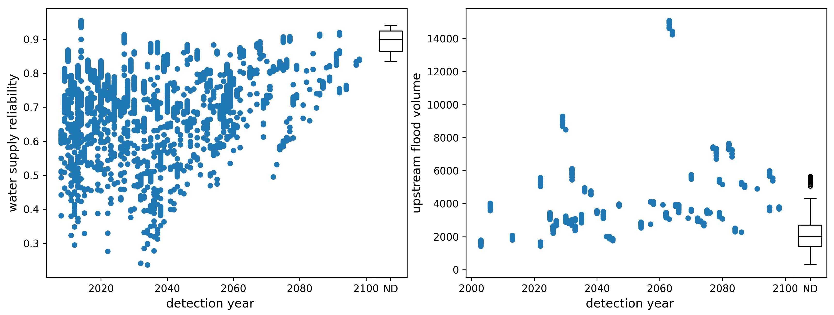
How is objective severity related to the time of detection?
Water supply reliability
Severe scenarios more likely to be detected earlier than later
Scenarios with no detection (ND) have low severity
Upstream flood volume
Little relationship between year of detection and severity
ND scenarios have low severity
Most severe scenarios are detected at some point

Slide 7
Uncertainty decomposition
Model scenarios make up of uncertain drivers: choice of climate change scenario (RCP), land use scenario (LULC), and choice of climate (GCM) model
Key question: which of these factors is driving significant detections and when they occur (i.e. variance in detection time)?

Slide 8
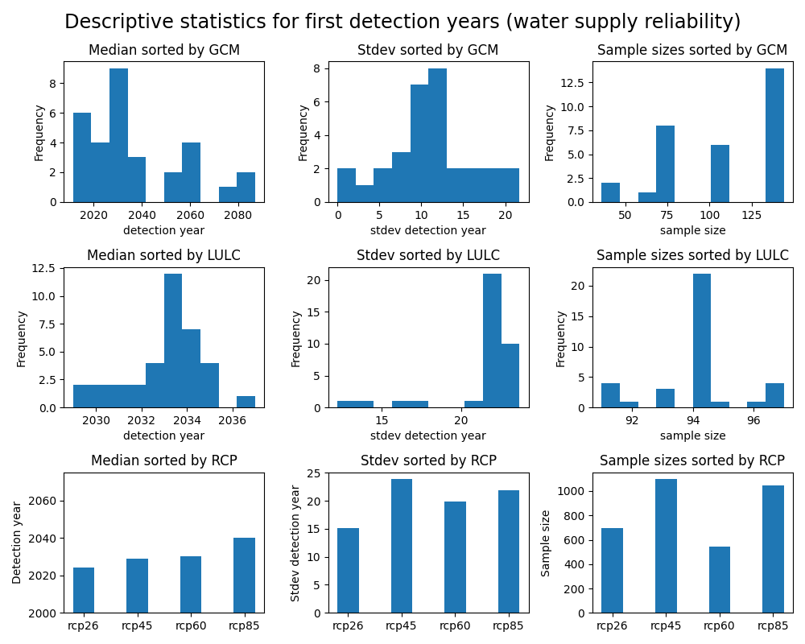
Water supply reliability detections sorted by GCM/RCP/LULC

Slide 9
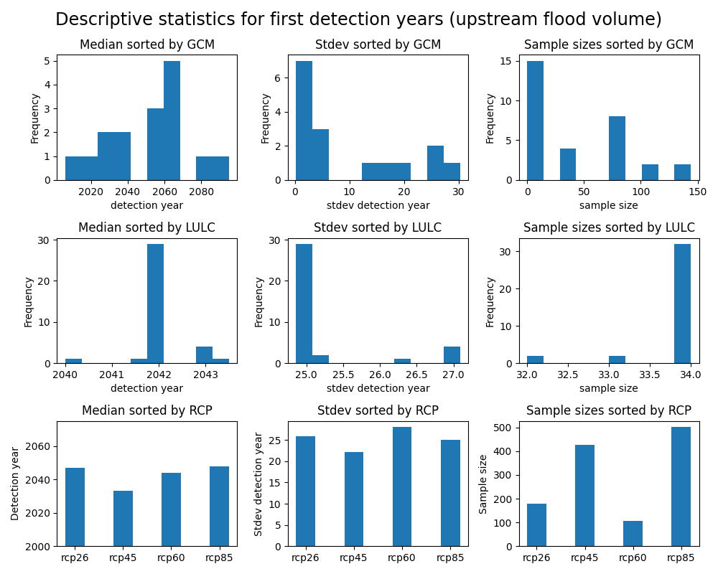
Flooding detections sorted by GCM/RCP/LULC

Slide 10
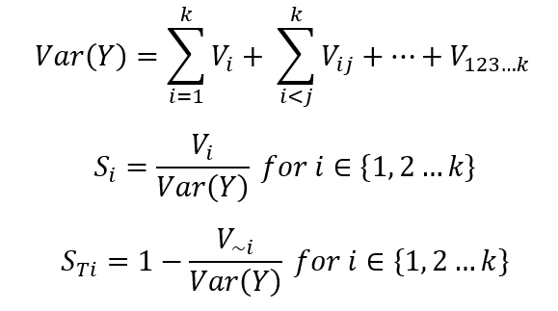
Sensitivity analysis on the year of first detection
Sobol variance decomposition method
Variance in detection times primarily attributable to the choice of GCM model and then the interaction between GCM and RCP

Slide 11

Can we find early warning signals of detection in the scenario pathways themselves?
Data
Use historical objective values, mean and standard deviation aggregated by the decade, as features
Training
Train logistic regression model to detect if a significant change will occur sometime between the present, t*, and a lead time L
Interpretation
Study model performance and trained coefficients (decision boundary) for interpretability

Slide 12
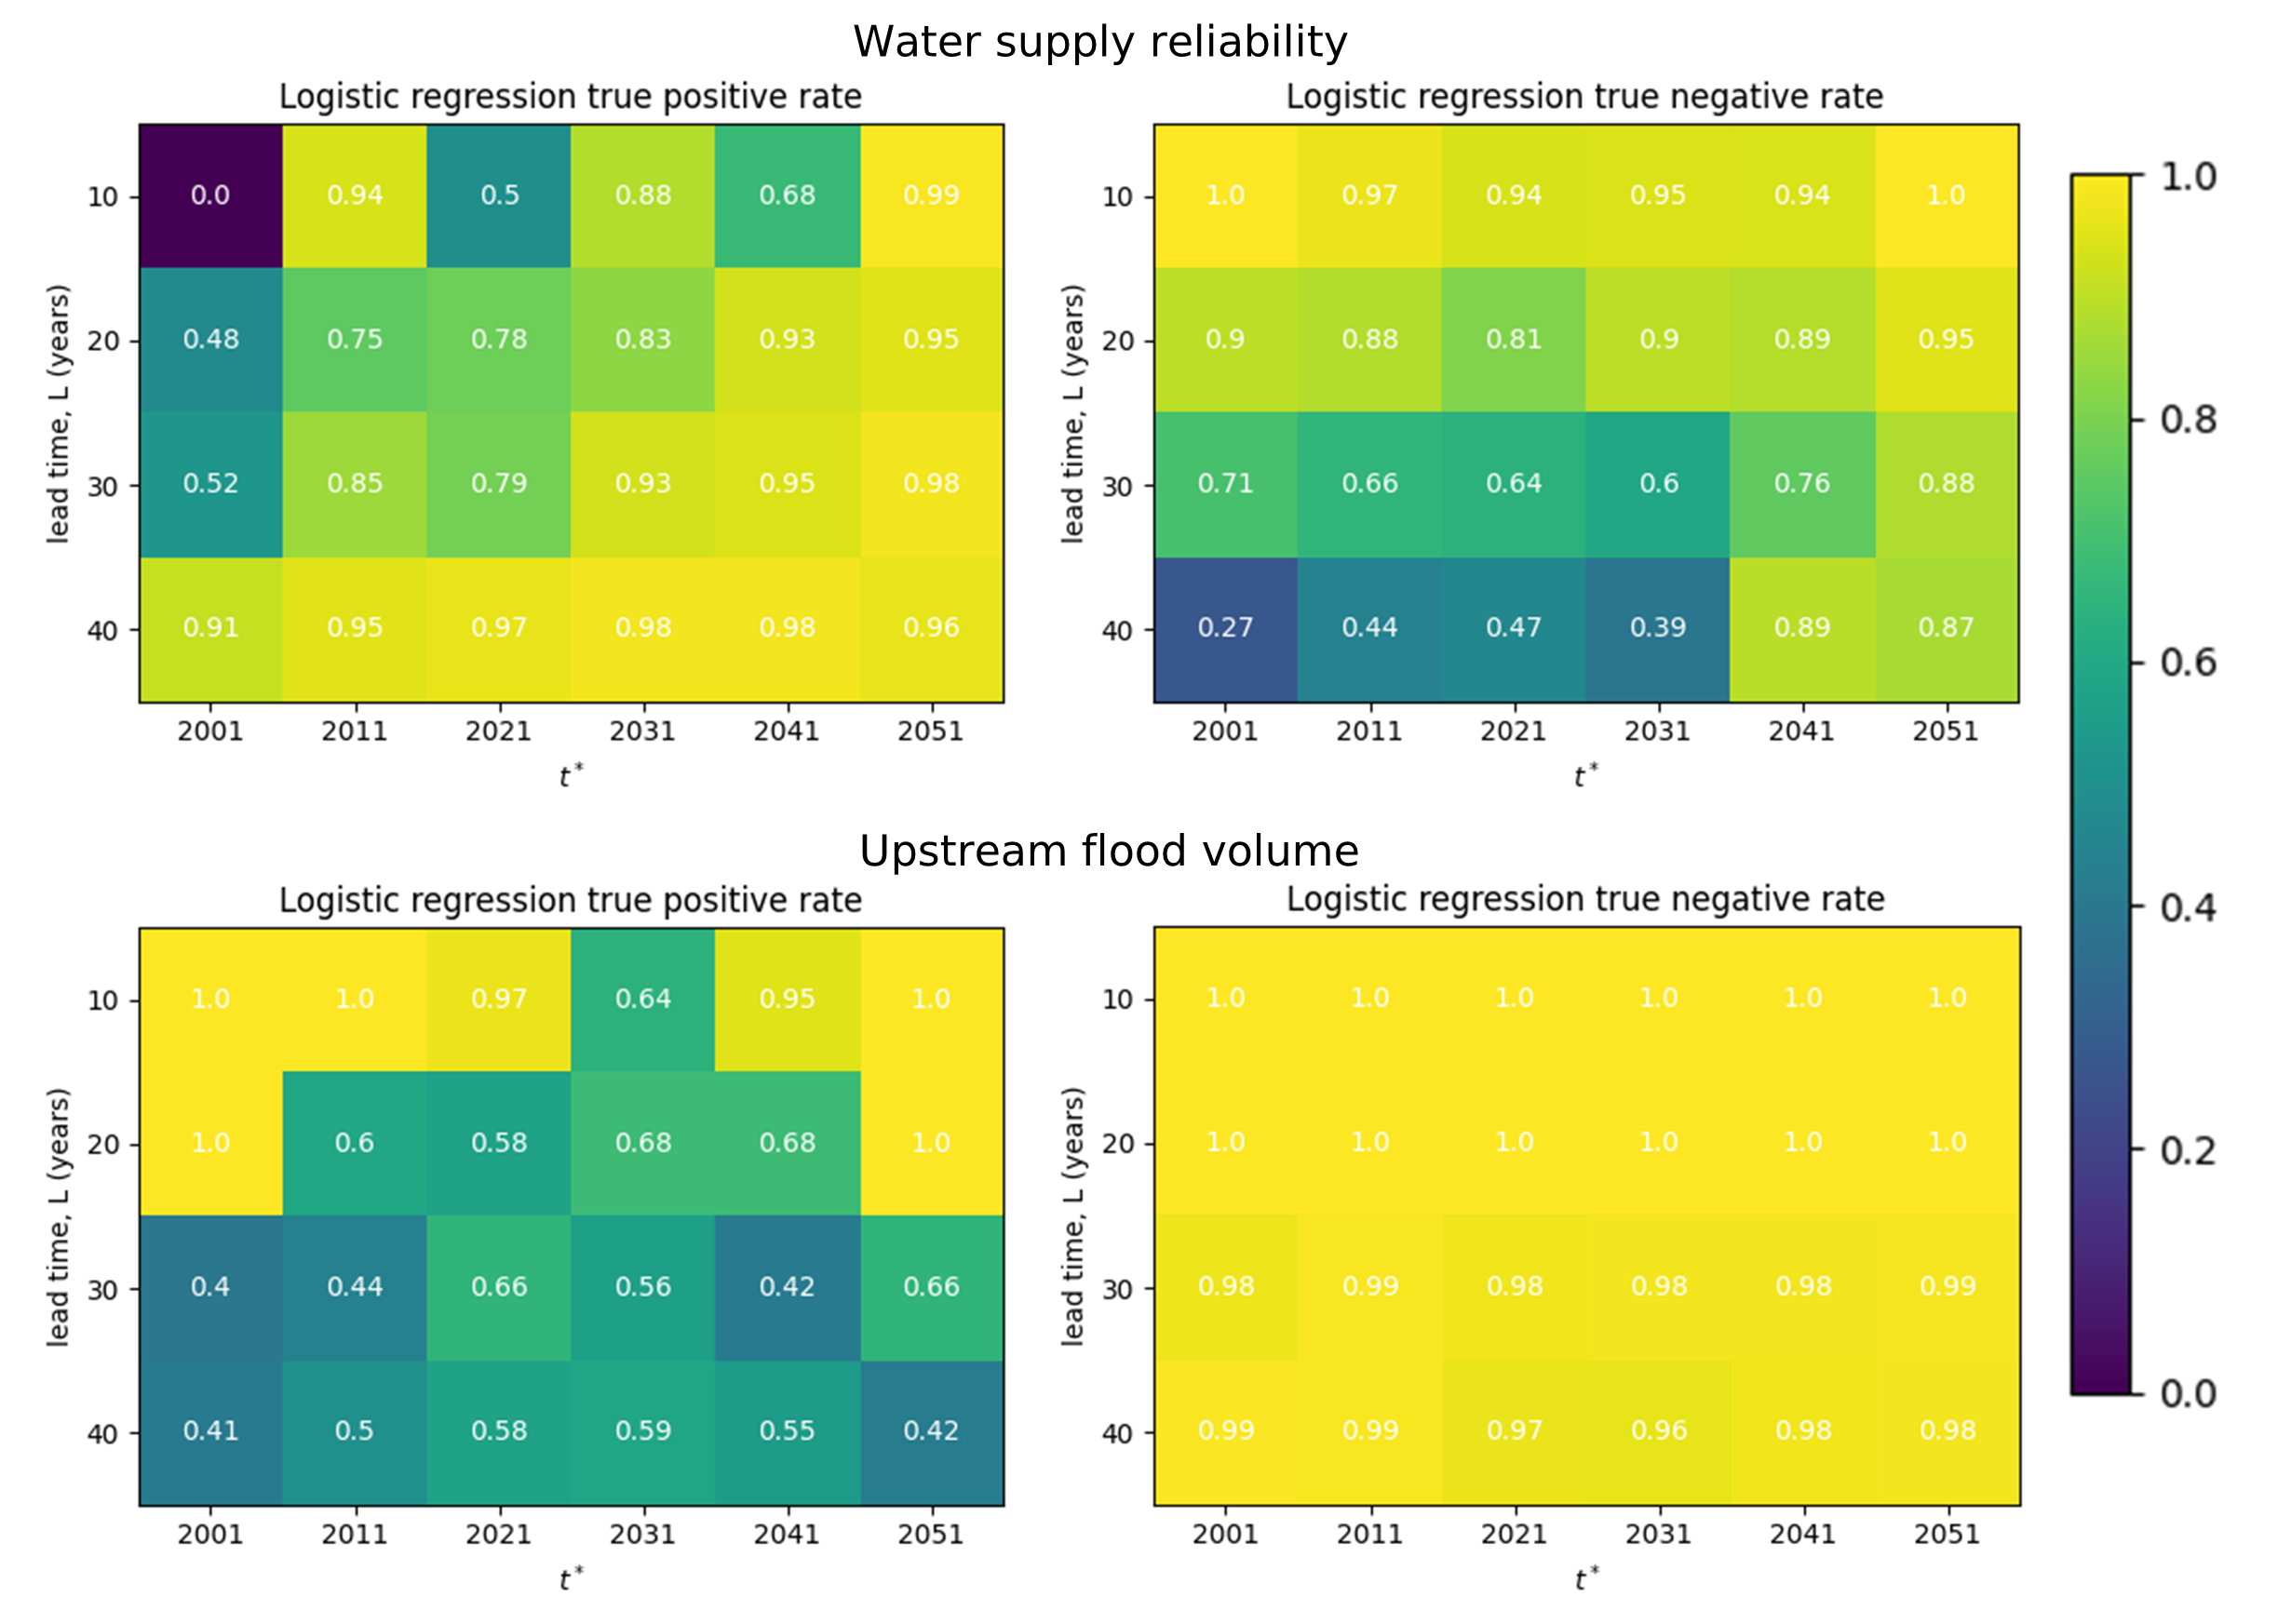
Model performance
Water supply reliability
Strong performance overall; scores tend to improve with longer lead times and later t*
Flood volume
Does not predict positive class better than random except for short lead times
Learned to attribute recent extreme events with detection. Predicts negative class with near perfect accuracy (absence of extreme event)
Model is worse at predicting exact timing of detection
Supports hypothesis that flooding detections are driven by natural variability

Slide 13
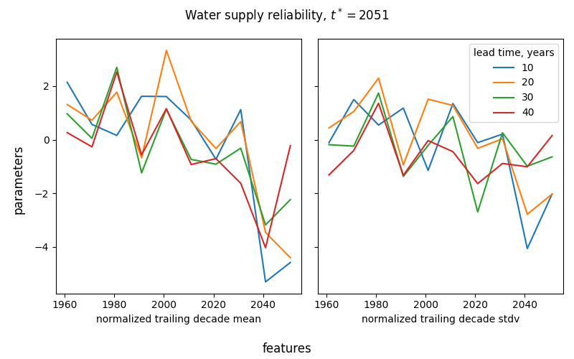
Water supply coefficients
Parameters for mean features trend downwards (more negative)
Standard deviation features less interpretable but tend to be more negative outside of historical period
E.g. scenario with high reliability and low variance later in the projection period is not likely to become significant

Slide 14
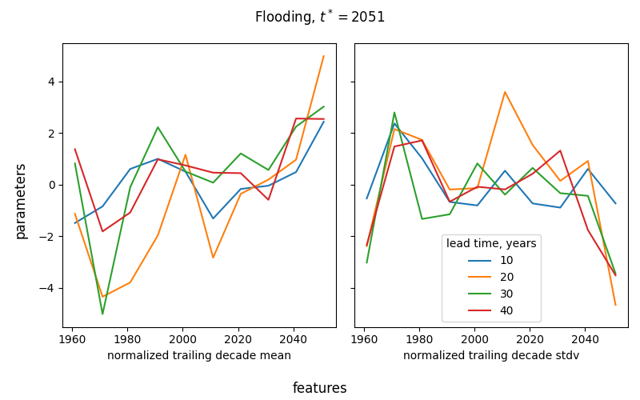
Upstream flooding coefficients
Parameters tend positive later in projection and tend negative in historical period
Detection probability higher when historical floods less extreme (if historical captures natural variability poorly – sampling uncertainty). Recent floods also increase detection probability.
Standard deviation features less interpretable

Slide 15
Conclusions
Reliability objective far more likely to detect change within the century, detections characterized by nonstationarity and long-term change
Flooding objective has low detection rate, detections characterized by natural variability
Variability in detection time attributable to the choice in climate model and its interaction with the emissions pathway
ML classifier performs well in predicting detection in water supply, but not the precise timing
ML classifier only performs well in short lead times for flooding – likely to be driven by extreme events
Irreversible infrastructure decisions based on natural variability can incur high regret. Important to differentiate natural variability and nonstationarity
Perhaps reliability detections are better indicators than flooding in the context of dynamic adaptation as it has less sampling uncertainty
It is possible to obtain an early warning for an incoming detection for reliability. Can we use this information to narrow down the ensemble of possible futures? Can we use a prediction of future significant change to adapt to climate change?

